Slide 1
Insertion sort and merge sort
John MacCormick

Slide 2














Insertion sort
20
15
18
7
12
20
15
20
15
18
20
7
15
18
20
7
12
15
18
20

Slide 3


Merge sort
20
15
18
7
12
23
3
17
20
15
18
7
12
23
3
17
20
15
18
7
12
23
3
17
15
20
7
18
12
23
3
17
7
15
18
20
3
12
17
23
3
7
12
15
17
18
20
23

Slide 4



















Complexity of insertion sort
20
15
18
7
12
20
15
20
15
18
20
7
15
18
20
7
12
15
18
20

Slide 5
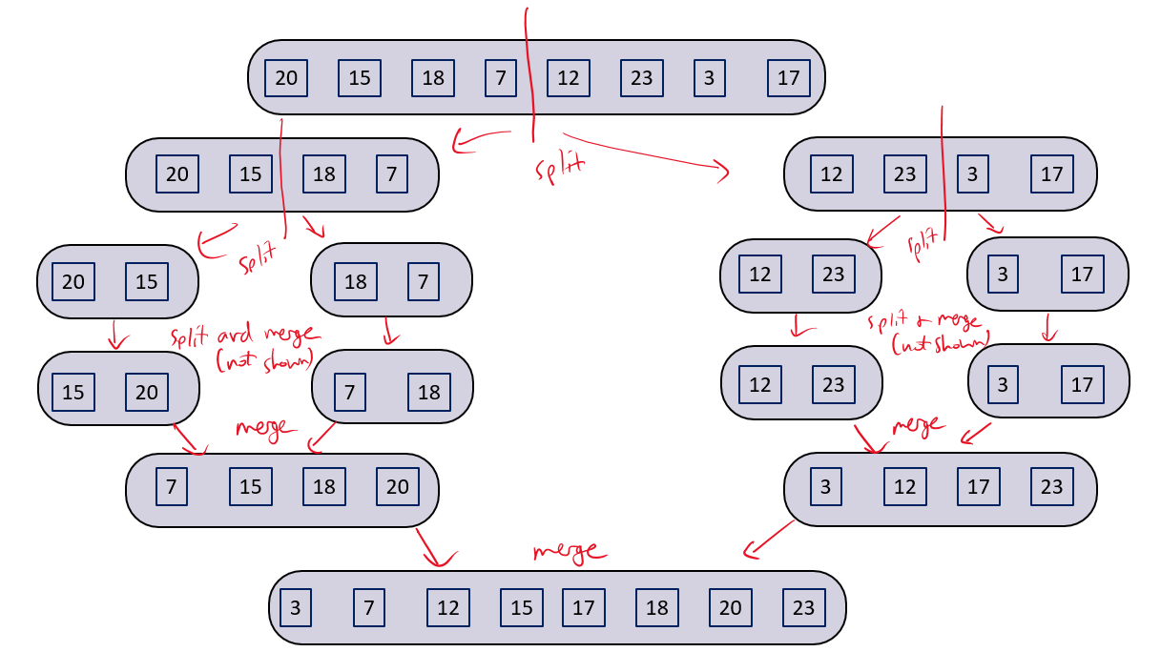









Complexity of merge sort

Slide 6
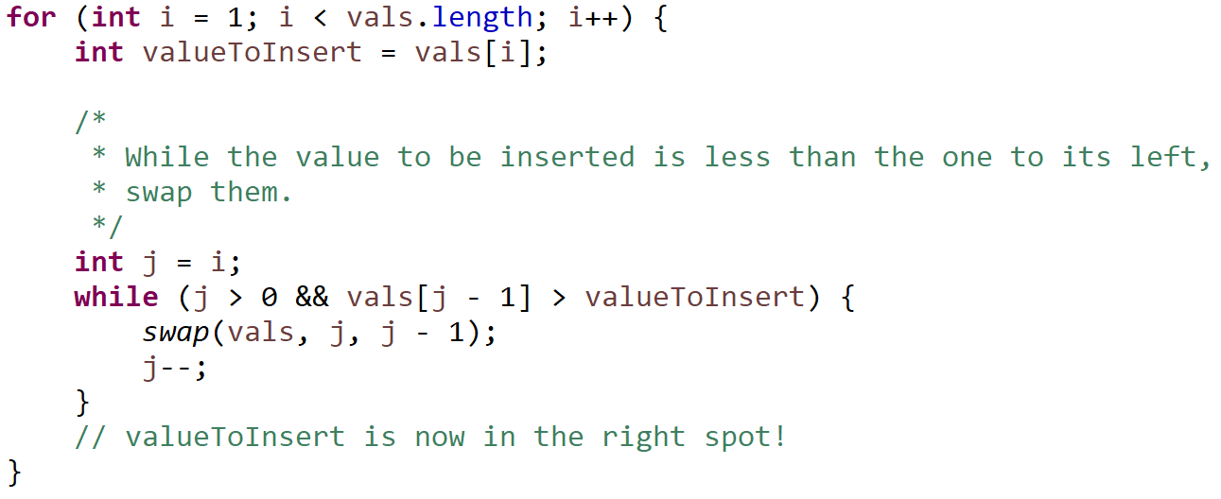
code for insertion sort
code from COMP232 sample code, authored by Prof. Grant Braught

Slide 7



The nested loop suggests $O(n^{2})$ for insertion sort
code from COMP232 sample code, authored by Prof. Grant Braught

Slide 8
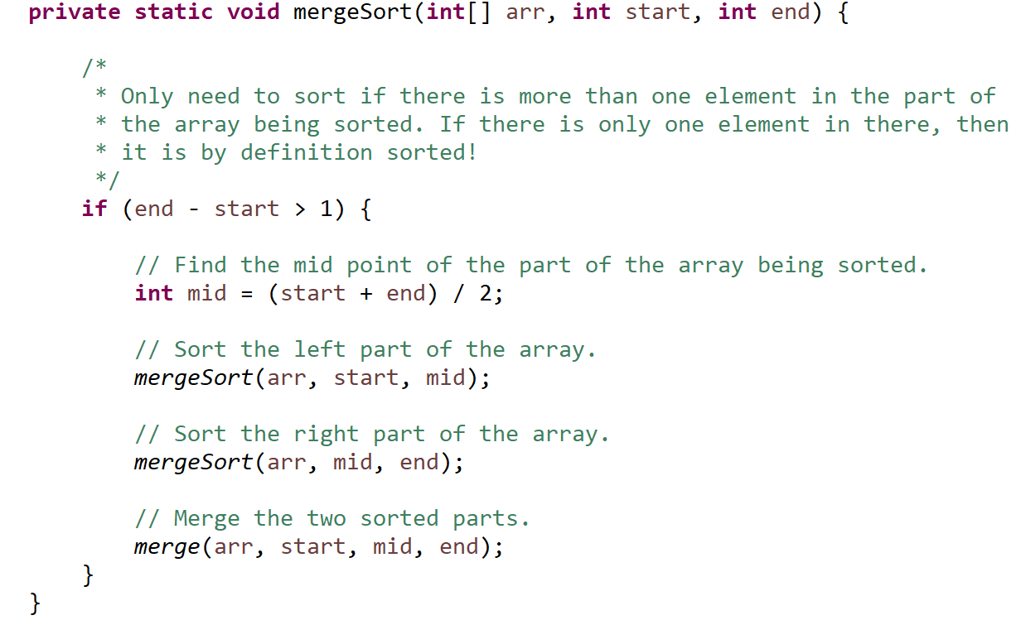
code for merge sort – recursion!
code adapted from COMP232 sample code, authored by Prof. Grant Braught

Slide 9



We can also use a recursion relation to compute the complexity of merge sort

