Slide 1

Binary Search Trees
Data Structures and Problem Solving
COMP232
Dickinson College
Slides created by Prof Farhan Siddiqui, with edits by John MacCormick

Slide 2


Basic idea of BST
Nodes are stored in left-to-right order:
Everything to the left is smaller
Everything to the right is larger
But what if duplicate keys are allowed?

Slide 3

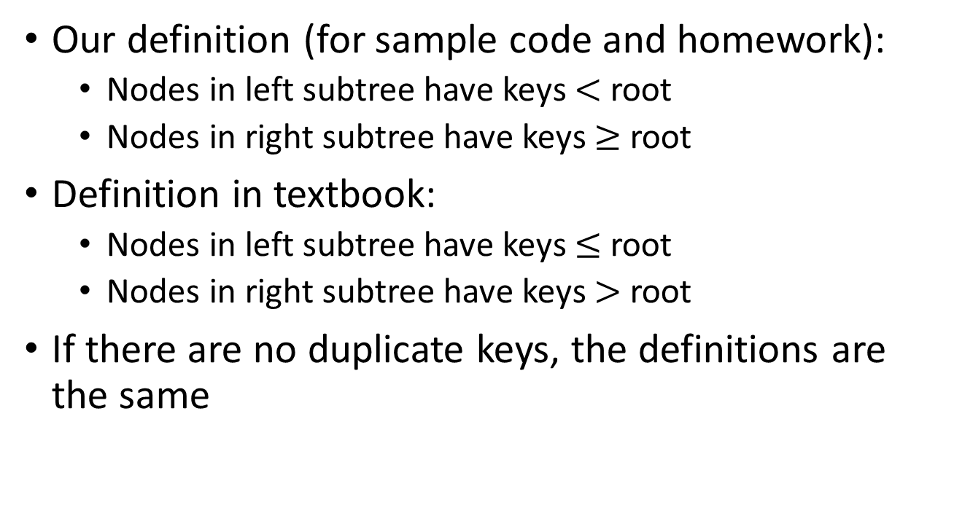



BST property (applies to all nodes and subtrees)
Our definition (for sample code and homework):
Nodes in left subtree have keys $<$ root
Nodes in right subtree have keys $≥$ root
Definition in textbook:
Nodes in left subtree have keys $≤$ root
Nodes in right subtree have keys $>$ root
If there are no duplicate keys, the definitions are the same

Slide 4
BST Operations: find (or get)
9
find(key)
if key < root.key, search left subtree
if key > root.key, search right subtree
If key == root.key, return the corresponding value
Example: find(7)
4
17
3
6
22
7
20

Slide 5
BST Operations: add
9
add(K key, V value)
if root is empty, add there
if key < root.key, add to left subtree
if key >= root.key, add to right subtree.
Example: add(5)
4
17
3
6
22
7
20

Slide 6
BST Operations: add
9
add(K key, V value)
add(5)
if root is empty, add there.
if key < root.key, add to left sub-tree.
if key >= root.key, add to right sub-tree.
4
17
3
6
22
Important reminder: In the textbook, equal keys are stored in the left child. In the CS232 sample code, equal keys are stored in the right child. For the homework, you must store equal keys in the right child, not the left child.
5
20
7

Slide 7

BST Operations: remove
9
remove(K key)
find node N with given key (get)
3 cases: 0, 1, 2 children
If N has no children (e.g. 5)- Remove N
N has one child (e.g. 17)- Promote child of N to N’s position
4
17
3
6
22
5
7
20

Slide 8
BST Operations: remove
9
remove(K key)
find the node N with given key (get)
N has no children (e.g. 5, 7)- Remove N.
N has one child (e.g. 17)- Promote child of N to N’s position
4
22
3
6
20
5
7

Slide 9
BST Operations: remove …the hard case… 2 children
9
4
17
remove(K key)
find the node, N, with key (get)
N has two children (e.g. 9)
Recursive algorithm: swap in value from smallest node S in right subtree, then call remove on S
3
6
22
5
7
20

Slide 10
BST Operations: remove …the hard case… 2 children
17
remove(K key)
find the node, N, with key (get)
N has two children (e.g. 9)
Recursive algorithm: swap in value from smallest node S in right subtree, then call remove on S
4
17
3
6
22
5
7
20

Slide 11
BST Operations: remove …the hard case… 2 children
17
remove(K key)
find the node, N, with key (get)
N has two children (e.g. 9)
Recursive algorithm: swap in value from smallest node S in right subtree, then call remove on S
4
22
3
6
20
Important note: In the textbook, duplicates are in the left subtree. So a different algorithm is needed for removing a node with 2 children: we replace the node N with the largest node L in the left subtree, then call remove on L.
5
7

Slide 12

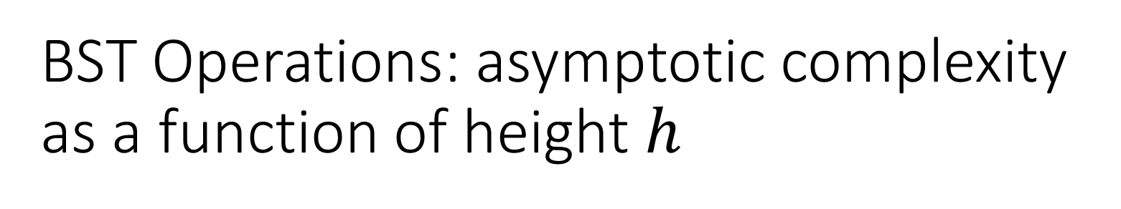
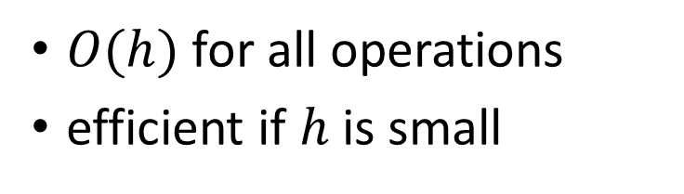


BST Operations: asymptotic complexity as a function of height $h$
9
Operation | Binary Search Tree
get(K key)
add(K key, V value)
remove(K key)
4
17
$$O(h)$$
$$O(h)$$
$$O(h)$$
3
6
$O(h)$ for all operations
efficient if $h$ is small
5
7

