Slide 1
Intuitive versions of depth-first and breadth-first graph traversals
John MacCormick

Slide 2






Intuitive version of depth-first
Treat it like a maze with backtracking
If there are multiple options, choose the option that is earliest in dictionary/numerical order

Slide 3
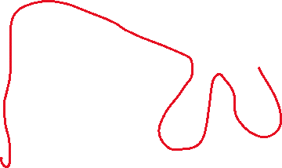


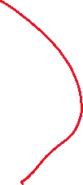

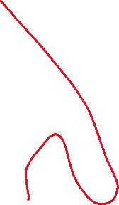
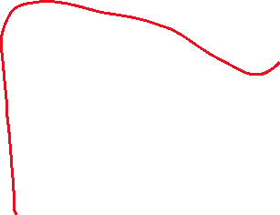
Intuitive version of depth-first
Treat it like a maze with backtracking
If there are multiple options, choose the option that is earliest in dictionary/numerical order
To code this up, use recursion, which is equivalent to using a stack of nodes in progress.

Slide 4
Intuitive version of breadth-first
Calculate distance from the starting node
List vertices in order of distance, breaking ties mostly by dictionary/numerical order

Slide 5

Intuitive version of breadth-first
Calculate distance from the starting node
List vertices in order of distance, breaking ties mostly by dictionary/numerical order
To code this up, use a queue of nodes that need to be visited.

