Slide 1
Asymptotic analysis
Based on chapter 10 of What Can Be Computed?
John MacCormick

Slide 2
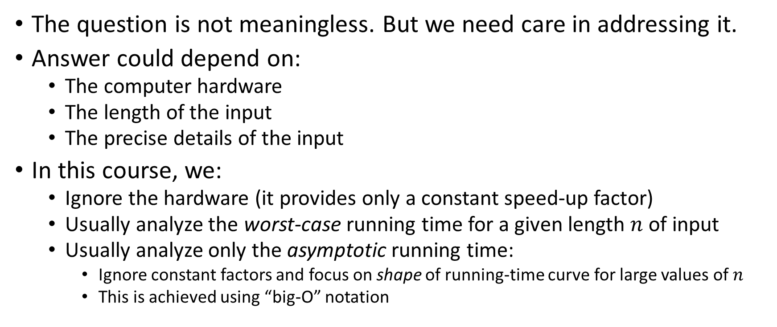
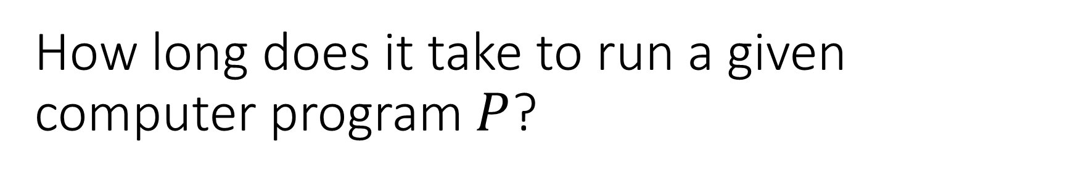
How long does it take to run a given computer program $P$?
The question is not meaningless. But we need care in addressing it.
Answer could depend on:
The computer hardware
The length of the input
The precise details of the input
In this course, we:
Ignore the hardware (it provides only a constant speed-up factor)
Usually analyze the worst-case running time for a given length $n$ of input
Usually analyze only the asymptotic running time:
Ignore constant factors and focus on shape of running-time curve for large values of $n$
This is achieved using “big-O” notation

Slide 3
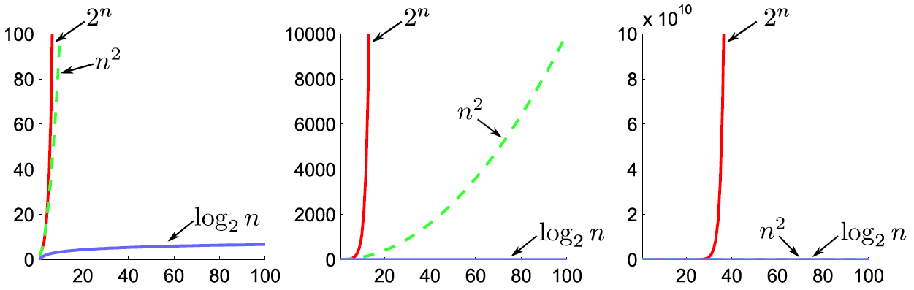
Key distinction: vast gulf between exponential, polynomial, and logarithmic functions
“Big-O notation” helps us formalize this distinction

Slide 4
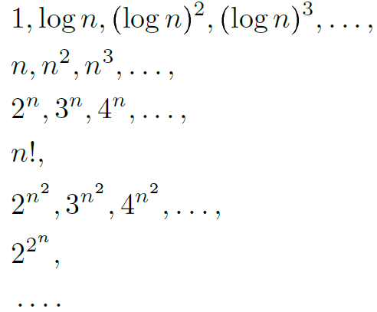
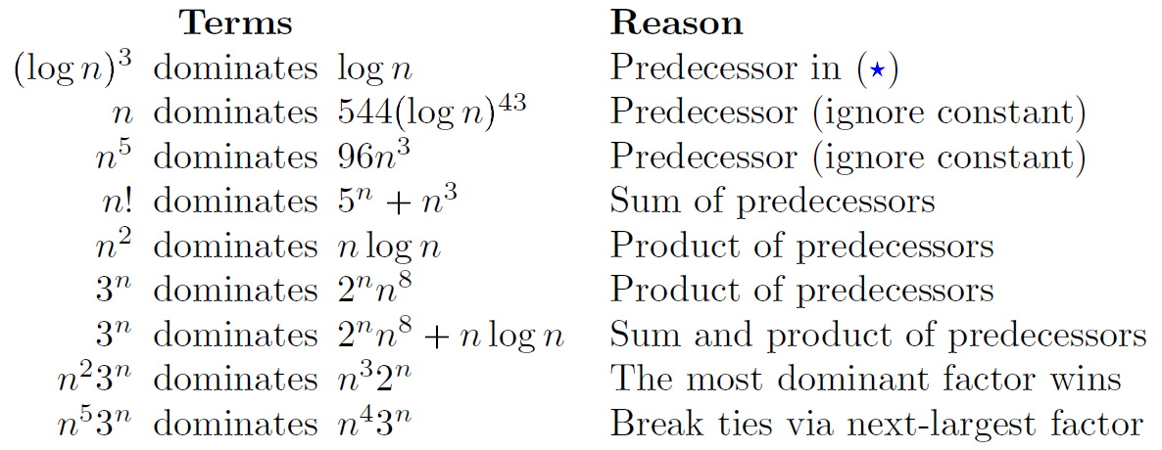

The book exceprt explains a simple approach to big-O, via dominant terms
Ordered list of dominant terms
Examples

Slide 5
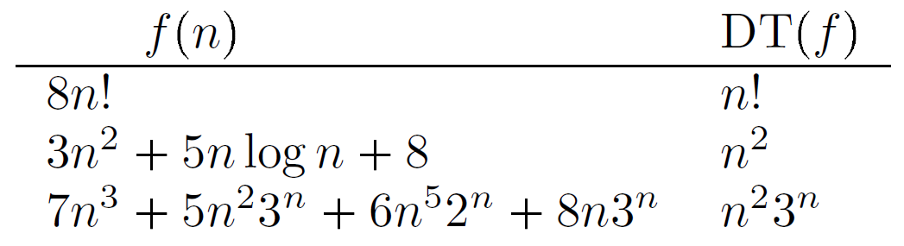
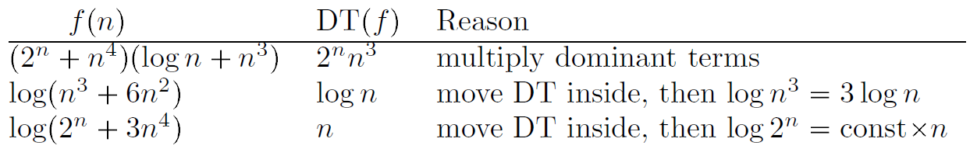
Examples of dominant terms

Slide 6
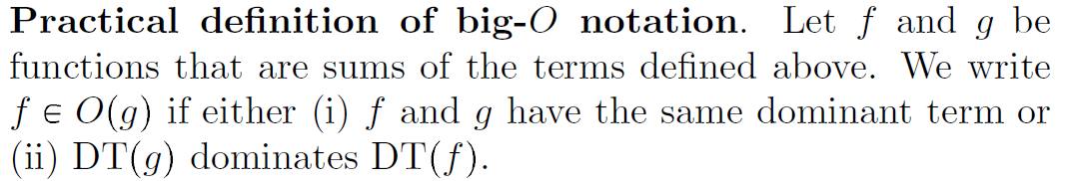
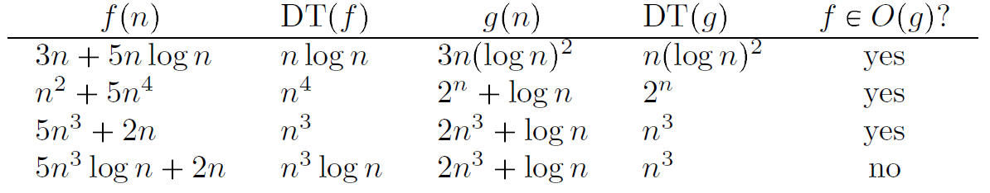
Practical definition of big-O notation

Slide 7
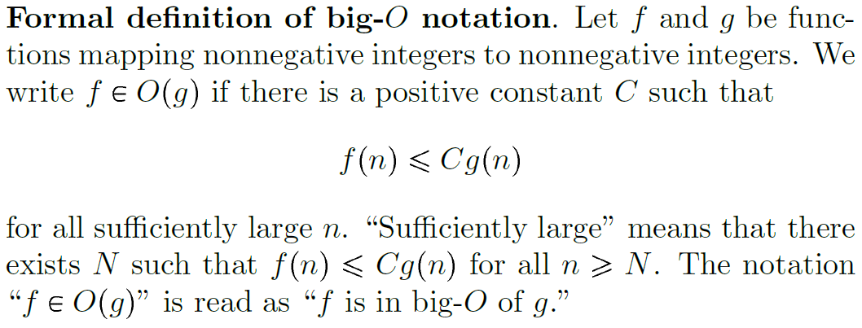
Formal definition of big-O notation

Slide 8
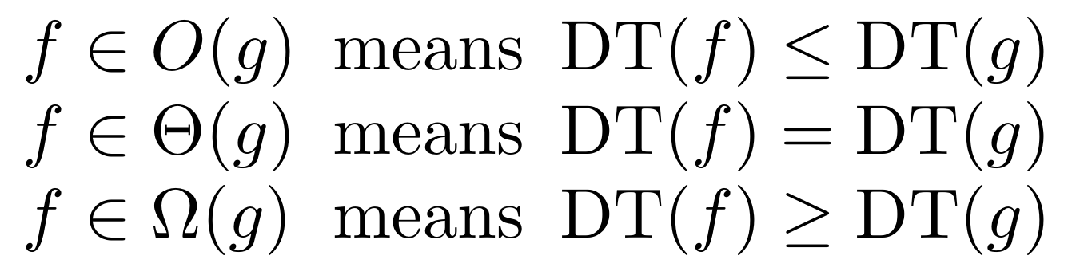
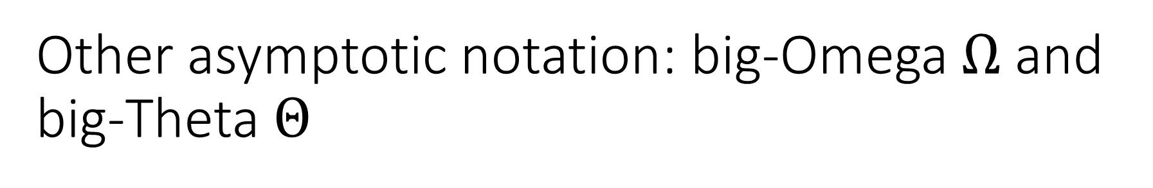
Other asymptotic notation: big-Omega $Ω$ and big-Theta $Θ$
[See the separate handout for formal definitions of big-Omega, big-Theta and how to use them.]

Slide 9
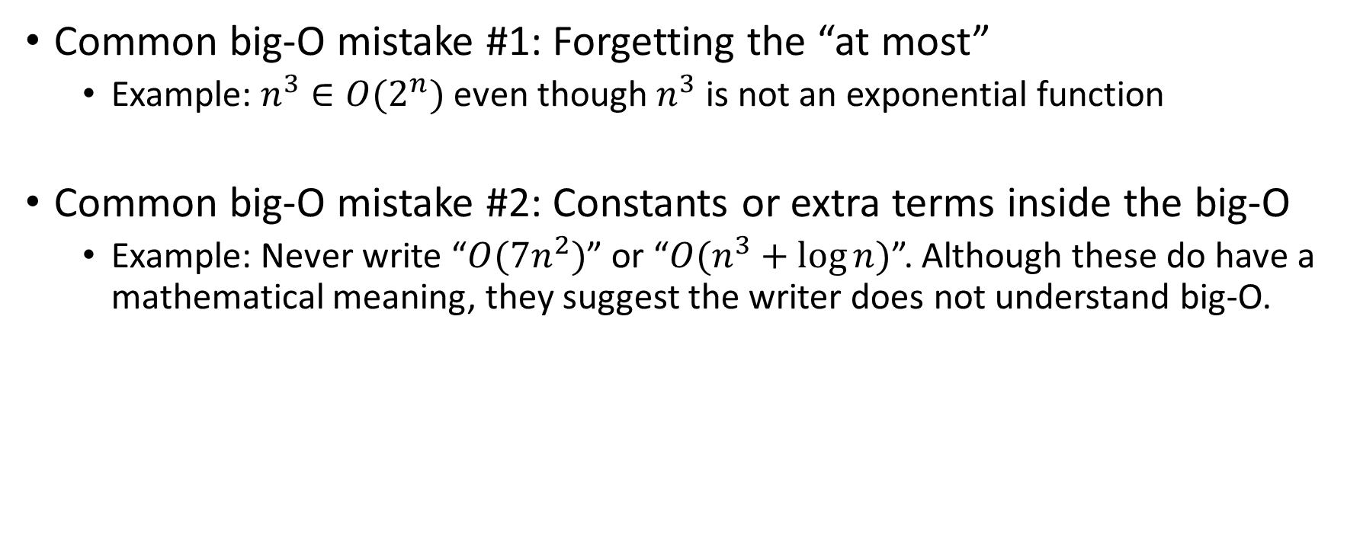
Two common big-O mistakes
Common big-O mistake #1: Forgetting the “at most”
Example: $n^{3}∈O(2^{n})$ even though $n^{3}$ is not an exponential function
Common big-O mistake #2: Constants or extra terms inside the big-O
Example: Never write “$O(7n^{2})$” or “$O(n^{3}+\log{n})$”. Although these do have a mathematical meaning, they suggest the writer does not understand big-O.

Slide 10
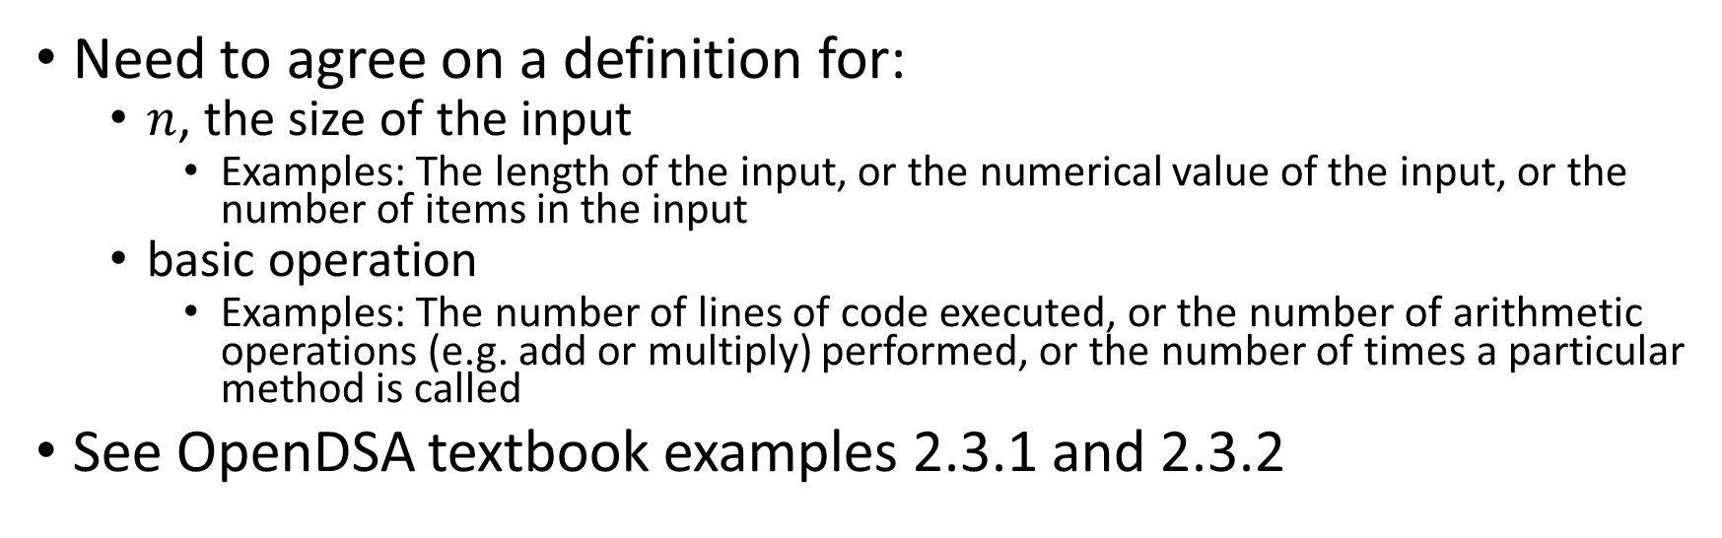
Program running time
Need to agree on a definition for:
$n$, the size of the input
Examples: The length of the input, or the numerical value of the input, or the number of items in the input
basic operation
Examples: The number of lines of code executed, or the number of arithmetic operations (e.g. add or multiply) performed, or the number of times a particular method is called
See OpenDSA textbook examples 2.3.1 and 2.3.2

Slide 11
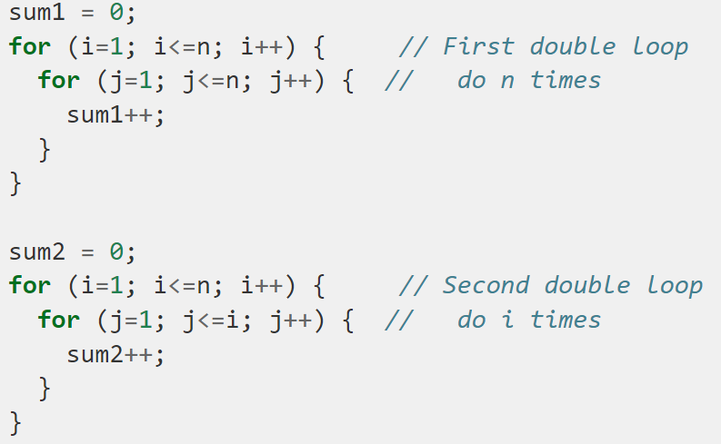
Examples of program running time (example 2.8.4 in OpenDSA textbook)
For each snippet:
What is input size?
What is basic operation?
What is asymptotic running time?

Slide 12
Best, worst and average case
See
replaceFirstX in OpCountExamples.java
indexOf in AverageCase.java

