Slide 1
Class 14: heaps
John MacCormick

Slide 2


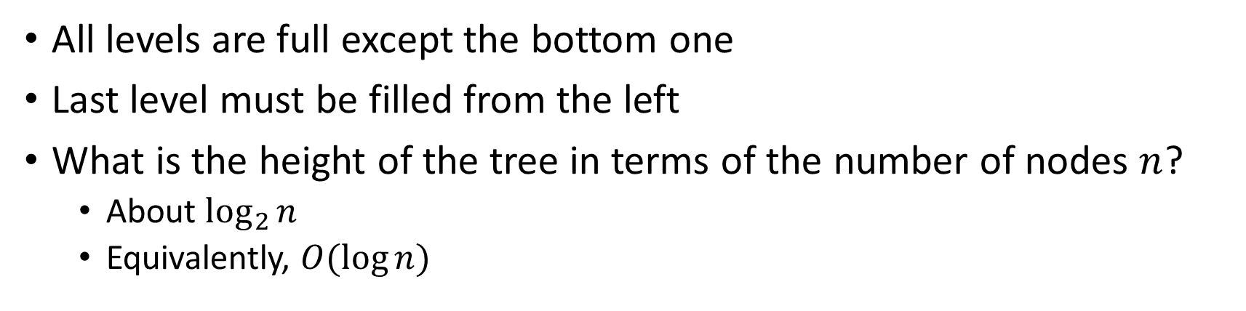





Recall: what is a complete binary tree?
All levels are full except the bottom one
Last level must be filled from the left
What is the height of the tree in terms of the number of nodes $n$?
About $\log_{2}{n}$
Equivalently, $O(\log{n})$
Why? (This is optional. We might discuss next time.) When height is $h$, number of nodes $n$ is less than $2^{h}$. But note $n=2^{h}$ means $h=\log_{2}{n}$. This is exactly the definition of the log function.

Slide 3

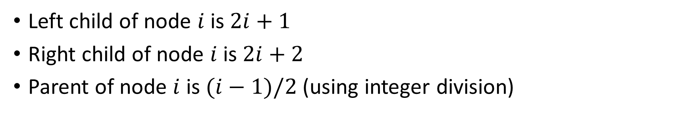

A complete binary tree can be stored and manipulated efficiently using an array
Left child of node $i$ is $2i+1$
Right child of node $i$ is $2i+2$
Parent of node $i$ is $(i−1)/2$ (using integer division)

Slide 4
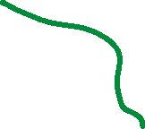








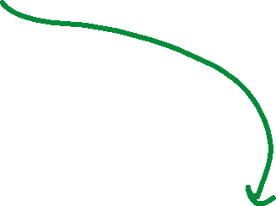







These are just the node indexes. In practice, we would also store keys and values in the nodes.

Slide 5









A min-heap is a complete binary tree where each node is less than or equal to its children.
(For a max-heap, each node is greater than or equal to its children.)

Slide 6
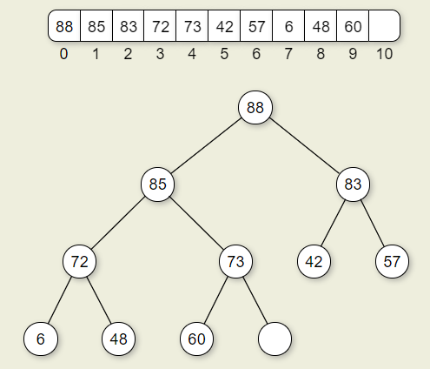
To add an element, place it at the end of the heap then bubble up
See example in textbook section 5.17.1:

Slide 7
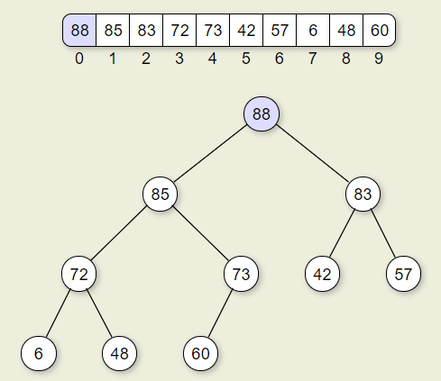
To remove the first (top) element, replace it with the last element then bubble down
See example in textbook section 5.17.3:

Slide 8
A heap can be used to implement the priority queue ADT
See the CS232PriorityQueue interface
Operations are add(), remove(), peek(), size()

Slide 9

What is the asymptotic complexity of heap operations?
add()
Bubble up at most $h$ levels, so $O\left(\log{n}\right)$
remove()
Bubble down at most $h$ levels, so $O\left(\log{n}\right)$

Slide 10











Activity: insert the following elements into a min-heap using alphabetical ordering
Nomadland, Joker, Selma, Brooklyn, Mank, Parasite, Vice, Lion

Slide 11











Activity: starting with the given heap, remove the minimum element twice

Slide 12








Activity: starting with the given heap, remove the minimum element twice
Solution:
See also the excellent practice exercises in the textbook.

