Slide 1
Class 11 – exam review

Slide 2
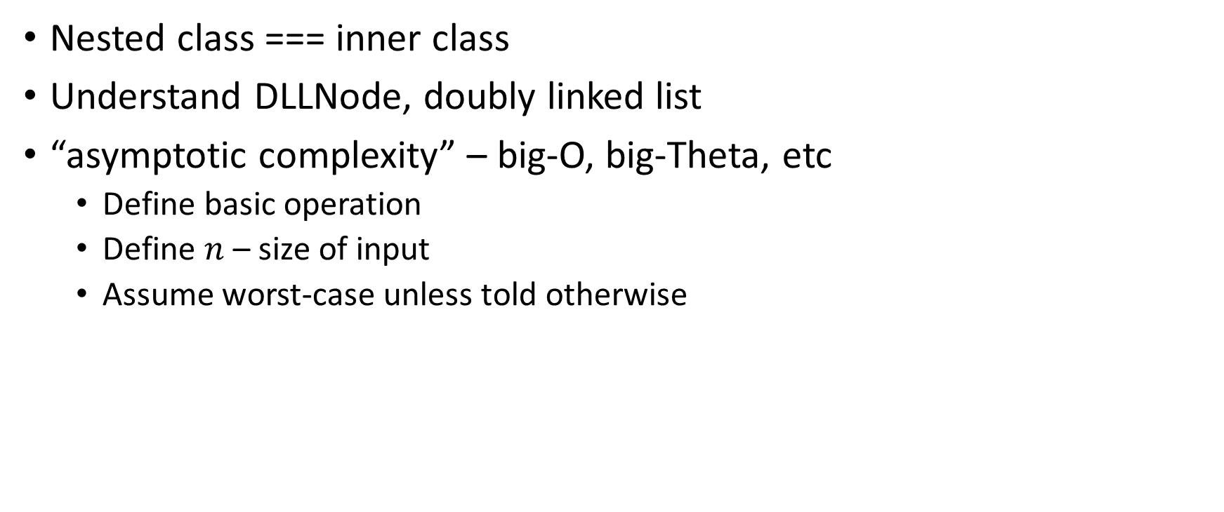
Nested class === inner class
Understand DLLNode, doubly linked list
“asymptotic complexity” – big-O, big-Theta, etc
Define basic operation
Define $n$ – size of input
Assume worst-case unless told otherwise

Slide 3
Nested class === inner class
Understand DLLNode, doubly linked list
“asymptotic complexity” – big-O, big-Theta, etc
Define basic operation
Define $n$ – size of input
Assume worst-case unless told otherwise

Slide 4
Number of points == (approx) number of minutes

Slide 5
Things to review
Recurrence and expansion
“average case vs Theta etc.”
Backing store – choice of implementation for an ADT
Queue vs stack complexities
Linked list code

