Slide 1
Heap sort (+ stable sorts + real-world implementations)
John MacCormick

Slide 2
The basic heap sort algorithm is simple:
Push each element onto a heap
Pop each element off the heap
Note: Assume we wish to sort in ascending order. Then we can use either a max heap or a min heap. With the min heap, fill the final array from left to right. With the max heap, fill the final array from right to left

Slide 3

The textbook suggests a better way to build the heap, but this does not improve the overall computational complexity
[this slide optional – not on the exam or homework]
To build the heap in only linear time: construct it from the bottom of the tree rather than the top

Slide 4



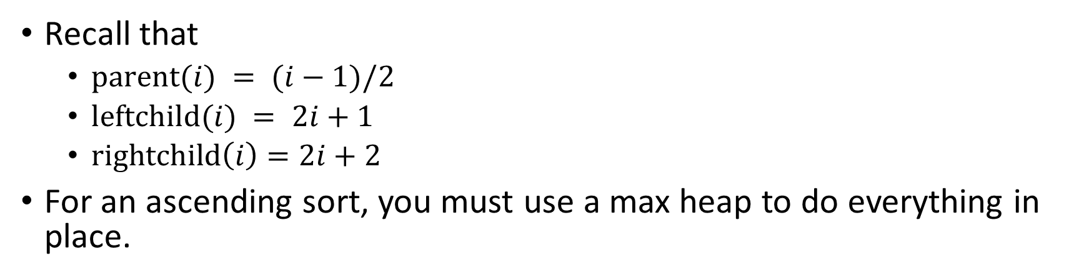


As with all heap operations, this can all be done in place, in a linear array
Recall that
$\text{parent}(i) = (i−1)/2$
$\text{leftchild}(i) = 2i+1$
$\text{rightchild}\left(i\right)=2i+2$
For an ascending sort, you must use a max heap to do everything in place.

Slide 5





Complexity of heap sort
Recall the basic algorithm:
Push each element onto a heap
Pop each element off the heap
Total cost is $O(n \log{n)}$.
Note: Using the fancy textbook algorithm, step 1 can be completed in linear time. But step 2 is still log-linear, so the total is still log-linear, i.e. $O(n \log{n)}$

Slide 6








A sorting algorithm is stable if elements with equal keys stay in the same order when the list is sorted
e.g. Have A9, B3, D9, B7, A2, C6, B4. Apply a sorting algorithm.
If the result is A9, A2, B3, B7, B4, C6, D9, the sort was stable
Otherwise (e.g. A9, A2, B7, B3, B4, C6, D9), it’s unstable
Insertion sort and merge sort are stable. (Try it!)
Heap sort is unstable
e.g. have A1, A2, A3. Sort using heap sort, obtain A1, A3, A2.

Slide 7


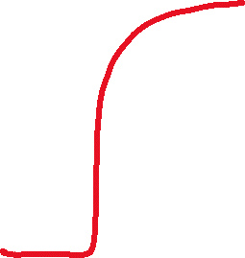



Stable sorting is important when we sort first on one key, then on another
Within each state, cities are sorted by population
city | state | population
Waldorf | Maryland | 81,410
Columbia | Maryland | 104,681
Pittsburgh | Pennsylvania | 302,971
Baltimore | Maryland | 585,708
Reading | Pennsylvania | 95,112
Germantown | Maryland | 91,249
Allentown | Pennsylvania | 125,845
Philadelphia | Pennsylvania | 1,604,000
city | state | population
Baltimore | Maryland | 585,708
Columbia | Maryland | 104,681
Germantown | Maryland | 91,249
Waldorf | Maryland | 81,410
Philadelphia | Pennsylvania | 1,604,000
Pittsburgh | Pennsylvania | 302,971
Allentown | Pennsylvania | 125,845
Reading | Pennsylvania | 95,112
city | state | population
Germantown | Maryland | 91,249
Columbia | Maryland | 104,681
Baltimore | Maryland | 585,708
Waldorf | Maryland | 81,410
Reading | Pennsylvania | 95,112
Philadelphia | Pennsylvania | 1,604,000
Allentown | Pennsylvania | 125,845
Pittsburgh | Pennsylvania | 302,971
city | state | population
Philadelphia | Pennsylvania | 1,604,000
Baltimore | Maryland | 585,708
Pittsburgh | Pennsylvania | 302,971
Allentown | Pennsylvania | 125,845
Columbia | Maryland | 104,681
Reading | Pennsylvania | 95,112
Germantown | Maryland | 91,249
Waldorf | Maryland | 81,410
Within each state, cities are not sorted by population
Try this in Excel!

Slide 8
Real-world example: OpenJDK uses a variant of merge sort, with insertion sort for small lists.
See OpenJDK’s Collections.sort() method
Note the mention of TimSort
Also note the reference to a publication from the 1990s:
McIlroy, Peter. "Optimistic sorting and information theoretic complexity." Proceedings of the fourth annual ACM-SIAM Symposium on Discrete algorithms. 1993.

