Slide 1
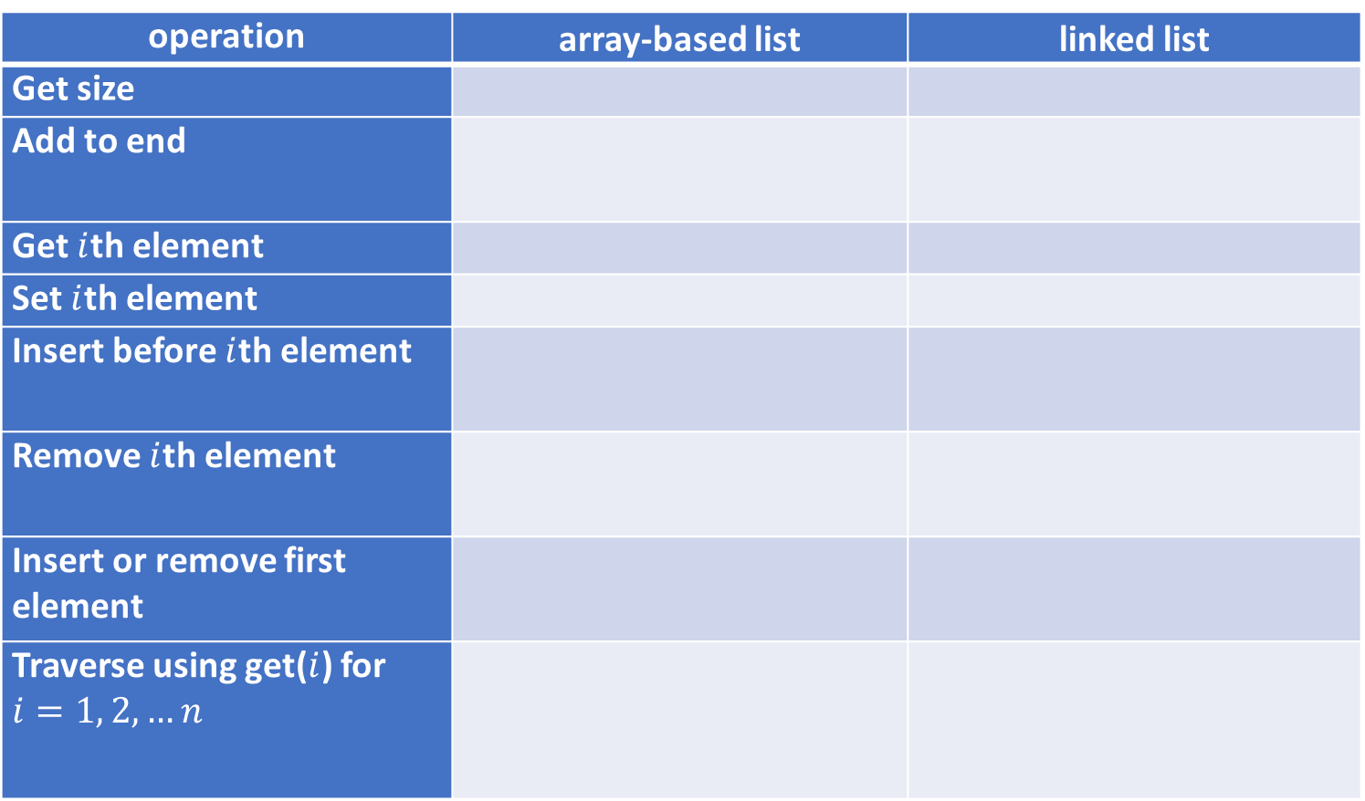
operation | array-based list | linked list
Get size
Add to end
Get $i$th element
Set $i$th element
Insert before $i$th element
Remove $i$th element
Insert or remove first element
Traverse using get($i$) for $i=1, 2, …n$

Slide 2
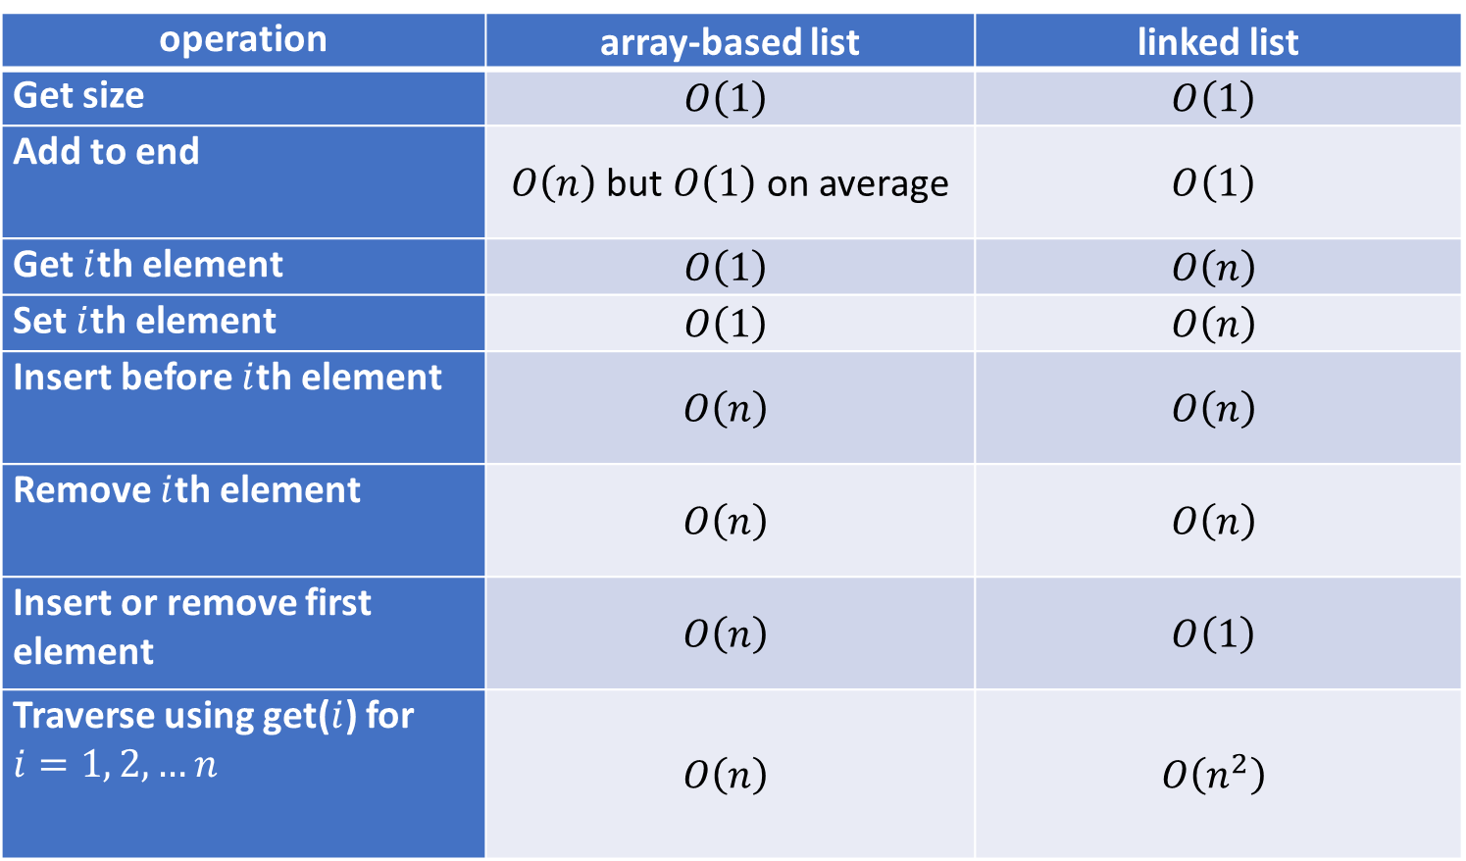
operation | array-based list | linked list
Get size | $$O\left(1\right)$$ | $$O\left(1\right)$$
Add to end | $O\left(n\right)$ but $O\left(1\right)$ on average | $$O\left(1\right)$$
Get $i$th element | $$O\left(1\right)$$ | $$O\left(n\right)$$
Set $i$th element | $$O\left(1\right)$$ | $$O\left(n\right)$$
Insert before $i$th element | $$O\left(n\right)$$ | $$O\left(n\right)$$
Remove $i$th element | $$O\left(n\right)$$ | $$O\left(n\right)$$
Insert or remove first element | $$O\left(n\right)$$ | $$O\left(1\right)$$
Traverse using get($i$) for $i=1, 2, …n$ | $$O\left(n\right)$$ | $$O\left(n^{2}\right)$$

