Slide 1
Hash tables
John MacCormick

Slide 2
Hash tables (2 lectures)
Basic idea:
An item maps to a fixed slot in a table via a hash function.
This provides constant time insertion and lookup.
Collision strategy 1: open hashing
Each slot points to a linked list of items
Resizing:
When the table becomes too full, copy and re-hash everything into a new, larger table
In-class activity: handout side 1
Collision strategy 2: closed hashing
If a slot is occupied, probe for an unoccupied slot
In-class activity: handout side 2
Additional topics:
Time complexity
Good hash functions and the simple uniform hashing assumption (SUHA)
Primary clustering
Deletion via tombstones
Real implementations

Slide 3
Hash tables have constant time insertion and lookup (average case)
A hash table stores key-value pairs. Given the key, we can find the value in constant time.
A hash table cannot:
Perform range queries, iterate over the elements, find the max or min, store the elements in sorted order

Slide 4
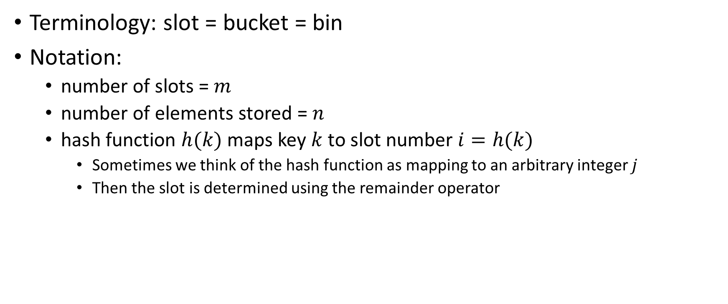
Basic idea: each key is mapped to a slot using a hash function
Terminology: slot = bucket = bin
Notation:
number of slots = $m$
number of elements stored = $n$
hash function $h(k)$ maps key $k$ to slot number $i=h(k)$
Sometimes we think of the hash function as mapping to an arbitrary integer $j$
Then the slot is determined using the remainder operator

Slide 5

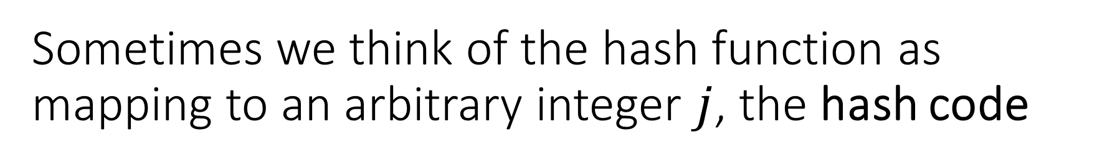
Sometimes we think of the hash function as mapping to an arbitrary integer $j$, the hash code
Then the slot is determined using the remainder operator:
Hash code $j=h\left(k\right)$
Slot $i=j \% m$
In Java, use the .hashcode() method
see HashCodes.java

Slide 6










Example 1 from HashCodes.java
In practice we store key-value pairs, but for simplicity we show only the keys here.
Assuming 100 slots in the hash table...
object: 5735, hash: 5735, slot: 35
object: 5736, hash: 5736, slot: 36
object: 27.5, hash: 1077641216, slot: 16
object: 27.75, hash: 1077657600, slot: 0
object: a, hash: 97, slot: 97
object: b, hash: 98, slot: 98
object: aa, hash: 3104, slot: 4
object: ab, hash: 3105, slot: 5
object: java.lang.Object@15db9742, hash: 366712642, slot: 42

Slide 7




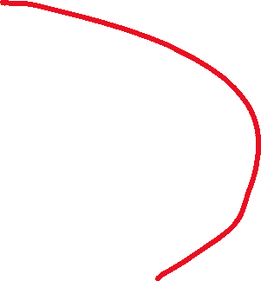

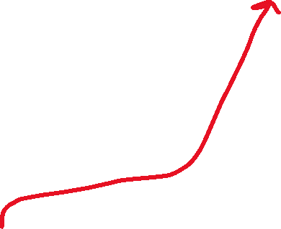
Example 1 from HashCodes.java
In practice we store key-value pairs, but for simplicity we show only the keys here.
Assuming 100 slots in the hash table...
object: 5735, hash: 5735, slot: 35
object: 5736, hash: 5736, slot: 36
object: 27.5, hash: 1077641216, slot: 16
object: 27.75, hash: 1077657600, slot: 0
object: a, hash: 97, slot: 97
object: b, hash: 98, slot: 98
object: aa, hash: 3104, slot: 4
object: ab, hash: 3105, slot: 5
object: java.lang.Object@15db9742, hash: 366712642, slot: 42

Slide 8
Hash tables (2 lectures)
Basic idea:
An item maps to a fixed slot in a table via a hash function.
This provides constant time insertion and lookup.
Collision strategy 1: open hashing
Each slot points to a linked list of items
Resizing:
When the table becomes too full, copy and re-hash everything into a new, larger table
In-class activity: handout side 1
Collision strategy 2: closed hashing
If a slot is occupied, probe for an unoccupied slot
In-class activity: handout side 2
Additional topics:
Time complexity
Good hash functions and the simple uniform hashing assumption (SUHA)
Primary clustering
Deletion via tombstones
Real implementations

Slide 9




But what if there is a collision? (Two different keys map to the same slot.)
We must use a collision resolution policy
The two main collision resolution policies are open hashing and closed hashing
Unfortunately,
open hashing is also known as closed addressing
closed hashing is also known as open addressing

Slide 10





In open hashing, every slot is a linked list (or maybe something fancier)
(example 2 from HashCodes.java )
Assuming 20 slots in the hash table...
object: a, hash: 97, slot: 17
object: m, hash: 109, slot: 9
object: abf, hash: 96357, slot: 17
object: gggl, hash: 3170757, slot: 17
object: xyz, hash: 119193, slot: 13

Slide 11









In open hashing, every slot is a linked list (or maybe something fancier)
(example 2 from HashCodes.java )
Assuming 20 slots in the hash table...
object: a, hash: 97, slot: 17
object: m, hash: 109, slot: 9
object: abf, hash: 96357, slot: 17
object: gggl, hash: 3170757, slot: 17
object: xyz, hash: 119193, slot: 13

Slide 12





In open hashing, every slot is a linked list (or maybe something fancier)
(example 2 from HashCodes.java )
Assuming 20 slots in the hash table...
object: a, hash: 97, slot: 17
object: m, hash: 109, slot: 9
object: abf, hash: 96357, slot: 17
object: gggl, hash: 3170757, slot: 17
object: xyz, hash: 119193, slot: 13

Slide 13


In open hashing, every slot is a linked list (or maybe something fancier)
(example 2 from HashCodes.java )
Assuming 20 slots in the hash table...
object: a, hash: 97, slot: 17
object: m, hash: 109, slot: 9
object: abf, hash: 96357, slot: 17
object: gggl, hash: 3170757, slot: 17
object: xyz, hash: 119193, slot: 13

Slide 14



In open hashing, every slot is a linked list (or maybe something fancier)
(example 2 from HashCodes.java )
Assuming 20 slots in the hash table...
object: a, hash: 97, slot: 17
object: m, hash: 109, slot: 9
object: abf, hash: 96357, slot: 17
object: gggl, hash: 3170757, slot: 17
object: xyz, hash: 119193, slot: 13

Slide 15
Hash tables (2 lectures)
Basic idea:
An item maps to a fixed slot in a table via a hash function.
This provides constant time insertion and lookup.
Collision strategy 1: open hashing
Each slot points to a linked list of items
Resizing:
When the table becomes too full, copy and re-hash everything into a new, larger table
In-class activity: handout side 1
Collision strategy 2: closed hashing
If a slot is occupied, probe for an unoccupied slot
In-class activity: handout side 2
Additional topics:
Time complexity
Good hash functions and the simple uniform hashing assumption (SUHA)
Primary clustering
Deletion via tombstones
Real implementations

Slide 16
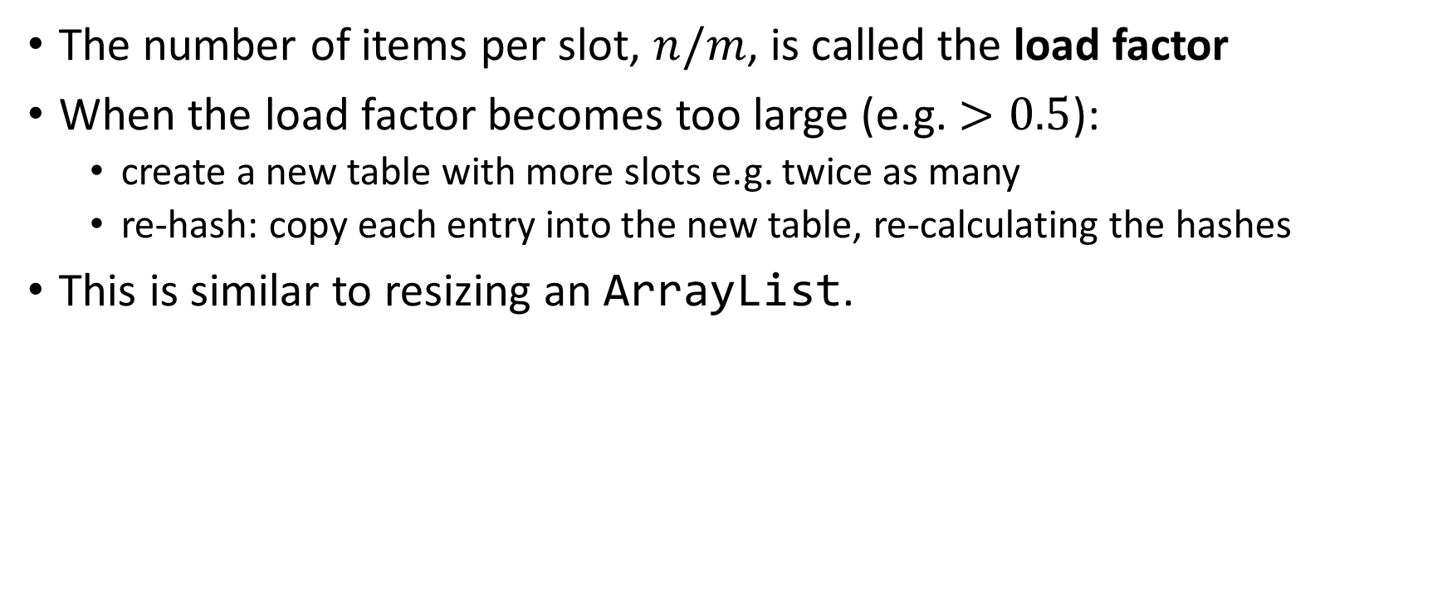
When the hash table becomes too full, we increase its size and re-hash
The number of items per slot, $n/m$, is called the load factor
When the load factor becomes too large (e.g. $>0.5$):
create a new table with more slots e.g. twice as many
re-hash: copy each entry into the new table, re-calculating the hashes
This is similar to resizing an ArrayList.

Slide 17
Hash tables (2 lectures)
Basic idea:
An item maps to a fixed slot in a table via a hash function.
This provides constant time insertion and lookup.
Collision strategy 1: open hashing
Each slot points to a linked list of items
Resizing:
When the table becomes too full, copy and re-hash everything into a new, larger table
In-class activity: handout side 1
Collision strategy 2: closed hashing
If a slot is occupied, probe for an unoccupied slot
In-class activity: handout side 2
Additional topics:
Time complexity
Good hash functions and the simple uniform hashing assumption (SUHA)
Primary clustering
Deletion via tombstones
Real implementations

Slide 18
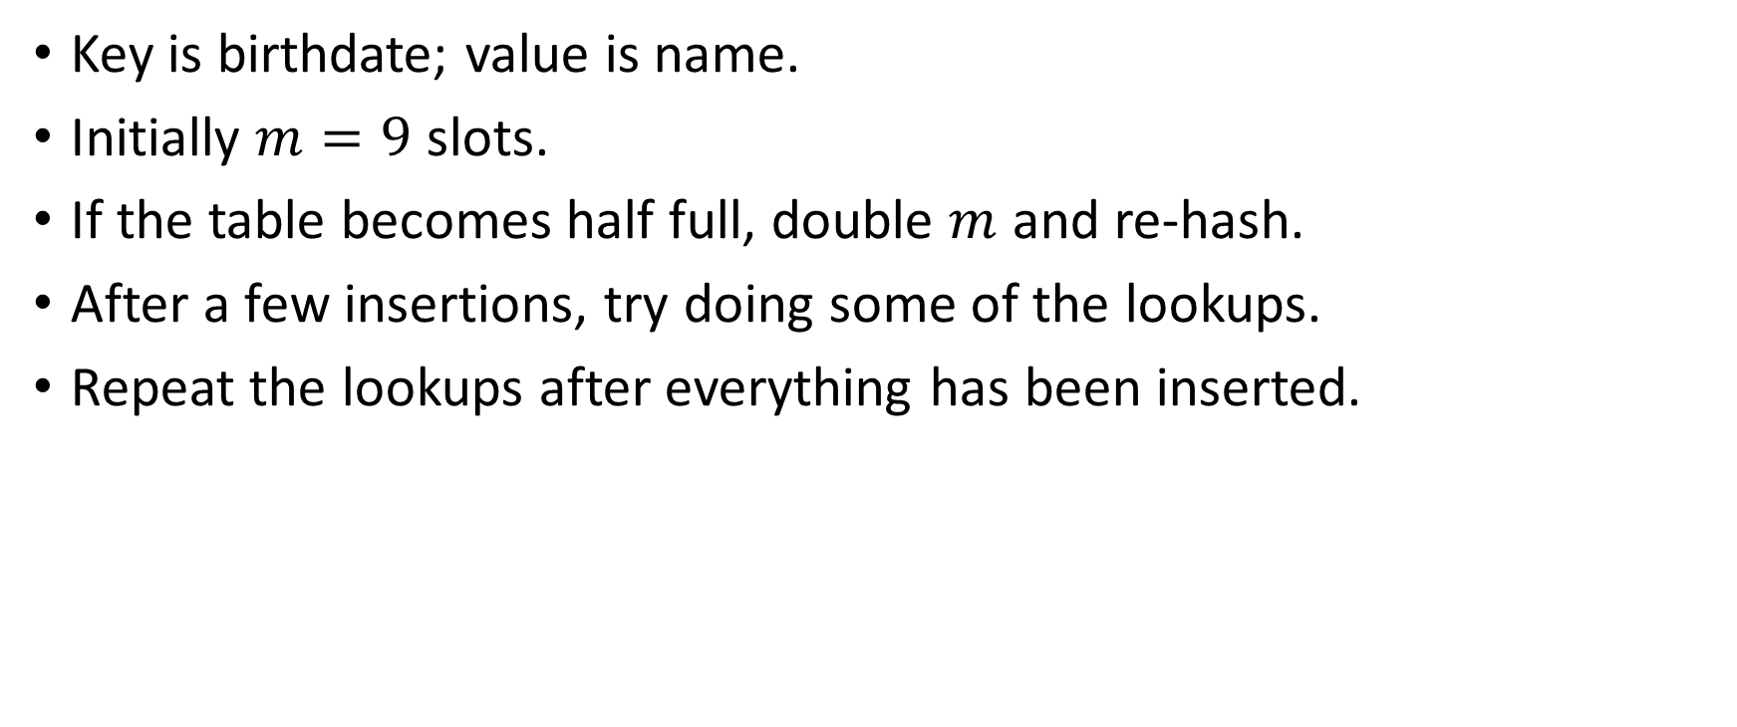
In-class activity: handout side 1 (open hashing). See also ComputerScientist.java
Key is birthdate; value is name.
Initially $m=9$ slots.
If the table becomes half full, double $m$ and re-hash.
After a few insertions, try doing some of the lookups.
Repeat the lookups after everything has been inserted.

Slide 19
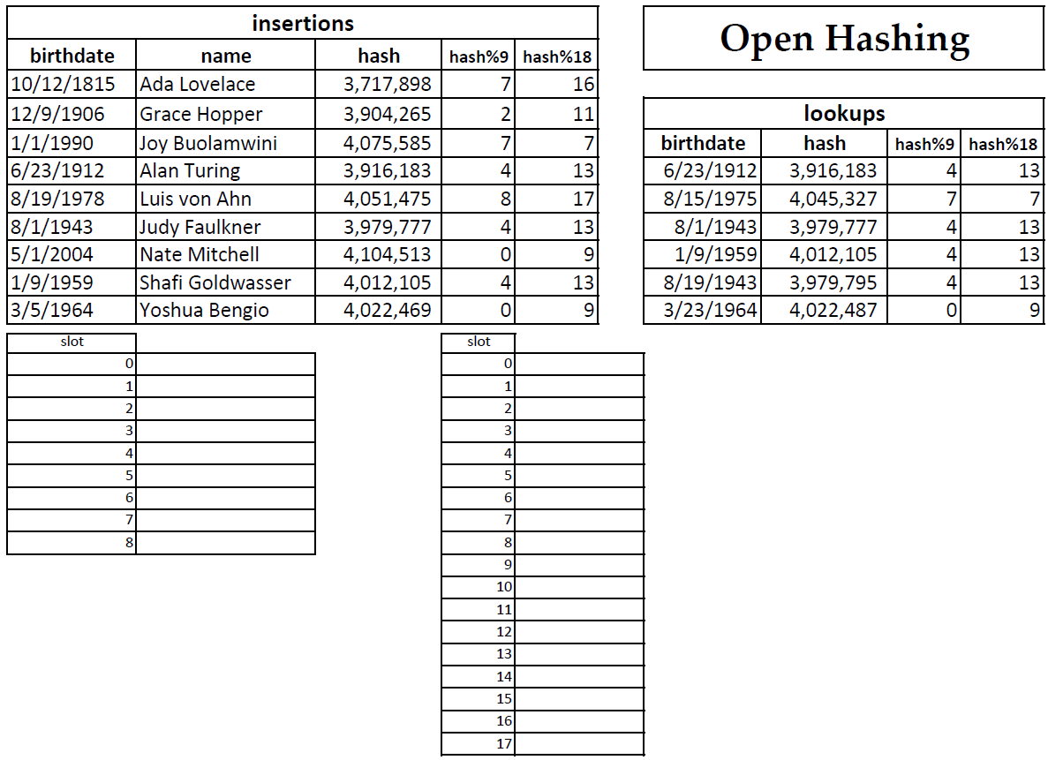
In-class activity: handout side 1 (open hashing). See also ComputerScientist.java

Slide 20
Hash tables (2 lectures)
Basic idea:
An item maps to a fixed slot in a table via a hash function.
This provides constant time insertion and lookup.
Collision strategy 1: open hashing
Each slot points to a linked list of items
Resizing:
When the table becomes too full, copy and re-hash everything into a new, larger table
In-class activity: handout side 1
Collision strategy 2: closed hashing
If a slot is occupied, probe for an unoccupied slot
In-class activity: handout side 2
Additional topics:
Time complexity
Good hash functions and the simple uniform hashing assumption (SUHA)
Primary clustering
Deletion via tombstones
Real implementations

Slide 21
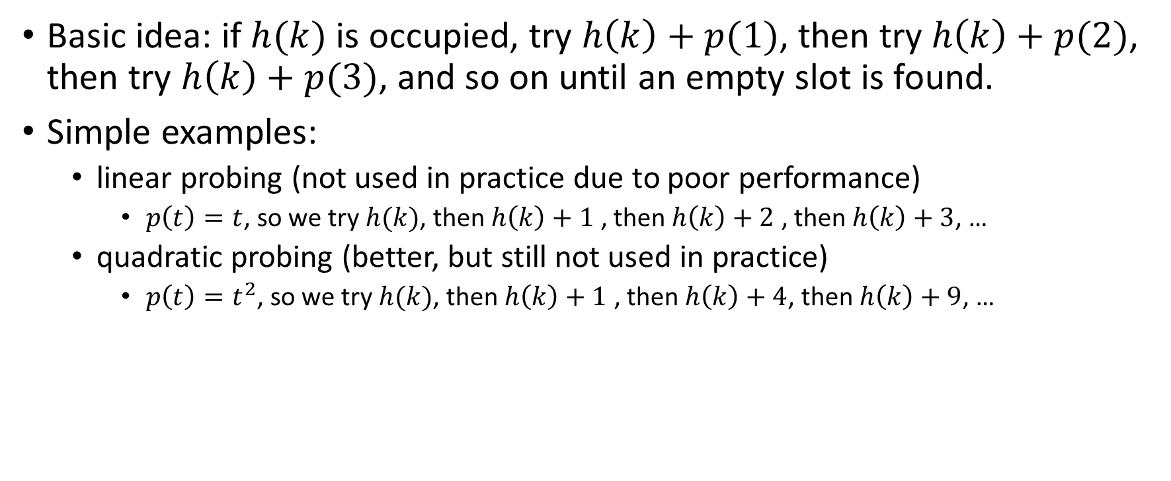
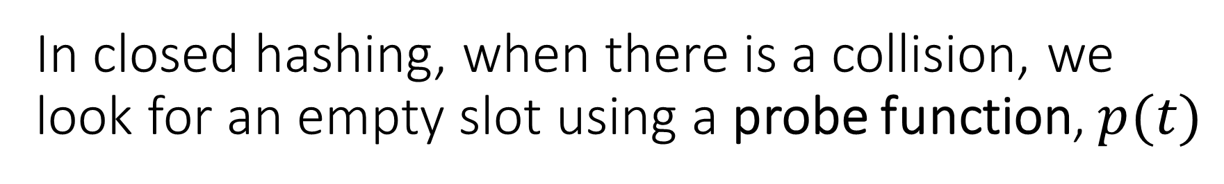
In closed hashing, when there is a collision, we look for an empty slot using a probe function, $p(t)$
Basic idea: if $h(k)$ is occupied, try $h\left(k\right)+p(1)$, then try $h\left(k\right)+p(2)$, then try $h\left(k\right)+p(3)$, and so on until an empty slot is found.
Simple examples:
linear probing (not used in practice due to poor performance)
$p\left(t\right)=t$, so we try $h(k)$, then $h\left(k\right)+1$ , then $h\left(k\right)+2$ , then $h\left(k\right)+3$, …
quadratic probing (better, but still not used in practice)
$p\left(t\right)=t^{2}$, so we try $h(k)$, then $h\left(k\right)+1$ , then $h\left(k\right)+4$, then $h\left(k\right)+9$, …

Slide 22





Example of closed hashing with linear probing
(example 2 from HashCodes.java )
Assuming 20 slots in the hash table...
object: a, hash: 97, slot: 17
object: m, hash: 109, slot: 9
object: abf, hash: 96357, slot: 17
object: gggl, hash: 3170757, slot: 17
object: xyz, hash: 119193, slot: 13

Slide 23
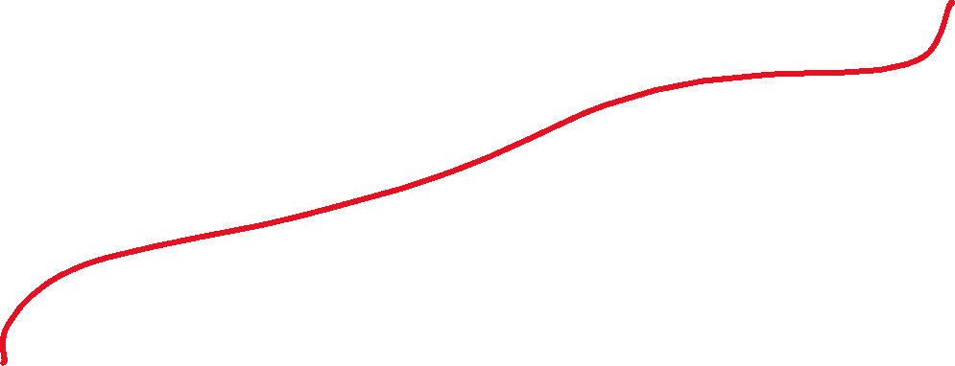

Example of closed hashing with quadratic probing
(example 2 from HashCodes.java )
Assuming 20 slots in the hash table...
object: a, hash: 97, slot: 17
object: m, hash: 109, slot: 9
object: abf, hash: 96357, slot: 17
object: gggl, hash: 3170757, slot: 17
object: xyz, hash: 119193, slot: 13

Slide 24
Hash tables (2 lectures)
Basic idea:
An item maps to a fixed slot in a table via a hash function.
This provides constant time insertion and lookup.
Collision strategy 1: open hashing
Each slot points to a linked list of items
Resizing:
When the table becomes too full, copy and re-hash everything into a new, larger table
In-class activity: handout side 1
Collision strategy 2: closed hashing
If a slot is occupied, probe for an unoccupied slot
In-class activity: handout side 2
Additional topics:
Time complexity
Good hash functions and the simple uniform hashing assumption (SUHA)
Primary clustering
Deletion via tombstones
Real implementations

Slide 25
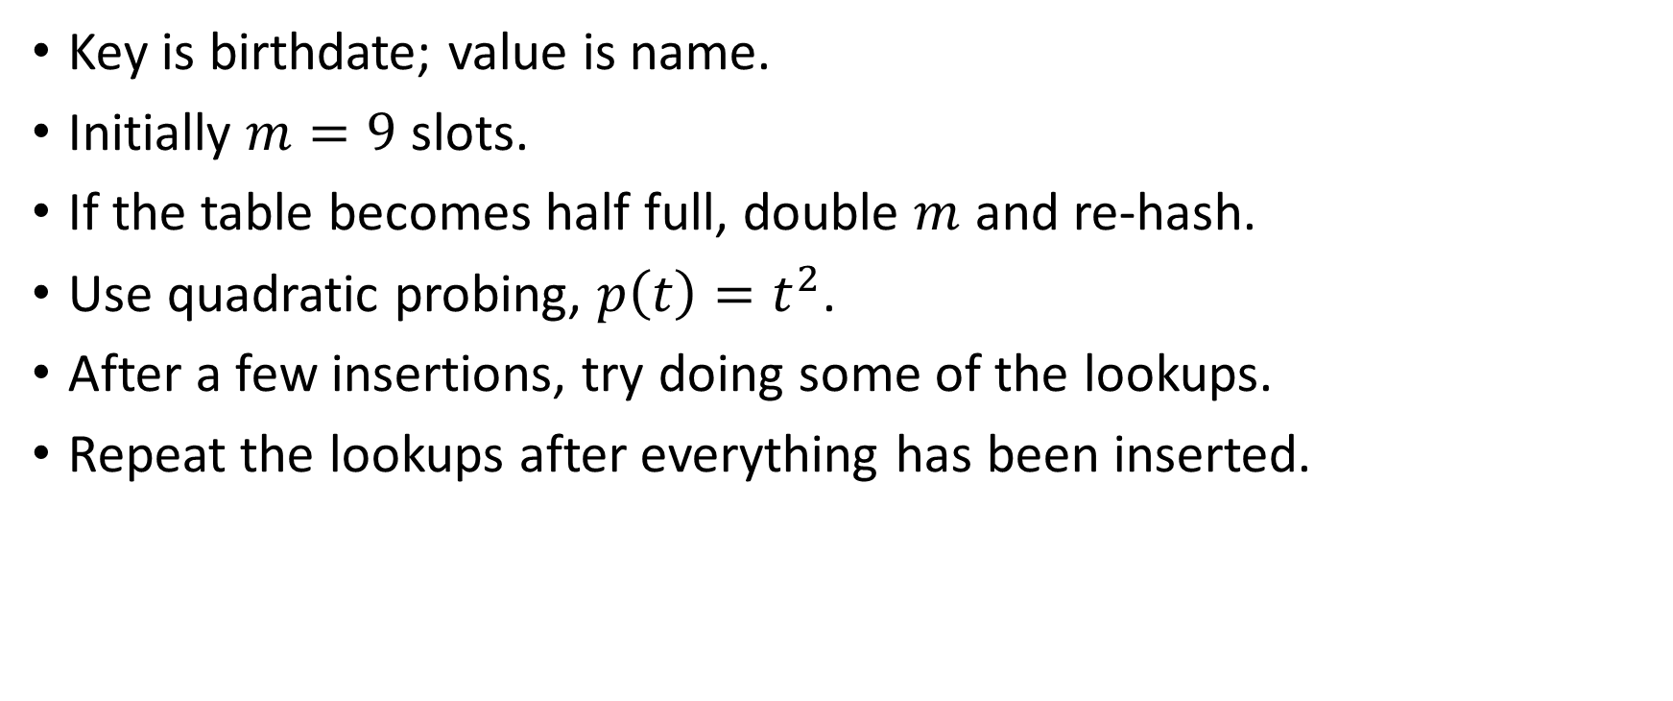
In-class activity: handout side 2 (closed hashing). See also ComputerScientist.java
Key is birthdate; value is name.
Initially $m=9$ slots.
If the table becomes half full, double $m$ and re-hash.
Use quadratic probing, $p\left(t\right)=t^{2}$.
After a few insertions, try doing some of the lookups.
Repeat the lookups after everything has been inserted.

Slide 26

In-class activity: handout side 2 (closed hashing). See also ComputerScientist.java

Slide 27
Hash tables (2 lectures)
Basic idea:
An item maps to a fixed slot in a table via a hash function.
This provides constant time insertion and lookup.
Collision strategy 1: open hashing
Each slot points to a linked list of items
Resizing:
When the table becomes too full, copy and re-hash everything into a new, larger table
In-class activity: handout side 1
Collision strategy 2: closed hashing
If a slot is occupied, probe for an unoccupied slot
In-class activity: handout side 2
Additional topics:
Time complexity
Good hash functions and the simple uniform hashing assumption (SUHA)
Primary clustering
Deletion via tombstones
Real implementations

Slide 28
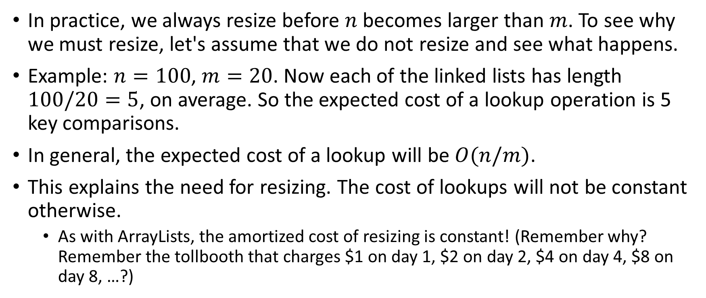
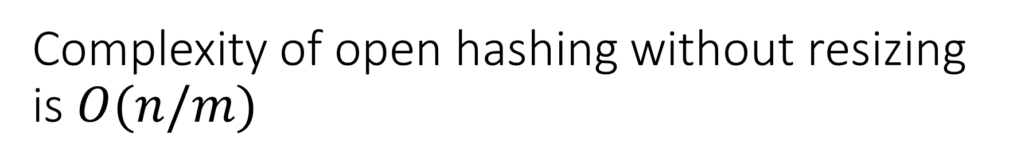
Complexity of open hashing without resizing is $O(n/m)$
In practice, we always resize before $n$ becomes larger than $m$. To see why we must resize, let's assume that we do not resize and see what happens.
Example: $n=100$, $m=20$. Now each of the linked lists has length $100/20=5$, on average. So the expected cost of a lookup operation is 5 key comparisons.
In general, the expected cost of a lookup will be $O(n/m)$.
This explains the need for resizing. The cost of lookups will not be constant otherwise.
As with ArrayLists, the amortized cost of resizing is constant! (Remember why? Remember the tollbooth that charges $1 on day 1, $2 on day 2, $4 on day 4, $8 on day 8, …?)

Slide 29
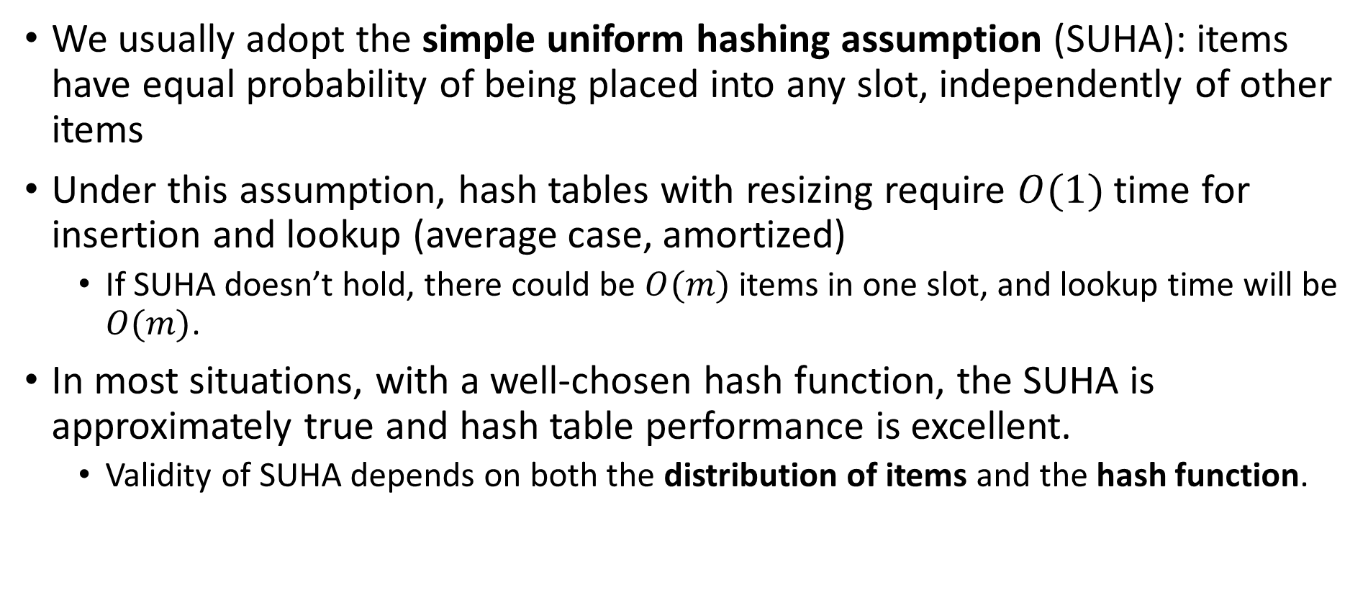
A good hash function spreads keys evenly across all slots
We usually adopt the simple uniform hashing assumption (SUHA): items have equal probability of being placed into any slot, independently of other items
Under this assumption, hash tables with resizing require $O(1)$ time for insertion and lookup (average case, amortized)
If SUHA doesn’t hold, there could be $O(m)$ items in one slot, and lookup time will be $O(m)$.
In most situations, with a well-chosen hash function, the SUHA is approximately true and hash table performance is excellent.
Validity of SUHA depends on both the distribution of items and the hash function.

Slide 30



In closed hashing, linear probing leads to poor performance because of primary clustering
After a collision, there is a primary cluster of at least two consecutive occupied slots
Compared to other probing techniques, linear probing makes it more likely that this cluster will be extended (because a key that hashes to anywhere in the cluster will extend the cluster)
This leads to lookup times that are longer than necessary.
Example: try the handout with linear probing

Slide 31
In closed hashing, deletion requires tombstones
A deleted key is replaced by a special value called a tombstone
Otherwise, there will be a gap in the probe sequence and lookups could fail
When inserting, we can replace a tombstone but only after checking the entire probe sequence.
Example: on the closed hashing handout, insert all keys then delete 8/1/1943.
Now look up 1/9/1959.
We need to skip over the tombstone
Now insert 1/9/1959.
We must again skip over the tombstone to find out that this key is already present and should not be re-inserted.
Now insert 8/19/1943.
After checking the whole probe sequence, this key can replace the tombstone.

Slide 32
Real implementations
CS232OpenHashMap, CS232ClosedHashMap
java.util.HashMap
Open hashing
Each slot is a balanced tree, not a linked list. Therefore, lookup time is worst-case logarithmic even if all keys hash to a single slot!
Python dictionaries
Closed hashing with pseudorandom probing
Resize when two-thirds full
Another trick allows the insertion order to be preserved

Slide 33
Hash tables (2 lectures)
Basic idea:
An item maps to a fixed slot in a table via a hash function.
This provides constant time insertion and lookup.
Collision strategy 1: open hashing
Each slot points to a linked list of items
Resizing:
When the table becomes too full, copy and re-hash everything into a new, larger table
In-class activity: handout side 1
Collision strategy 2: closed hashing
If a slot is occupied, probe for an unoccupied slot
In-class activity: handout side 2
Additional topics:
Time complexity
Good hash functions and the simple uniform hashing assumption (SUHA)
Primary clustering
Deletion via tombstones
Real implementations

