Slide 1
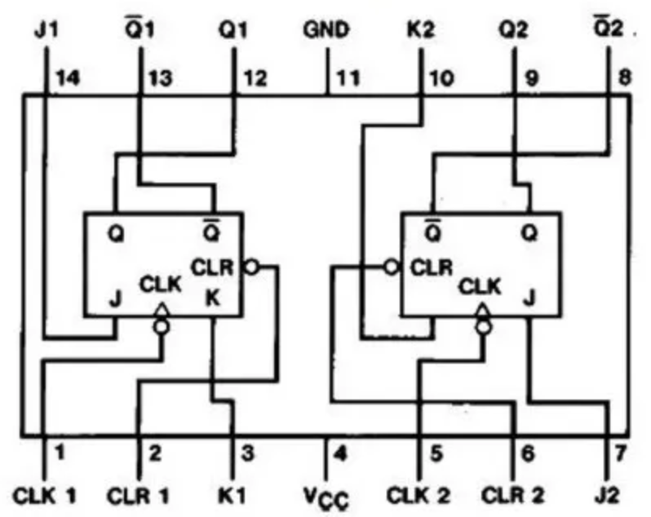
74HC73

Slide 2
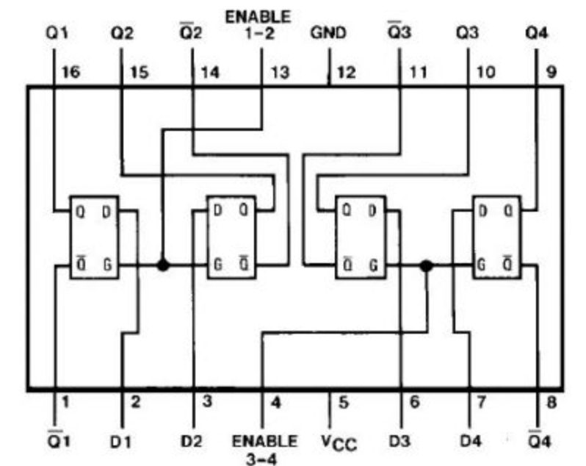
74HC75

Slide 3


D
D
D
Q
G
LE
Q
0
LE
Q
1
0
0
1
1
1
0
D
D
0
D
0
D
D
1
D
1
1
LE
Q
0
0
LE
Q
0
LE
Q
1
LE
Q
1
0
LE
Q
0
LE
Q
(i)
(ii)
(iii)
(iv)
(v)
(vi)

Slide 4







NOT
AND
OR
XOR
A
Z
A
A
A
B
Z
B
Z
B
Z
$$Z=\overline{A}$$
$$Z=AB$$
$$Z=A+B$$
$$Z=A⊕B$$
A Z
0 1
1 0
A B Z
0 0 0
0 1 0
1 0 0
1 1 1
A B Z
0 0 0
0 1 1
1 0 1
1 1 1
A B Z
0 0 0
0 1 1
1 0 1
1 1 0
NAND
NOR
XNOR
A
A
A
Z
B
Z
Z
B
B
A B Z
0 0 1
0 1 0
1 0 0
1 1 0
$$Z=\overline{AB}$$
$$Z=\overline{A+B}$$
$$Z=\overline{A⊕B}$$
A B Z
0 0 1
0 1 1
1 0 1
1 1 0
A B Z
0 0 1
0 1 0
1 0 0
1 1 0
A B Z
0 0 1
0 1 0
1 0 0
1 1 1

Slide 5
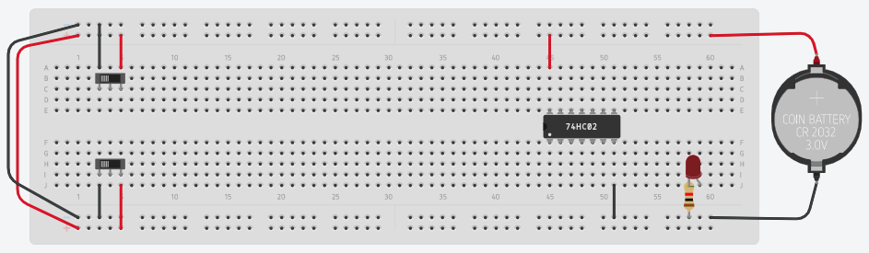
S
P
Q
R
S
Q
R

Slide 6
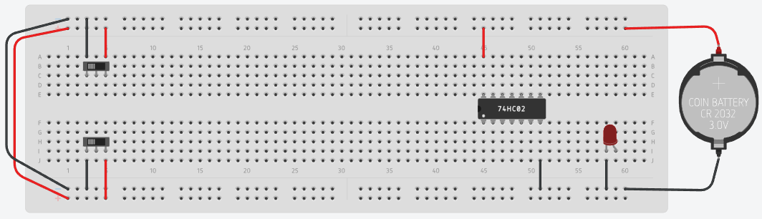
S
Q
R

Slide 7
D
S
P
Q
LE
R
1
S
P
0
1
0
0
0
1
0
Q
R

