Slide 1
03 – Logic Gates to Logic Circuits
COMP 256 – Dickinson College
Prof. Braught
Spring 2022

Slide 2







The Basic Logic Operations
NOT
AND
OR
XOR
A
Z
A
A
A
Schematic
Symbol
B
Z
B
Z
B
Z
$$Z=\overline{A}$$
$$Z=AB$$
$$Z=A+B$$
$$Z=A⊕B$$
Logic
Expression
A Z
0 1
1 0
A B Z
0 0 0
0 1 0
1 0 0
1 1 1
A B Z
0 0 0
0 1 1
1 0 1
1 1 1
A B Z
0 0 0
0 1 1
1 0 1
1 1 0
Truth
Table
NAND
NOR
XNOR
A
A
A
Each logic operation can be represented using: a schematic symbol (gate), a logic expression, or a truth table.
B
Z
B
Z
B
Z
$$Z=\overline{AB}$$
$$Z=\overline{A+B}$$
$$Z=\overline{A⊕B}$$
A B Z
0 0 1
0 1 1
1 0 1
1 1 0
A B Z
0 0 1
0 1 0
1 0 0
1 1 0
A B Z
0 0 1
0 1 0
1 0 0
1 1 1
Logic Gate Schematic Symbols from: https://www.tes.com/en-us/teaching-resource/logic-gate-symbols-for-powerpoint-11139006å
Notes:
Three equivalent ways of representing the logic operations
- Saw these in the activities due today.
Do basics then just point out complements.
- AND – 1 only when both inputs are 1
- OR – 1 when one or the other or both inputs are 1
- XOR – Exclusive OR
- 1 when exactly one or the other of the inputs is 1.
Complements:
- NAND – NOT AND
- is 1 when AND is 0
- NOR – NOT OR
- XNOR – NOT XOR
- Short name is a bit odd (Seems should be NXOR but it isn’t)
Point out NOT Bars in logic expressions. (different notations !, ~, ‘, etc)
Discuss NOT bubbles on schematics.

Slide 3

Logic Gates are Abstractions
Logic gates are an abstraction for a configuration of transistors that compute a logic function.
Relevant: Inputs and the function being computed.
Irrelevant: The actual transistor circuit.
NOT
A
Z
$$Z=\overline{A}$$
A Z
0 1
1 0
Notes:
Doesn’t matter to us as users of a gate what transistors are inside
- at least most of the time.
In fact, there are many other technologies that could be used to build a NOT gate:
- Even electromechanical relays or vacuum tubes.
- Check that Wikipedia page on Inverter that you looked at in the HW for today
- It shows a number of different transistor based implementations of NOT gates.
- We focus on CMOS because it is probably the easiest to understand and the most common.

Slide 4
Combinational Logic Circuits
A Combinational Logic Circuit is a collection of logic gates that are wired together to perform a computation.
Combinational Logic circuits compute Boolean Functions.
A Boolean Function is a function that maps as collection of Boolean input(s) (i.e. true/false, 1/0, +3V/ground) to a Boolean output.
A
0
1
0
Z
1
0
B
Notes:
If we apply logic values at the inputs…
The logic gates each transform their inputs into the appropriate output
Those outputs are routed further along in the circuit
Until a final output is generated.
What we will see is that once we have some facility with these types of circuits
We can design them to do specific computations that are useful to us.
- e.g. addition, multiplication, etc…

Slide 5

Logic Circuits to Truth Tables
The Boolean function computed by any logic circuit can be represented by a truth table.
The Truth Table lists all possible combinations of the inputs to the function and indicates the resulting output.
0
1
A B Z
0 0
0 1
1 0
1 1
A
0
Z
0
1
0
B
What output will be generated for the input 1 0?
Notes:
As for logic gate a logic circuit will have three equivalent representations.
- circuit, truth table, expression
To do so…
- list all of the possible input combinations.
- Apply one to the inputs and propagate it through to find the output.
Do row 2.
Ask them to do Row 3.
- compare with neighbor
- confirm

Slide 6
Logic Circuits to Truth Tables
The Boolean function computed by any logic circuit can be represented by a truth table.
The Truth Table lists all possible combinations of the inputs to the function and indicates the resulting output.
0
1
A B Z
0 0
0 1
1 0
1 1
A
0
Z
0
0
1
0
1
B
0
Notes:
As for logic gate a logic circuit will have three equivalent representations.
- circuit, truth table, expression
To do so…
- list all of the possible input combinations.
- Apply one to the inputs and propagate it through to find the output.
Do row 2.
Ask for Row 3.
Can check yourself later with others.

Slide 7





Logic Circuits to Logic Expressions
The Boolean function computed by a combinational logic circuit can also be expressed by a Logic Expression.
$$C=\overline{A}$$
$$D=AB$$
C
A
Z
$$Z=\overline{C+D}$$
D
B
$$Z=\overline{\overline{A}+D}$$
$$Z=\overline{\overline{A}+AB}$$
Notes:
Seen that we can represent behavior of a circuit as a truth table
Can also represent it using an expression.
Substitution Method:
- Label each intermediate result with a new variable.
- Write an expression for each intermediate variable in terms of the inputs
- Write an expression for the output in terms of the intermediate variables.
- Perform substitution until the output expressed in terms of the inputs.

Slide 8
Logic Circuits to Logic Expressions
We’ll call this method of finding the Logic Expression for a Logic Circuit the Substitution Method
Label intermediate results
Write expressions for each label
Write the output in terms of labels
Use substitution to express the output in terms of the inputs.
Use the substitution method to find a logic expression for this logic circuit.
P
S
Q

Slide 9




Logic Circuits to Logic Expressions
We’ll call this method of finding the Logic Expression for a Logic Circuit the Substitution Method
Label intermediate results
Write expressions for each label
Write the output in terms of labels
Use substitution to express the output in terms of the inputs.
Use the substitution method to find a logic expression for this logic circuit.
$$X=\overline{P+Q}$$
$$Y=PQ$$
P
X
$$S=X+Y$$
S
$$S=\overline{P+Q}+PQ$$
Q
Y
Notes:
If there are more inputs, and more gates there will be…
- more intermediate labels
- more substitution

Slide 10
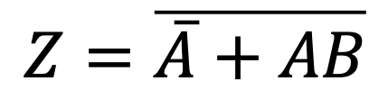
Logic Expressions to Logic Circuits
We can do a Direct Implementation of a Boolean function described by a logic expression as logic circuit.
$$Z=\overline{\overline{A}+AB}$$
A
Z
B
Notes:
Build it piece by piece.
Direct Implementation:
- Find all input variables and add them to the circuit.
- Identify terms in the expression that map to logic gates
- Add them to the circuit
- Combine those results with additional logic gates
Notice last two gates could also have been combined into a NOR.

Slide 11

Equivalent Representations
Any Boolean Function can be expressed equivalently as a Logic Circuit (a.k.a. Schematic Diagram), as a Truth Table, or as a Logic Expression.
?
✔
$$Z=\overline{\overline{A}+AB}$$
✔
✔
X
✔
Notes:
Might get the sense by now that these are all equivalent.
- We have done some of these… and all are possible
- Not all are routinely done.
From expression to truth table, can do it directly.
- A lot like building a circuit.
Truth table to circuit is possible but usually not done directly.
Instead we go around the other way.
- Truth table to expression (haven’t seen that yet, but we will in a moment).
- Expression to circuit.

Slide 12
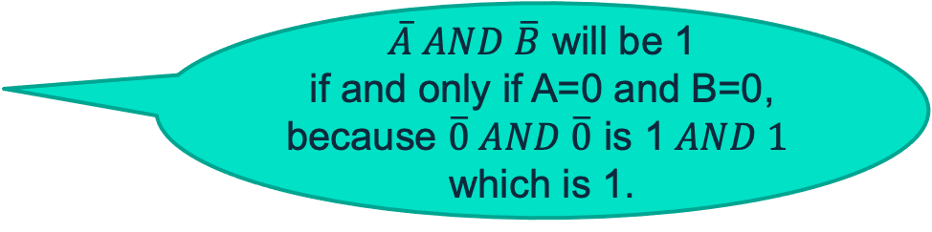
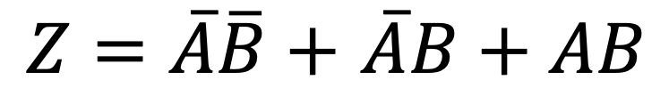
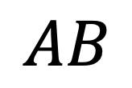
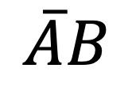
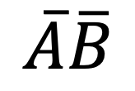
Truth Table to SOP Logic Expression
A logic expression in sum-of-products (SOP) form can readily be derived from a truth table.
$\overline{A} AND \overline{B}$ will be 1 if and only if A=0 and B=0, because $\overline{0} AND \overline{0}$ is 1$AND 1$ which is 1.
$$\overline{A}\overline{B}$$
$$\overline{A}B$$
$Z=\overline{A}\overline{B}+$ $\overline{A}B+AB$
$$AB$$
Notes:
What we need is an expression that gives a 1 when
- AB is 00
or when
- AB is 01
or when
- AB is 11
To do that we produce a term using A and B that will be 1 when A=0 and B=0.
- That term is NOT A AND NOT B
- If A=0 then NOT A = 1
- Similarly if B=0 then NOT B = 1
- We know that 1 AND 1 is 1.
- So NOT A AND NOT B will be 1 only when A=0 and B=0.
We do the same thing for the other places where there is a 1
Then we use OR to put them together.
So Z will be 1 when
- NOT A AND NOT B = 1
- OR when NOT A AND B = 1
- OR when A AND B = 1

Slide 13
Truth Table to SOP Logic Expression
A logic expression in sum-of-products (SOP) form can readily be derived from a truth table.
Give a logic expression in SOP form for output P of the Boolean function expressed by this truth table.
Notes:
First term is: (NOT M) AND N AND O

Slide 14




SOP Logic Expression to a Schematic
A Logic Expression in SOP form can be converted directly to an equivalent logic circuit.
$Z=\overline{A}\overline{B}+$ $\overline{A}B+AB$
A
B
$$\overline{A}\overline{B}$$
$$\overline{A}B$$
Z
$$AB$$
Notes:
SOP form is particularly nice because it gives a very straight forward way to build a circuit.
- Pick out the inputs and draw lines.
- Add a NOT version of each input
- Then compute each of the product terms using an AND gate
- OR all of the product terms together to get the output.

Slide 15
Extending the AND/OR Gates
The AND and OR gates have natural extensions to more than two inputs.
AND – output will be 1 if all inputs are 1, and 0 otherwise.
OR – output will be 1 if at least 1 input is 1, and 0 otherwise.
Notes:
May have noticed on last slide an OR with 3 inputs…
Similarly, if our product terms had A, B and C in them
Then we would need AND gates with 3 inputs.

Slide 16

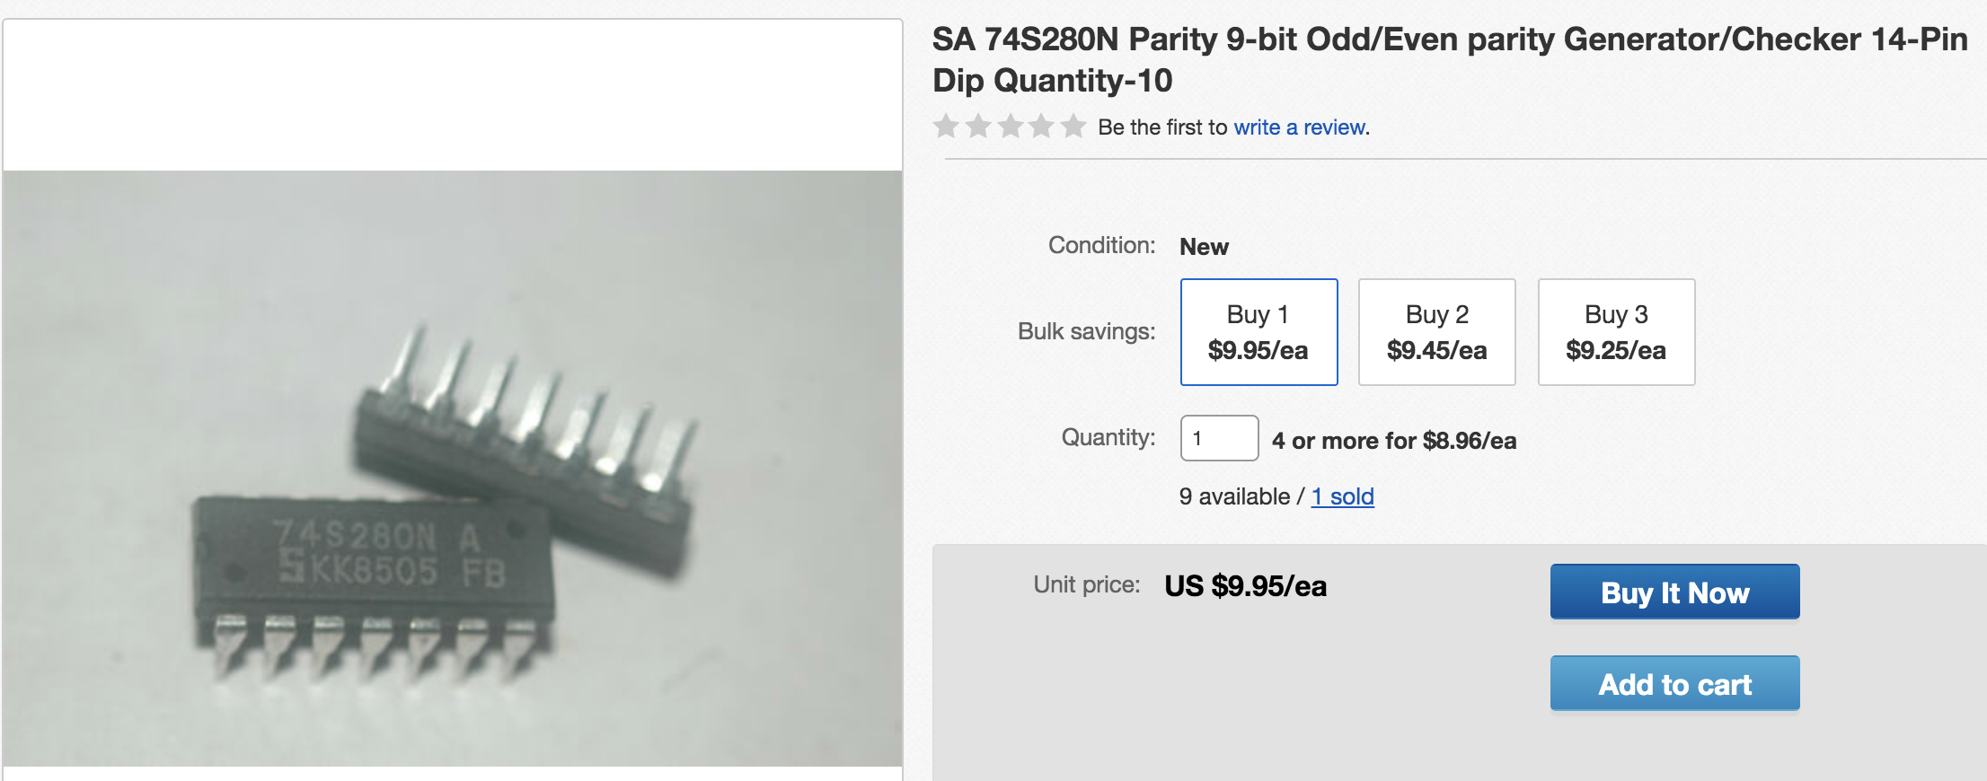
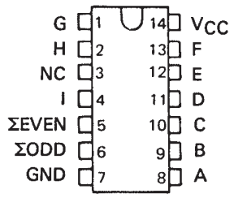
Abstracting Logic Circuits
Logic circuits can be packaged into abstractions called integrated circuits.
9 Bit even/odd parity generator/checker
https://www.ti.com/lit/ds/sdls152/sdls152.pdf (for the curious)
Image from: http://www.yd-tech.com.tw/product_info.php/
products_id/63503
Notes:
Relevant information is a description of what each input and output does.
Irrelevant, which gates and further, which transistors are used and how they are connected.
For example, this chip will set the output
EVEN = 1 if an even number A-I are 1’s
ODD = 1 if an odd number of A-I are 1’s
Don’t need to know the details of how it works, just how to use it!
But just for fun, you’ll build a small version of the even part of this circuit in the activities.

Slide 17


Acknowledgments
Slide Template From:
https://creativecommons.org/licenses/by/4.0/
Slide Content Licensed as:
Creative Commons Attribution-NonCommercial-ShareAlike 4.0 International License.
Notes:
Note: Individual images may be covered by their own licensing agreements and were incorporated here under fair use. Their use in this slide deck does not change or alter their licensing.

Slide 19
NOT
AND
OR
XOR
A
Z
A
A
A
B
Z
B
Z
B
Z
$$Z=\overline{A}$$
$$Z=AB$$
$$Z=A+B$$
$$Z=A⊕B$$
A Z
0 1
1 0
A B Z
0 0 0
0 1 0
1 0 0
1 1 1
A B Z
0 0 0
0 1 1
1 0 1
1 1 1
A B Z
0 0 0
0 1 1
1 0 1
1 1 0
NAND
NOR
XNOR
A
A
A
B
Z
B
Z
B
Z
A B Z
0 0 1
0 1 0
1 0 0
1 1 0
$$Z=\overline{AB}$$
$$Z=\overline{A+B}$$
$$Z=\overline{A⊕B}$$
A B Z
0 0 1
0 1 1
1 0 1
1 1 0
A B Z
0 0 1
0 1 0
1 0 0
1 1 0
A B Z
0 0 1
0 1 0
1 0 0
1 1 1

Slide 20
1
S
P
G
D
A
Z
D
N
G
S
0

Slide 21
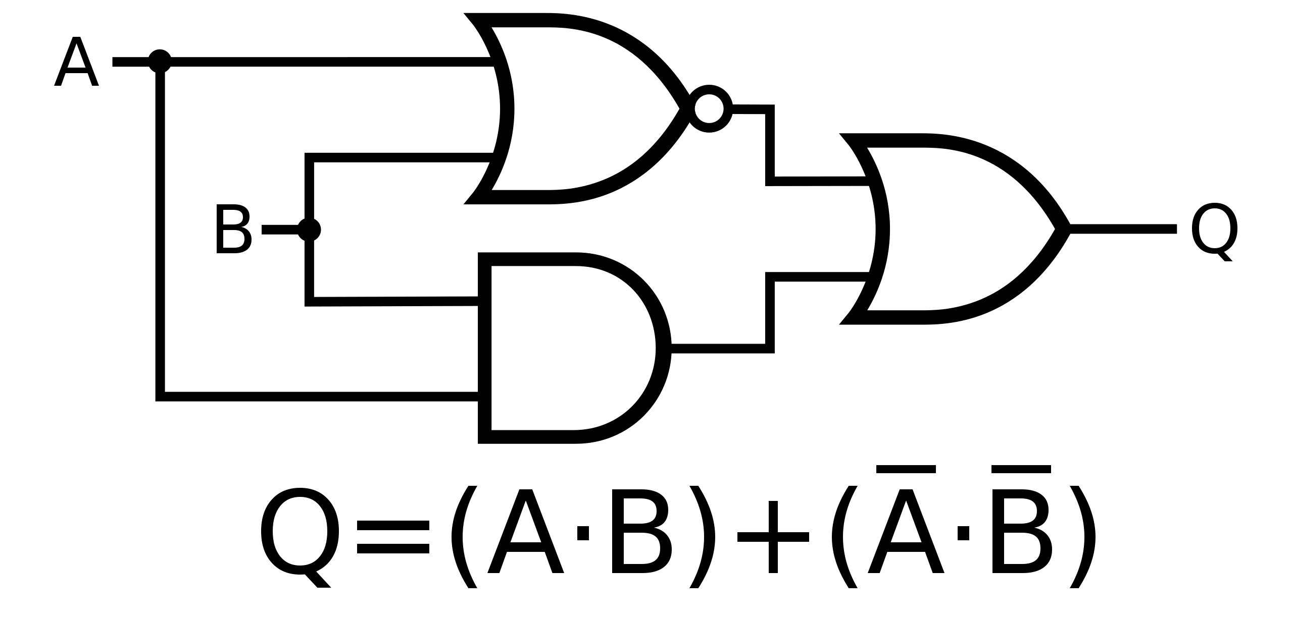
A
Z
B
P
S
Q
Officer781, CC BY-SA 4.0 <https://creativecommons.org/licenses/by-sa/4.0>, via Wikimedia Commons

Slide 22
R S T P
0 0 0 0
0 0 1 0
0 1 0 0
0 1 1 1
1 0 0 0
1 0 1 1
1 1 0 0
1 1 1 1

