Slide 1
L07/08 – An Interpreter
COMP 256 – Dickinson College
Prof. Braught
Spring 2022

Slide 2
Program Execution
Huge Idea: Use programs to convert instructions for high-level language machines into machine language instructions.
Compiler, Assembler, Interpreter, Virtual Machine
pay=salary+bonus;
High-Level Language Machine
pay=salary+bonus;
Compiler
Compiler
Translation
Interpreter
ASM
Interpretation
Hybrid Approach
Byte
Code
Assembler
Virtual Machine
R0 ← R1 + R2
Machine Language Machine
Notes:
These are different approaches to getting the instructions in a HLL turned into ML that the machine can execute.
Don’t describe each… rather… the main point is that
These are different ways of implementing the abstract machine
- any language can be implemented in any one of these ways.
Similar to the way there were multiple ways of implementing the abstract memory cell.
- SRAM and DRAM
- Abstract level behavior is the same.
- The mechanism by which that is achieved is different.
Similarly we saw logic gates with CMOS technology
Can also build all of the same stuff using different types of transistors using TTL technology
But just like with other abstractions the way we build it may show through…
Some of the details of each of these will be in the activities along with
the pros and cons of each

Slide 3
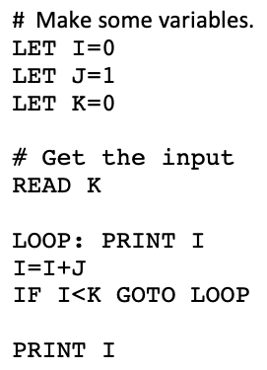
A Silli Little Language
Simple Instruction Language for Learning Interpreters

Slide 4
Interpreting a little Silli Program:
# A Little Program.
LET X=0
LET Y=0
LET Z=0
READ X
READ Y
Z=X*Y
PRINT Z
Variable Map
Variable Value
X 0
Y 0
Z 0

Slide 5
Interpreting a little Silli Program:
# A Little Program.
LET X=0
LET Y=0
LET Z=0
READ X
READ Y
Z=X*Y
PRINT Z
Variable Map
Variable Value
X 0
Y 0
Z 0
?

Slide 6
Interpreting a little Silli Program:
# A Little Program.
LET X=0
LET Y=0
LET Z=0
READ X
READ Y
Z=X*Y
PRINT Z
Variable Map
Variable Value
X 0
Y 0
Z 0
? 5

Slide 7
Interpreting a little Silli Program:
# A Little Program.
LET X=0
LET Y=0
LET Z=0
READ X
READ Y
Z=X*Y
PRINT Z
Variable Map
Variable Value
X 5
Y 0
Z 0
? 5

Slide 8
Interpreting a little Silli Program:
# A Little Program.
LET X=0
LET Y=0
LET Z=0
READ X
READ Y
Z=X*Y
PRINT Z
Variable Map
Variable Value
X 5
Y 3
Z 0
? 3

Slide 9
Interpreting a little Silli Program:
# A Little Program.
LET X=0
LET Y=0
LET Z=0
READ X
READ Y
Z=X*Y
PRINT Z
Variable Map
Variable Value
X 5
Y 3
Z 15

Slide 10
Interpreting a little Silli Program:
# A Little Program.
LET X=0
LET Y=0
LET Z=0
READ X
READ Y
Z=X*Y
PRINT Z
Variable Map
Variable Value
X 5
Y 3
Z 15
15

Slide 11
The Java Map Interface
Variable Map
Variable Value
X 5
Y 3
Z 15
The Map in Java maps keys to values
like a Dictionary in Python.
Map<String, Integer> varMap =
new HashMap<String, Integer>();
…
String var = “X”;
int val = 5;
…
varMap.put(var, val);
…
val = varMap.get(var);

Slide 12

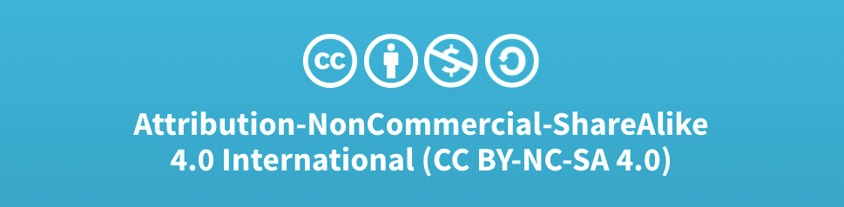
Acknowledgments
Slide Template From:
https://creativecommons.org/licenses/by/4.0/
Slide Content Licensed as:
Creative Commons Attribution-NonCommercial-ShareAlike 4.0 International License.

