Slide 1
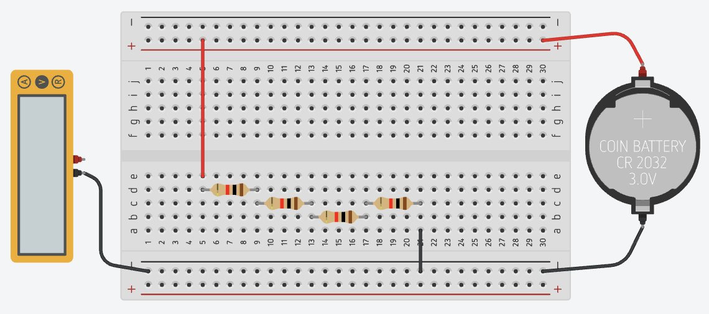
A
B
C
D
E

Slide 2
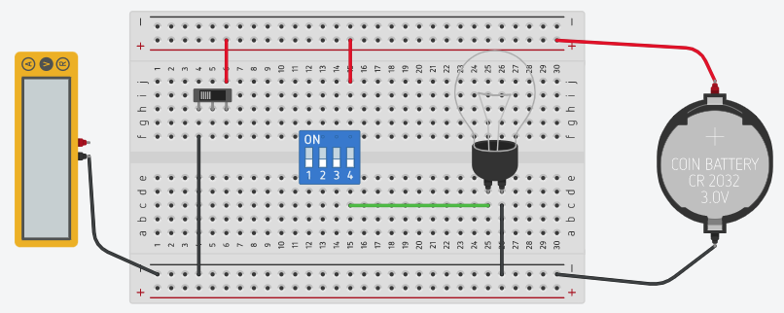
A

Slide 3
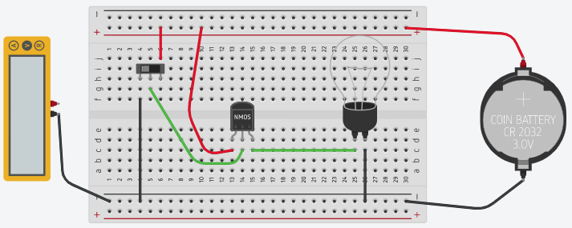

Slide 4
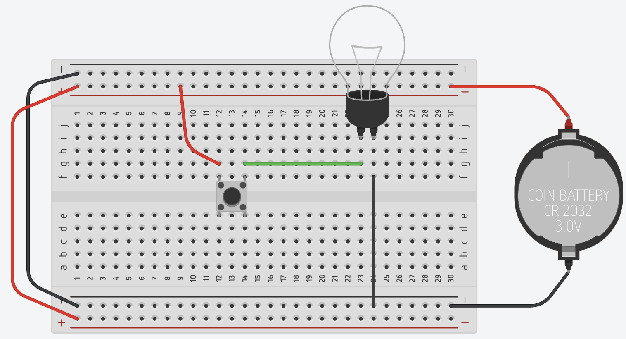
Terminals
Power
Rails

Slide 5
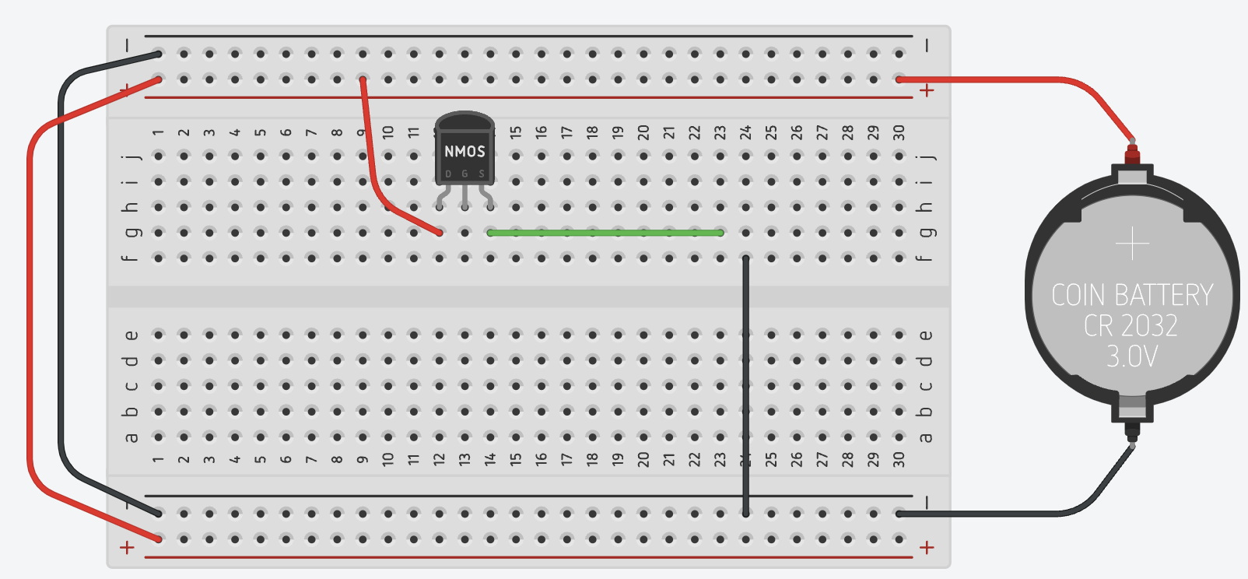

Slide 6
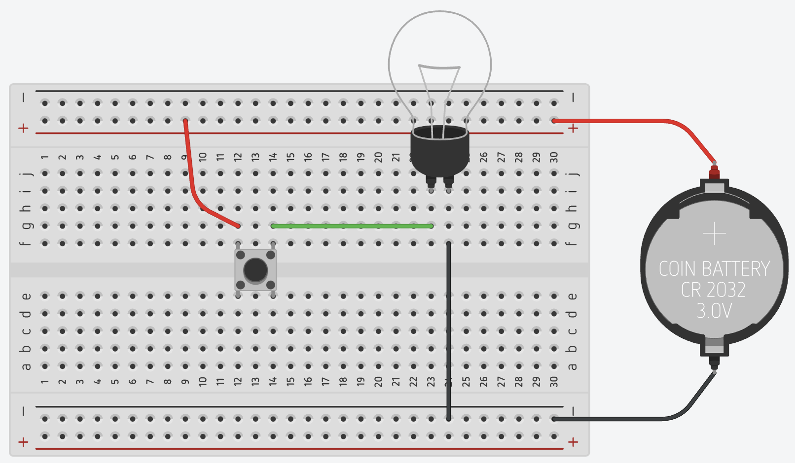
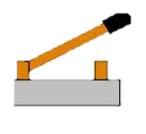
Terminals
Power
Rails

Slide 7
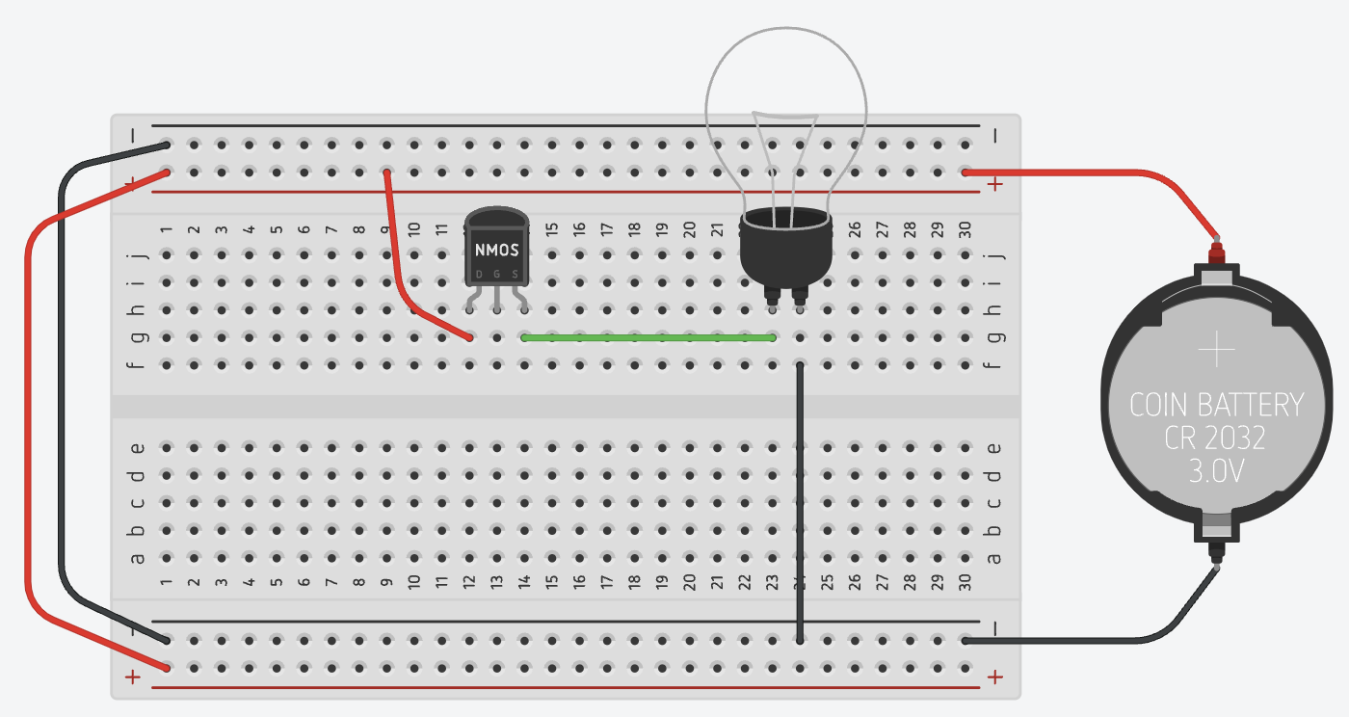

Slide 8
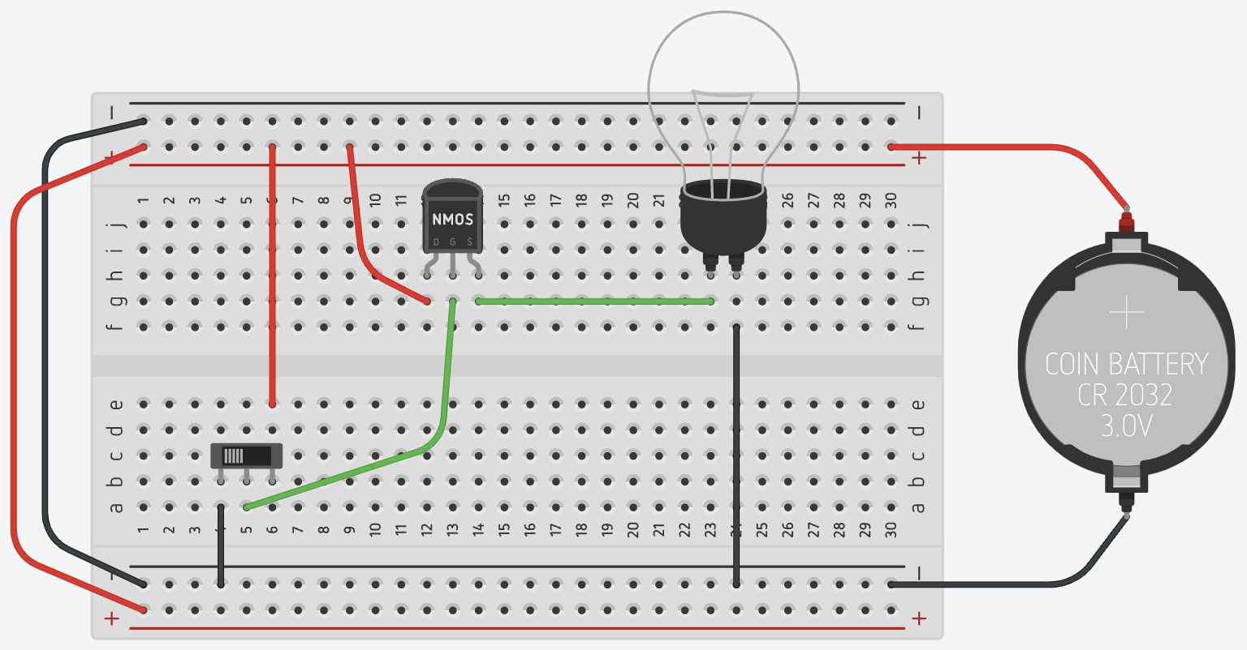

Slide 9
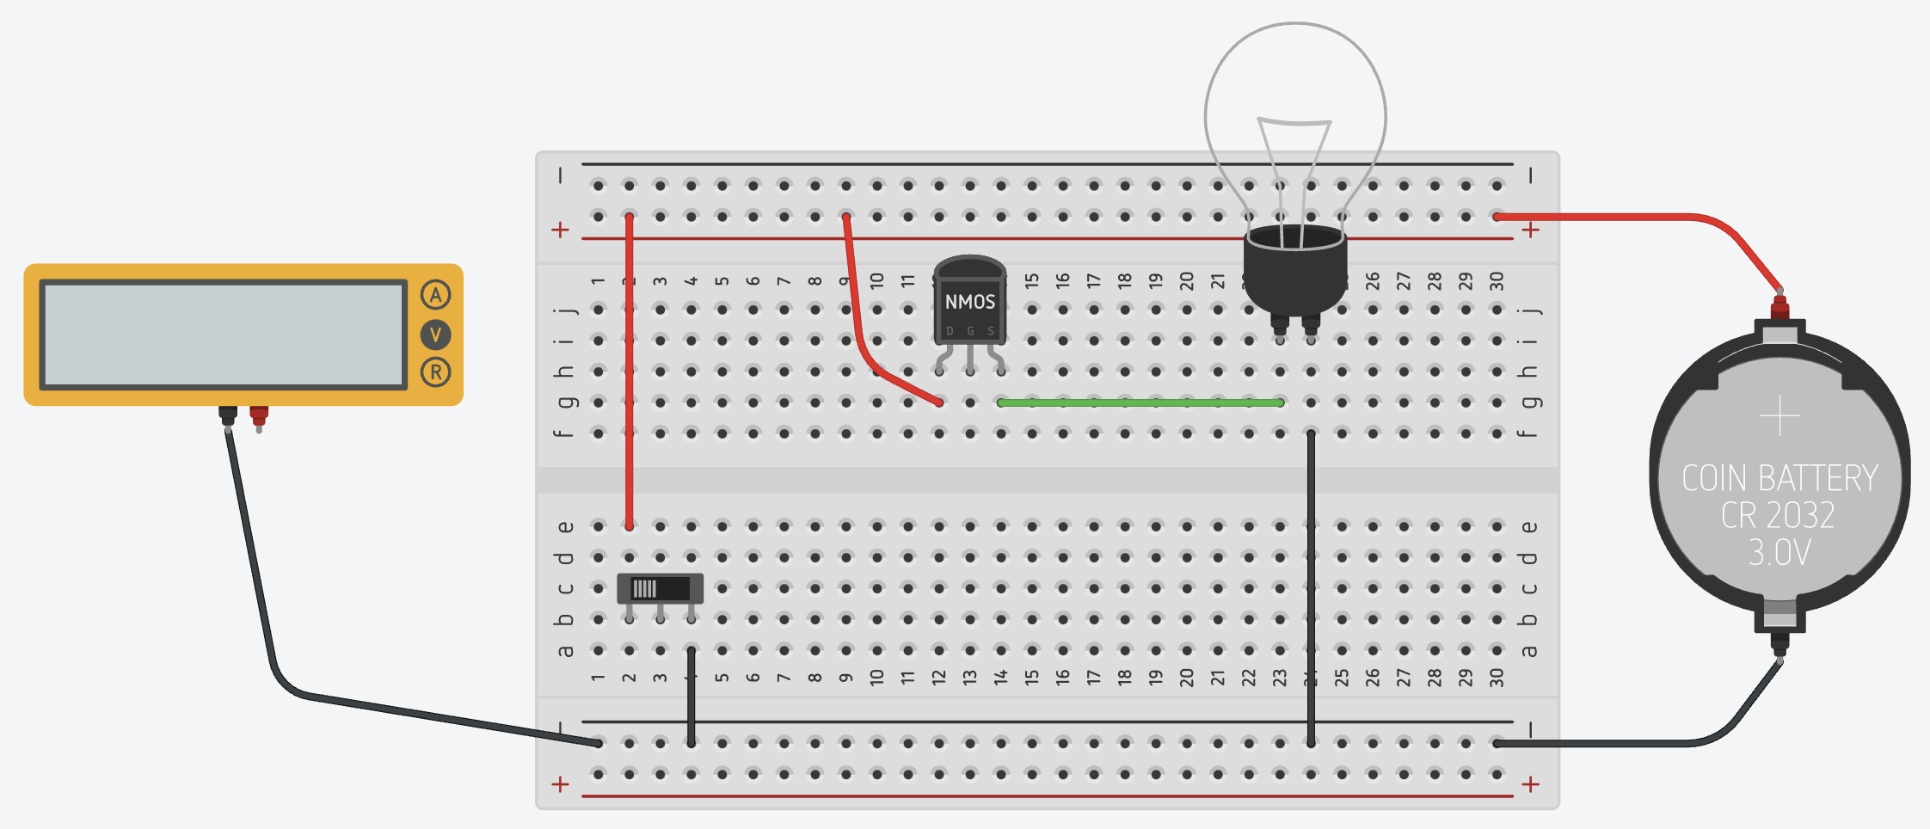
A

Slide 10
S
S
S
P
P
P
G
0
G
1
G
D
D
D
D
D
D
N
N
N
G
0
G
1
G
S
S
S

