Slide 1
OSA7 – Race Conditions & Mutual Exclusion
COMP 256 – Dickinson College
Prof. Braught
Spring 2023

Slide 2
Multithreaded Processes
TCB:main
Logical Memory
PC:76
0:
2^{m}-1:
ML
PCB
Registers
PID:139
R0:20
R1:141
R2:12
R3:0
…
R14:141
Data
Page Table
TCB:PrintIt
Proc Info:
Heap
PC:893
Empty
Files:
Threads:
main
PrintIt
Registers
R0:3
R1:5
R2:75
R3:0
…
R14:19
it:Stack
Empty
main:Stack
Notes:
Recall Threads
Key points:
- We have a single process with its own logical memory
- The currently used pages will be loaded into physical page frames by the paged virtual memory system.
Because we have multiple threads we have multiple execution contexts
- These are represented by the red and blue squiggly lines in the diagram
- The OS keeps track of these using Thread Control Blocks (one for each thread)
Each thread will have:
- its own program counter
- its own copy of the registers
- its own stack for function calls and local variable
OS will context switch between the threads (e.g. on timer interrupts).

Slide 3


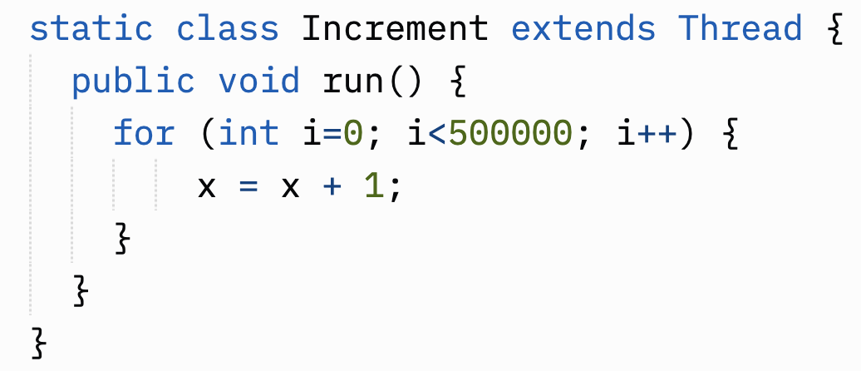
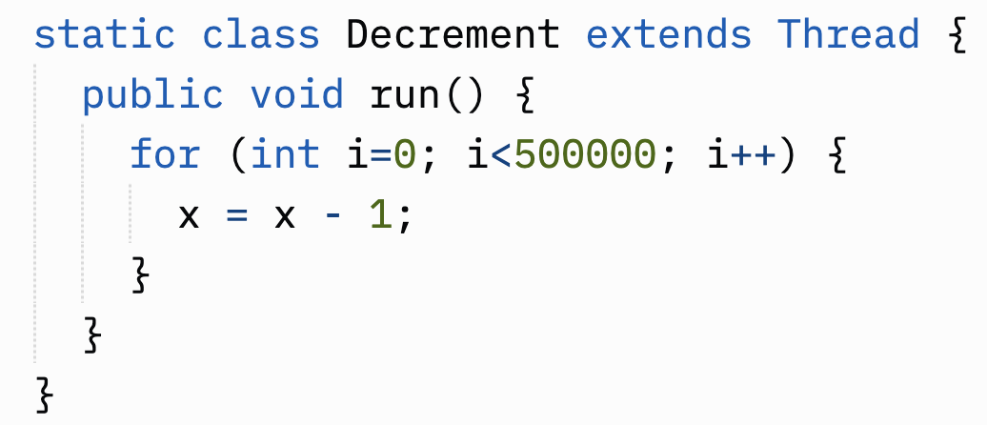
A Multithreaded Example
Imagine main starts these two threads and then join’s both of them.
What should the value of x be at the end?
What values do you actually get when you run the program?
Program at: https://replit.com/@braughtg/ThreadRaceCondition
Notes:
Let’s look at a multithreaded process.
Consider a main program (not shown here) that
- Creates two additional threads
- One using Increment
- One using Decrement
- Starts both of them running (i.e. calls their start() method)
- Calls join() on both of them to wait for them to finish.
The Threads share the static variable x that is stored in the heap segment.
What does increment do?
What does decrement do?
What should the value be once Increment and Decrement both finish?
Run the program a few times.
What values do you get?

Slide 4
Simple Thread Example:
Imagine two threads running concurrently (i.e. timesharing on a single core, or at the same time on multiple cores)
x=5
Notes:
Let’s dig in a little and see what might be happening here.
In this example
- if both of these threads complete the value of X should should be 3.
- It should not matter whether thread 1 gets to go first or if thread 2 gets to go first.
- Their order should not matter the end result should be the same.
But we will see that it does matter, and if we are not careful we can get a result other than 3
That may seem very strange at the moment, but that is because we are viewing threads from the perspective of their high-level language abstraction.
We will need to understand some of the details that are hidden from us by that abstraction to understand why we see the results that we do.

Slide 5
Looking deeper
Peeling away the HLL abstraction:
x=5
Notes:
The key insight here is that x=x+2 or x=x-3 are not a single operation.
- Remember that these HLL statements will be converted to
- Assembly (or other intermediate) Language by a compiler
- And then ultimately to an equivalent machine language by an assembler or a virtual machine (interpreter) as in Java.
- So the statement X = X + 1 is not a single operation
- The value of X has to be loaded from main memory into a register
- Then we can add 1
- Then we have to store X back into main memory.
Now remember that we are also timesharing between multiple threads of execution and multiple processes as well.
So the OS might switch from Thread 1 to Thread 2 or vice versa at any time.
If the threads run through in order:
- Thread 1
- loads X as 5
- Adds 1 making it 6
- Stores it back into X
- Thread 2
- Loads X as 6
- subtracts 3
- stores X as 3
- Or vice versa…
Then we get the expected result.
No problems.

Slide 6
Race Conditions
A race condition exists when the order in which the instructions interleave can affect the result.
x=5
Thread 1
Thread 2
PC: …
PC: …
Registers
Registers
R0: 5
R1:
R2:
R3:
…
R14:
R0:
R1:
R2:
R3:
…
R14:
Notes:
But that may not happen.
- Let’s look at what can happen if we switch from Thread 1 to Thread 2 somewhere in the middle of these operations.
Imagine Thread 1 is scheduled to run first
- It may do some things before it gets to this point in its execution.
- When it gets to this point it will load X, which currently has the value 5, into R0

Slide 7
Race Conditions
A race condition exists when the order in which the instructions interleave can affect the result.
x=5
Thread 1
Thread 2
PC: …
PC: …
Registers
Registers
R0:
R1:
R2:
R3:
…
R14:
R0:
R1:
R2:
R3:
…
R14:
6
Notes:
If Thread 1 continues to run.
- It will next add 1 to R0 making its new value 6.

Slide 8
Race Conditions
A race condition exists when the order in which the instructions interleave can affect the result.
x=5
Thread 1
Thread 2
Timer Interrupt
PC: …
PC: …
Registers
Registers
R0:
R1:
R2:
R3:
…
R14:
R0: 5
R1:
R2:
R3:
…
R14:
6
Notes:
At this point let’s image that the time slice for Thread 1 expires
- I.e. the timer device goes off and generates a timer interrupt
- We’ll assume that the OS transfers control to Thread 2 at this point.
- We know the details of how this happens and will generally just think of it happening.
- But this once… Recall that…
- The OS interrupt service routine for the timer device will runs (via the IRQ and the Interrupt Vector).
- The OS Saves the context of Thread 1 to its TCB and moves it to the Ready state.
- At some point later, possibly after other timer interrupts and scheduling other processes or threads,
- the scheduler will pick Thread 2 to run
- The OS will switch the context of Thread 2 onto the CPU.
- Thread 2 will begin running.
Thread 2 may do some other work before this…
- But it eventually will load x from main memory, which still has the value 5, into R0.
- Note that Thread 1 has not yet put its value for x back into main memory because it was interrupted.
Note: All this talk of main memory, would also include the use of cache!
- But we’ll ignore that!

Slide 9
Race Conditions
A race condition exists when the order in which the instructions interleave can affect the result.
x=5
Thread 1
Thread 2
PC: …
PC: …
Registers
Registers
R0:
R1:
R2:
R3:
…
R14:
R0: 2
R1:
R2:
R3:
…
R14:
6
Notes:
Thread 2 then subtracts 3 from its value in R0 giving it the value 2.

Slide 10
Race Conditions
A race condition exists when the order in which the instructions interleave can affect the result.
x=2
Thread 1
Thread 2
PC: …
PC: …
Registers
Registers
R0:
R1:
R2:
R3:
…
R14:
R0: 2
R1:
R2:
R3:
…
R14:
6
Notes:
We’ll imagine that Thread 2’s time slice is not quite up yet.
So Thread2 continues on and stores R0 into X in the main memory, giving it the value 2.

Slide 11
Race Conditions
A race condition exists when the order in which the instructions interleave can affect the result.
x=6
Thread 1
Thread 2
Timer Interrupt
PC: …
PC: …
Registers
Registers
R0:
R1:
R2:
R3:
…
R14:
R0: 2
R1:
R2:
R3:
…
R14:
6
Notes:
Thread 2 may have gone on to do some other things
Eventually its time slice would expire and the OS would eventually context switch back to Thread 1
- Possibly running some other threads or processes in between.
Thread 1 will then pick up right where it left off
- It stores its value of R0 (6) into main memory as the value of x
- This replaces the value of 2 that Thread 2 has just put there.
So if the threads were to run in that order with those interrupts and context switches
- The end result would be that x is 6 and not the expected value of 3.
If the threads happen to run in a different order we might get other values.

Slide 12
Race Conditions
A race condition exists when the order in which the instructions interleave can affect the result.
x=5
We saw how the final value of x could be 3 or could be 6.
What other value is possible? How would that happen?
Notes:
The result will be 5 if
- Thread 1 runs all the way through, then Thread 2 runs all the way through.
- Or vice versa.
The result will be 6 if
- The threads run as illustrated on the prior slides.
There is one more possible value for x at the end.
What is it?
How does it happen?

Slide 13
Vocabulary
Critical sections are portions of code that create a race condition.
Shared variable(s) create critical sections.
Mutually exclusive execution of critical sections prevents race conditions.
x=5
Critical
Section
Critical
Section
Image from: https://openclipart.org/
Notes:
Just some additional vocabulary that is useful in discussing these ideas.
- Critical section: Any parts of the programs that may result in a race condition.
- Race condition: when the order in which the instruction are interleaved can affect the end result.
- Shared variable(s): A variable in the process’s data or heap segments that is used by multiple threads.
- It is when threads share variables that critical sections are created.
- That is because, once they share variables, the order in which they access/modify those variables can affect the result.
- Mutually Exclusive Execution of critical sections: Only one critical section may execute at a time.
- If one critical section starts, the others must be prevented from starting until the other finishes.
- This prevents the instructions in the critical sections from interleaving, which guarantees a correct result.
- The OS will provide a way to do this as part of its protection and sharing responsibilities.

Slide 14

Preventing Race Conditions
A lock is an OS data structure that is used to enforce mutually exclusive execution of critical sections, thus preventing race conditions.
x=5
Threads use a system call to request a lock.
Only one thread at a time may hold a lock.
Image from: https://openclipart.org/
Notes:
Sections of the code that contain a race condition are setup to share a ”lock”.
- In this case the lock is a data structure supported by the operating system.
- When one thread is given the lock
- Any other thread wanting that same shared lock is forced to wait.
In practice, a lock is just an OS data structure that can be used to enforce mutually exclusive execution of critical sections.
Metaphorically we can think of a lock as a special room where the computation in the critical section must be performed.
- Requesting the lock is like trying to enter the room.
- When a thread wants to perform the computation it tries to enter the room.
- If the room is open when a thread ties to enter…
- then the thread enters the room
- Locks the door
- and performs the computation.
- Taking as long as it needs.
- When the thread is done, it unlocks the door.
- If the room is locked when a thread tries to enter
- Then it gets into a waiting line for the room.
- When the thread using the room unlocks it and leaves the next thread gets to enter and do it’s computation.
So, at the start of a section the code that contains a race condition
- A thread will make a system call to request the lock.
- if the lock is available
- the OS gives that thread the lock
- and the thread will continue to run.
- If the lock is not available (another thread is using it)
- The OS will move the TCB for the requesting block to the waiting state.
- It will stay there until the lock is available
- When the lock is available the TCB for the waiting thread is moved back to the ready queue.
- Note there can be more than one thread waiting… all would be moved back to the ready queue.
- That allows the scheduler to decide which goes next.
Here we imagine that Thread 2 is running and requests the lock.
- It calls a library function that makes a system call to request the lock.
- Because no other thread currently has the lock
- I.e. it is available.
- The OS will assign the lock to Thread 2.

Slide 15
Preventing Race Conditions
A lock is an OS data structure that is used to enforce mutually exclusive execution of critical sections, thus preventing race conditions.
When a thread requests a lock held by another thread it’s TCB is put into the waiting state by the OS.
We say that this thread is
blocked on
(i.e. waiting for) the lock.
x=5
Timer Interrupt
Thread 1 requests the lock, but Thread 2 already holds the lock, so Thread 1 must wait.
Waiting
Image from: https://openclipart.org/
Notes:
Now imagine thread 2’s time slice runs out
- Thread 2’s TCB will be placed into the Ready state.
- The OS scheduler will eventually pick Thread 1 to run and context switch to it
- When thread 1 begins running
- It makes a system call to request the lock
- The OS will know that it has already given the lock to Thread 2.
- So Thread 1 is not allowed to have the lock at this time.
- The OS moves thread 1’s TCB to the waiting state
- When this happens, we say that “Thread 1 is blocked” waiting for the lock.

Slide 16
Preventing Race Conditions
A lock is an OS data structure that is used to enforce mutually exclusive execution of critical sections, thus preventing race conditions.
x=2
Waiting
Image from: https://openclipart.org/
Notes:
Eventually the OS scheduler will pick thread 2 to run again.
Thread 2 will eventually make a system call to release the lock (i.e. tell the OS that it is finished with it)
- the OS notes that the lock is now available again.
- the OS also moves Thread 1’s TCB from the waiting state to the ready state.
- if there were multiple threads blocked on the lock, then all of their TCBs would be moved to the Ready state.

Slide 17
Preventing Race Conditions
A lock is an OS data structure that is used to enforce mutually exclusive execution of critical sections, thus preventing race conditions.
x=2
Image from: https://openclipart.org/
Notes:
Eventually, Thread 1 will be scheduled to run again.
- When this happens
- Thread 1 will make its system call to request the lock again.
- This time, when Thread 1 makes that system call
- The lock is available
- So the OS will assign it to Thread 1.

Slide 18
Preventing Race Conditions
A lock is an OS data structure that is used to enforce mutually exclusive execution of critical sections, thus preventing race conditions.
x=3
Image from: https://openclipart.org/
Notes:
Because Thread 1 now “holds” the lock lock, it can now continue
- It will load X, which had value 2, from main memory.
- It will add 1 to that, giving R0 the value 3
- And then store R0 into main memory at X
- So x has now been set to the expected value.

Slide 19
Preventing Race Conditions
A lock is an OS data structure that is used to enforce mutually exclusive execution of critical sections, thus preventing race conditions.
x=3
Image from: https://openclipart.org/
Notes:
Eventually Thread 1 makes its system call to release the lock.
So in our example the lock ensured that Thread 2 completed this section of code before Thread 1.
- this resulted in the correct value in x.
Note that it could also have gone the other way.
- Thread 1 could have requested the lock first.
- Then thread 2 would have been forced to wait.
- In that case, the value of x would have been set to 6 by Thread 1.
- And then when Thread 2 was able to get the lock it would have changed it to 3.
- The net result is the same.
Neither of the other results, 6 or 2 are possible now that the lock is in place.
- This is because the lock prevents the other thread from being scheduled so the instructions cannot interleave as they did earlier.
- Note that this does not mean that the thread with the lock is not interrupted.
- It still is… but it keeps the lock even when it is interrupted.
- So any other thread wanting that lock are forced to wait.

Slide 20
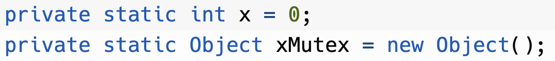
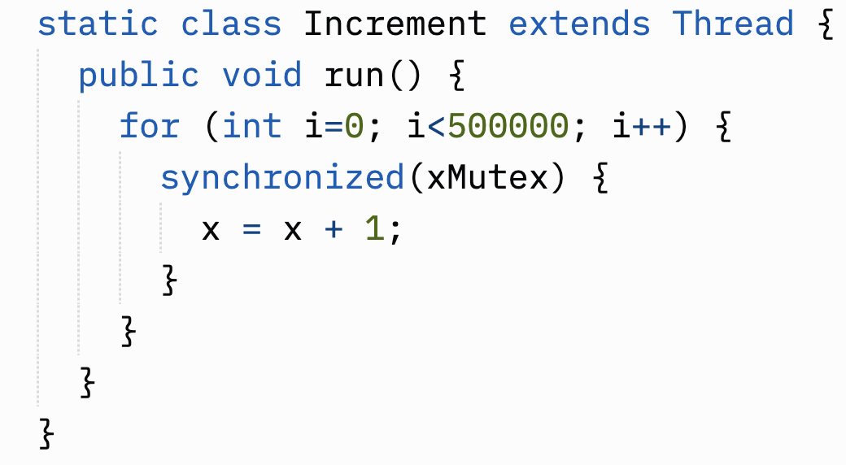
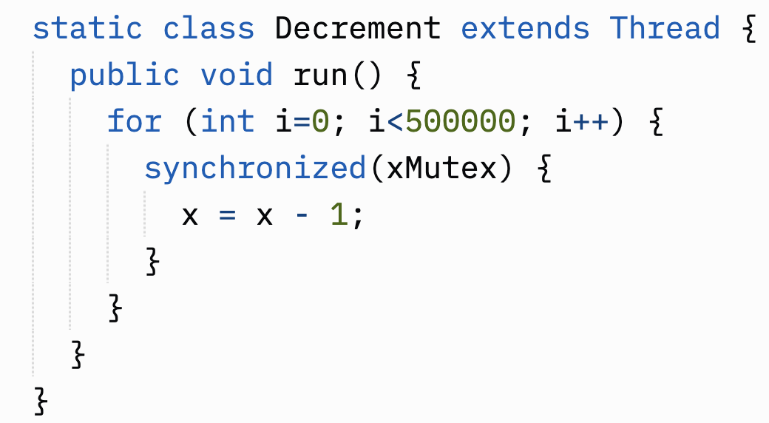

Mutually Exclusive Execution in Java
Synchronized blocks using the same Object (i.e. lock) are guaranteed to be executed mutually exclusively.
Program at: https://replit.com/@braughtg/ThreadMutualExclusion
Notes:
Java provides a synchronized keyword that can be used for locking.
- Every object in Java has a lock associated with it.
- It is just part of the Object class in Java.
- So here we defined xMutex to be an Object and we will use it as our lock.
- Note: Mutex is just a common thing to call a lock being used for mutual exclusion.
- We then wrap our critical section in a synchronized block.
- The synchronized block is the Java way of saying
- Request the lock before doing what is in this block
- The the stuff in the block is then guaranteed to be executed mutually exlusively with any other critical sections using the same lock.
- Release the lock at the end of the block so that others may use it.
- By doing this with a block it eliminates a common bug:
- Forgetting to release the lock!
Every programming language that supports threads will have different mechanisms for mutual exclusion via locking.
- There are lots of others and you will see some of them if you take the OS course.
An interesting question to consider is:
- What would the difference be if we put the synchronized block around the for loops instead of just around the x=x+1 and x=x-1?

Slide 21


Acknowledgments
Slide Template From:
https://creativecommons.org/licenses/by/4.0/
Slide Content Licensed as:
Creative Commons Attribution-NonCommercial-ShareAlike 4.0 International License.
Notes:
Note: Individual images may be covered by their own licensing agreements and were incorporated here under fair use. Their use in this slide deck does not change or alter their licensing.

