Slide 1
06 – Non-Numeric Data
COMP 256 – Dickinson College
Prof. Braught
Spring 2022

Slide 2

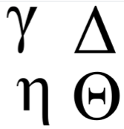


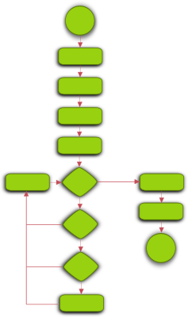




Some “non-numeric” Data
1
Characters and Strings
Colors, Images and Video
Sounds and Music
Instructions and Programs
8
Image from: openclipart.org
Notes:
Characters – letters, digits, symbols, emoji
Put together to make strings
Colors
Put together to make images and videos.
Sounds
Put together to make music.
Instructions
Put together to make programs.

Slide 3






The Simple Idea
Assign an unsigned integer value to each of the things to be represented.
9388506
54162
A 65
z 122
# 35
2342528
129315
15139198
1692

Slide 4
Character Encodings
ASCII
American Standard Code for Information Interchange
7 or 8 bits
7 bits - 128 standard ASCII characters
8 bits - adds 128 extended ASCII characters
Unicode
Universal Coded Character Set
Between 7 and 21 bits
1,114,112 code points (~characters*)
Notes:
ASCII – Standard designed to allow data to be moved between computers.
- prior to this standard each computer manufacturer used a different code
- They assigned different unsigned values to the characters.
- So moving the data required translation
Unicode – Extension of ASCII to eventually cover all languages plus useful / fun symbols
* Disclaimer
- A code point is not technically a character its more complex than that.
- But that interpretation is close enough for our purposes here.
- Short answer… some characters are composed of multiple code points (e.g. letter with accent).
- Also worth note that some of those code points are reserved for other things
- So there are not that many useable code points – but is close.

Slide 5
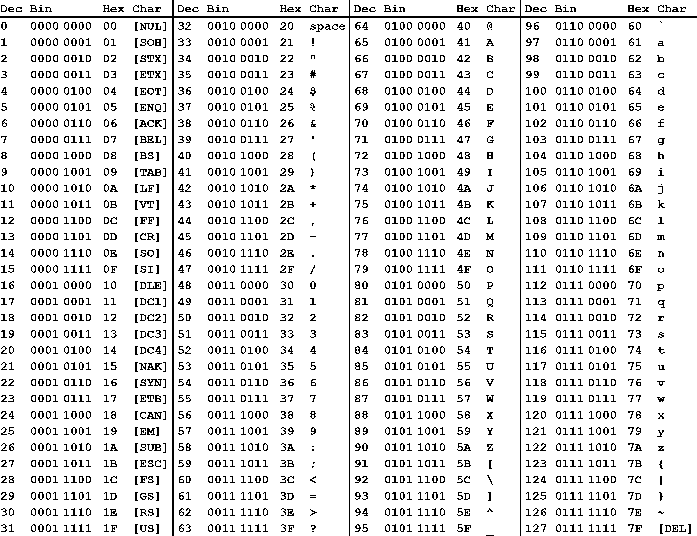
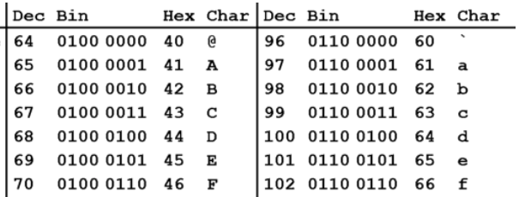
ASCII Code
The ASCII Table - maps numbers from 0-127 to the corresponding character.
@Face
64 70 97 99 101
0100 0000 0100 0110 0110 0001 0110 0011 0110 0101
ASCII Table From: https://medium.com/@lynxluna/under-the-bonnet-representing-characters-and-strings-ff7cec26ee3c
Notes:
Pop up table zoom
- notice each character maps to a unique decimal number (Dec)
- @ -> 64 which also has the indicated unsigned binary value in 8 bits.
- Also Hex which we will get to in a minute.
If we have a string of characters: @Face
Then can convert to decimal values
Which can be represented in binary using 1’s and 0’s
Which we know are either +V or 0V (ground)
You’ll also notice Hex in the ASCII table.
Hex values are something that come up a lot when looking at non-numeric data.
- Characters
- Colors
Basically, looking at lists of decimal numbers or long binary strings is inconvenient.
Hex gives us an easier way to do that.

Slide 6
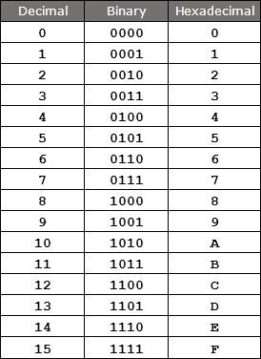

Hexadecimal (Hex) as Shorthand
Hex Table from: https://www.watelectronics.com/hexadecimal
-numbering-system-conversion-to-binary-numbering-system/
Hex is a base 16 number system that provides a compact way to represent binary strings.
Each hex “digit” corresponds to exactly 4 bits (one nibble) using unsigned binary representation.
0xD ➝ 13₁₀ ➝ 1101₂
0x3 ➝ 3₁₀ ➝ 0011₂
Express the binary string using hex.
1010 1011 1100 0001 0010 0011
0x ???
Notes:
Hex is short for hexadecimal
- it is a base 16 number system
- so it has 16 different “digits”
Each hex digit can represent 4 bits as seen in the table.
Because of this, Hex is often used as a shorthand for writing long binary strings more compactly
- Each nibble translates to 1 hex digit.
What is this string represented in hex?

Slide 7
Hexadecimal (Hex) as Shorthand
Hex Table from: https://www.watelectronics.com/hexadecimal
-numbering-system-conversion-to-binary-numbering-system/
Hex is a base 16 number system that provides a compact way to represent binary strings.
Each hex “digit” corresponds to exactly 4 bits (one nibble) using unsigned binary representation.
0xD ➝ 13₁₀ ➝ 1101₂
0x3 ➝ 3₁₀ ➝ 0011₂
Express the binary string using hex.
1010 1011 1100 0001 0010 0011
10₁₀=0xA
11₁₀=0xB
12₁₀=0xC
1₁₀=0x1
2₁₀=0x2
3₁₀=0x3
0xABC123
Notes:
That is a straight forward process.
- The hex is a lot more compact and easier to look at.
- Once you look at enough of it you can make sense of what the bits.
It is also easy to go back the other way.
- given a Hex string it can be expanded into its binary equivalent.
Note though:
- We don’t in general know what the binary string means!
- could be unsigned binary
- could be 3 ASCII codes
- could be a color
So just like binary,
- when given a hex string you need to be told what the representation is before we can interpret it.

Slide 8
ASCII Code
Dson! Dec Binary Hex
D
s
o
n
!
Find an ASCII table on-line and convert the string “Dson!” into ASCII codes in decimal, unsigned binary and hex.

Slide 9
ASCII Code
Dson! Dec Binary Hex
D 68 0100 0100 0x44
s 115 0111 0011 0x73
o 111 0110 1111 0x6F
n 110 0110 1110 0x6E
! 33 0010 0001 0x21
Find an ASCII table on-line and convert the string “Dson!” into ASCII codes in decimal, unsigned binary and hex.
Notes:
So now if you were given the hex string:
0x44 73 6F 6E 21
And told it was ASCI then you would know it is Dson!
If you were told it was unsigned binary
- then you’d have to convert it to binary
- then figure out the base 10 value from there.

Slide 10
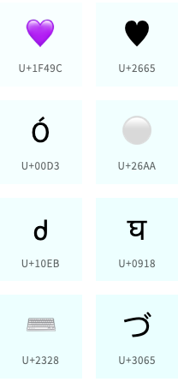

Unicode
Unicode assigns a code point of between 7 and 21 bits to each character*
Here again, hex is used as a compact representation for the unsigned binary values.
Z ➝ U+005A ➝ 0101 1010₂ ➝ 90₁₀
💜 ➝ U+1F49C ➝ 0001 1111 0100 1001 1100 ➝ 128156₁₀
https://unicode-table.com/
U+005A
Image from: https://home.unicode.org/
Notes:
Let’s look at Unicode now.
Unicode code points are written in hex
- They tend to use U+ instead of 0x
- This is just a convention
- Values following U+ are just hex digits representing binary strings
- For Z
- U+005A
- 0x5A
- We can safely ignore the leading 0’s
- 5 hex is 5 dec which is 0101 in unsigned binary
- A hex is 10 dec which is 1010 in unsigned binary.
- When we put those together we get a binary string.
- 0101 1010
- If we interpret that as unsigned binary we get the base 10 value assigned to the “character” in Unicode.
- 0101 1010 in unsigned binary is 90 in base 10
Have a quick look at the Unicode table site
- highlights region of the world where characters are used.
- Show search for code points
- Z – point at it and see U+ and decimal value.
- Note: first 127 characters have same mapping as ASCII.
- Purple Heart
- Same deal.
* Disclaimer…
- same as on the earlier slide.

Slide 11


Graphics Images
Computer images are made up of pixels (picture elements).
The color of each pixel is specified by a color model.
A color model uses a list of unsigned integer values to specify a color.
RGB (Red, Green, Blue)
CMYK (Cyan, Magenta, Yellow, Black)
HSB (Hue, Saturation, Brightness)
Images from: https://en.wikipedia.org/wiki/RGB_color_model
and: https://commons.wikimedia.org/wiki/File:TN_display_closeup_300X.jpg
Notes:
If we look really close at the pixels,
- each pixel has 3 parts
- Red, Green and Blue
- Each part emits light of that color.
- The intensity of the light is controlled by a color model
- In the RGB color model
- The higher the value for Red or Green or Blue the brighter the light of that color.
- That light is mixed by the receptors in our eyes to produce the resulting color we see.
Other color models do the same thing
- but mix the light in slightly different ways.
- hardware or software then converts it to RGB to be displayed by the graphics system.

Slide 12
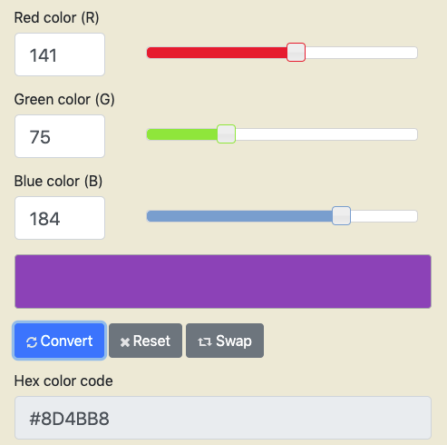
Red/Green/Blue (RGB) Color Model
141₁₀ = 1000 1101₂ = 0x8D
75₁₀ = 0100 1011₂ = 0x4B
184₁₀ = 1011 1000₂ = 0xB8
0x8D4BB8
Color Converter at: https://www.rapidtables.com/convert/color/rgb-to-hex.html
Notes:
Color Pickers
- Allow you to specify the color levels in a model
- This is an RGB color picker
- The level of RGB here is specified in decimal.
- But can be converted into unsigned binary and then to hex.
- You’ll often see these RGB values specified using a hex string.

Slide 13

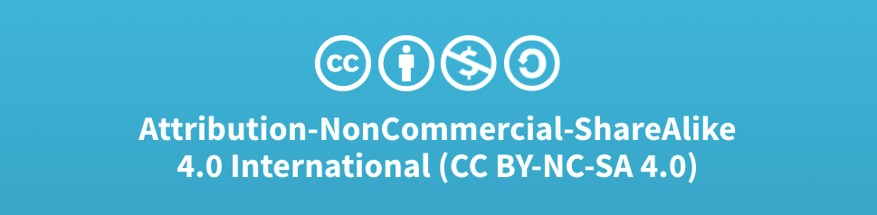
Acknowledgments
Slide Template From:
https://creativecommons.org/licenses/by/4.0/
Slide Content Licensed as:
Creative Commons Attribution-NonCommercial-ShareAlike 4.0 International License.
Notes:
Note: Individual images may be covered by their own licensing agreements and were incorporated here under fair use. Their use in this slide deck does not change or alter their licensing.

Slide 14
Hex / Hexadecimal (base 16)
Hex values use 16 “digits”
0 to 9
A (10) ,B (11), C (12), D (13), E (14), F (15)
Hex values are interpreted using base 16:
0xC5A
= C *16² + 5*16¹ + A*16⁰
= C *256 + 5*16 + A*1
= 12*256 + 5*16 + 10*1
= 3162₁₀
Notes:
Hex or Hexadecimal is a base 16 number system
So 16 “digits”
Representing values from 0 - 15
- like base 10, 10 digits representing 0-9
- or base 2, with 2 digits representing 0-1
For Hex we use
- 0-9 and then A-F because we don’t have anything else.
- can probably guess that A=10, B=11, C=12 … F=15.
- could have just invented new symbols but…
Hex value s are written by convention with a 0x prefix instead of a subscript.
To know what value 0xC5A represents:
1. We can simply expand that like any other base number, just using base 16.
2. Compute out the powers of 16.
3. Substitute in the base 10 values for any A-F “digits”
4. Work it all out to get the final value in base 10.

Slide 15
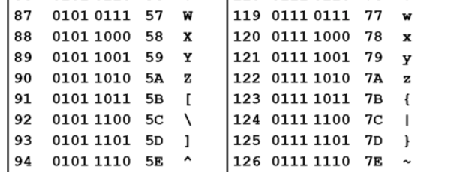
Hex as Shorthand
Hex provides a compact way to express binary values.
Example:
Z^x
Z 0101 1010 0x5A
^ 0101 1110
x 0111 1000 0x78
0x5A 5E 78
0x5E
Hex Table from: https://www.watelectronics.com/hexadecimal
-numbering-system-conversion-to-binary-numbering-system/
Notes:
Why use hex?
- Computer scientists like hex because it provides a shorthand for expressing binary strings.
For Z for example:
- Its ASCII value is 90
- which has the unsigned binary value 0101 1010
- W
Do Z step by step.
Then ask for Hex for ^
Then give hex for x

Slide 16
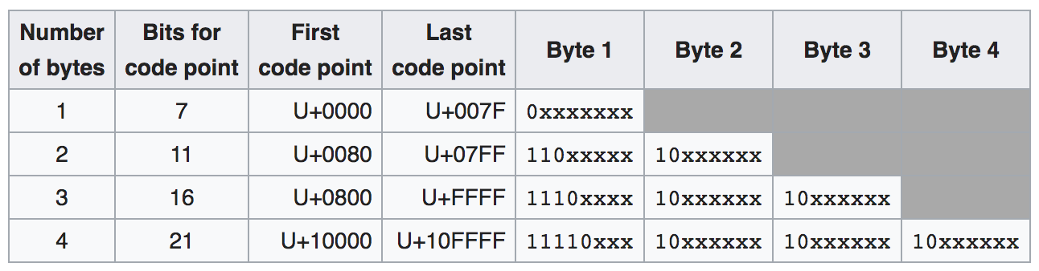
UTF-8
UTF-8: A variable width character encoding for storing and transmitting Unicode code points using from 1 to 4 bytes.
> 95% of web pages and traffic
Backward compatible with ASCII
Optimizes the common case
UTF Encodings
Image from: https://en.wikipedia.org/wiki/UTF-8
Notes:
Used for nearly all internet communications today.
Basic idea is:
- if code point is in the range, then used the bit pattern shown.
- e.g. 0000 to 007F then 0xxx xxxx
- e.g. 10000 to 01FFFF then 11110xxx 10xxxxxx etc….
Advantages:
- Backward compatible with ASCII
- the values 0xxx xxxx map to the same characters as the first 127 ASCII characters.
- Optimizes the common case:
- Patterns are chosen so that…
- Characters stored or transmitted most often use fewer bytes
- Reduces storage requirements and transmission times.
Let’s do some examples.

Slide 17
UTF-8 Example
UTF Encodings
Image from: https://en.wikipedia.org/wiki/UTF-8
Example 1:
Unicode
U+005A 101 1010
UTF-8 Encoding
0xxx xxxx
0101 1010
5 A
Backward compatible: 0x5A is ‘Z’ in Ascii
Notes:
So…
- When you send a text message with the letter ’Z’ in it…
- Your phone takes the code point, converts it to UTF-8 and sends it to your friend’s phone
- Your friend’s phone decodes the UTF-8 to find the code point
- Uses the code point to display the ‘Z’.
It can decode this one easily
- because the MSb is 0
- it can recognize it as the one byte row
- Note all others, none of the bytes have MSb = 0.

Slide 18

UTF-8 Example
UTF Encodings
Image from: https://en.wikipedia.org/wiki/UTF-8
Example 2:
Unicode
U+1F49C 1 1111 0100 1001 1100
UTF-8 Encoding
1 F 4 9 C
1111 0xxx 10xx xxxx 10xx xxxx 10xx xxxx
1111 0xxx 10x1 1111 1001 0010 1001 1100
1111 0000 1001 1111 1001 0010 1001 1100
Notes:
Decoding this one…
- From LSByte … each one ends with 10 in MSbs
- That is a continuation code saying there is another byte
- Then last byte ends with 110, 1110 or 11110 indicating how many bytes there were.
So again to send a message with a purple heart emoji
- you type it
- Your phone has the Unicode code point
- Encoded to UTF-8
- Bytes are sent over the internet
- Friend’s phone decodes the UTF-8 to find the code point
- Displays the emoji
Optimization of common case:
- Each time ‘Z’ is stored or transmitted one byte is used.
- Each time purple heart is stored or transmitted 4 bytes are used.
- Since ‘Z’ is likely stored and transmitted more than purple heart emoji we save space over using 4 bytes all of the time.
Note: (no need to mention) But this one is a little odd since it will fit in 3 bytes but falls in the 4 byte range.

