Slide 1
DA2 – Non-Numeric Data
COMP 256 – Dickinson College
Prof. Braught
Spring 2023

Slide 2

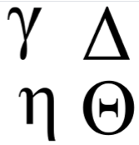


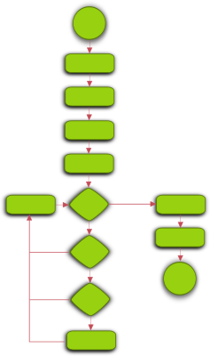




Some “non-numeric” Data
1
Characters and Strings
Colors, Images and Video
Sounds and Music
Instructions and Programs
8
Image from: openclipart.org
Notes:
Characters include things like letters, digits, symbols, emoji.
Strings are a sequence of characters.
Colors
Colors are put together spatially to make images and spatially and in a sequence to make videos.
Sounds
Sounds are put together into a sequence to make music or audio
Instructions
Instructions are put together in patterns to make programs.

Slide 3







The Simple Idea
Assign an unsigned (non-negative) integer value to each of the things to be represented.
9388506
54162
A 65
z 122
# 35
2342528
129315
15139198
1692
65
Notes:
The basic idea here is simple.
- We know how to represent zero and positive integers using unsigned binary.
- We just take everything we want to represent and assign it a corresponding non-negative integer value.
- Then when we want to represent that thing, we use the unsigned binary value for that non-negative value.
For example:
- The character ‘A` is represented in the computer as 65 base 10 or 0100 0001 in unsigned binary.
- Similarly, we assign integer values to different colors or different emoji.
Note that the same unsigned integer value can represent a letter, color, emoji, sound, etc…
- For example the value 65 base 10 also represents a very dark blue
- looks almost black above, but it is not quite black.
- Black has the base 10 value 0.
So like we learned last time with “pie”
- You will need to know what representation we are using to interpret the unsigned binary value.

Slide 4
Character Encodings
ASCII
American Standard Code for Information Interchange
7 or 8 bits
7 bits - 128 standard ASCII characters
8 bits - adds 128 extended ASCII characters
Unicode
Universal Coded Character Set
Between 7 and 21 bits
1,114,112 code points (~characters*)
Notes:
ASCII – Standard designed to allow data to be moved between computers.
- prior to this standard each computer manufacturer used a different code
- They assigned different unsigned values to the characters.
- So moving the data between different brands of computers required translation
Unicode – Extension of ASCII to eventually cover all languages plus useful / fun symbols
* Disclaimer
- A code point is not technically a character it is more complex than that.
- But that interpretation is close enough for our purposes here.
- Short answer… some characters are composed of multiple code points (e.g. letter with accent).
- Note
- With 21 bits we have 2^21 possible values.
- But 2^21 is 2,097,152.
- So not every possible combination of 1’s and 0’s corresponds to a code point.
- Again, more complicated than we need to get into here.

Slide 5
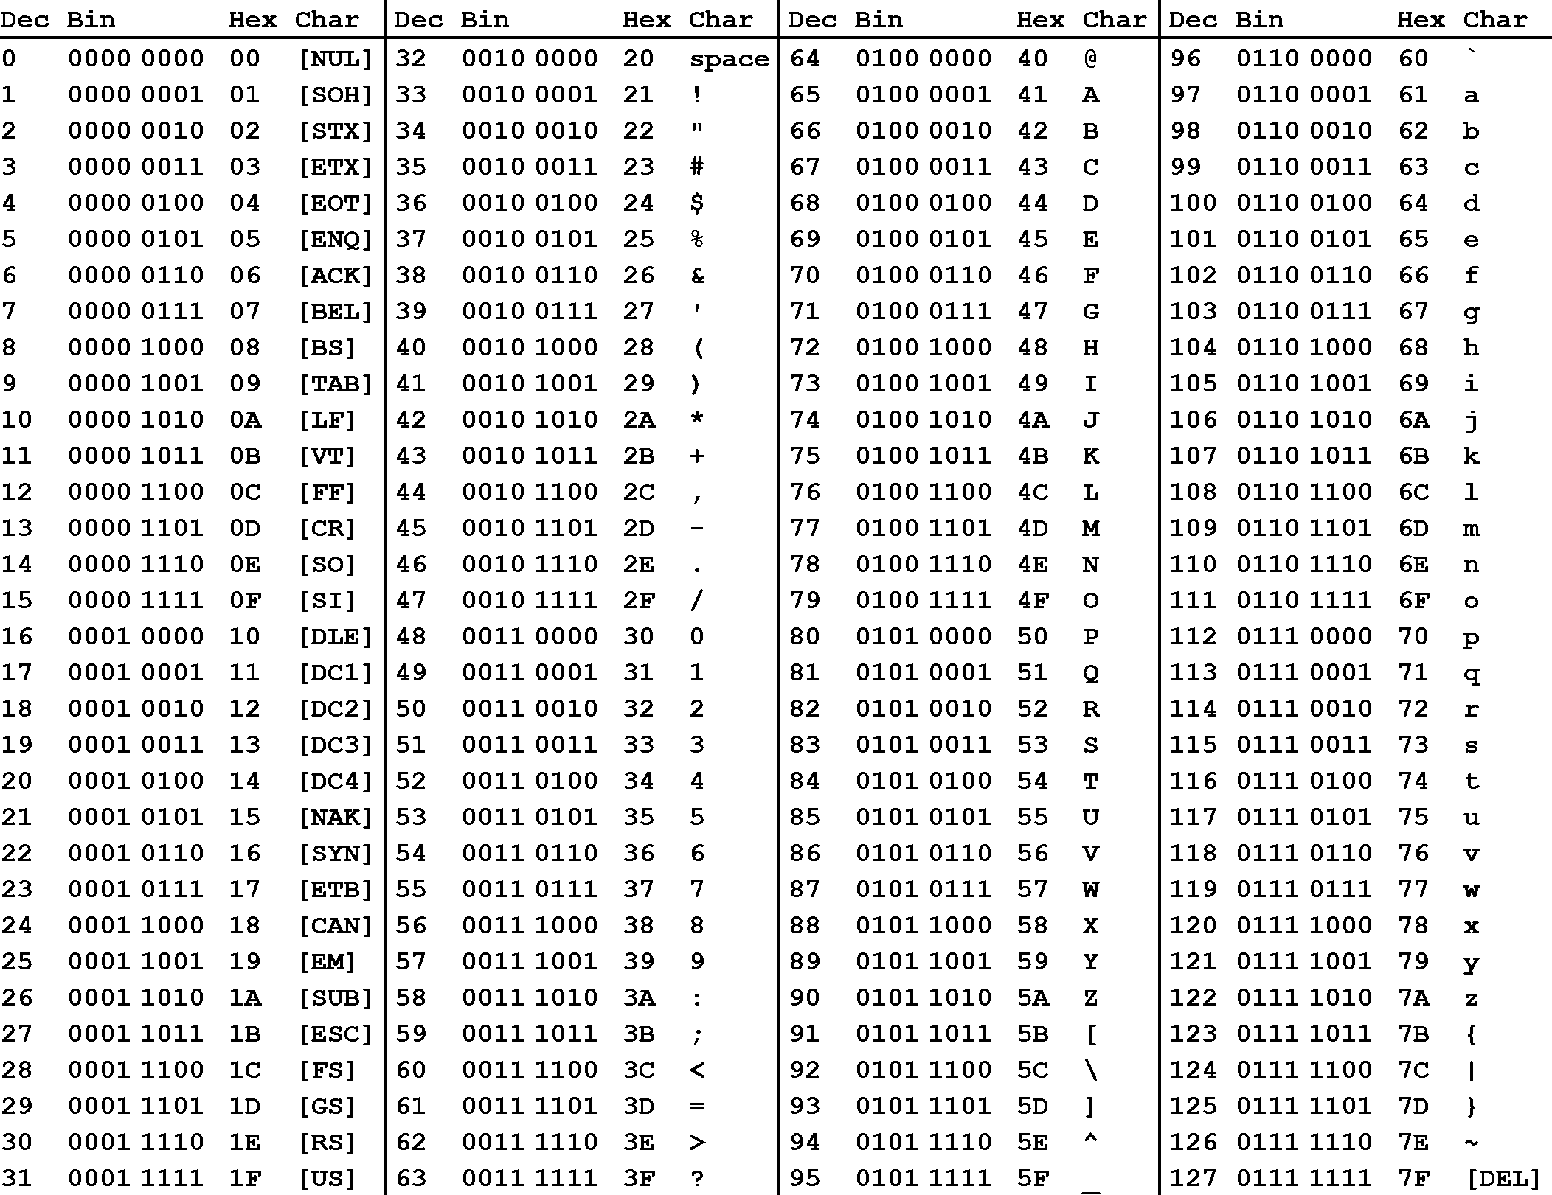
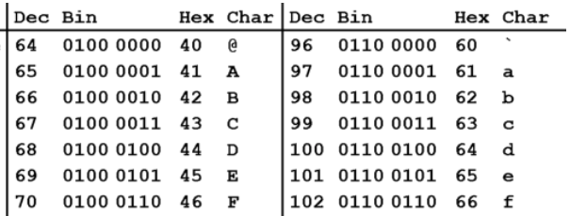
ASCII Code
The ASCII Table - maps numbers from 0-127 to the corresponding character.
@Face
64 70 97 99 101
0100 0000 0100 0110 0110 0001 0110 0011 0110 0101
ASCII Table From: https://medium.com/@lynxluna/under-the-bonnet-representing-characters-and-strings-ff7cec26ee3c
Notes:
The white table is just a zoom into the indicated are of the full table so that we can read it.
- notice each character maps to a unique decimal (base 10) number (Dec column)
- @ -> 64 which also has the indicated unsigned binary value in 8 bits (0100 0000)
- Also has a Hex value (40), which we will get to in a minute.
If we have a string of characters, for example: @Face
- Then can convert to decimal values
- Which can be represented in binary using 1’s and 0’s
- Which we know are either +V or 0V (ground)
You’ll also notice Hex in the ASCII table.
Hex values are something that come up a lot when looking at non-numeric data.
- Characters
- Colors
We’ll look at hex on the next few slides.

Slide 6

Hex / Hexadecimal (base 16)
Hexadecimal is a base-16 number system.
Use 16 “digits”
0 to 9
A (10) ,B (11), C (12), D (13), E (14), F (15)
Hex values are interpreted using base 16:
0xC5A =
Find the base-10 value of this hex number.
Notes:
Hex or Hexadecimal is a base 16 number system
So 16 “digits”
Representing values from 0 - 15
- like base 10, 10 digits representing 0-9
- or base 2, with 2 digits representing 0-1
For Hex we use
- 0-9 and then A-F
- We use A-F because we don’t have any more digits…
- Could have invented other symbols, but that would have been hard.
- Computers already know A-F so we use those.
- A=10, B=11, C=12 … F=15.
Hex values are written by convention with a 0x prefix instead of a subscript.

Slide 7
Hex / Hexadecimal (base 16)
Hexadecimal is a base-16 number system.
Use 16 “digits”
0 to 9
A (10) ,B (11), C (12), D (13), E (14), F (15)
Hex values are interpreted using base 16:
0xC5A
= C *16² + 5*16¹ + A*16⁰
Find the base-10 value of this hex number.
= C *256 + 5*16 + A*1
= 12*256 + 5*16 + 10*1
= 3162₁₀
Notes:
Note the parallel here to the examples we did last time.
To know what value 0xC5A represents:
1. Expand the number like we did with base 10 or base 2, just using base 16 instead.
2. Compute out the powers of 16.
- E.g. 16^0 =1, 16^1 = 16, 16^2 = 256
3. Substitute in the base 10 values for any A-F “digits”
- E.g. C = 12, A = 10
4. Work it all out to get the final value in base 10.
Can also revere the process.
- Same as with other bases.
- Just a little more tedious because of thinking with A-F and in powers of 16.
- You’ll get to practice it in the HW.

Slide 8
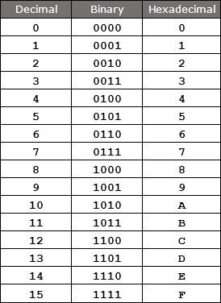
Hexadecimal (Hex) as Shorthand
Hex Table from: https://www.watelectronics.com/hexadecimal
-numbering-system-conversion-to-binary-numbering-system/
Hex provides a convenient compact way to represent binary strings.
Each hex “digit” corresponds to exactly 4 bits (one nibble) using unsigned binary representation.
0x0 ➝ 0₁₀ ➝ 0000₂
0xF ➝ 15₁₀ ➝ 1111₂
Express the binary string using hex.
1010 1011 1100 0001 0010 0011
0x ???
Notes:
One of the main reasons we use Hex is that it provides a compact shorthand for writing binary strings.
Each hex digit can represent 4 bits as seen in the table.
- 4 bits gives us 2^4 possible values
- 2^4 = 16
- 16 is the number of different hex digits.
Because of this, Hex is often used as a shorthand for writing long binary strings more compactly
- Each 4-bit nibble translates into 1 hex digit.
What is this string represented in hex?

Slide 9
Hexadecimal (Hex) as Shorthand
Hex Table from: https://www.watelectronics.com/hexadecimal
-numbering-system-conversion-to-binary-numbering-system/
Hex provides a convenient compact way to represent binary strings.
Each hex “digit” corresponds to exactly 4 bits (one nibble) using unsigned binary representation.
0x0 ➝ 0₁₀ ➝ 0000₂
0xF ➝ 15₁₀ ➝ 1111₂
Express the binary string using hex.
1010 1011 1100 0001 0010 0011
10₁₀=0xA
11₁₀=0xB
12₁₀=0xC
1₁₀=0x1
2₁₀=0x2
3₁₀=0x3
0xABC123
Notes:
That is a straight forward process.
- The hex is a lot more compact and easier to look at.
- Once you look at enough of it you can make sense of what the bits are.
It is also easy to go back the other way.
- given a Hex string it can be expanded into its binary equivalent.
Note though that as always we don’t in general know what the binary string means!
- could be unsigned binary
- could be 3 ASCII codes
- could be a color
So a hex value represents a binary string.
That binary string can be interpreted using any of our representations.
So just like binary,
- when given a hex value you need to be told what the representation is before we can interpret it.

Slide 10
ASCII Code
Dson! Dec Binary Hex
D
s
o
n
!
Find an ASCII table on-line and convert the string “Dson!” into ASCII codes in decimal, unsigned binary and hex.

Slide 11
ASCII Code
Dson! Dec Binary Hex
D 68 0100 0100 0x44
s 115 0111 0011 0x73
o 111 0110 1111 0x6F
n 110 0110 1110 0x6E
! 33 0010 0001 0x21
Find an ASCII table on-line and convert the string “Dson!” into ASCII codes in decimal, unsigned binary and hex.
Notes:
So now if you were given the hex string:
0x44 73 6F 6E 21
And told it was ASCI then you would know it is Dson!
If you were told it was unsigned binary
- then you’d have to convert it to binary
- then figure out the base 10 value from there.

Slide 12
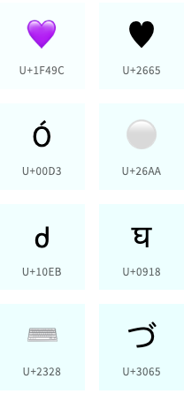

Unicode
Unicode assigns a code point of between 7 and 21 bits to each character*
Here again, hex is used as a compact representation for the unsigned binary values.
Z ➝ U+005A ➝ 0101 1010₂ ➝ 90₁₀
💜 ➝ U+1F49C ➝ 0001 1111 0100 1001 1100 ➝ 128156₁₀
https://unicode-table.com/
U+005A
Image from: https://home.unicode.org/
Notes:
Let’s look at Unicode now.
Unicode code points are written in hex
- They tend to use U+ instead of 0x as a prefix
- This is just a convention
- But it communicates two thigns:
- One… that the value is hex and
- Two… that the value is to be interpreted using the Unicode representation.
Values following U+ are just hex digits representing binary strings
- For Z
- U+005A
- 0x5A
- We can safely ignore the leading 0’s
- 5 hex is 5 dec which is 0101 in unsigned binary
- A hex is 10 dec which is 1010 in unsigned binary.
- When we put those together we get a binary string.
- 0101 1010
- If we interpret that as unsigned binary we get the base 10 value assigned to the “character” in Unicode.
- 0101 1010 in unsigned binary is 90 in base 10
Have a quick look at the Unicode table site at the URL above.
- (Seems to not load the full table sometimes)
- (But can still search for specific character using search bar).
- The page includes a map
- As you scroll down, the map highlights the region of the world where the displayed characters are used.
- Show search for code points
- Z – point at it and see U+ and hex value.
- Note: first 127 characters have same mapping as ASCII.
- Purple Heart
- Same deal.
* Disclaimer…
- bits represent codepoints and not characters.
- same as was described on the earlier slide.

Slide 13

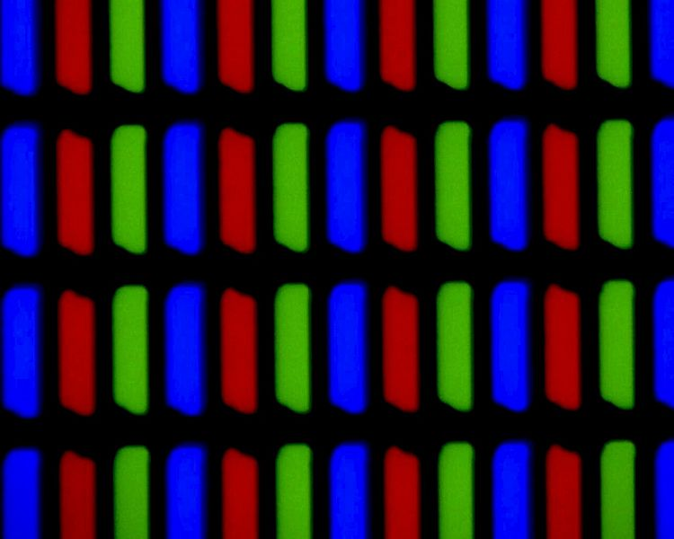
Graphics Images
Computer images are made up of pixels (picture elements).
The color of each pixel is specified by a color model.
A color model maps each color to an unsigned integer value.
RGB (Red, Green, Blue)
CMYK (Cyan, Magenta, Yellow, Black)
HSB (Hue, Saturation, Brightness)
Images from: https://en.wikipedia.org/wiki/RGB_color_model
and: https://commons.wikimedia.org/wiki/File:TN_display_closeup_300X.jpg
Notes:
If you look really close at your screen you can see the individual pixels.
- Improved screen technology has made the pixels smaller and smaller.
- So, if you can’t see them, try to find an older monitor or TV where they are larger.
Then if you look really close at the pixels,
- Might need a magnifying glass.
- you can see that each pixel has 3 parts
- Red, Green and Blue
- Each part emits light of that color.
- The intensity of the light is controlled by a color model
- In the RGB color model
- The higher the value for Red or Green or Blue the brighter the light of that color.
- Those three colors of light are mixed by the receptors in our eyes to produce the resulting color we see.
Other color models do the same thing
- but mix the light in slightly different ways.
- If you use one of the other color models in your software
- Which is pretty common particularly in art or photography programs.
- The graphics hardware and software converts the values of that color model to RGB so that it can be displayed on the screen.

Slide 14
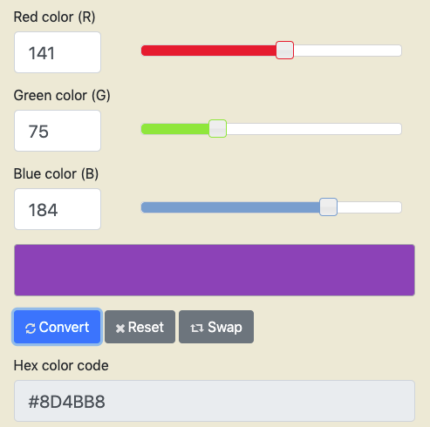
Color Pickers: Red/Green/Blue (RGB) Color Model
141₁₀ = 1000 1101₂ = 0x8D
75₁₀ = 0100 1011₂ = 0x4B
184₁₀ = 1011 1000₂ = 0xB8
0x8D4BB8
Color Converter at: https://www.rapidtables.com/convert/color/rgb-to-hex.html
Notes:
A Color Picker
- Allow you to find or specify the color levels in a model
- This is an RGB color picker
- The level of RGB here is specified in decimal.
- But can be converted into unsigned binary and then to hex.
- You’ll often see these RGB values specified in code using a hex string.

Slide 15

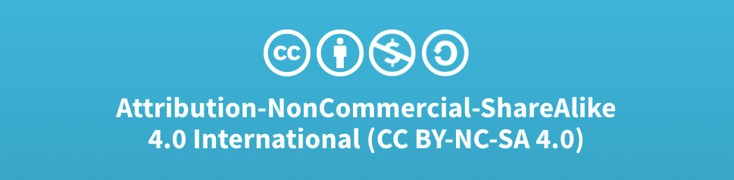
Acknowledgments
Slide Template From:
https://creativecommons.org/licenses/by/4.0/
Slide Content Licensed as:
Creative Commons Attribution-NonCommercial-ShareAlike 4.0 International License.
Notes:
Note: Individual images may be covered by their own licensing agreements and were incorporated here under fair use. Their use in this slide deck does not change or alter their licensing.

Slide 16
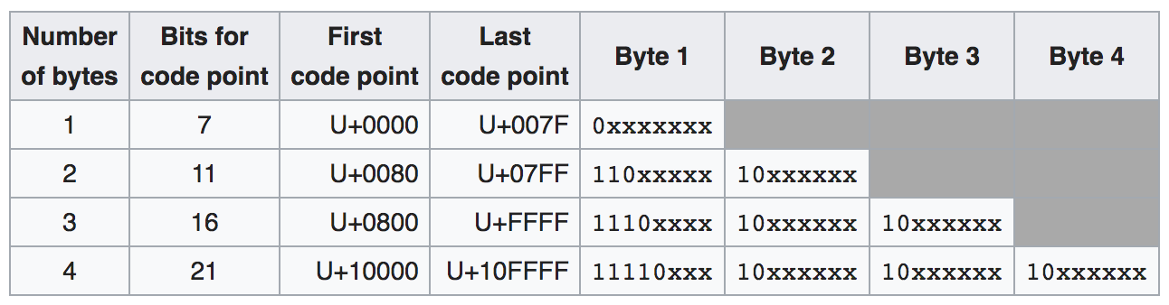
UTF-8
UTF-8: A variable width character encoding for storing and transmitting Unicode code points using from 1 to 4 bytes.
> 95% of web pages and traffic
Backward compatible with ASCII
Optimizes the common case
UTF Encodings
Image from: https://en.wikipedia.org/wiki/UTF-8
Notes:
Used for nearly all internet communications today.
Basic idea is:
- if code point is in the range, then used the bit pattern shown.
- e.g. 0000 to 007F then 0xxx xxxx
- e.g. 10000 to 01FFFF then 11110xxx 10xxxxxx etc….
Advantages:
- Backward compatible with ASCII
- the values 0xxx xxxx map to the same characters as the first 127 ASCII characters.
- Optimizes the common case:
- Patterns are chosen so that…
- Characters stored or transmitted most often use fewer bytes
- Reduces storage requirements and transmission times.
Let’s do some examples.

Slide 17
UTF-8 Example
UTF Encodings
Image from: https://en.wikipedia.org/wiki/UTF-8
Example 1:
Unicode
U+005A 101 1010
UTF-8 Encoding
0xxx xxxx
0101 1010
5 A
Backward compatible: 0x5A is ‘Z’ in Ascii
Notes:
So…
- When you send a text message with the letter ’Z’ in it…
- Your phone takes the code point, converts it to UTF-8 and sends it to your friend’s phone
- Your friend’s phone decodes the UTF-8 to find the code point
- Uses the code point to display the ‘Z’.
It can decode this one easily
- because the MSb is 0
- it can recognize it as the one byte row
- Note all others, none of the bytes have MSb = 0.

Slide 18

UTF-8 Example
UTF Encodings
Image from: https://en.wikipedia.org/wiki/UTF-8
Example 2:
Unicode
U+1F49C 1 1111 0100 1001 1100
UTF-8 Encoding
1 F 4 9 C
1111 0xxx 10xx xxxx 10xx xxxx 10xx xxxx
1111 0xxx 10x1 1111 1001 0010 1001 1100
1111 0000 1001 1111 1001 0010 1001 1100
Notes:
Decoding this one…
- From LSByte … each one ends with 10 in MSbs
- That is a continuation code saying there is another byte
- Then last byte ends with 110, 1110 or 11110 indicating how many bytes there were.
So again to send a message with a purple heart emoji
- you type it
- Your phone has the Unicode code point
- Encoded to UTF-8
- Bytes are sent over the internet
- Friend’s phone decodes the UTF-8 to find the code point
- Displays the emoji
Optimization of common case:
- Each time ‘Z’ is stored or transmitted one byte is used.
- Each time purple heart is stored or transmitted 4 bytes are used.
- Since ‘Z’ is likely stored and transmitted more than purple heart emoji we save space over using 4 bytes all of the time.
Note: (no need to mention) But this one is a little odd since it will fit in 3 bytes but falls in the 4 byte range.

