Slide 1
L05 – An Interpreter
COMP 256 – Dickinson College
Prof. Braught
Spring 2023

Slide 2
Program Execution
Huge Idea: Use programs to convert instructions for high-level language machines into machine language instructions.
Compiler, Assembler, Interpreter, Virtual Machine
pay=salary+bonus;
High-Level Language Machine
pay=salary+bonus;
Compiler
Compiler
Translation
Interpreter
ASM
Interpretation
Hybrid Approach
Byte
Code
Assembler
Virtual Machine
R0 ← R1 + R2
Machine Language Machine
Notes:
These are different approaches to getting the instructions in a HLL turned into ML that the machine can execute.
Don’t describe each… rather… the main point is that
These are different ways of implementing the abstract machine
- any language can be implemented in any one of these ways.
Similar to the way there were multiple ways of implementing the abstract memory cell.
- SRAM and DRAM
- Abstract level behavior is the same.
- The mechanism by which that is achieved is different.
Similarly we saw logic gates with CMOS technology
Can also build all of the same stuff using different types of transistors using TTL technology
But just like with other abstractions the way we build it may show through…
Some of the details of each of these will be in the activities along with
the pros and cons of each

Slide 3
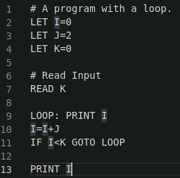
A Silli Little Language
Simple Instruction Language for Learning Interpreters
Notes:
Variable Declarations (LET)
Input Statements (READ)
Output Statements (PRINT)
Arithmetic Statements (+, -, *, /)
Conditional Statements (IF / GOTO)
Line Labels (LOOP:)

Slide 4
Variable and Label Maps
The interpreter uses Maps to track variable values and line labels.
varMap
Variable Value
I 0
J 2
K 0
labelMap
Label Line
LOOP 9

Slide 5
The Java Map Interface
A Map in Java maps keys to values
like a Dictionary in Python.
Map<String, Integer> varMap =
new HashMap<String, Integer>();
…
String var = “X”;
int val = 5;
…
varMap.put(var, val);
…
val = varMap.get(var);
…
if (varMap.containsKey(var)) {
…
}
varMap
Variable Value
X 5
Y 3
Z 15

Slide 6

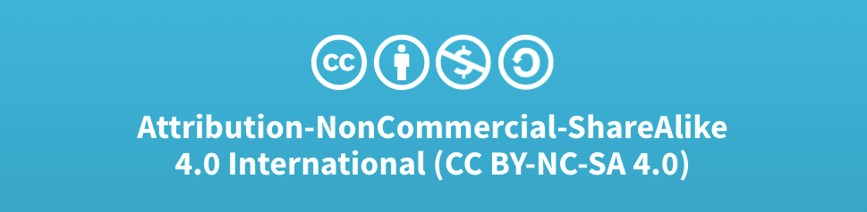
Acknowledgments
Slide Template From:
https://creativecommons.org/licenses/by/4.0/
Slide Content Licensed as:
Creative Commons Attribution-NonCommercial-ShareAlike 4.0 International License.

Slide 7
Interpreting a little Silli Program:
# A Little Program.
LET X=0
LET Y=0
LET Z=0
READ X
READ Y
Z=X*Y
PRINT Z
varMap
Variable Value
X 0
Y 0
Z 0

Slide 8
Interpreting a little Silli Program:
# A Little Program.
LET X=0
LET Y=0
LET Z=0
READ X
READ Y
Z=X*Y
PRINT Z
varMap
Variable Value
X 0
Y 0
Z 0
?

Slide 9
Interpreting a little Silli Program:
# A Little Program.
LET X=0
LET Y=0
LET Z=0
READ X
READ Y
Z=X*Y
PRINT Z
varMap
Variable Value
X 0
Y 0
Z 0
? 5

Slide 10
Interpreting a little Silli Program:
# A Little Program.
LET X=0
LET Y=0
LET Z=0
READ X
READ Y
Z=X*Y
PRINT Z
var Map
Variable Value
X 5
Y 0
Z 0
? 5

Slide 11
Interpreting a little Silli Program:
# A Little Program.
LET X=0
LET Y=0
LET Z=0
READ X
READ Y
Z=X*Y
PRINT Z
varMap
Variable Value
X 5
Y 3
Z 0
? 3

Slide 12
Interpreting a little Silli Program:
# A Little Program.
LET X=0
LET Y=0
LET Z=0
READ X
READ Y
Z=X*Y
PRINT Z
varMap
Variable Value
X 5
Y 3
Z 15

Slide 13
Interpreting a little Silli Program:
# A Little Program.
LET X=0
LET Y=0
LET Z=0
READ X
READ Y
Z=X*Y
PRINT Z
varMap
Variable Value
X 5
Y 3
Z 15
15

