Slide 1
MA3 – The Stored Program Architecture
COMP 256 – Dickinson College
Prof. Braught
Spring 2023
Notes:
The stored program architecture is the big idea around the way the K&S and all other computers you use are organized.
- We’ll come back to it at the end of the class.
- At that point we’ll already understand what the stored program architecture is.
- We will just give some things names and place what we know into that framework.
First, we will look at a little more of how the K&S works…
- and in particular one big thing it needs to be able to do
- that we don’t yet know how to do.

Slide 2

K&S Machine Language Programming
What operations would a machine language program for the K&S computer need to do to perform the following computation: MM[20] = absolute value of MM[19]
Operation
Notes:
A little warmup and motivation for today’s topic…
- Write these using our shorthand.
Easy to start:
- move MM[20] into a register…
- But then what?
A little bit of a trick question…
- What’s the problem?

Slide 3
Branching
A branch changes the flow of the program.
while (i >= 0) {
<code>
}
if (x < 0) {
y = -x;
}
else {
y = x;
}
for (j=0; j < 10; j++) {
<code>
}
Notes:
The issue is that to compute the absolute value:
- You need to do one thing under one condition
- y = -x if x is negative
- and something else under another condition.
- y = x if x is not negative
We would typically express that using an if/else statement in a high level language like Java.
- Under one condition (x < 0) we just go to the next instruction
- Under a different condition (x >= 0) we jump or branch to a different instruction.
- We’ll call this “branching”
- All of the programs we have written so far have just gone from one instruction to the very next one
- With our microprograms, it just happened
- With our ML programs, the Program Counter (PC) controlled this.
- Branching allows the program to not simply go from one instruction to the next
- It makes it possible to jump (i.e. branch) to other instructions
- Possibly based on conditions.
Some other examples:
- while loop and for loop
- branch over the loop body,
- or jump back to the top of the loop.

Slide 4
Branching
Under what condition is each of these branches taken?
A branch changes the flow of the program.
Branches are conditional or unconditional.
while (i >= 0) {
<code>
}
if (x < 0) {
y = -x;
}
else {
y = x;
}
for (j=0; j < 10; j++) {
<code>
}
Notes:
- Conditional branches
- A conditional branch is one that may or may not be taken
- If the branch is taken
- the flow of the program changes
- i.e. the program jumps to an instruction that is not the next one.
- If the branch is not taken
- the program simply goes onto the next instruction.
- Just like we had seen previously when it ran one instruction after the other.
The conditional branch points are pretty easy to spot.
And the locations to which they branch should make sense based on our understanding of high level language constructs.
Now notice the definition… a branch changes the flow of the program.
- That is the program does not go to the next instructions.
- So under what condition are these branches taken?
- Think carefully…

Slide 5
Branching
Under what conditions are these branches taken?
A branch changes the flow of the program.
Branches are conditional or unconditional.
while (i >= 0) {
<code>
}
if (x < 0) {
y = -x;
}
else {
y = x;
}
i < 0
x >= 0
for (j=0; j < 10; j++) {
<code>
}
j >= 10
Notes:
Notice that conditions for taking each branch is inverted from what we normally write in a high level language like java.
For example:
- If
- when x >= 0 the branch is taken, and the program jumps to the else.
- when x < 0 the branch is not taken, and the program just goes onto the next instruction.
- while
- when i < 0, the branch is taken, and the program jumps to the end of the loop
- when i >= 0 the branch is not taken, and the program just goes to the next instruction.
- for
- when j >= 10, the branch is taken, and the program jumps to the end of the loop.
- when j < 10, the branch is not taken, and the program just goes to the next instruction.

Slide 6
Branching
Where are the unconditional branches and to where to they branch?
A branch changes the flow of the program.
Branches are conditional or unconditional.
while (i >= 0) {
<code>
}
if (x < 0) {
y = -x;
}
else {
y = x;
}
for (j=0; j < 10; j++) {
<code>
}
Notes:
An unconditional branch is always taken.

Slide 7
Branching
Where are the unconditional branches and to where to they branch?
A branch changes the flow of the program.
Branches are conditional or unconditional.
while (i >= 0) {
<code>
}
if (x < 0) {
y = -x;
}
else {
y = x;
}
for (j=0; j < 10; j++) {
<code>
}
Notes:
An unconditional branch is always taken.
In the if statement:
- there is an unconditional branch at the end of the if body
- it is what causes the program to jump over the else body.
- then execution continues with whatever instructions are there.
In the while loop:
- there is an unconditional branch at the end of the loop body
- it is what causes the program to to jump back to the top of the loop.
- then the condition is checked again.
In the for loop:
- there is an unconditional branch at the end of the loop body
- it is what causes the program to jump back to the “update” (e.g. j++) part of the loop.
- then the condition is checked again.

Slide 8
Not Branching…
When there is no branch or a conditional branch is not taken, then instructions execute sequentially.
i = 1000;
while (i >= 0) {
x = x + 2;
y = 2*x – 7;
z = 4*y*y – x*i + 13;
i = i – x;
}
Notes:
This is just totally made up code…
- The point is just to illustrate the idea…
Here as long as I >= 0
- the loop condition is true so
- the program does not take the conditional branch to the end of the loop
- and the loop body will execute.
- each instruction in the loop executes one after the other (i.e. sequentially)
- the Program Counter (PC) will increment one by one
- going through the Machine Language instructions that carry out these operations
When the bottom of the loop is reached
- The unconditional branch causes the program to jump back to the loop condition.
- Then the loop body is executed sequentially (i.e. one after the other, in order) again.
So the point here is just that…
- If there is no branch
- Or if a conditional branch is not taken
- The instructions execute sequentially (i.e. one after the other in order).
We know this about our high level language programs
- It is just worth making it explicit here.

Slide 9
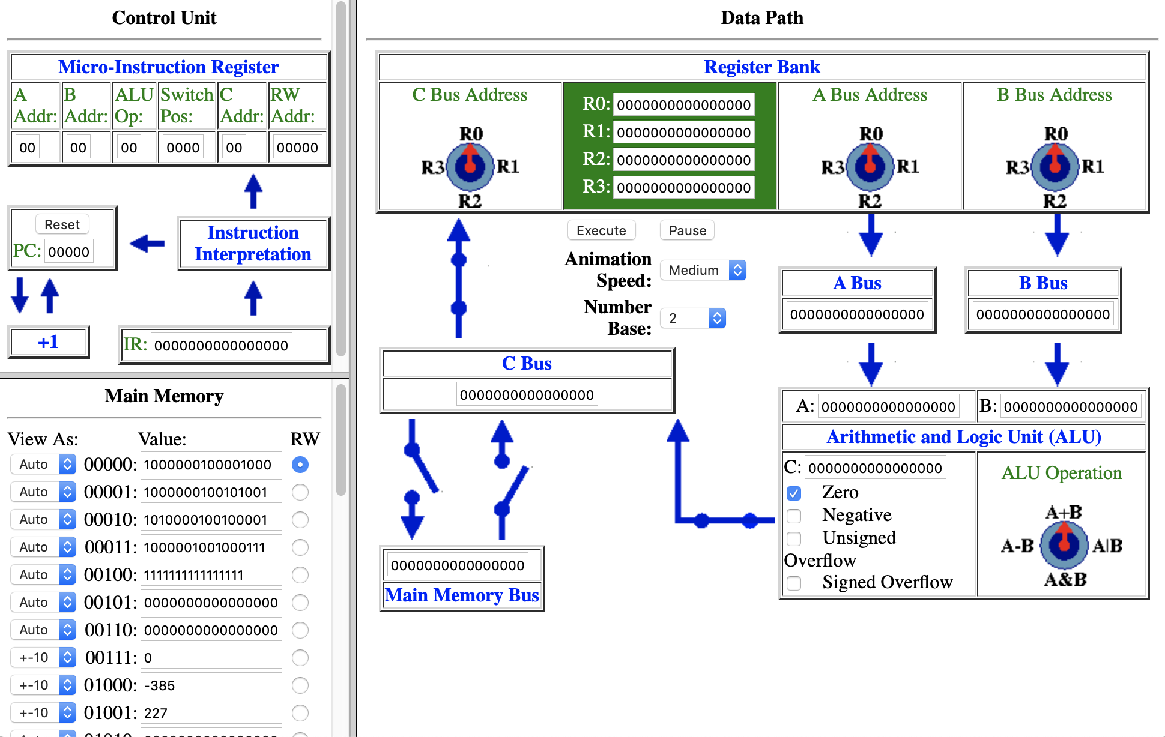
Branching
How can the machine change which instruction is executed next?
How can it be conditional?
Notes:
If programs are going to branch, and most interesting ones will need to…
It is necessary that the hardware on which the program is running be able to make it happen…
Turns out, we already have the parts we need.
Can you figure out what they are and how they are used?

Slide 10
Branching
How can the machine change which instruction is executed next?
How can it be conditional?
Notes:
Recall:
- The Program Counter PC determines the memory address from which the next instruction is fetched
- I.e. The instruction at MM[PC] is the next one that is moved into the Instruction Register (IR)
- So if an instruction that is executing can change the PC then we can branch.
- That simple.
- Notice the Arrow from the Instruction Interpretation Unit to the PC
- We ignored that last class…
- It indicates that the Instruction Interpretation Unit can change the PC.
- So, some instructions (and we’ll see them in a moment) will be able to change the PC.
- That is… they can Branch!!!
To make the branching conditional:
- The ALU flags are useful.
- Zero – is set when the last ALU result was zero.
- Negative – is set when the last ALU result was negative in two’s complement.
- Two others for overflow that we pretty much will ignore.
- But are interesting if you want to delve more into understanding overflow.
- So while it is not shown in the K&S
- These ALU flags are available to the Instruction Interpretation unit
- It uses them to look at the result of an ALU operation
- its circuits then use that information to decide if the branch should be taken.

Slide 11
Branching in the K&S Machine Language
Convenient Shorthand
Branching Instructions
If Zero PC ← 7
If Zero PC ← MM
MM
0000 0010 000
xxxxx
Note:
Memory Address (7) not
the value at
Memory Address 7 (MM[7])
Conditional
Branches
If Negative PC ← MM
MM
0000 0011 000
xxxxx
PC ← MM
MM
Unconditional
Branch
0000 0001 000
xxxxx
Notes:
The K&S contains three instructions that will can change the Program Counter (PC).
- These are called the branching instructions.
There is a branching instruction for the Zero flag
- if the zero flag is set (i.e. the last ALU result was zero)
- then change the PC to the address of the instruction we want to branch to.
- But if the zero flag is not set (i.e. the last ALU result was any value but zero)
- Then the PC just increments and the program goes to the next instruction.
There is a branching instruction for the Negative flag
- if the negative flag is set (i.e. the last ALU result was negative in two’s complement)
- then change the PC to the address of the instruction we want to branch to.
- But if the negative flag is not set (i.e. the last ALU result was zero or positive in two’s complement)
- Then the PC just increments and the program goes to the next instruction.
There is also an unconditional branching instruction
- It changes the PC to the address of the instruction we want to branch to.
- There is no if, because there is no condition.
- The flags do not matter.
- E.g. when we reach the end of a while loop we need to branch to the top.
Like our other ML instructions we have a convenient shorthand that we can use to write programs:
- If Zero PC <- 7
- means if the last ALU result was zero (i.e. the zero flag is set)
- then put the address 7 (00111) into the PC.
- Then the next instruction that will run will come from address 7.
- Be careful here:
- We really do mean PC <- 7 here.
- PC <- MM[7] would mean something very different (it it were valid).
- The value at memory address 7 would be put into the PC
- Which would jump our program to that memory address – which not likely what we want!
There are shorthands for the negative branch and the unconditional branch as well.

Slide 12
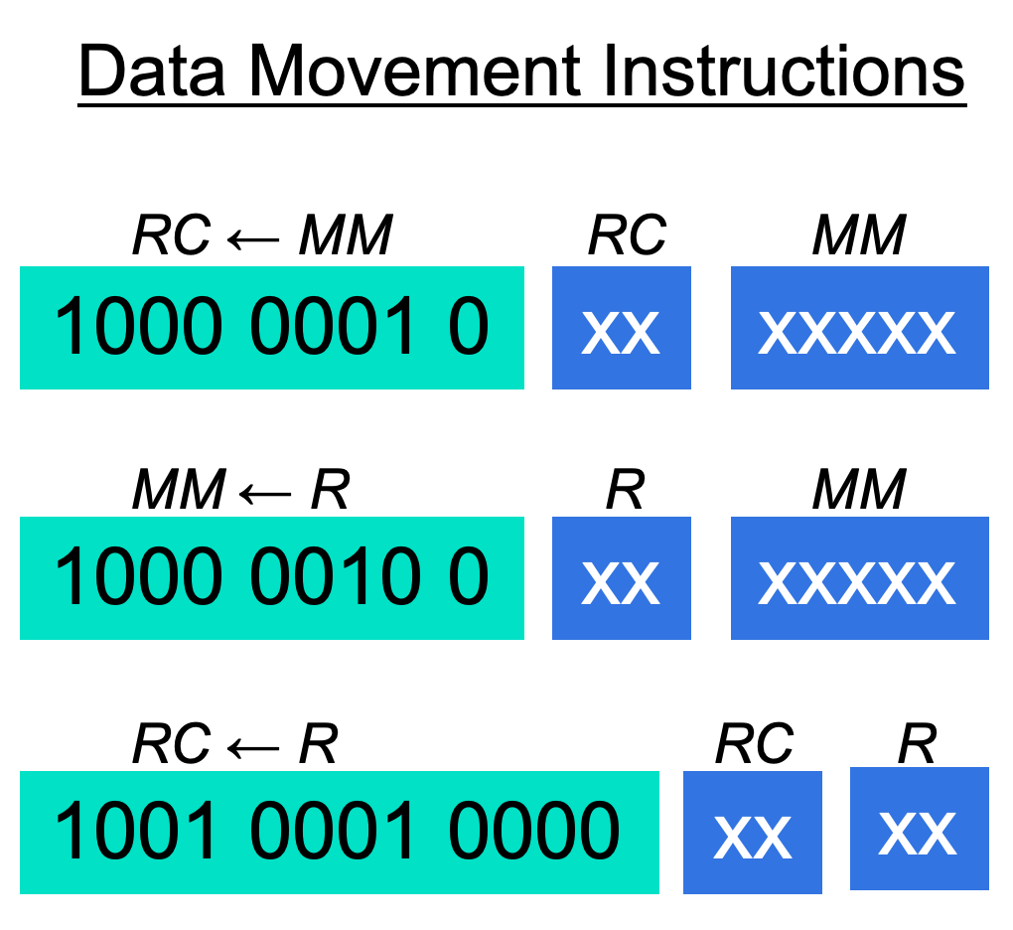
K&S Machine Language Reference
Notes:
This is just a summary of all of the K&S Machine Langauge instructions we have learned about
- In fact, it is actually all of them.
- So the K&S has a very small instruction set.
- But as we will see, it is pretty powerful…
There is one instruction we haven’t discussed yet…
- The NOP – no operation.
- Seems a little silly…
- It tells the computer to take the time to execute one instruction
- but don’t change anything except the PC.
- So no registers change, no memory locations change.
Why in the world would we want that?
- Once upon a time used as a timing device
- Run 1000 NOP and then do something.
- If they take 1/100 of a second each then we have waited 1 second.
- Much less useful as computers became more powerful and started running multiple programs simultaneously.
- It can also be a debugging tool
- Allowing you to take out an instruction
- but not change the speed at which the program runs.
- It also has a few other uses that we won’t get into very much…
- But it has to do with pipeline hazards, which we will discuss in a few days.

Slide 13
Example
if R0 == R1
MM[20] ← R0
Done
Implement this program in K&S Machine Language.
MM
0:
1:
2:
3:
4:
Operation
Machine Language Instruction
Notes:
Assume that there are values in R0 and R1.
- In a complete program they would have been put there by code that executed earlier.
- We’ll do this a lot,
- we will assume that there is other code
- that has executed before our code
- that will execute after our code
- We will then just translate a snippet of code.
- It keeps things simple and lets us focus just on the relevant parts for what we are trying to learn at the moment.
Note that there is no instruction that will let us branch when two registers are equal.
- We only have instructions for branching on zero or negative or unconditionally
- So you have to be a little creative!
For now
- Just write the operations out using our shorthand.
- If you finish that quickly
- then do the translation to ML.
See what they come up with.
- cover it.
- next slide contains a solution.
- may be similar, may be different.

Slide 14

Example
if R0 == R1
MM[20] ← R0
Done
Implement this program in K&S Machine Language.
MM
0:
1:
2:
3:
4:
Operation
R2 ← R0 - R1
if Zero PC ← 3
PC ← 4
MM[20] ← R0
HALT
Machine Language Instruction
1010 0010 00 10 00 01
Pro Tip: You must do an ALU operation immediately before a conditional branch so that ALU Flags are set!
Notes:
The appraoch here is to Subtract R1 from R0
- NOTE: R0-R1 will be zero if R0=R1
- So we’ll do R0 – R1
- If that gives a zero result the zero flag will be set
- So we can use the If Zero instruction to branch.
Here we will branch to 3
- At 3 we’ll put R0 into MM[20].
- Then the PC is incremented
- And we HALT at 4.
But what happens if R0 != R1?
- then the if Zero PC <- 3 branch will not be taken.
- When that happened the PC is incrementeed
- the next instruction is executed
- that is the unconditional branch PC <- 4
- Which jumps to the HALt
Can just look up the equivalent ML on the reference sheet.
- here the branch at 5 is a branch zero, to 7
- Can see the unsigned value 7 in the operand.
Note at end:
We have to construct all other branches using the 3 we have.
- turns out that’s enough to do everything we need to do.
- we’ll get some more experience with this in the activities and in later classes.

Slide 15
Example
if R0 == R1
MM[20] ← R0
Done
Implement this program in K&S Machine Language.
MM
0:
1:
2:
3:
4:
Operation
R2 ← R0 - R1
if Zero PC ← 3
PC ← 4
MM[20] ← R0
HALT
Machine Language Instruction
1010 0010 00 10 00 01
0000 0010 000 00011
0000 0001 000 00100
1000 0010 0 00 10100
1111 1111 1111 1111
Notes:
To translate, just look up the equivalent ML on the reference sheet.
The branch at 1 is a branch zero, to the instruction at address 3
- Can clearly see the unsigned value 3 in the operand.
The branch at 2 is an unconditional branch to the instruction at address 4
- Can clearly see the unsigned value 4 in the operand.
Notice that the opcodes for the two branches are different
- One is for branch on zero (0000 0010 000)
- the other is for the unconditional branch (0000 0001 000)
- These opcodes tell the instruction interpretation unit what to do.
- I.e. Under what condition should they put the operand (i.e. address) into the PC.

Slide 16
Stored Program Computer
In a stored program computer, the program instructions and the data are stored in the main memory.
Program
Instructions
Data
Notes:
We did something last time that I want to talk more about
It may not have seemed like a big deal…
- but this “trick” is the foundation of modern computing!
We put both the program instructions and the data on which they operate into the main memory.
- This is what happens when you run a program …
- The instructions and data for the program are moved from the disk drive in your computer to the main memory.
- The Control Unit the causes those instructions to be executed:
- The PC indicates the memory address of the instruction to be executed
- That instruction is moved from the main memory to the IR
- The Instruction interpretation unit translates the ML instruction into micro-instructions
- The micro instructions configure the machine to carry out the operation.
- Then it repeats over and over and over again until the program halts.
Today, I want to first, put some conceptual structure on this “big idea”.
- We’ll connect the K&S into the vocabulary and structures that are used to talk about modern computer architectures.

Slide 17
The “First” Stored Program Computer
Von Neuman
Architecture
EDVAC – 1949
John Mauchly, J. Presper Eckert
John Von Neuman, University of PA
EDSAC – 1949
Maurice Wilkes
Cambridge UK
Manchester Mark I – 1949
Frederic C. Williams, Tom Kilburn
Manchester, UK
Image from: https://www.thocp.net/
hardware/edvac.htm
Image from: https://en.wikipedia.org/wiki/EDSAC
Image from: https://en.wikipedia.org/wiki/
Manchester_Mark_1
Notes:
The big idea here is that the program and the data are stored in the memory
Contrast this with the earlier computers we’ve seen where they were programmed by physically reconfiguring them.
This made these new machines “General Purpose” computers.
- The same machine could do different computations
- Simply by loading a different program into its main memory.
- It did not require any reconfiguration.
We’ve talked earlier about how the idea that ”First” is somewhat controversial in many inventions
- Depends on exact definitions and timing particularly when things have been kept secret
- There is lots of really good history and interesting stories around these machines
- Arguments can be made for any of these machines as the “first” stored program computer.
- Some really good books have been written about it,
- check them out if this type of history interests you.
The stored program computer is also sometimes referred to as the Von Neuman Architecture
- This has been a controversial term…
- History suggests that that idea originated with Mauchly and Eckert
- But has become associated with Von Neuman
- One version of what happened is…
- Von Neuman was a very famous mathematician at the time
- he was brought into the project to help refine idea
- he wrote a draft description of the stored program idea
- That draft was not intended for distribution and had only his name on it.
- But it got out and it stuck.
- So Stored Program Architecture is a better term to use.
- Though you may hear / see the other
- So good to know they are the same.
===
EDSAC - Electronic Delay Storage Automatic Calculator
EDVAC, Electronic Discrete Variable Automatic Computer
- Origins of the idea in 1945
- Others built on the inspiration from this idea
- But it also didn’t run until 1949

Slide 18
The Stored Program Architecture
Disk Drive (SSD/HDD),
Mouse, Monitor
Wifi, Network
Keyboard, Speakers,
…
Notes:
The stored program architecture has three main components:
- CPU – Central Processing Unit
- Where the computations are performed.
- Main Memory – or RAM
- Where the program instructions and data are stored.
- Input / Output Devices
- Devices connected to the computer
- For moving information into and out of the CPU and memory
- This is essentially everything except the Main memory and the CPU.
- Disk drive, thumb drive
- network/wifi, bluettooth interface
- Mouse, keyboard
- speakers, monitors
- Note that things can be connected and be in the same box
- E.g. trackpad, screen, keyboard on a laptop
- These are still I/O devices because they are not part of the CPU or the Main Memory.
The K&S very clearly has a CPU and main memory
It does not not support external I/O devices directly.

Slide 19
The Central Processing Unit (CPU)
The CPU is made up of three interconnected components that control the machine and perform computations:
The Arithmetic and Logic Unit (ALU)
The General Purpose Registers
The Control Unit (CU)
Notes:
These are the same components that you have seen in operation in the K&S CPU
- We are just giving them more formal names and definitions here.
ALU
- Performs arithmetic and logical operations
- The K&S could do addition, or, and and subtraction.
- The ALU’s in modern processors can do hundreds of different operations.
- e.g. multiply / divide for signed, unsigned and floating point values, sounds and graphics.
Registers:
- Temporary storage for the data that is being used in the computations performed by the ALU.
- This is R0-R3 in the K&S.
Control Unit:
- Coordinates the instruction cycle by controlling the operation of all of the other components.
- This is the Control Unit with the Instruction interpretation unit and micro instructions in the K&S

Slide 20
The Instruction Cycle
The control unit coordinates the instruction cycle consisting of the three phases:
Fetch, Decode and Execute.
Notes:
The Instruction cycle is the process the computer goes through to run an instruction.
- We can break this down into three phases: Fetch/Decode/Execute
Fetch:
- Fetching is the process of retrieving the next instruction from the main memory.
- The program counter (PC) gives the address of the next instruction
- The machine language (ML) instruction is moved from that address (i.e. MM[PC]) into the instruction register (IR)
Decode:
- Decoding is the process of figuring out what the instruction in the IR is and how to configure the machine to carry it out.
- The instruction interpretation circuit uses the bits of the IR to compute the microinstruction needed.
- It is possible that complex operations may require multiple micro-instructions to complete.
Execute:
- Execution is the process by which the configured machine performs the operation indicated by the ML instruction that is in the IR
- Data moves around the machine, the ALU performs its operation, etc…
This is exactly what we have seen happening in the K&S
We really are just putting names to things we have seen before.

Slide 21
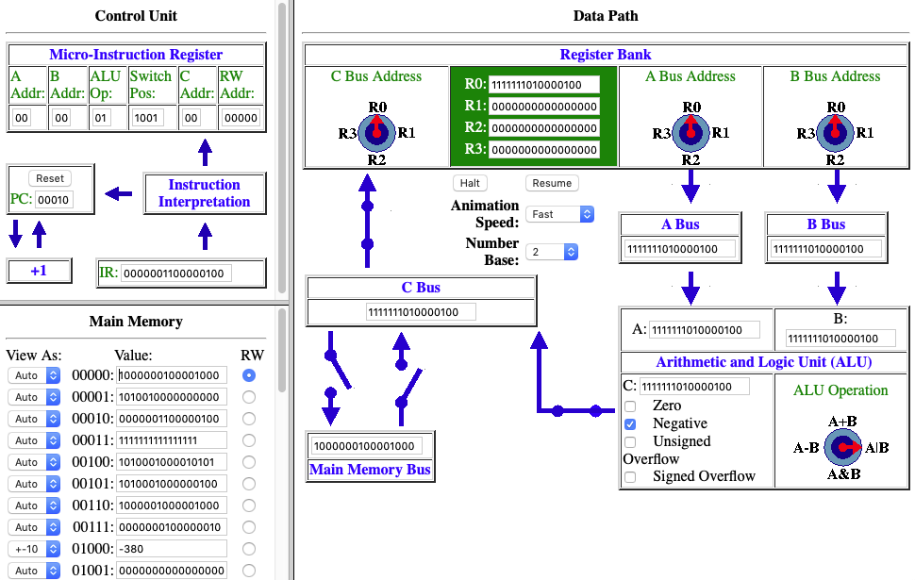
The Instruction Cycle: Fetch
MM[2]: If Negative PC ← 4
Fetch
IR ← MM[PC]
Decode
Execute
Notes:
Let’s trace through a complete instruction cycle in the K&S to see it in deatail.
- In class it might work well to do this via a live demo using the K&S
- Set it up to run the Example from earlier.
- Set R0, R1 not equal so we don’t take the first branch.
- Then take the second branch.
For this sequence of slides:
- Note that the PC = 2 (00010)
- so we will be looking at the execution of the instruction at MM[2]
- That instruction happens to be If Negative PC <– 4
We know that the machine will Fetch/Decode/Execute
- over and over and over again.
Fetch
- Use the PC to find the instruction in memory.
- Move the ML instruction from MM[PC] to IR
- PC = 00010 = 2 (base 10)

Slide 22
The Instruction Cycle: Decode
MM[2]: If Negative PC ← 4
Fetch
IR ← MM[PC]
Decode
00000011000 00100
if negative branch to 4
Execute
Notes:
The next thing that happens is decode…
The instruction interpretation unit uses the bits of the ML instruction in the IR to determine how to configure the machine.
It sets the microiinsruction register to the proper bits to:
- Make the knobs turn to where they are supposed to
- Make the switches open and closed as necessary
- Pick the R/W address for the operation as necessary

Slide 23

The Instruction Cycle: Execute
MM[2]: If Negative PC ← 4
Fetch
IR ← MM[PC]
Decode
00000011000 00100
if negative branch to 4
Execute
Last ALU result negative?
PC ← 4
Notes:
Once the instruction interpretation unit configures the machine via the microinstruction
The instruction is executed.
Check if the last ALU result was negative…
- Looking at the ALU, we can see that it was.
- So the instruction interpretation unit will set the PC to 4.
That means that the next fetch will be from 4
- we will skip over the instruction at 3.
Note that if the prior result was not Negative then
- We just do what we normally do
- PC = PC + 1.
- And we would have gone onto the instruction at 3 instead.

Slide 24

The Instruction Cycle: Again
Fetch
IR ← MM[PC]
Decode
00000011000 00100
if negative branch to 4
Execute
Last ALU result negative? PC ← 4
Fetch… Decode… Execute
Notes:
So now when we continue to fetch / decode / execute
The PC now contains 4
- So the next instruction is fetched from address 4
- instead of from address 3.

Slide 25
Stored Program Architecture Summary
Stored Program Architecture
ML program instructions and data are stored in the main memory.
CPU + Main Memory + Input/Output Devices
Central Processing Unit
ALU + Registers + Control Unit
Instruction Cycle
Fetch / Decode / Execute
Program Counter (PC)
Instruction Register (IR)
Notes:
Nothing to talk about here.
Just a summary slide to bring it all together
Give them a chance to ask questions.

Slide 26

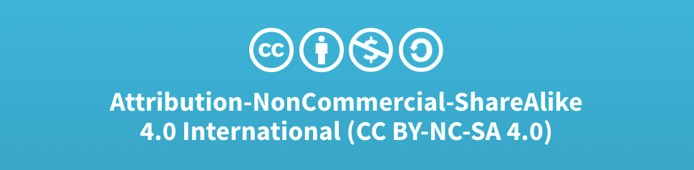
Acknowledgments
Slide Template From:
https://creativecommons.org/licenses/by/4.0/
Slide Content Licensed as:
Creative Commons Attribution-NonCommercial-ShareAlike 4.0 International License.
Notes:
Note: Individual images may be covered by their own licensing agreements and were incorporated here under fair use. Their use in this slide deck does not change or alter their licensing.

Slide 27
Motivating Branching
Programs often make decisions…
while (i >= 0) {
<code>
}
if (x < y) {
<code1>
}
else {
<code2>
}
for (i=0; i<10; i++) {
<code>
}
Notes:
Branching code allows programs to make decisions
- To execute in one way under one condition
- And another way under a different codition
if
- if x < y then do instructions in code1 and skip code2
- Otherwise, skip code 1 and do instructions in code 2.
while
- repeat code as long as i>=0
- if I becomes less than 0 then skip over code and continue
for
- you get the idea…

Slide 28
K&S Branching Machine Language Instructions
Branching Instructions
If Zero PC ← MM
MM
0000 0010 000
xxxxx
If Negative PC ← MM
MM
0000 0011 000
xxxxx
PC ← MM
MM
Unconditional
Branch
while (i >= 0) {
<code>
}
0000 0001 000
xxxxx
Notes:
The K&S contains just three branching instructions.
- The one we saw was based on the Negative Flag.
There is one for the zero flag
- if the zero flag is set, then branch to the address given.
There is an unconditional branch
- Just change the PC so that we branch to a new instruction.
- E.g. when we reach the end of a while loop we need to branch to the top.

Slide 29
Main
Memory
(RAM)
CPU
Input/ Output

Slide 30
Main
Memory
(RAM)
Input/ Output

Slide 31
CPU
General Purpose Registers
Control Unit
ALU

