Slide 1
OSA4 – Logical Memory
COMP 256 – Dickinson College
Prof. Braught
Spring 2023
Notes:
Talked about physical memory
- registers, cache, main memory
- physically exists in the machine.
Logical memory is an abstraction crated by the OS
- Used by processes.
- Uses the physical memory
- but abstracts it
- to improve multiprogramming
- to expand the capabilities of processes

Slide 2
Physical vs. Logical Memory
CPU
Main Memory
CPU
0:
1598:
…:
2888:
…:
3680:
…:
4892:
…:
7240:
…:
PC:76
PC:76
BIOS
Logical (Memory) Addresses:
Logical addresses are relative to the program.
The PC contains logical addresses.
Physical (Memory) Addresses:
Physical addresses are a location in the physical RAM.
PC + Offset gives the physical address.
+
OFF:2888
OFF:2888
OS
Registers
Registers
R0:20
R1:141
R2:12
R3:0
…
R14:141
P1
R0:20
R1:141
R2:12
R3:0
…
R14:141
ML
Data
Heap
Stack
P2
ML
Data
Heap
Stack
Notes:
Recall that in OSA2 we distinguished between Physical vs. Logical Memory
- to give us the ability to place multiple processes in RAM at once.
- which made it possible to do multiprogramming.
Physical memory is the memory hardware from the machines perspective.
- It is the actual RAM chips that are included in the machine
- The addresses run from 0 up to some maximum
- Most addresses are on the RAM chips and used for programs and data, including the OS
- Some addresses are remapped to ROM chips like the BIOS
- Some addresses may be remapped to devices (e.g. STDIN, STDOUT)
Logical memory is how the program views its own memory
- The addresses start from 0 and go up to some maximum
- The program thinks its first instruction is at address 0
- All of the addresses within the program are computed with that assumption.
- E.g. LOAD/STORE/JUMP addresses are all relative to the start of the program.
So:
- When the program generates an address
- LOAD / STORE / branching
- Those addresses are Logical Addresses
- They are relative to the start of the program.
- When an address is sent to the main memory to access the instruction or data
- They must be physical addresses.
- There is a combination of hardware and software in the machine that does this translation.
- There are multiple ways it can be done.
The Offset Register that we have learned about provided one way to perform this translation:
- We know that for multiprogramming the programs and data that are being used must be in main memory
- We are using a stored program architecture – so… data and instructions must be in the physical memory.
- The Offset register gave us a straightforward way to have multiple processes sharing the main memory.
- Offset register is just added to every logical address generated by the program to get the corresponding physical address.
- The value of the offset register is then a part of the process’ context
This approach has some limitations:
- Total amount of memory use by all processes cannot exceed size of the physical memory.
- Limits the size of the processes and the number of them that can be running.
- Makes it difficult for processes to grow over time (e.g. accumulate more and more data as they run)
- They would bump into each other!
- Could allocate enough physical memory to them at the start (might be wasteful)
- Could move them if they need to grow beyond initial size (complex and inefficient)

Slide 3

Logical Memory Abstraction
College Metaphor
Hardware:
rooms, library
Process:
class, team, student
OS:
faculty, staff, coaches
Logical memory is an abstraction produced by a combination of the OS and added hardware support that:
Creates the illusion within each process that:
It has its own memory addressed from 0
Its own memory is larger than the physical memory.
Photo by: Steven Gerner, https://www.flickr.com/photos/
sgerner/16477700444/in/photostream/
Notes:
Logical memory is an abstraction…
- Here we will talk about that abstraction without worrying about how it works.
- Then next class we’ll see how it actually works.
Logical memory is an abstraction created by a combination of the OS and some additional Hardware support that
- Makes it seem from the process perspective that
- each process has its own independent memory
- This is done by using the offset registers and
- offset register does this already… but we will see another way next time.
- that its memory is much much larger than the physical memory.
Seems impossible… how can that be…. We’ll we will see.
- today we’ll look at it from the process perspective
- and understand what the process sees
- then next time we’ll see how that illusion is created.
The Library as a metaphor for Logical Memory
- Let’s simplify the job of the library to be providing a requested resource.
- Similarly, the memory’s job is to provide a requested instruction or data
- From this perspective the library provides the Illusion that
- each student has his/her own full library
- You can request any book and you will receive it
- If its on the shelf you go get it.
- If someone else has it checked out you can request it.
- So the library still does its job and delivers you the resource
- So from this perspective each student seems to have their own library
- The library is also much larger than its physical space on campus…
- When you request something if it is here it comes quickly.
- But there is way more than that…
- Things we don’t own accessed by ILL
- When those are requested, the staff requests them from other libraries
- This takes longer, but we still get them.
- So again, the library does its job of delivering the resource
- By waiting a little longer, we get access to vastly more resources than we can house in our library.
- If we think about it abstractly,
- the library provides the illusions that each student has their own personal library.
- The fact that some things take a little longer… is us seeing the effects of how the abstraction is built
- Sort of like memory and cache from earlier…

Slide 4
Logical Memory
The Logical Memory has:
Addressed using m-bit memory addresses.
Memory addresses from 0 to 2^{m}-1
We say: “The logical memory has an m-bit logical address space”
Logical Memory
0:
2^{m}-1:
ML
Data
For Context:
64 bit Linux processes have a 48-bit logical address space
m=48, so each process has 2⁴⁸ addresses
➜ 256,000 GB of logical memory!!!
Physical RAM
Typically, 4 to 64GB ?!?!?
Heap
Empty
Stack
Notes:
A little more about Logical Memory.
- The addresses in logical memory run from 0 up to 2^m-1
- Where m is the number of bits used to represent the memory addresses.
- Think back to the Knob & Switch computer.
- There m=5, so we had 32 addresses that ran from 0 up to 2^5-1=31.
- We use the term “m-bit logical address space” to talk about a logical address space with m-bit memory addresses.
- So the K&S had a 5-bit logical address space.
- That is tiny…
Now, we have decoupled logical memory from the physical memory we can pick any m that we want…
- So each process can actually have its own HUGE logical memory
- It has access to memory addresses from 0…2^m-1
- So we have m bit memory addresses
- you might recall from the K&S that we called this the address space
- if addresses are m bits then it is an m bit address space.
But in practice this logical memory can be huge!!
- … how huge?
- In a typcial linux system m=48
- …
- most machines today
- 4-32 gigabytes of physical RAM
- So this has to be an illusion / an abstraction!!
- And it is…
- part of the secret is that we’ll only put the parts of the logical memory that we actually need into physical memory.
- another part of the secret is that most of the logical memory is empty most of the time.
- Today, I want to focus on understanding the logical memory as an abstraction…
- We’ll see next class how this abstraction is created.
Note: m is slightly different on different systems and in different modes.
- There are some technicalities in that m=48 for 64-bit linux
- There are different memory modes in modern processors
- In at least one you get m=57.
- Not worth going into the details here.

Slide 5
Each Process has its own Logical Memory
Logical memory is structured into four segments in two categories:
Static - Created by Compiler
Code: Machine language instructions
Data: Global variables and constants
Dynamic - Managed by the OS
Stack: Scoped (Transient)
parameters, register preservation, local variables
Heap: Persistent
Arrays, structures and objects
Logical Memory
0:
2^{m}-1:
Code
Data
Heap
Empty
Stack
Notes:
Logical memory has the same structure as we looked at before…
The important parts of the logical memory can be split into two categories:
- Static – setup by the compiler
- Dynamic – managed by the operating system
- Static
- This is the executable program file
- CODE: Instructions begin at 0
- DATA: the global and static data
- Dynamic:
- This is what the program creates and uses as it runs.
- STACK: for function arguments and local variables.
- HEAP: for space allocated with new – e.g. objects or arrays
Stack is scoped…
- That is variables go in and out of scope
- e.g. local variables and parameters only exist inside the function.
- Variable declared inside of a loop only exists inside that loop.
Heap is persistent
- Objects created on the heap can exist outside of the scope of a function.
- e.g. things created with ”new” in Java
- We usually interact with these through references.
Like we have seen… stack grows upward as we push
Heap will grow downward a new objects and arrays are created.
- Rather than dividing that space in half
- This allows for more efficient use of that space.
- If the heap is small the stack can be bigger
- or if the stack is small the heap can be bigger
- Though they can still collide
- that is your stack overflow
- or running out of heap space.
Exact layout is defined by the OS
- This is Unix Like
- it will be slightly different on different OS’s.

Slide 6
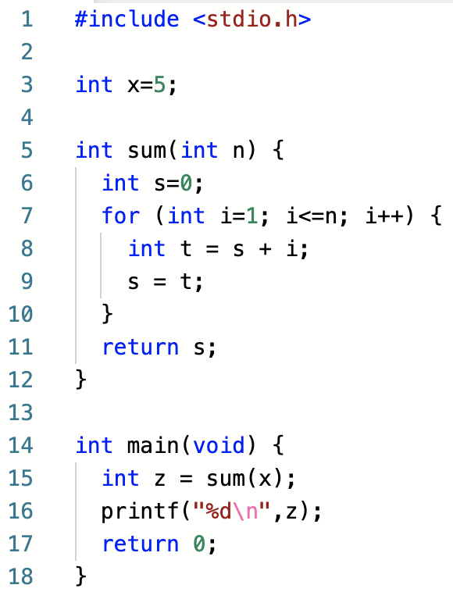
Memory Allocation: Data & Stack
Logical Memory
0:
2^{m}-1:
Code
include brings in library code like import in Java
Heap
Code available at: https://repl.it/@braughtg/MemoryAllocation1
Notes:
Let’s look at how code in a HLL interacts with its Logical Memory
- Goal
- To more fully understand the Processes’ logical memory
- To understand the abstraction the OS provides
- Then next time we’ll look at how the OS creates this illusion.
To help, we are going to look at user process code in C
- Not expecting you know C or that you will be C coders after this.
- We are just using its features to illustrate the connection between HLL code and the OS
- Doing it in C because it It is the closest to what is actually going on without getting into assembly.
- I.e. Its abstractions are ”thinner” – they don’t hide as much.
- They still hide a lot… just not as much.
Let’s pull this program apart a little.
- Overall it just adds up the numbers from 1 to x and prints the result.
- It doesn’t necessarily do it in the most efficient way
- I included a few extra variables and a function
- Because they help to illustrate the way programs interact with their logical memory
- Not because this is the way I would write a program to add up these numbers.
The include statement:
- pretty much like import in Java or Python
- brings in a library of code that we can use
- functions we can call.

Slide 7
Memory Allocation: Code Segment
Logical Memory
0:
2^{m}-1:
Code
The compiler translates HLL instructions to Machine Language in the Code Segment.
x
Heap
Code available at: https://repl.it/@braughtg/MemoryAllocation1
Notes:
A compiler (and assembler) would translate this to machine language instructions.
- The sum(x) becomes a PUSH and a CALL
- The for loop is translated like we saw back in writing assembly.
- The return s
- moves the value to a return value register (e.g. R14 in our machine) and jumps back to the return address
- All that stuff we know from before
- All of those instructions become part of the executable program.
- They make up the code segment.

Slide 8
Memory Allocation: Data Segment
Logical Memory
0:
2^{m}-1:
Code
The compiler allocates global variables in the Data segment.
x
Heap
Code available at: https://repl.it/@braughtg/MemoryAllocation1
Notes:
Any global variables
- i.e. those not in a function…
- are allocated in the data segment
- These also become part of the executable program
When you download or install a program it is these two parts that are in the executable file.
- the instructions in the code segment
- the data in the data segment.
These are the two parts that our assembler puts into the .ml files that it produces.

Slide 9
Memory Allocation: Stack Segment
Logical Memory
0:
2^{m}-1:
Code
Local variables are allocated on the stack when they come into scope
x
Heap
z
Code available at: https://repl.it/@braughtg/MemoryAllocation1
Notes:
The stack and heap segments are dynamic.
They exist only when the program is running.
- They are part of the process context.
Stack is used for: local variables and parameters.
- for example z is a local variable in the main function
- it may be created on the stack.
- Code would access it using an offset from the stack pointer.
- E.g. LOAD R5 R13 +4
Note the color code:
- blue stuff in data
- purple stuff on stack
- heap will be green

Slide 10
Memory Allocation: Stack Segment
Logical Memory
0:
2^{m}-1:
Code
x
Parameters are just Local variables.
Heap
n
z
Code available at: https://repl.it/@braughtg/MemoryAllocation1
Notes:
Parameters are treated just like local variables.
- they are created on the stack by the PUSH’s that were done to pass the arguments.
- So here the value of x would be pushed as an argument to create the parameter n.
- this is the stuff we did in the topic on assembly language when calling a function.
- the function then accesses those values using the stack pointer with an appropriate offset.

Slide 11
Memory Allocation: Stack Segment
Logical Memory
0:
2^{m}-1:
Code
Heap
s
n
z
Code available at: https://repl.it/@braughtg/MemoryAllocation1
Notes:
When sum is called
- parameter n was created on the stack (by the push that passed it.)
- local variable S is created on the stack
- The code in the function does this by doing a PUSH
- Note: A smart (optimizing) compiler may not actually do this.
- It may instead just use registers – like we often did in our programs.
- But, even then, this is what it would do if there are lots of local variables
- I.e. it’s not hard to imagine having more local variables than we have registers.
Local variables are created in order… so they are on the stack in that order.
- Code would access them using offsets
- like we did with parameters.

Slide 12
Memory Allocation: Stack Segment
Logical Memory
0:
2^{m}-1:
Code
x
Heap
t
i
s
n
z
Code available at: https://repl.it/@braughtg/MemoryAllocation1
Notes:
When the for loop is reached
- Local variables i and t are created on the stack
- because they are local and scoped…

Slide 13
Memory Allocation: Stack Segment
Logical Memory
0:
2^{m}-1:
Code
Local variables are removed from the stack when they go out of scope.
x
Heap
s
n
z
Code available at: https://repl.it/@braughtg/MemoryAllocation1
Notes:
When the for loop completes
- the local variables i and t no longer exist
- so they are removed (POP) from the stack.
- they have gone out of scope.

Slide 14
Memory Allocation: Stack Segment
Logical Memory
0:
2^{m}-1:
Code
Local variables are removed from the stack when they go out of scope.
x
Heap
z
Code available at: https://repl.it/@braughtg/MemoryAllocation1
Notes:
Similarly, when the sum function ends
- the parameter n and local variable s go out of scope.
- they are removed from the stack.
- This is just what we did when calling functions in assembly
- We removed the parameters from the stack by popping them into R15
- all of that still applies.
- the code generated for the function would take care of removing any local variables that were created on the stack.
The thing that is important here
- we can think about what this HLL program is doing only in terms of the Logical Memory.
- we don’t need to know what is actually happening in the physical memory
- which we know is much smaller
- so there must be some “magic” going on behind the scenes.
There is an abstraction here!!
- What details is it letting us focus on?
- What details is it letting us ignore?

Slide 15
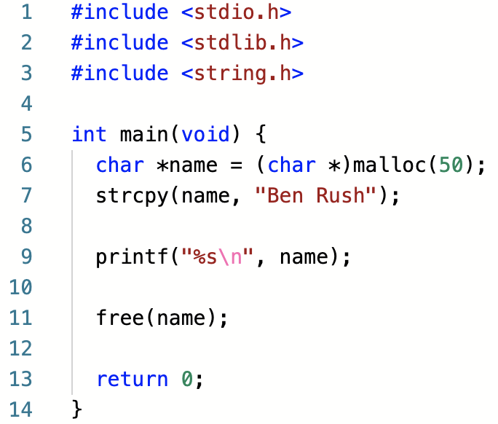
Memory Allocation: Heap Segment
Logical Memory
0:
2^{m}-1:
Code
Code available at: https://repl.it/@braughtg/MemoryAllocation2
Notes:
That was the stack.
Let’s look at another example that involves the heap.
This program brings in some other library code with include
- stuff for doing i/o (stdio) - standard input and output (printing)
- Stuff for interacting with the heap (stdlib)
- Stuff for manipulating strings (string)

Slide 16
Memory Allocation: Heap Segment
Logical Memory
0:
2^{m}-1:
Code
* in C creates a pointer, which we can think of a being like a reference in Java.
Code available at: https://repl.it/@braughtg/MemoryAllocation2
Notes:
Here we have a local variable name
- preceded by an *
- this creates a pointer (i.e. a reference)
- in this case
- name will be the address of some characters (i.e. a string in C).

Slide 17
Memory Allocation: Heap Segment
Logical Memory
0:
2^{m}-1:
Code
* in C creates a pointer, which we can think of a being like a reference in Java.
name
Code available at: https://repl.it/@braughtg/MemoryAllocation2
Notes:
Name is a local variable,
- so it will be created on the stack.
- but it will be a pointer (or a reference) to somewhere else.

Slide 18
Memory Allocation: Heap Segment
Logical Memory
0:
2^{m}-1:
Code
malloc makes a system call asking the OS to allocate bytes in the heap, growing the heap segment if necessary.
name
Code available at: https://repl.it/@braughtg/MemoryAllocation2
Notes:
In java we might create a new String object.
That hides some of what is going on.
In C, if we want to set aside space in memory for something we use malloc.
malloc is a library function that
- makes a system call to the operating system.
- so an interrupt… switch to kernel mode… run a system call handler… return…
The malloc system call:
- asks the OS to set aside some number of bytes in the heap segment.
- Here the program asks the OS to:
- set aside 50 bytes of space on the heap.
The OS will make the heap segment larger if necessary as well.

Slide 19
Memory Allocation: Heap Segment
Logical Memory
0:
2^{m}-1:
Code
malloc makes a system call asking the OS to allocate bytes in the heap, growing the heap segment if necessary.
name
Code available at: https://repl.it/@braughtg/MemoryAllocation2
Notes:
The OS
- sets aside the 50 bytes
- room for up to 50 standard Latin characters in ASCII or UNICODE
- Heap grows in size if necessary.
- The call to malloc returns the address of those 50 bytes.
- The program uses that address to set the pointer.
- This is just like what we did with Arrays in assembly language.
- So it will be using those indirect addressing mode instructions.

Slide 20
Memory Allocation: Heap Segment
Logical Memory
0:
2^{m}-1:
Code
Ben Rush
name
Code available at: https://repl.it/@braughtg/MemoryAllocation2
Notes:
In C
- we have to copy the characters we want in the string into the space set aside for it.
- the strcpy function does that for us.
- copy the given characters into the bytes at the address in name.
The printf statement then says
- print %s – a string
- that you will find at the address in name.
- followed by a \n – which is a new line character - same as in Java.
Note:
- We are ignoring a small detail here that C strings must have a null terminator to indicate the end of the string.
- So this string would be “Ben Rush\0”.
- Just trying to simplify down to the important OS concepts.

Slide 21
Memory Allocation: Heap Segment
Logical Memory
0:
2^{m}-1:
Code
free makes a system call asking the OS to release bytes back into the heap, possibly shrinking the heap segment.
Ben Rush
name
Code available at: https://repl.it/@braughtg/MemoryAllocation2
Notes:
When we are done using space on the heap
- we need to tell the OS that it can reuse that for other purposes.
- the free() function does that.
- it makes a system call to the OS
- asking that the space set aside on the heap at the address in name be released.
- the OS records that that memory is now free
- and can resize the heap if appropriate.

Slide 22
Memory Allocation: Heap
Name is now a “dangling reference”
Logical Memory
0:
2^{m}-1:
Code
free makes a system call asking the OS to release bytes back into the heap, possibly shrinking the heap segment.
name
Code available at: https://repl.it/@braughtg/MemoryAllocation2
Notes:
Notice that name still holds the address of that space
- even though it is not actually allocated any more.
- this is a common issue in C
- It is called a dangling pointer or a dangling reference.
- if the program were to go on to use name again
- it may produce unpredictable results
- because another malloc call may allocate that memory space for something else.

Slide 23
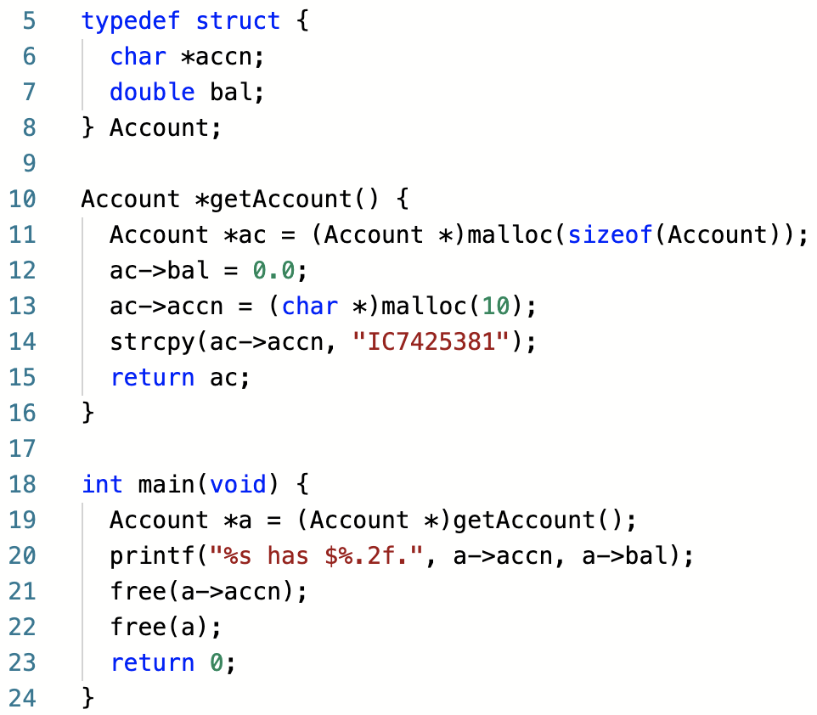
Memory Allocation: Heap & Persistence
Logical Memory
0:
2^{m}-1:
Code
We can think of a struct in C like a class in Java, with fields but no methods.
Code available at: https://repl.it/@braughtg/MemoryAllocation3
Notes:
Here let’s see an example where we put something on the heap that persists across functions.
The stuff on the stack will come and go
But the stuff on the heap persists.
Struct…
- a C language feature that is sort of like a class
- Just fields
- no methods.
- a way to group together a collection or related variables.
- predates OO programming.
Here Defines a struct of type Account
- Account is like the class name.

Slide 24
Memory Allocation: Heap & Persistence
Logical Memory
0:
2^{m}-1:
Code
a
Code available at: https://repl.it/@braughtg/MemoryAllocation3
Notes:
Define a local variable a
- pointer – will be a reference to a struct of type Account.
- created on the stack because it is a local variable.

Slide 25
Memory Allocation: Heap & Persistence
Logical Memory
0:
2^{m}-1:
Code
ac
a
Code available at: https://repl.it/@braughtg/MemoryAllocation3
Notes:
Call the function getAccount
The getAccount function
- will return to us the address of the Account struct on the heap
- creates local variable ac
- on the stack because it is a local variable

Slide 26
Memory Allocation: Heap & Persistence
Logical Memory
0:
2^{m}-1:
Code
The malloc here is similar to
new Account()
in Java
accn:
bal:
ac
a
Code available at: https://repl.it/@braughtg/MemoryAllocation3
Notes:
malloc
- allocates enough bytes to hold the variables that are in the Account struct
- the sizeof function calculates how many that is so we don’t have to.
- a nice abstraction.
- returns the address of the memory that is allocated
Assign that to the ac variable
- pointer/reference is set to point to the allocated memory.
- i.e. ac holds the address of the allocated space
- like the arrays we saw earlier.

Slide 27
Memory Allocation: Heap & Persistence
Logical Memory
0:
2^{m}-1:
Code
The -> operator in C is used to follow a pointer to get the field, similar to the
. operator in java
accn:
bal: 0.0
ac
a
Code available at: https://repl.it/@braughtg/MemoryAllocation3
Notes:
Set the bal field of the Account structure pointed to by ac to 0.0
- the -> notation is C for
- go to the bal field in the struct
- this is kind of like what you would do in the constructor in java.

Slide 28
Memory Allocation: Heap & Persistence
Logical Memory
0:
2^{m}-1:
Code
accn:
bal: 0.0
ac
a
Code available at: https://repl.it/@braughtg/MemoryAllocation3
Notes:
Accn is going to be a string
- so like the previous example
- C uses a pointer to char to represent a string
- so we need to allocate space for it.
- malloc
- Set aside 10 bytes
- make ac->accn point to the allocated space

Slide 29
Memory Allocation: Heap & Persistence
Logical Memory
0:
2^{m}-1:
Code
accn:
bal: 0.0
IC7425831
ac
a
Code available at: https://repl.it/@braughtg/MemoryAllocation3
Notes:
Copy the characters for the account number into the space pointed to by accn.

Slide 30
Memory Allocation: Heap & Persistence
Logical Memory
0:
2^{m}-1:
Code
accn:
bal: 0.0
IC7425831
ac
a
Code available at: https://repl.it/@braughtg/MemoryAllocation3
Notes:
Return to the calling code the address
That is then assigned into a.

Slide 31
Memory Allocation: Heap & Persistence
Logical Memory
0:
2^{m}-1:
Code
accn:
bal: 0.0
IC7425831
a
Code available at: https://repl.it/@braughtg/MemoryAllocation3
Notes:
When the getAccount function ends
- the local varliable ac is removed from the stack
- it has gone out of scope.
But the space for the Account struct
- persists
- because it was allocated on the heap
- and has not been freed.
- So even though it was created in a function
- it was allocated on the heap.
- so it does not go out of scope.
- This is just like objects created with new in Java.

Slide 32
Memory Allocation: Heap & Persistence
Logical Memory
0:
2^{m}-1:
Code
Each piece of allocated memory must be freed.
accn:
bal: 0.0
IC7425831
Not doing so is a common C error called a memory leak.
a
Code available at: https://repl.it/@braughtg/MemoryAllocation3
Notes:
Might imagine we could just free(a)
- but that won’t work in C.
- need to free each piece of memory that has been allocated.
- It is a common mistake in C programming to not do this.
- for example if I were to just free(a) but not a->accn.
- then the block for the Account would go away,
- but the block for the accn would still be there with no pointer to it.
- So it would be allocated
- But be unusable.
- That creates a memory leak
- if that operation is done over and over
- the program will use more and more and more memory.
- eventually the machine runs out of memory.
- This is called a memory leak.

Slide 33
Memory Allocation: Heap & Persistence
Logical Memory
0:
2^{m}-1:
Code
accn:
bal: 0.0
a
Code available at: https://repl.it/@braughtg/MemoryAllocation3
Notes:
Once we free accn it goes away

Slide 34
Memory Allocation: Heap & Persistence
Logical Memory
0:
2^{m}-1:
Code
accn:
bal: 0.0
a
Code available at: https://repl.it/@braughtg/MemoryAllocation3
Notes:
Then we can free a
If we were to forget to free a then we would have a dangling pointer
- A dangling pointer is a pointer into the heap to memory that is no longer allocated to us.
- They are an endless source of headaches in C programming.

Slide 35
Memory Allocation: Heap & Persistence
Logical Memory
0:
2^{m}-1:
Code
a
Code available at: https://repl.it/@braughtg/MemoryAllocation3
Notes:
Again, it is not expected that you could write this.
But you should be able to look at programs like this and draw the associated pictures.
That would require knowing:
- global variables are in the data segment.
- locals and parameters are on the stack
- malloc is a system call
- allocates space on the heap
- what pointers or references are
- free is a system call
- releases memory allocated on the heap.

Slide 36

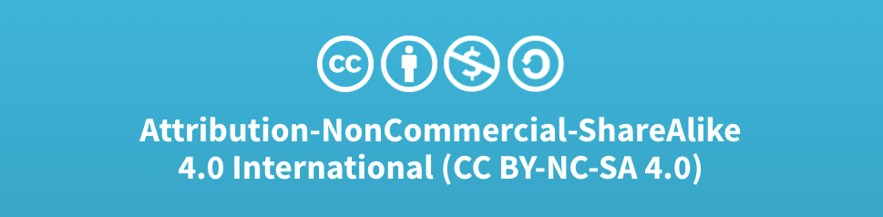
Acknowledgments
Slide Template From:
https://creativecommons.org/licenses/by/4.0/
Slide Content Licensed as:
Creative Commons Attribution-NonCommercial-ShareAlike 4.0 International License.
Notes:
Note: Individual images may be covered by their own licensing agreements and were incorporated here under fair use. Their use in this slide deck does not change or alter their licensing.

