Slide 1
MA5 – Pipelining & Parallelism
COMP 256 – Dickinson College
Prof. Braught
Spring 2023

Slide 2
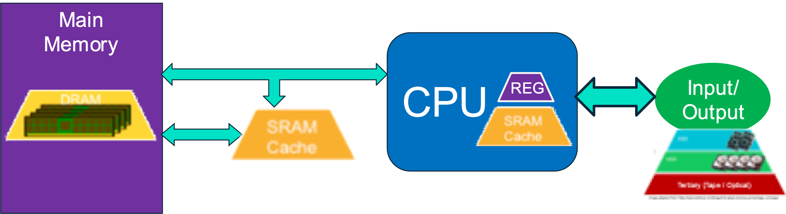
Stored Program Architecture
The stored program architecture with memory hierarchy and processor cache.
Notes:
Last class we looked at the memory hierarchy
That included large, slower, cheaper storage on I/O devices
- Solid State Drives (SSD)
- Hard Disk Drive (HDD)
- Optical Drives
- Tape backup
It also included smaller, faster more expensive memories
- Main memory (DRAM)
- Cache and CPU Registers (SRAM)

Slide 3
Performance Improvements
Moore’s Law → More Transistors
Better Designs
Processor Caching
Pipelining & Parallelism
Better Software
COMP232, COMP332
Notes:
So, caching was about getting information to the processor with less delay
Recall that processors got faster more quickly than did memory
So CPU would have been sitting idle waiting for data.
Cache memory makes it possible to get data to the CPU faster at a reasonable cost.
Today’s topic…
Pipelining and Parallelism are both about making the processor even faster
- Well really more about having it do multiple things at the same time
- Thus, getting more done per unit of time
- Even if none of those individual things are any faster.

Slide 4





You have 4 loads of laundry to wash, dry and fold. You have 1 washer and one dryer. Each step takes 20 minutes. What is the fastest way to get all of the laundry done? How long does it take?
Image adapted from: http://www.cs.iit.edu/~cs561/cs350/piplining/laundry.html
with Images from: openclipart.org
Notes:
I know how college is…
- This is a public service announcement… ;)

Slide 5
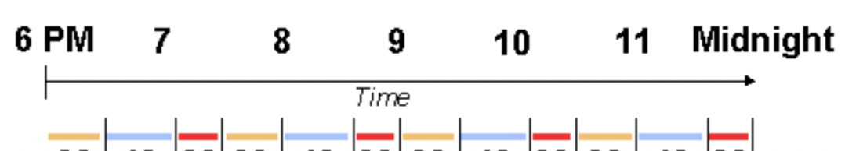

A Pipelining Metaphor
20
20
20
20
20
20
20
20
20
20
20
20
F
D
E
W
D
F
Program
Instructions
Loads of
Laundry
F
D
E
F
D
E
F
D
E
Image adapted from: http://www.cs.iit.edu/~cs561/cs350/piplining/laundry.html
with Images from: openclipart.org
Notes:
Here’ we will use another metaphor…
Imagine you have 4 loads of laundry to do.
- Starting with load A,
- wash (20 minutes)
- dry (20 minutes)
- fold (20 minutes)
- Then we could do load B
- Then C and D and by Midnight you’d be finished with your laundry.
- Of course, that’s not how you would do your laundry right?
But that it is exactly the way we have been talking about the instruction cycle of the computer
- Replace WDF with FDE (Fetch, Decode, Execute) and we have the instruction cycle.
- Just like it doesn’t make sense to let the washer sit there doing nothing while we were drying and folding.
- It doesn’t make sense to let the hardware for Fetch just sit there while we Decode and Execute.
So, let’s do with the instruction cycle what you do with your laundry.

Slide 6
A Better Solution
20
20
20
20
20
20
20
20
20
20
20
20
F
D
E
Program
Instructions
Loads of
Laundry
F
D
E
F
D
E
F
D
E
Image adapted from: http://www.cs.iit.edu/~cs561/cs350/piplining/laundry.html
with Images from: openclipart.org
Notes:
Because each step uses distinct hardware (Washer, Dryer, Folding Area)
- we can overlap them in time.
- While drying the first load, we can wash the second load.
- While folding the first load, we can dry the second and wash the third.
- Or in terms of an instruction, we execute the first one, while decoding the second one, while fetching the third one.
We finish in half the time!
So even though none of the pieces got any faster, we got more done per unit of time
So, if someone is just looking at how long it takes to do laundry
- It seems like the ”Laundry doing machine” is now twice as fast as it was.
- We can imagine a laundry service here as an abstraction…
- You hand off your clothes and pay (relevant details)
- They come back clean, dry and folded (relevant details)
- Doesn’t matter which process they use internally to get that done (hidden details)
- We can do the same with our processor…
- We give it a list of instructions to execute
- It gives us back the result
- We don’t care how it does it
- So the processor provides an abstraction
- It may be pipelined, it may not be, it doesn’t matter to us.
- We just know it gives us the result faster.
One important point to keep in mind:
- At any given time, we can only use a given piece of hardware for one thing.
- Washer, dryer, folding table.
- Circuits for Fetch, Decode or Execute
- E.g. Main memory, a register, the ALU, etc…
- We cannot use the same washer for two different loads of laundry at the same time.
- Colors bleed and whites turn pink.
- Or in a computer the instructions and data would become corrupted.

Slide 7

Instruction Cycle Pipelining
A pipelined instruction cycle overlaps the stages of the cycle (e.g. Fetch / Decode / Execute) by using independent hardware components in each stage.
Pipeline Hazards are conditions that prevent the the instruction pipeline from operating at maximum efficiency.
Image from: openclipart.org
Notes:
Just a definition of pipelined instruction cycle.
- Worth note that the cycle is typically broken into more stages in practice.
- Intel Pentium 4 chip in ~2010 had 20 stages
- Newer processors have
- ARM – 3, 5 or 6 stages
- Intel / AMD chips – went as high as 31 stages
- But has decreased again…
- Cost/Complexity vs performance tradeoff has shifted.
- Just break it down into smaller and smaller stages
- Fetch: might become request, retrieve, store
- Decode: might have multiple steps
- Execute: might become
- get data from registers
- do the alu op
- store result back to registers
Pipeline hazards are things that come up that cause things to not work perfectly.
- Painted kind of a rosy picture of FDE all nicely overlapped.
- Turns out there are some things that will mess that up.

Slide 8
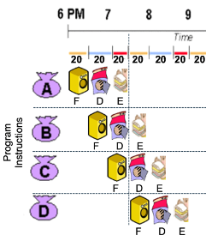
Pipeline Hazards
What issue arises with the pipelined instruction cycle in the situation shown here?
Notes:
Here we have a pipelined instruction cycle
- Fetch the first instruction
- Decode it while fetching the second instruction
- Execute it while decoding the second instruction and fetching the third instruction
- And so on…

Slide 9
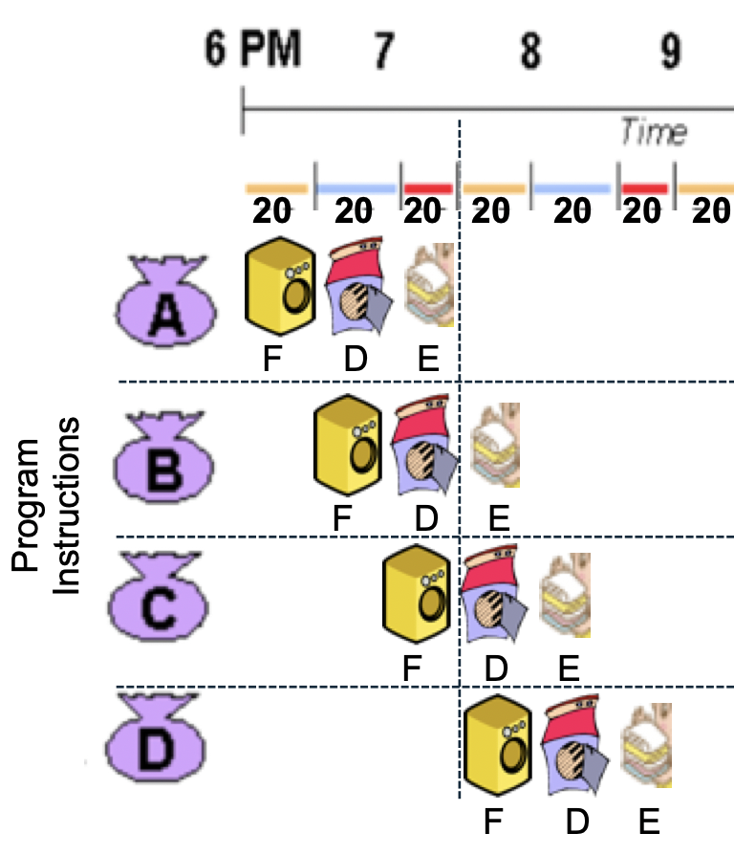
Pipeline Hazards
R0←MM[25]
What issue arises with the pipelined instruction cycle in the situation shown here?
IR←MM[PC]
Notes:
Here we have a pipelined instruction cycle
- Fetch the first instruction
- Decode it while fetching the second instruction
- Execute it while decoding the second instruction and fetching the third instruction
- And so on…
Now imagine that first instruction moves a value from MM to a register
- R0 <- MM[25]
Then notice that fetching the 3rd instruction requires the use of MM also!
- IR <- MM[PC]
This type of hazard is called a resource hazard:
- The execute and the fetch both need to use the same hardware (i.e. MM) at the same time.
- Just like we can’t wash bright colored clothes and white clothes in the same machine at the same time.
- We can’t access MM[25] and MM[PC] at the same time.
- Well unless we were to build special main memory that allows us to do that…
- Explore: Multiported Memory if this stuff is interesting to you.
- Any time there is a challenge, technical solutions have been explored
- continuously a rich research area in computer engineering.

Slide 10
Pipeline Hazards
Three primary types:
Resource Hazard
A resource hazard occurs when two pipeline stages need the same resource as the same time (e.g. memory).
Control Hazard
A control hazard occurs when the pipeline begins processing an incorrect instruction due to a branch.
Data Hazard
A data hazard occurs when an instruction needs data from an prior instruction that is not yet complete.
Notes:
Develop an analogy using laundry for each of these!
- Resource Hazard:
- We saw this on the previous slide.
- The main memory was needed simultaneously
- To fetch an instruction
- To store a value into main memory.
- Control Hazard:
- ??? Start washing underwear, but then get a delivery from home with new ones
- Like a branch – didn’t need to wash those… should have started the bright colors instead.
- Have to clean up
- Data Hazard
- In longer pipelines the execute phase is divided into multiple smaller stages
- A computation that relies on the result of a prior computation can create a problem
- E.g. x = y + z comes immediately after z = x * 5
- When trying to compute x, the result of the prior instruction is needed
- However, that multiplication may take longer than the addition.
- Therefore, we may not fully know z at the point when we want to compute x.
There are a variety of strategies that are used to resolve pipeline hazards.
- That is beyond the scope of this course.
- It would be a topic for an advanced Computer Architecture course.
- The Wikipedia page on Pipelining gives a decent quick overview.

Slide 11
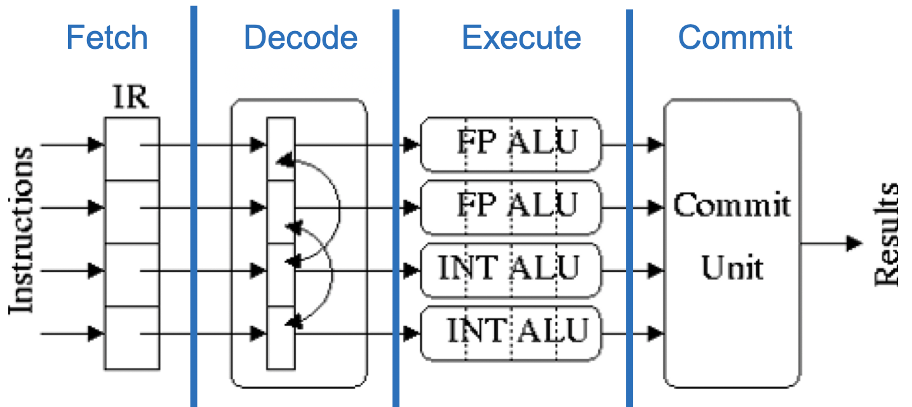
Super Scalar Processors
A Super-Scalar Processor has multiple functional units (e.g. ALUs).
Multiple instructions are fetched at the same time.
Instructions are matched to the available functional units during decoding.
Multiple instructions are executed in parallel.
Results are put back into order by a “commit unit”
Notes:
The super scalar processor adds multiple functional units to the ALU.
- Like adding more washing machines and more dryers.
- Here, some of those 4-billion transistors are used to build more ALU’s (i.e. functional units)
- Each functional units can be executing its own instruction.
- For example, there may be several integer ALU’s and several Floating Point ALUs
- Each one can do one instruction.
- So in the image above the processor could execute 2 floating point instructions and two integer instructions in parallel.
Because each execute phase can process multiple instructions…
- we also need to expand our pipeline
- to send through multiple instructions at a time
- And to match those instructions to the functional units that are available.
Fetch:
- Build the hardware so that it fetches multiple Instructions at at time.
- Uses multiple instruction registers (IR)
- Also possibly multiple program counters (PC)
- So instructions may even come from different programs.
Decode:
- The machine figures out what each instruction is
- Matches each instruction to an appropriate functional unit
- Imagine specialized washing machines…
- machines for small and large loads
- or machines that only have cold water or hot water
Execute:
- Each functional unit processes its instruction in parallel with the others
- all washers (small and large, hot and cold) work at the same time.
Commit:
- Reorder the results of the instructions so that they are back in the correct order.
- hides the fact that they were done all at the same time.
- All the wash gets folded and put back in the right drawers
Like with pipelining
- There can be dependency issues that limit the maximum benefit.
- For example:
- x = y + 2
- y = x +4.5
- We could not do these two operations in parallel.
- Why not?

Slide 12
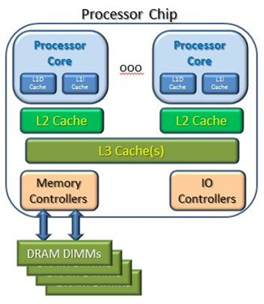
Multicore Processors
…
L1 Data Cache
L1 Inst Cache
L1 Data Cache
L1 Inst Cache
A multicore processor has multiple complete CPU cores on a single processor chip.
Each core is super-scalar and pipelined
Cores can execute:
different programs
different parts of same program
Main Memory
Input/ Output
Image adapted from: https://www.enterpriseai.news/2014/07/09/
Shared-memory-clusters-numa-cache-latencies/
Notes:
A core is a full CPU with its own
- Registers
- ALU (super-scalar)
- Control unit (pipelined)
They are different than multiple CPU’s in that the cores share
- Cache memories (L3)
- Access to memory
- Access to I/O devices

Slide 13
Multi Level Cache
…
L1 Data Cache
L1 Inst Cache
L1 Data Cache
L1 Inst Cache
A multi Level cache.
Shared L3 cache
Per Core L2 and L1 cache
Separate L1 caches for data and instructions.
Main Memory
Input/ Output
Image adapted from: https://www.enterpriseai.news/2014/07/09/
Shared-memory-clusters-numa-cache-latencies/
Notes:
Multi-Level cache works in stages:
- Check the appropriate L1 cache for the data or instruction.
- If there is a hit use the returned value.
- done
- If not then check the L2 cache
- If there is a hit use the returned value
- and copy it and the nearby stuff to the L1 cache.
- done
- If not then check the L3 cache
- If there is a hit then use the returned value
- and copy it and the nearby stuff to the L2 and L1 caches.
- done
- If not then retrieve the data or instruction from main memory
- Use the returned value
- and copy it and the nearby stuff to the L3, L2 and L1 caches.
- done
- One optimization that can be made
- Issue the request for the data to all cache levels and MM at the same time.
- Then if there is a hit, cancel the request at any of the slower levels.
This is super efficient for reading data and instructions.
- However, it creates some complications with writing data.
- E.g. If Core 1 writes some data to a memory location…
- How do we ensure that when Core 2 reads that location it gets the most up to date information?
- We could write it directly to memory
- That’s slow and inefficient if Core 2 never needs that data.
- So maybe there are more clever things we can do…
- This is called the Cache Coherency problem.
- really interesting area of research in computer engineering.

Slide 14
Writing in the Discipline (WiD)
Develop your own metaphor for processor caching and use it to explain cache concepts including:
Cache hits / misses
Locality principles
Temporal
Spatial
MA5 Homework guides you through the process.
Submit a draft to WiD repository.
In a later homework you will do peer review and give each other feedback.
In a later homework you will revise and submit a final draft.
Notes:
COMP256 is part of the WiD thread in the COMP major.
- Every core course in COMP requires some type of writing
- By collectively completing all of the writing assignments
- And placing the products into your WiD repository you will satisfy the college WiD requirement.
Each course has different writing goals.
- Exposes you to the different types of thinking and writing that computer scientists do.
- In COMP256 the goal is to:
- “Be able to use metaphor and analogy to explain complex technical concepts.”
- This is a suitable goal for COMP256 as metaphors and analogies are themselves forms of abstraction.
Details are in the assignment MA5.
- This slide just gives a quick overview.

Slide 15

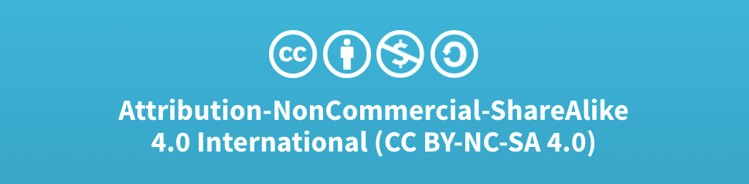
Acknowledgments
Slide Template From:
https://creativecommons.org/licenses/by/4.0/
Slide Content Licensed as:
Creative Commons Attribution-NonCommercial-ShareAlike 4.0 International License.
Notes:
Note: Individual images may be covered by their own licensing agreements and were incorporated here under fair use. Their use in this slide deck does not change or alter their licensing.

Slide 16


Main
Memory
CPU
Input/ Output
REG

Slide 17

20
20
20
20
20
20
20
20
20
20
20
20
F
D
E
Program
Instructions
F
D
E
F
D
E
F
D
E
F
D
E
Notes:
Because each step uses distinct hardware (Washer, Dryer, Folding Area)
- we can overlap them in time.
- While drying the first load, we can wash the second load.
- While folding the first load, we can dry the second and wash the third.
- Or in terms of an instruction, we execute the first one, while decoding the second one, while fetching the first one.
Finish in half the time.
Important piece is that at any given time we are using a piece of hardware for only one thing.
- Washer, dryer, folding table.
- Not trying to use the same washer for two different loads at the same time.
- Colors bleed and whites turn pink.
- Or instructions and data get corrupted.

Slide 18
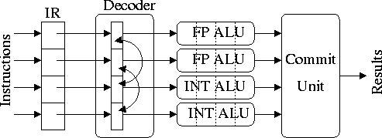
Fetch
Decode
Execute
Commit

Slide 19
Resource Hazards
A resource hazard occurs when two pipeline stages require the same hardware at the same time.
E.g. Fetch and Execute may both need to access main memory at the same time.
R0←MM[25]
IR←MM[PC]
Notes:
Here we have a pipelined instruction cycle
- Fetch the first instruction
- Decode it while fetching the second instruction
- Execute it while decoding the second instruction and fetching the third instruction
- And so on…
Let’s imagine that first instruction moves a value from MM to a register
- R0 <- MM[25]
But then notice that fetching the 3rd instruction requires the use of MM also!
- IR <- MM[PC]
This is a resource hazard
- The execute and the fetch both need to use MM at the same time.
- But just like we can’t wash colored clothes and white clothes in the same machine at the same time
- We can’t access MM[25] and MM[PC] at the same time.

Slide 20
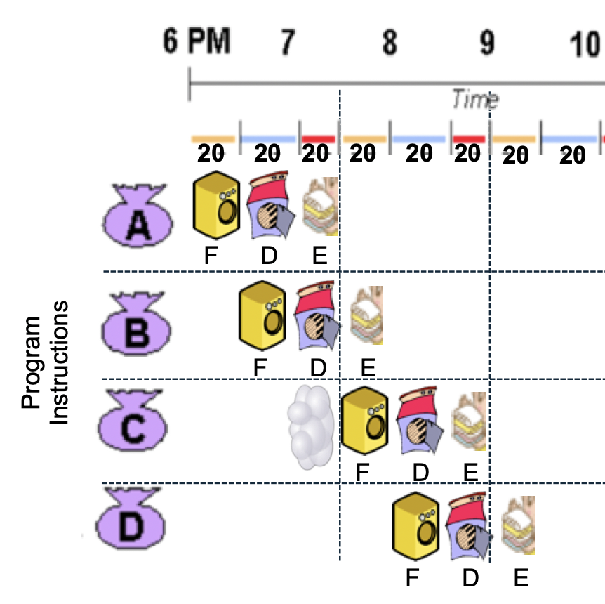
Pipeline Bubbles
Inserting a bubble into the pipeline is one technique that can be used to resolve a hazard.
R0←MM[25]
R2←R0+R1
Pipeline
Bubble
(NOP)
IR←MM[PC]
Notes:
So one way to deal with hazards is to insert a bubble.
For example
- We insert a bubble where we would have fetched the third instruction.
- The bubble is essentially a NOP instruction that does nothing (uses no hardware)
-The conflicting fetch is then shifted one time slot to the right
- Thus, it no longer conflicts with the execution of the first instruction.
- So, as long as the execution of the second instruction doesn’t use MM everything is okay.
- E.g. it could add two registers.

Slide 21
Control Hazards
Branch 7
PC=14,
IR←MM[14]
PC←7
A control hazard occurs when a branch causes instructions that have already been fetched to not be executed.
IR←MM[15]
IR←MM[16]
Notes:
If the PC = 14 then the next instruction is fetched from MM[14]
It is then decoded
- imagine it is an unconditional branch to address 7
- while that is being decoded the next instruction is being fetched
- From address 15
- We know that isn’t right, but the computer doesn’t yet
- Because it hasn’t been decoded, yet alone executed.
- So it just carries on as if the the next instruction would be at address 15.
Then the branch is executed and the PC is changed to 7.
- but in the meantime the control unit has
- decoded the instruction at MM[15]
- fetched the instruction at MM[16]

Slide 22
Control Hazards
PC←7
(branch)
A control hazard occurs when a branch causes instructions that have already been fetched to not be executed.
Decoding and execution of incorrect instructions is canceled.
X
X
X
IR←MM[7]
Notes:
So once the machine hardware recognizes that
- It has fetched and decoded incorrect instructions
- it cancels further processing of them.
Then the next fetch
- Comes from the correct location MM[7] because the branch has executed
- The PC has been changed.
[Maybe mention depending upon time]
Because nothing in the incorrect instructions has been executed
- There is no issue once they are canceled.
- In more complex pipelines, sometimes these instructions will have changed something before they are canceled.
- In that case, in addition to canceling further processing
- anything that has been done has to be undone.
- More complex, but overall still an improvement in performance.

Slide 23
L1 Data Cache
L1 Inst Cache
L1 Data Cache
L1 Inst Cache
Why might it be an advantage to have separate Data and Instruction caches for each core?
Main Memory
Input/ Output
Image adapted from: https://www.enterpriseai.news/2014/07/09/
Shared-memory-clusters-numa-cache-latencies/
Notes:
Hints:
- Locality of references
- Resource hazards

Slide 24
L1 Data Cache
L1 Inst Cache
L1 Data Cache
L1 Inst Cache
What issues might arise with writing data changes to main memory in a system with multiple cores where each has its own cache?
Main Memory
Input/ Output
Image adapted from: https://www.enterpriseai.news/2014/07/09/
Shared-memory-clusters-numa-cache-latencies/
Notes:
Hint:
- There may be multiple copies of the data.
- Which get’s updated?
- What would be fastest?
- What problems might arise?
Any ideas on how that issue could be addressed?

Slide 25
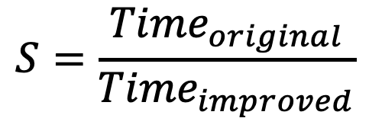
Speedup
Derive an equation that gives the maximum possible speedup due to an instruction pipeline as a function of the number of stages (k) and the number of instructions (n)
The speedup of an improvement is:
$$S=\frac{{Time}_{original}}{{Time}_{improved}}$$
Notes:
For example:
- if the time taken for the improved version is ½ the original
- then the speedup S = 2.
Hints:
- Assume each stage takes 1 time unit.
- Write an expression for the time to complete n instructions without overlapping the stages.
- I.e. doing your wash the slow way.
- That is Time Original
- Write an expression for the time to complete n instructions with overlapping (i.e. pipelining).
- I.e. doing your wash the fast way.
- That is Time Improved.
Hints:
- Figure it out Time original and Time improved for the wash example.
- Does your formula give the same result?
Now, can you simplify your formula if you assume the number of instructions is very large?

