Slide 1
WA3 –Front-End: JavaScript
COMP 256 – Dickinson College
Prof. Braught
Spring 2023

Slide 2


Typical Elements of a Web Application
http
https
Front
End
Web APIs
Back
End
Image from: https://rubygarage.org/blog/technology-stack-for-web-development
Notes:
Today JavaScript

Slide 3


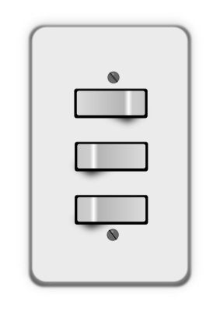

Fundamental Front-End Technologies
HTML – Hypertext Markup Language
Specifies structure and content
CSS – Cascading Style Sheets
Defines presentation and style
JavaScript
Provides action and Interactivity
Images from: openclipart.org
Notes:
Today we will discuss JavaScript
- If HTML is the blueprint for the house
- content and structure
- And CSS is the style and colors used to decorate
- Then JavaScript is the plumbing and electricity
- it is how the people interact with the house
- It provides the interactivity to a web page.

Slide 4
Dynamic Pages with JavaScript
Responding to User Events
E.g. clicking on a button
Using HTML Input Elements
text fields, check boxes, dropdowns, etc.
Modifying Attributes of HTML elements
E.g the src or width of an image
Modifying CSS class Attribute of HTML elements
E.g. adding or removing CSS classes
Modifying the DOM (Document Object Model)
Adding new HTML elements to the DOM
Removing HTML elements from the DOM
Notes:
There will be 5 main ways that we will see that JavaScript can add Dynamic content to pages.
We can run JavaScript when the user does something that causes an event:
- We will be able to run a JavaScript function when a user clicks on a button, or types something.
We can use HTML Input Elements
- JavaScript can access and use user input from HTML Input Elements.
- These include things like text fields, check boxes and dropdown menus
- This will allow use input to provide values that alter the behavior of the program.
We can use JavaScript to modify attributes of HTML elements.
- For example, we can change the value of the src attribute of an image (img) element.
- Recall that the value of the src attribute indicated what image to display.
- So, changing this value changes the image that is displayed.
We can use JavaScript to change the class attribute of HTML elements.
- By adding or removing CSS classes we can change the styling of elements dynamically.
- E.g. Change fonts, colors, sizes and even show or hide elements.
- Note that this is really a special case of the previous method were the attribute we are modifying is the class attribute.
Finally, we can use JavaScript to modify the Document Object Model (DOM)
- Remember that the DOM is the tree data structure that tells the browser how to render the page.
- If we add new elements to the DOM they will appear in the rendered page.
- If we remove elements from the DOM they will be removed from the rendered page.
The next set of slides give an example of each of these 5 ways of using JavaScript in a page.
- The source code for the examples is at the bottom of the comments sections
- It is also available in the development container you are using for the homework.

Slide 5
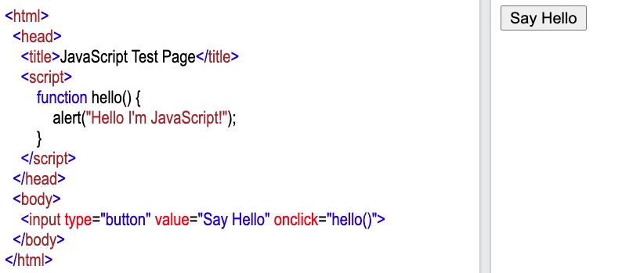
Responding to User Events
The script element can be used to include JavaScript code in a page.
JavaScript functions can be called when an event happens
(e.g. the click event)
Editor at: https://www.w3schools.com/html/tryit.asp?filename=tryhtml_basic
Notes:
The code for this example is available at the bottom of this note.
- It can be pasted into into: https://www.w3schools.com/html/tryit.asp?filename=tryhtml_basic
- It is also available in the js1.html file in the Comp256Web container at localhost:8080/www
The behavior of this page is
- When the button is clicked a dialog box appears and displays the message “Hello I’m JavaScript”
Now how does it work…
The HTML Input element is used to create all of the different types of input elements.
- The type of input element that is created is specified by the type attribute.
- Here type=“button” indicates that this input element will be rendered in the page as a button.
- The value attribute gives the text that is displayed on the button.
- Here value=“Say Hello” so that is what is rendered on the button in the page.
- The onclick attribute specifies what should happen when the user clicks on the button.
- The value of the onclick attribute is JavaScript code that is executed when the click event happens.
- Here onclick=“hello()”
- this is JavaScript saying to call a function named hello() with no parameters.
- the function call here looks just like a function call in most any other language you may have used.
Now if we are going to call the function hello() when the button is clicked we need to define that function.
- We can include JavaScript function in a page by adding a script element to the head element.
- Here we define the function named hello()
- You define a function in JavaScript by
- Using the keyword function
- Then the name of the function
- Then the list of parameters in ( )
- Then the code that makes up the function in { }
- Here the code in the body of the function calls the built in function named alert
- The alert function takes a string as an argument and displays it in a dialog box.
So, when a user clicks the button…
- The click event occurs
- The code associated with the onclick attribute is executed
- In this case, that code calls the hello() function defined in the head of the document.
Source Code for this Example:
<html>
<head>
<title>JavaScript Test Page</title>
<script>
function hello() {
alert("Hello I'm JavaScript!");
}
</script>
</head>
<body>
<input type="button" value="Say Hello" onclick="hello()"></p>
</body>
</html>

Slide 6

Responding to User Events
How could we display a second message?
Notes:
Some other things we could do:
- What if we wanted to display 2 messages?
- add another an alert statement
- The main point is that we can put any code we want in the function
- it executes top to bottom like code in any other language you have used.
- can include if / for / while / call other functions / etc…
- so you’ll be able to use a lot of what you already know about programming
- you may just have to look up the JavaScript syntax.

Slide 7
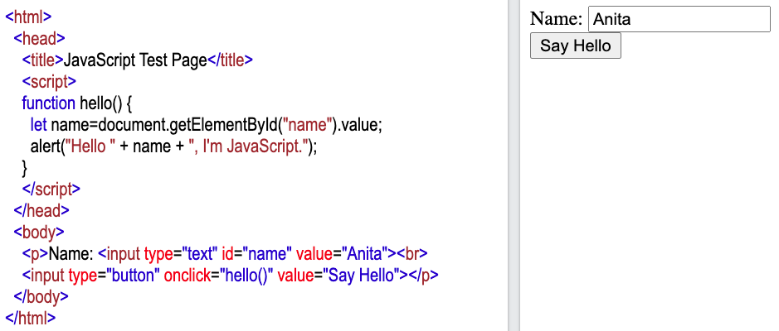
Using HTML Input Elements
JavaScript can use the DOM (document) to get objects representing the HTML elements.
Input elements provide ways for users to interact with the page (e.g. a text field)
Notes:
The code for this example is available at the bottom of this note.
It can be pasted into into: https://www.w3schools.com/html/tryit.asp?filename=tryhtml_basic
It is also available in the js2.html file in the development container.
The behavior of this page is
- When the button is clicked a dialog box appears and displays the message “Hello, Anita, I’m JavaScript”
- And if we change the name in the text field, the message changes to use whatever name is entered.
Now, how does it work…
Again, we are going to use an input element:
- this time we set type=“text”
- causes the element to be rendered as a text input field in which the user can type.
- we give this element an id, just like the id we used for CSS
- here we have id=“name”
- we’ll use this later to get the value that is in the text field.
- there is also a value attribute, which indicates the value that is in the text field.
We still have our input element for the button and it still calls the hello() function.
The hello() function has now changed so that it can get the value from the text field and use it in the dialog box.
- let defines a local variable in JavaScript
- So, let name creates a new local variable named name inside the hello() function.
- We then get the value that is in the text field and assign it to the name variable.
- document is the name for the object representing the DOM
- The document variable is available in every script.
- getElementByID is a function that can be called on the document object
- the getElementByID function gets an object representing the HTML element with the given id.
- Here we use the argument “name” to get, from the DOM, an object representing the text input element in the page with that id.
- We then access the value field in that element (.value)
- This gives us the contents of the text field (e.g. “Anita”)
- Which is then stored into the variable name.
- Then the argument to alert uses string concatenation to build a string using the name.
- “Hello” + name + “, I’m JavaScript”
- Gives the string “Hello Anita, I’m JavaScript”
- Which is then displayed in the dialog box.
Source code for the page:
<html>
<head>
<title>JavaScript Test Page</title>
<script>
function hello() {
let name=document.getElementById("name").value;
alert("Hello " + name + ", I'm JavaScript.");
}
</script>
</head>
<body>
<p>Name: <input type="text" id="name" value="Anita"><br>
<input type="button" onclick="hello()" value="Say Hello"></p>
</body>
</html>

Slide 8
Using HTML Input Elements
How could we also have the text area cleared after the message is shown?
Notes:
Other things…
- What if we wanted to set the value in the text area to a different name after the first click?
- What if we wanted a last name field too? (Homework!)
- What else?

Slide 9
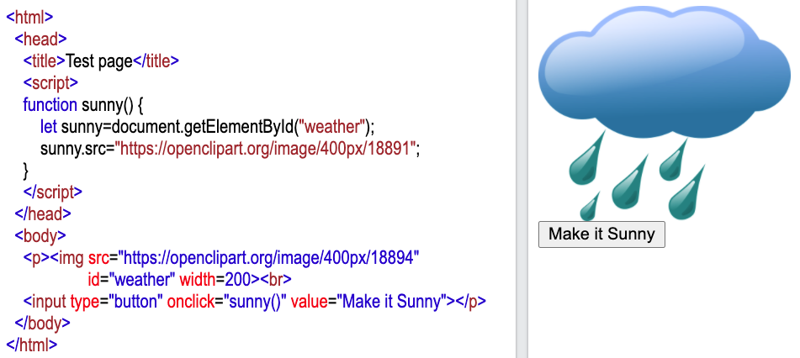
Changing HTML Element Attributes
Notes:
The code for this example is available at the bottom of this note.
It can be pasted into into: https://www.w3schools.com/html/tryit.asp?filename=tryhtml_basic
It is also available in the js3.html file in the development container.
The behavior of this page is
- When the button is clicked the image changes from cloudy and rainy to sunny.
Now, how does it work…
We have an image (img) element
- Its src is set to the URL of an image that is the cloud with rain (18894)
- This image lives on openclipart.org.
- All images have a license that makes them free to use.
- I just searched for a rain image there and copied the URL.
- This element has an id attribute
- id=“weather”
- We’ll use this later in our JavaScript to get the element.
- It also has a width element that controls how wide it is when it is rendered.
- in this case 200 pixels.
- The browser automatically scales the image to have this specified width.
We have an input element of type button (like we’ve seen before).
- It calls the function sunny() when there is a click event on the button (i.e. it is clicked).
- It also has a value attribute that sets the text that appears on the button
- “Make it Sunny”
The script element in the head contains the sunny() function.
- We get the img element from the DOM (document) by using its id (weather)
- We then set the src attribute of that element to be the URL of a different image.
- sunny.src=”https://openclipart.org/image/400px/18891”
- which changes the image to be an image of a sun.
- Again, the sunny URL is just an image hosted on Openclipart.com.
Source code for the page:
<html>
<head>
<title>Test page</title>
<script>
function sunny() {
let sunny=document.getElementById("weather");
sunny.src="https://openclipart.org/image/400px/18891";
}
</script>
</head>
<body>
<p><img src="https://openclipart.org/image/400px/18894"
id="weather" width=200><br>
<input type="button" onclick="sunny()" value="Make it Sunny"></p>
</body>
</html>

Slide 10
Changing HTML Element Attributes
How could we make the sun appear twice as big as the cloud?
Notes:
What would we do if we wanted to:
- make the sun larger when it is displayed?
- hide the ”Make it Sunny” button? (Homework)?
- what else?

Slide 11
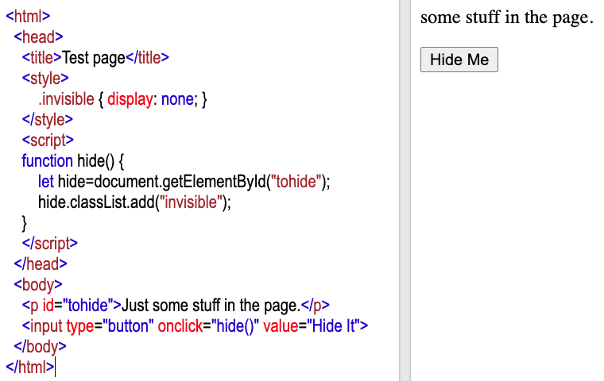

Changing the CSS class Attribute
There are also functions for:
classList.remove(…)
classList.contains(…)
Notes:
The code for this example is available at the bottom of this note.
It can be pasted into into: https://www.w3schools.com/html/tryit.asp?filename=tryhtml_basic
It is also available in a the js2.html file in the development container.
The behavior of this page is
- When the button is clicked the text is hidden.
Now, how does it work…
We have a paragraph element (p)
- It has an id attribute with the value ”tohide”
- and some text as its content that is rendered as plain text in the page
- “Just some stuff in the page”
The input element of type button calls the hide() function on a click event.
The hide function
- uses the document.getElementById to get the p element with the id “tohide”
- It then adds the class “invisible” to the to the list of CSS classes for that element
- This would be like adding class=“invisible” to the p element.
- so this causes the p element to be styled with the CSS rule .invisible
The .invisible rule is defined in the style element
- It sets the property display to have the value “none”
- This causes any element to which it is applied to not be displayed.
- i.e. the element is hidden.
There are also classList functions for:
- remove which allows us to remove a style from an element’s list of classes.
- contains which allows us to check if a style is in an element’s list of classes.
- returns true if the list contains the style
- can be used in if/else statements
Here looking at the DevTools and the page source is instructive.
- Look at the class attribute for the paragraph element when the page is loaded.
- Then click the button and look at the class attribute again.
- Can see that the “invisible” class has been added.
The source code for the page:
<html>
<head>
<title>Test page</title>
<style>
.invisible { display: none; }
</style>
<script>
function hide() {
let hide=document.getElementById("tohide");
hide.classList.add("invisible");
}
</script>
</head>
<body>
<p id="tohide">Just some stuff in the page.</p>
<input type="button" onclick="hide()" value="Hide It">
</body>
</html>

Slide 12
Changing the CSS class Attribute
How could we have the text reappear if the button is clicked again?
Notes:
What would we do if we wanted to change this code so that:
- if the button is clicked again the text will reappear?
Ideally, we would also change the names of
- The function since it doesn’t just hide the text anymore.
- The local variable because it isn’t just the element to be hidden anymore.
- The id of the paragraph element since it isn’t just to be hidden anymore.
While the code works if we don’t change those…
- and it is quicker
- it would be harder for someone else to understand later!

Slide 13
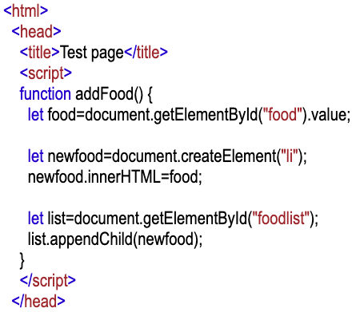
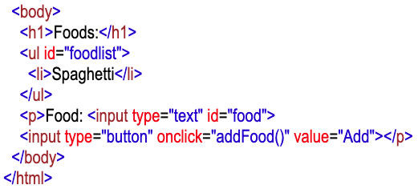
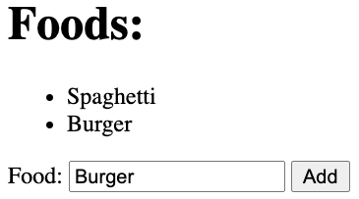
Manipulating the DOM
Notes:
The code for this example is available at the bottom of this note.
It can be pasted into into: https://www.w3schools.com/html/tryit.asp?filename=tryhtml_basic
It is also available the js5.html file in the development container.
The behavior of this page is
- When the button is clicked the food in the text area is added to the list.
How does it do that…
- Look at the DOM on the next slide…
- What do we need to do?
Now, how does this page do that?
The page contains:
- A unordered list (ul) element with an id of “foodlist”
- we’ll use the id later to get this element in our JavaScript so that we can add the new item.
- the list contains one item (“Spaghetti”) initially.
- An input element of type “text” with an id of “food”
- This is the text box where we’ll get the name of the food to add.
- The button calls the addFood() function when a click event occurs.
The addFood() function
- let food=document.getElementById(“food”).value;
- Uses getElementById to get the text input element from the DOM
- It then uses .value to get the contents of the text field
- let newfood=document.createElement(‘li”);
- We want to add a new item to the list (i.e. insert it into the DOM).
- The list must contain <li> elemements.
- So we need an <li> eem list item element (li)
- The DOM (document) allows us to create new HTML elements using createElement.
- newfood.innerHTML=food;
- The innerHTML property is the content of the element.
- So the newfood.innerHTML=food statement is placing the value of food into the li element.
- It is like adding the following element to the list:
- <li>Burger</li>
- let list=document.getElementById("foodlist");
- list.appendChild(newfood);
- It then gets the unordered list element (ul) with the id “foodlist” from the DOM.
- and appends the newfood <li> element to the it as a child.
- This means that the new <li> element is inserted into the DOM as a child of the <ul> element.
- When the new element is added to the DOM the browser will re-render the page.
- the new element “Burger” will then appear in the list.
The Source Code for the page:
<html>
<head>
<title>Test page</title>
<script>
function addFood() {
let food=document.getElementById("food").value;
let newfood=document.createElement("li");
newfood.innerHTML=food;
let list=document.getElementById("foodlist");
list.appendChild(newfood);
}
</script>
</head>
<body>
<h1>Foods:</h1>
<ul id="foodlist">
<li>Spaghetti</li>
</ul>
<p>Food: <input type="text" id="food">
<input type="button" onclick="addFood()" value="Add"></p>
</body>
</html>

Slide 14
Manipulating the DOM
html
head
body
title
script
h1
ul
p
Test Page
function addFood() {
…
}
Foods:
li
li
Food:
input
text
input
button
Spaghetti
Burger
Notes:
This slide displays the DOM for the initial page.
Then the animation shows the new li element being added.
- The new li element is added as a child of the ul element.
- The content of that li element is “Burger”
When that new element is added to the DOM the browser will re-render the page.
- The ul element will then have two li elements in it.
- one for Spaghetti and one for Burger.
- so the list then appears in the rendered page with both elements.

Slide 15
Manipulating the DOM
How can we prevent adding a blank food?
Notes:
Note it is okay to use == to compare two string values in JavaScript
- As long as you know they are both strings!
What would we do if we wanted to
- Clear the text field after we add the element?

Slide 16


Acknowledgments
Slide Template From:
https://creativecommons.org/licenses/by/4.0/
Slide Content Licensed as:
Creative Commons Attribution-NonCommercial-ShareAlike 4.0 International License.
Notes:
Note: Individual images may be covered by their own licensing agreements and were incorporated here under fair use. Their use in this slide deck does not change or alter their licensing.

