Slide 1
DA1 - Unsigned Binary Numbers
COMP 256 – Dickinson College
Prof. Braught
Spring 2023

Slide 2
Data Abstractions
How is all of the information that computers store and manipulate represented using only 0’s and 1’s?
Non-negative (unsigned) whole numbers.
Colors, Images, Videos, Characters, Sounds.
Negative whole numbers.
Decimal numbers.
Program Instructions (next topic)
…

Slide 3
Some Helpful Terminology
Binary (base 2/radix 2) is a representation of numeric values using only 0’s and 1’s.
Least
Significant
Byte (LSB)
Most
Significant
Byte (MSB)
Byte
0110 1101
0011 0011 1010 1101 1010 0000 0110 1101
Most Significant
Bit position (MSb)
Bit(s)
(LSb)
Notes:
With all the 1’s and 0’s running around it will be helpful to have some terminology to help us identify which parts we are talking about.
Binary – 2
Decimal – 10
Byte is an ordered collection of 8 adjacent 1’s and 0’s.
The individual 1’s and 0’s are called bits.
In a longer string of bits, bytes will usually begin at an offset from the right that is a multiple of 8.
- will also often write with with a space every 3 bits
- just to make it easier to read.
Least significant Byte – think about least significant digit in base 10 –right most digit
Most significant Byte – think about most significant digit in base 10.
Can similarly talk about the most or least significant bit – better to call it most significant bit position
- right most or left most bit in whatever we are looking at (byte or longer string)
- written with leading zeros – so MSb is whichever value is in the leftmost spot
- Contrast with MS digit – where in base 10 we don’t typically write leading 0’s

Slide 4
Some Helpful Terminology
Binary (base 2/radix 2) is a representation of numeric values using only 0’s and 1’s.
Half Word
Nibble
1011 0011 1010 1101 1010 0000 0110 1101
Word
Double Word: 64 bits
Notes:
Word – 32 bits conventionally in modern programing languages
A little complicated in common use
- When we say 32 or 64 bit computer
- means that computer can operates on 32 or 64 bits at a time.
- Frequently you will hear that the computer has a 32 or 64 bit word size.
For our purposes, when I say word, I’ll be referring to 32 bits.
If I want to talk about 64 bits, I’ll say “Double Word”
- if you ever wondered where the Java datatype double comes from… this is it.
- double values use 64 bits (more later)

Slide 5
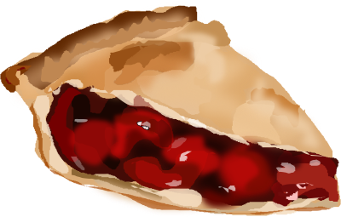
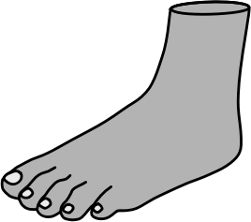
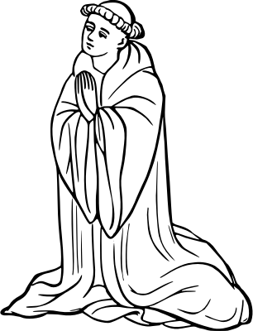


It’s All Just 1’s and 0’s
What does the byte 1001 0100 mean?
Kind of like asking what does “pie” mean?
Images from: openclipart.org
Notes:
Pie:
Yummy desert (English)
Bird (French)
Foot (Spanish)
Devout (Italian)
May be others as well... If you know of one in other languages let me know!!
The point is:
- Until we know how to interpret the 1’s and 0’s we can’t know their meaning.
- In the same way we don’t know the meaning of the letters p i e until we are told how to interpret them.

Slide 6
It’s All Just 1’s and 0’s
So then what does the byte 1001 0100 mean?
Some possible interpretations:
148 94 20 107
9.25 4.5x2⁻³
‘m’
A medium dark grey
An instruction the computer to perform an addition
Notes:
Like the interpreting the word “pie” depended upon the language
Interpreting the bits will depend upon knowing the representation that is being used.

Slide 7
It’s All Just 1’s and 0’s
So then what does the byte 1001 0100 mean?
Depends on the representation we use to interpret it!
Non-Negative Integers
Unsigned Binary
Binary Coded Decimal
Signed Integers
Sign Magnitude
Two’s Complement
Decimal Numbers
Fixed Point
Floating Point
Text Data
EBCDIC
ASCII
Unicode
Colors
RGB
CMYK
HSV
Instructions
Processor dependent
Notes:
In the language analogy, the representation is a language or a dialect.
- interpreting a byte as unsigned binary will give us one value
- interpreting it as fixed point gives us another
- and as RGB color something different again
These are some of the representations or interpretations we’ll be learning about in this topic.
Today… non-negative integers. 0,1,2 …

Slide 8






Making Change
Using 0, 1 or 2 of each coin make a total of 54 cents.
1
2
1
0
2
How much money does the given “number” represent?
Image from: openclipart.org
Notes:
Quick warmup to get you thinking in a particular way.

Slide 9
Making Change
54 Cents = 2*20 + 1*10 + 0*5 + 2*2 + 0*1
2
1
0
2
0
Using 0, 1 or 2 of each coin make a total of 54 cents.
47 Cents = 1*20 + 2*10 + 1*5 + 0*2 + 2*1
1
2
1
0
2
How much money does the given “number” represent?
Image from: openclipart.org
Notes:
The idea is that we can create a number by placing digits in each place.
Here we use 0,1,2 and place them in the 20’s, 10’s, 5’s, 2’s and 1’s columns.
As long as we know the value of each place
We can make up a number.
Note: With these particular values there are multiple numbers that will represent the same value.
In general, our number systems will avoid that.

Slide 10
Representing Numbers
19,204 using 0…9
100,000
10,000
1,000
100
10
1
88 using only 0…5
125
25
5
1
21 using only 0 or 1
32
16
8
4
2
1
Fill in the blanks to represent the indicated values.
46 using only 0 or 1
32
16
8
4
2
1
Notes:
Puzzle these out with a neighbor.
Use the same kind of thinking that you did for the money.
Note: Unlike the money example, there is only one way to represent each of these values.

Slide 11
Representing Numbers
19,204 using 0…9
0
1
9
2
0
4
100,000
10,000
1,000
100
10
1
88 using only 0…5
0
3
2
3
125
25
5
1
21 using only 0 or 1
0
1
0
1
0
1
32
16
8
4
2
1
Fill in the blanks to represent the indicated values.
46 using only 0 or 1
1
0
1
1
1
0
32
16
8
4
2
1
Notes:
Solution to the prior slide.

Slide 12
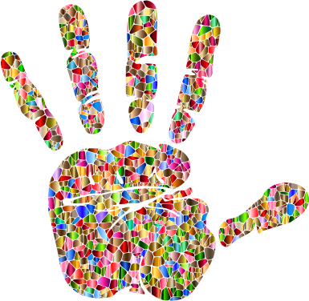
Unsigned (non-negative) Numbers
For base 10 (decimal) numbers:
501₁₀ = 5*100 + 0*10 + 1*1
= 5*10² + 0*10¹ + 1*10⁰
Hundreds
Tens
Ones
501₁₀
Base 10
Images from: openclipart.org
Notes:
So what’s going on…
Let’s think about the base 10 (decimal) numbers that we use all the time.
501 base 10
- I will use subscripts to indicate the base of the number when it is not clear from the context.
5 * 100 …
5 hundreds, 0 tens, 1 one
or as powers of 10
- which is why we call it base 10.

Slide 13

Unsigned (non-negative) Numbers
For base 2 (binary) numbers:
110₂ = 1*2² + 1*2¹ + 0*2⁰
= 1*4 + 1*2 + 0*1
= 6₁₀
Base 2
110₂
Fours
Twos
Ones
Image from: openclipart.org
Notes:
For base 2
- we just change the base …
- we get 1’s, 2’s, 4’s columns
Note: Here the subscript 2 helps…
- is it one hundred ten?
- or 110 binary?

Slide 14
Unsigned Binary to Decimal
1011₂
Find the base 10 value of each unsigned binary number.
1001 0101₂
Notes:
Let them work these out
Showing the work as on the previous slide.
Then if there is a need do one as another example.
To deal with the additional bits.
2^4 = 16
2^5 = 32
2^6 = 64
2^7 = 128

Slide 15
Unsigned Binary to Decimal
1011₂
= 1*2³+0*2²+1*2¹+1*2⁰
= 1*8 +0*4 +1*2 +1*1
Find the base 10 value of each unsigned binary number.
= 8 + 2 + 1
= 11₁₀
1001 0101₂
= 1*2⁷ +1*2⁴ +1*2²+1*2⁰
= 1*128+1*16 +1*4 +1*1
= 128+ 16 + 4 + 1
= 149₁₀
Notes:
Solution to the prior sl9ide.

Slide 16
Decimal to Unsigned Binary
Convert 13₁₀ to 4-bit unsigned binary.
13₁₀
= _*2³ + _*2² + _*2¹ + _*2⁰
Notes:
Walk through this one.
You did conversions this way earlier intuitively.
Here is a process you can use.
- Write out the powers of two
- Expand them to base 10 values if you like
- or just start here if you know them.
- Fill in blanks from left to right with either:
- 0 if the value to be represented is < the value of the place
- 1 if the value to be represented it >= the value of the place
- subtract the value of the place from the number to be represented.
- Continue until you reach 0.
When doing decimal to binary, you will be told how many bits are to be used
- The number will be written with that many bits – using leading zeros if necessary.
- For example, if you were asked to represent 13 in 8 bits:
0000 1101

Slide 17
Decimal to Unsigned Binary
Convert 13₁₀ tp 4-bit unsigned binary.
13₁₀
= _*2³ + _*2² + _*2¹ + _*2⁰
= _*8 + _*4 + _*2 + _*1
13
- 8
5
= 1*8 + _*4 + _*2 + _*1
= 1*8 + 1*4 + _*2 + _*1
- 4
1
= 1*8 + 1*4 + 0*2 + _*1
- 1
0
= 1*8 + 1*4 + 0*2 + 1*1
= 1101₂
Notes:
Animated step by step version of the problem on the prior slide.

Slide 18
Decimal to Unsigned Binary
Convert the decimal value 77 to unsigned binary using 8 bits.
77₁₀
Notes:
Let them work this one out.

Slide 19
Decimal to Unsigned Binary
Convert the decimal value 77 to unsigned binary using 8 bits.
77₁₀
= _*2⁷ + _*2⁶ + _*2⁵ + _*2⁴ + _*2³ + _*2² + _*2¹ + _*2⁰
= _*128 + _*64 + _*32 + _*16 + _*8 + _*4 + _*2 + _*1
= 0*128 + 1*64 + _*32 + _*16 + _*8 + _*4 + _*2 + _*1
= 0*128 + 1*64 + 0*32 + 0*16 + 1*8 + _*4 + _*2 + _*1
= 0*128 + 1*64 + 0*32 + 0*16 + 1*8 + 1*4 + 0*2 + 1*1
= 0100 1101₂
77
-64
13
- 8
5
- 4
1
- 1
0
Notes:
Solution to the prior slide.

Slide 20
Binary Addition
Addition can be performed directly in binary.
0100
+ 0101 +
0011
+ 1010 +
0111
+ 0011 +
Notes:
Do the first one…
- ask them to do the other two…
When practicing and learning:
Convert values to base 10
Do the addition in binary
Convert result to base 10
Then check against base 10 addition.

Slide 21
Binary Addition
Addition can be performed directly in binary.
1
1
1
1
1
0100 4
+ 0101 + 5
0011 3
+ 1010 +10
0111 7
+ 0011 + 3
1001
9
1101
13
1010
10
Notes:
Solutions to the prior slide.

Slide 22

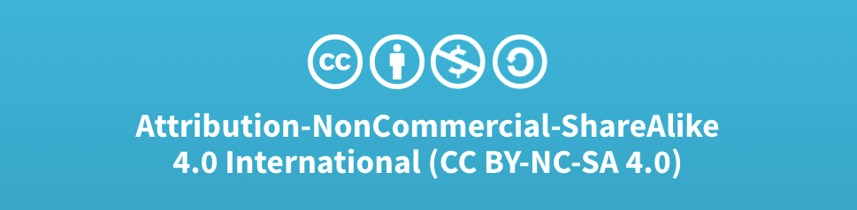
Acknowledgments
Slide Template From:
https://creativecommons.org/licenses/by/4.0/
Slide Content Licensed as:
Creative Commons Attribution-NonCommercial-ShareAlike 4.0 International License.
Notes:
Note: Individual images may be covered by their own licensing agreements and were incorporated here under fair use. Their use in this slide deck does not change or alter their licensing.

Slide 23
Example: Unsigned Binary to Decimal
What is the decimal value of the unsigned binary number: 1011₂
1011₂ = 1*2³ + 0*2² + 1*2¹ + 1*2⁰
= 1*8 + 0*4 + 1*2 + 1*1
= 8 + 0 + 2 + 1
= 11₁₀
Notes:
Have them work this one out!
If more bits, just keep increasing the power of 2.
Good example of why we need the subscripts.
Use them in your work to avoid any ambiguity.

Slide 24
Binary Addition
Addition can be performed directly in binary.
1
1
1
1
1100 12
+ 0001 + 1
0011 3
+ 1010 +10
0111 7
+ 0011 + 3
1
1
0
1
13
1
1
0
1
13
1
0
1
0
10
Notes:
Cover the values in the first one.
4 + 8 = 12
1
1 + 4 + 8 = 13.
When practicing and learning:
Convert values to base 10
Do the addition in binary
Convert result to base 10
Then check against base 10 addition.

