Slide 1
HA2 – Transistors to Logic Gates
COMP 256 – Dickinson College
Prof. Braught
Spring 2023
Notes:
Before we start…
- Questions on Syllabus?
- Grading clear enough for now?
- We’ll discuss more as things come in and get returned.
- Open to questions at any time.
- Ask in
- Discussion channel on Team
- At the start of any class
- During office hours.

Slide 2

The Hardware Abstraction Hierarchy
The Hardware abstraction hierarchy bridges the gap from electrical signals to programmable machines that perform useful computation.
Electrical signals
0’s and 1’s
Transistors
Logic gates
Circuits
Programmable machines
Photo by: Steven Gerner, https://www.flickr.com/photos/
sgerner/16477700444/in/photostream/
Image from: https://www.aroundkent.net/
computational-thinking-a-world-of-1s-and-0s
Notes:
Today we begin looking at the abstraction hierarchy for the computer hardware
- Essentially from what transistors are through a simple machine that can be programmed.
We will look at:
- Electrical Signals: Voltages and currents
- 0’s and 1’s: Define conventions for interpreting the electrical signals as abstract 0’s and 1’s
- Transistors: Use those 0’s and 1’s as abstractions to control transistors
- Logic Gates: Combine transistors into circuits and treat them as logic gates
- Circuits: Combine logic gates into more complex circuits that perform specific functions.
- Combine those into machines that do useful computation
At each level, we are able to
- hide and forget about the details of the lower levels (mostly).
- pay attention to the details that matter to us at that level.

Slide 3
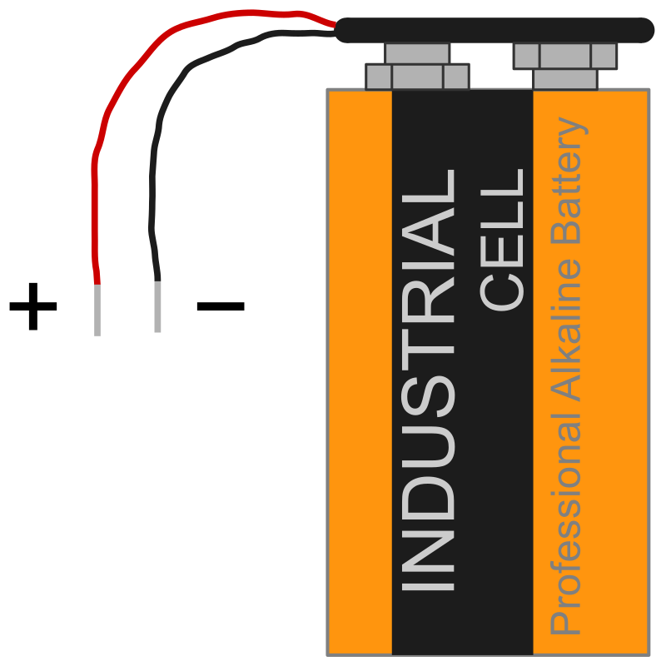
Voltages and 0’s and 1’s … oh my! *
Voltages are the physical representation of the 0’s and 1’s that we think of being manipulated by computers.
Low voltages close to 0V (Volts), also called ground, represent 0.
Positive voltages, close to some maximum (e.g. 1.8V, 3.3V or 5V), represent 1.
Different applications use different voltage levels to represent 1 depending upon noise and power consumption constraints.
1
0
Image from: https://openclipart.org/
* Cultural Reference: The Wizard of Oz.
Notes:
One way to think of this is as a battery:
- if a voltage is the same as the + side of the battery then it will be a 1
- if a voltage is the same as the – side of the battery then it will be a 0.
Need to be able to reliably differentiate between ground (0V)
And a voltage above which we designate to be (1)
- The specific value above which we designate to be 1 depends on a variety of factors that are beyond the scope of this course.
- This is one of the details we will ignore in our abstractions
- But include thing like power consumption and electrical noise.
- The lower the voltage the longer your device battery lasts.
- For electrical noise (think radio static or phone call breakup).

Slide 4
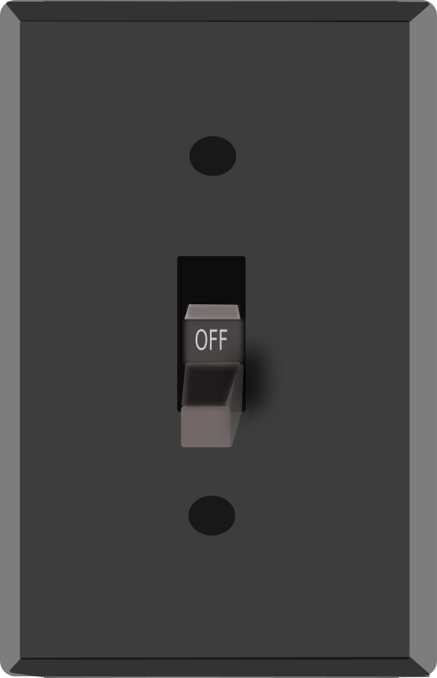
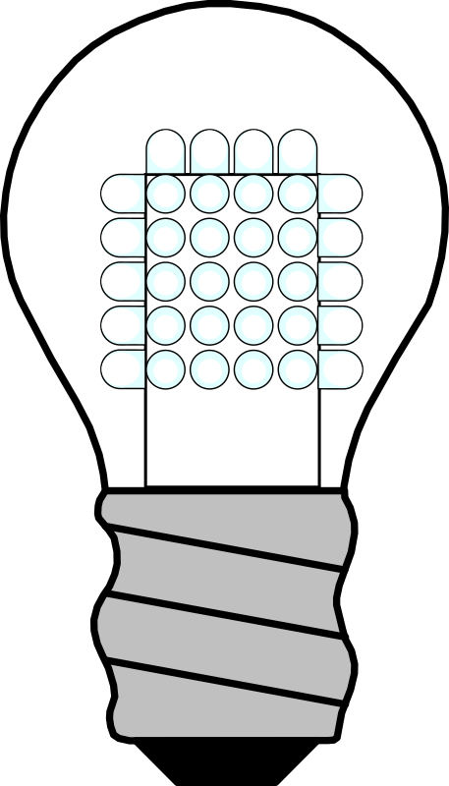
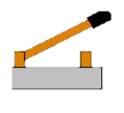
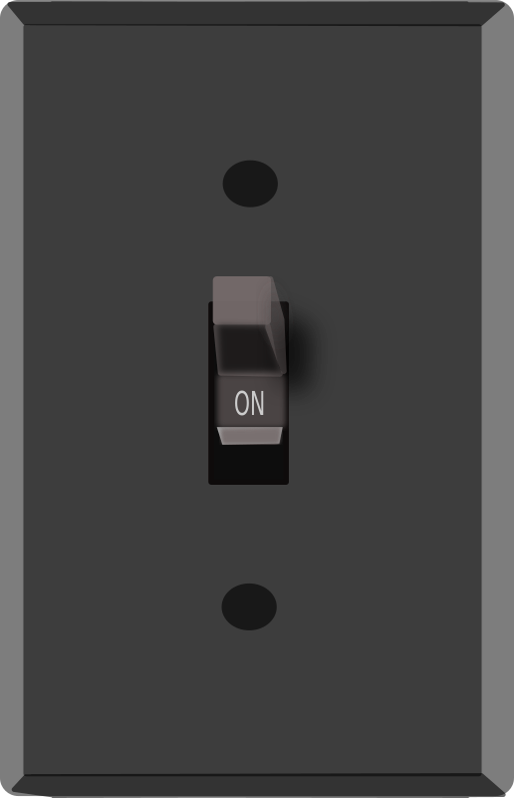
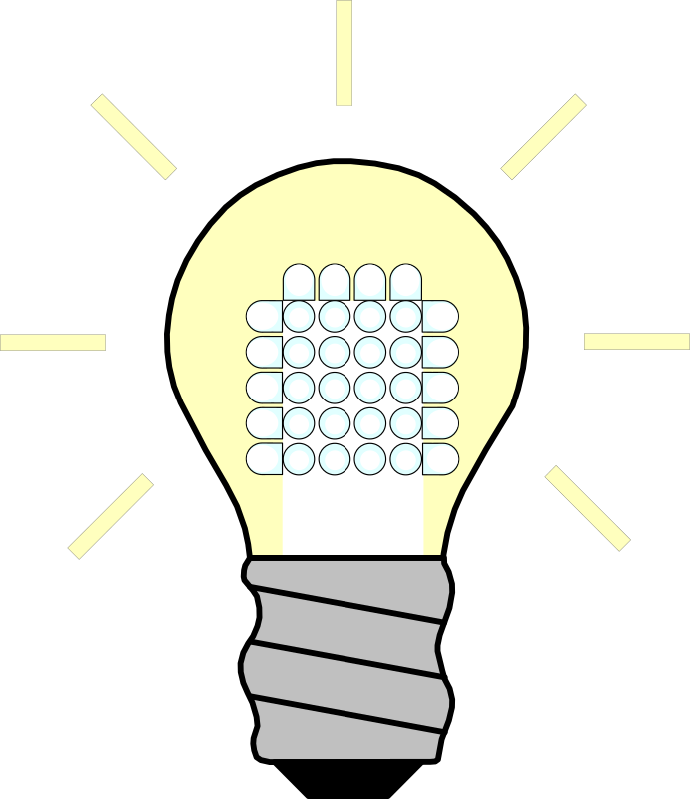
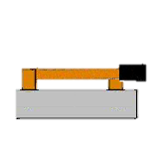
A Metaphor: Voltage-Controlled Switch
Control
Value
0
Switch open
electricity
cannot flow.
OFF
Open
1
ON
Switch closed electricity
can flow.
Closed
Images from: http://www.learningaboutelectronics.com/Articles/Door-alarm-circuit.php
Images from:
https://openclipart.org/
Images from:
https://openclipart.org/
Notes:
All computation in modern computers is based on voltage-controlled switches.
- We will see a number of different technologies that have been used to build voltage-controlled switches
- These roughly correspond to a chronological history of how computers have been constructed.
Regardless of the technology used to build them, this metaphor explains how they behave.
We’ll imagine that instead of flipping the switch like we are used to
- We will use a control value to do this.
- The control value will be either a 0 or a 1
- This value will control whether the switch is off (open) or on (closed).
When the control value is 0 (ground)
- the switch is off or open
- no electricity (current) flows
- an attached light will be off.
When the control value is 1 (a positive voltage)
- the switch is on or closed
- electricity (current) flows
- an attached light will be on.
When current flows or doesn’t flow,
- it can go on to create voltages (1’s an 0’s) that will open or close other switches.
- This cascading is ultimately what does the computation in the computer.
****** Note can also have switches that behave the other way around.
Closed when there is a 0, open when there is a 1.
We’ll see those soon.

Slide 5
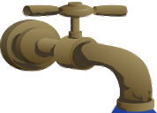
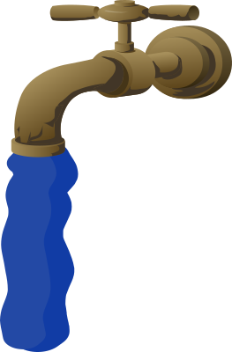
Another Metaphor: Voltage-Controlled Faucet
Control
Value
0
Switch open
electricity
cannot flow.
Faucet off
water
cannot flow.
OFF
Open
1
ON
Switch closed electricity
can flow.
Faucet on water
can flow.
Closed
Images from: http://www.learningaboutelectronics.com/Articles/Door-alarm-circuit.php
Images from:
https://openclipart.org/
Images from:
https://openclipart.org/
Notes:
Another way to think about it would be as a voltage controlled faucet.
The control value (0 or 1) controls whether the water can flow or not.
- I.e. the water is analogous to the electricity.
When the control value is 0
- the faucet is off and the water cannot flow.
- Just like the switch being open and the electricity not flowing.
When the control value is 1
- the faucet is on and the water can flow.
- Just like the switch being closed and the electricity flowing.

Slide 6
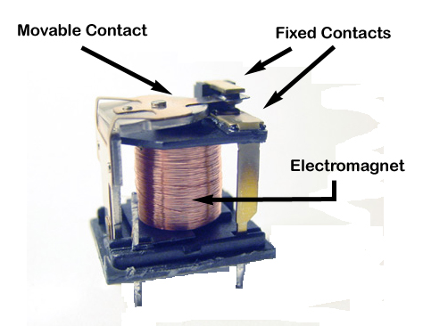
The First Switches
The first digital computers were built using Electromagnetic Relays.
Electrically controlled switches.
Spring
Images from: https://www.gomog.com/BLAIR/
tech/electrical/relay/troubleshoot_relay.html
Notes:
Think of the electromagnet as a nail with wire wrapped around it in science class years ago!
Tue spring holds the movable contact up
- in this position the switch is open (off)
When electromagnet turns on, it pulls the movable contact down
- in this position the switch is closed (on)
This is fast but the mechanical movement does place limits on how fast.
There is also an issue of mechanical wear and tear
- These would need to turn on and off millions and millions of times.
- Things like contacts, hinges and springs eventually break
Also very noisy!!
- Image thousands of these clacking open and closed hundreds of times per second!

Slide 7
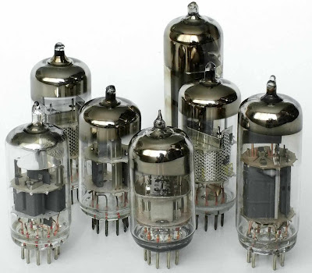
Faster Switches
Relays were later replaced with Vacuum Tubes.
Electrically controlled switches
No moving parts
Faster and cheaper and more reliable!
Image from: http://www.quantumday.com/2012/07/
nanotechnology-and-vacuum-tube.html
Notes:
Vacuum tubes contain no moving parts
- so there can’t be an actual switch.
- but they behave just like one.
- Strange…
- How they work is beyond the scope of this course.
But idea is the same and as an abstraction we can think of them as a switch…
- Applying a control value of 1 makes it behave like a closed switch letting electricity flow.
- Applying a control value of 0 makes it behave like an open switch stopping electricity from flowing.
These not only look like lightbulbs:
- They can burn out like lightbulbs
- They generate heat like (incandescent) lightbulbs
- These issues created reliability issues

Slide 8
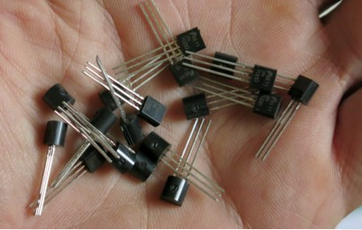
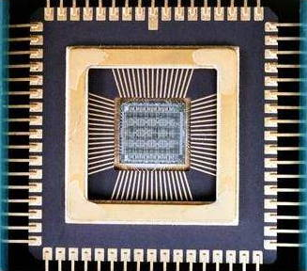
Transistors – Super Fast Switches
Modern computers are built using Transistors
Electrically controlled switches.
Solid state
Revolutionary - Way smaller, way faster, way cheaper, way more reliable!
Image from: https://www.explainthatstuff.com/
integratedcircuits.html
Image from: http://www.megaprocessor.com/
Notes:
Transistors are Solid State
- They are solid material, no moving parts, typically nothing to burn out.
- But still behave as a switch.
- They can reliably turn on and off millions of times a second for decades!!
But again as an abstraction:
- a control value of 1 lets current flow – acts like closed switch
- a control value of 0 does not let current flow – acts like open switch
Left: Discrete or individual transistors
Right: Integrated circuit
- containing lots of transistors in a single package.
- organized as an abstraction…
- inputs go in, results of computations come out.
- e.g. input 0’s and 1’s representing numbers… out come 0’s and 1’s representing their sum

Slide 9
CMOS Transistors
Metal Oxide Semiconductor (MOS)
Made using silicon dioxide or other materials with similar properties.
Most common transistor technology in modern computer designs.
CMOS: Complementary MOS Transistors
Two types that behave in complementary ways:
NMOS transistors
PMOS transistors
N or P are types of impurities that are added to the silicon dioxide when a transistor is made in order to change its behavior.
Notes:
The two types behave in “complementary ways”
- we’ll see what that means in a moment.
- for now know there are two types.

Slide 10
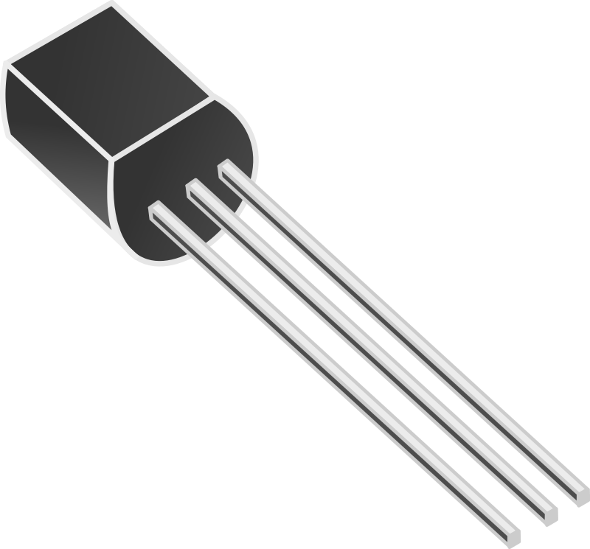
N-Type or NMOS Transistors
NMOS Transistor
3 connections
(D)rain
(G)ate
(S)ource
Gate value controls the switch.
G = 0 - Switch is open
G = 1 – Switch is closed
DGS
Image from: https://openclipart.org/
D
D
N
N
0
G
1
G
Control
Value
S
S
Notes:
Remember there are no moving parts.
- So it is not an actual switch…
- but that is a useful way to think about them as an abstraction.
N-Type are indicated by
- the little (N)
- with the Drain on top
- with the Source on the bottom.
The Gate is the control value.
When the gate is 0:
- The transistor behaves like (abstraction!) an open switch
- The source is not connected to the drain.
- This means that electricity cannot flow through the transistor.
When the gate is 1:
- The transistor behaves like (abstraction!) a closed switch
- The source is connected to the drain.
- This means that electricity will be able to flow through the transistor.
INSTRUCTOR NOTE: DGS ordering of terminals is based on TINKERCAD.
This may need to be updated to match physical component when back in actual lab.

Slide 11
An NMOS Transistor in Our Metaphor
Control
Value
0
D
N
0
G
S
OFF
Open
Gate
(Control
Value)
1
ON
D
N
1
G
S
Closed
Notes:
So an NMOS transistor behaves just like the electrically controlled switch from our metaphor.
When the gate (i.e. the control value) is 0:
- The transistor behaves like (abstraction!) an open switch
- The source is not connected to the drain.
- This means that electricity cannot flow through the transistor.
When the gate (i.e. the control value) is 1:
- The transistor behaves like (abstraction!) a closed switch
- The source is connected to the drain.
- This means that electricity will be able to flow through the transistor.

Slide 12
P-Type or PMOS Transistors
PMOS Transistor
3 connections
(S)ource
(G)ate
(D)rain
Gate value controls the switch.
G = 0 - Switch is closed
G = 1 – Switch is open
SGD
S
S
P
P
0
G
1
G
D
D
Notes:
PMOS is the complement of NMOS
They look exactly the same
They have the same 3 contacts … sometimes reversed… but…
They behave in the opposite (complementary) way.
P-Type are indicated by
- the little (P)
- with the Drain on bottom
- with the Source on the top.
When the gate is 0:
- The transistor behaves like (abstraction!) a closed switch
- The source is connected to the drain.
- This means that electricity will be able to flow through the transistor.
- Notice that this is the exact opposite of an NMOS (i.e. it is the complement of the NMOS).
When the gate is 1:
- The transistor behaves like (abstraction!) an open switch
- The source is not connected to the drain.
- This means that electricity cannot flow through the transistor.
- Again, this is the exact opposite (the complement) of an NMOS.
INSTRUCTOR NOTE: SGD is based on TINKERCAD
It may need to be updated to match physical component when back in the lab.

Slide 13

Quick Check
Use our abstraction of NMOS and PMOS transistors to indicate which switches would be open an which would be closed.
S
D
D
S
0
P
1
N
0
N
1
P
G
G
G
G
D
S
S
D
Notes:
Think and then compare with your neighbors.
Come to consensus.
Any disagreements?

Slide 14
A CMOS Circuit
CMOS Circuits are created by connecting multiple transistors together.
0’s (ground, -) and 1’s (power, +) are connected.
Connections at intersections will be indicated by a thick dot.
1
S
P
G
Input
D
Output
D
N
G
S
0
Notes:
Thick dots represent connections between wired.
- Here the same input value is used as the control value to two transistors.
- It is hooked to the Gate of both the N and P transistor.
- If it is a 1 then a 1 is presented at the Gate of both.
Sometimes wires will cross without having a thick dot
- That indicates that they cross, but that there is no connection at that point.
- This doesn’t happen in this figure, but it will in others.

Slide 15
A CMOS Circuit
CMOS Circuits are created by connecting multiple transistors together.
0’s (ground, -) and 1’s (power, +) are connected.
A 0 or 1 is applied at the input.
The 0’s or 1’s flow from sources to drains setting the output.
1
1
S
S
P
P
G
G
D
Input
D
1
Input
0
Output
D
Output
D
N
N
G
G
S
S
0
0
Notes:
The 0’s and 1’s flow
- Like electrical current.
- Or like water.

Slide 16
A CMOS Circuit
What will the output of this CMOS circuit be if the input is 1? Why?
CMOS Circuits are created by connecting multiple transistors together.
0’s (ground, -) and 1’s (power, +) are connected.
A 0 or 1 is applied at the input.
The 0’s or 1’s flow from sources to drains setting the output.
1
S
P
G
Input
D
Output
1
D
N
G
S
0
Notes:
The other possibility for the input is a 1.
Think it through.
Compare with a neighbor.
Come to consensus.
Discuss and draw it out.

Slide 17
CMOS Circuit Rule
The 0’s or 1’s flow from sources to drains setting the output.
In a correct circuit there will:
always be at least one path from a 1 or a 0 to the output.
never be a path from both a 1 and a 0 to the output.
Notes:
if you are interested in learning more about transistors
- Take Physics 213 – Electronics

Slide 18
🤔
Thinking about a bunch of transistors and their “switches” and whether they are open or closed can be difficult.
If only there were some way to just think about what the circuit computes and forget about the specific configuration and operation of the transistors.
Notes:
You’ll see that in the homework.

Slide 19
Challenge:
What are all of the possible combinations of 0’s and 1’s that can be used as inputs A and B to this CMOS circuit?
What output (Z) is produced for each of those possible input combinations?
Notes:
Notice, that the wire from b to the gate of the right hand NMOS transistor crosses another wire without a connection (no thick dot).
Work out the combinations first.
Then try to figure out what Z is for each of them.

Slide 20
What’s Next?
HW 02 – Due Friday 9:30am
Submit to Moodle
Lab 01 – Tomorrow 3:00
Tome 231

Slide 21

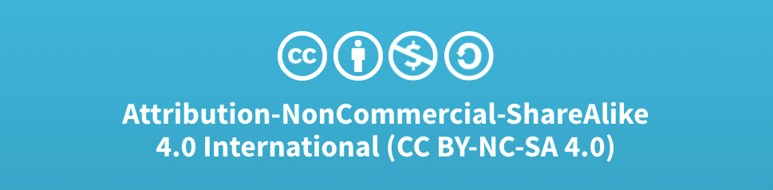
Acknowledgments
Slide Template From:
https://creativecommons.org/licenses/by/4.0/
Slide Content Licensed as:
Creative Commons Attribution-NonCommercial-ShareAlike 4.0 International License.
Notes:
Note: Individual images may be covered by their own licensing agreements and were incorporated here under fair use. Their use in this slide deck does not change or alter their licensing.

Slide 22
A Metaphor: Voltage-Controlled Switches
0
OFF
Open
1
ON
Closed
Images from: http://www.learningaboutelectronics.com/Articles/Door-alarm-circuit.php
Images from:
https://openclipart.org/
Images from:
https://openclipart.org/
Notes:
All computation in modern computers is based on voltage-controlled switches.
- We will see a number of different technologies that have been used to build voltage-controlled switches
- These roughly correspond to a chronological history of how computers have been constructed.
Regardless of the technology used to build them, this metaphor explains how they behave.
0 being ground – turns switch off or open – no current flows – an attached light will be off.
1 being positive voltage – turns switch on or closed – current flows – an attached light will be on.
When current flows or doesn’t flow,
- it can go on to create voltages that will open or close other switches.
- This cascading is ultimately what does the computation in the computer.
****** Note can also have switches that behave the other way around.
Closed when there is a 0, open when there is a 1.
We’ll see those soon.

Slide 23
S
S
S
P
P
P
G
0
G
1
G
D
D
D
D
D
D
N
N
N
G
0
G
1
G
S
S
S

Slide 24
1
1
S
S
P
P
G
G
D
D
Z
D
N
A
G
S
D
N
B
G
S
0
Notes:
NAND

Slide 25
1
S
P
A
G
D
S
P
B
G
D
Z
D
D
N
N
G
G
S
S
0
0
Notes:
NOR

Slide 26
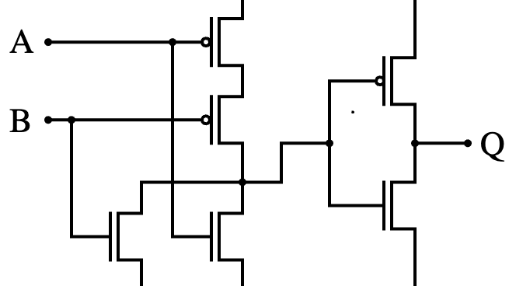
By inductiveload - Own work using: Inkscape 0.43, Public Domain, https://commons.wikimedia.org/w/index.php?curid=943028
1
1
0
0
0

Slide 27
A CMOS Circuit
Circuits are created by connecting multiple transistors together.
0’s (ground, -) and 1’s (power, +) are connected.
A 0 or 1 is applied at the input.
The 0’s or 1’s flow from sources to drains setting the output.
1
1
S
S
P
P
G
G
D
D
Output
Input
0
Input
1
D
Output
D
N
G
N
G
S
S
0
0
Notes:
In this case the switches are reversed
- P open
- N closed

Slide 28
CMOS Circuit Rules
PMOS Source is always closer to 1 than to 0.
i.e. power or + battery terminal
NMOS Source is always closer to 0 than to 1.
i.e to ground or – battery terminal
The path through the transistors (switches) to either 0 or 1 determines the output.
In a correct circuit there will:
always be at least one path to 1 or to 0.
never be a path to both 1 and 0.
Notes:
Rules of thumb when designing circuits using CMOS.
These are required for our abstraction of transistors as switches works…
If the transistors just like switches then these rules (at least the first two) wouldn’t matter.
But if we don’t use them in this way, then the details we are ignoring will cause the abstraction to fail.
So sort of like the while loop program you saw…
- when we use an abstraction outside of its intended scope it fails.
- we then need to know the details to understand why it does what it does.
We will understand that program… but not the transistor…
- Physics 213 if you are interested.

