Slide 2
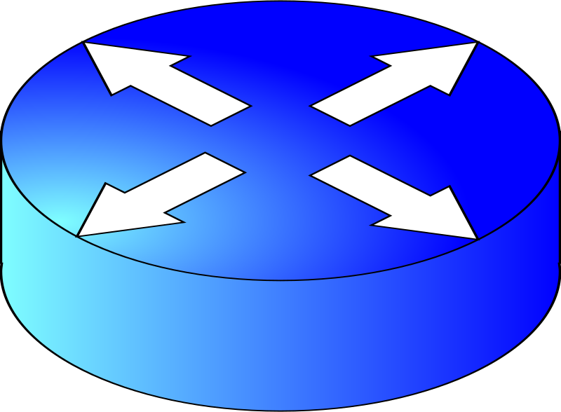
RIP: Routing Information Protocol
4 hops
R1
R2
R3
V
X
Q
P
Y
R4
R5
2 hops
Notes:
Maybe a new link between networks is created.
What updates would occur?
In what order?

Slide 3


Decentralized Routing Activity
B.2
A.2
A.1
B.1
B.3
A.7
R1
R2
A
A.9
V.2
V.4
B.6
B
V
Z.1
X.2
Z
X
Z.9
D
D.4
X.7
C.2
Y
C
D.1
Y.4
Y.6
C.9
R4
R3
D.2
D.3
C.3
C.7
Notes:
Network Topology
- Assign four students near center of the room to be the routers.
- Give them a routing table and their assigned Addresses
- They are connected via subnets V, X, Y, Z as shown.
- As well as to their local networks A, B, C, D as shown.
- Note: Drawn this way just to keep the lines from crossing and getting messy.
- But these could be stretched and distorted and twisted however.
- Routers hand out LAN address addresses to 2 or 3 students around them (just not the other routers)
- E.g. A.1, A.2, A.7.

Slide 4
Decentralized Routing Activity
Routing Table R1
Routing Table R2
Routing Table R3
Routing Table R4
Dest Net | IFace | Next Hop
A | W | -
B | E | V.4
C | S | Z.9
D | E | V.4
Dest Net | IFace | Next Hop
A | W | V.2
B | E | -
C | SW | X.7
D | SW | X.7
Dest Net | IFace | Next Hop
A | W | Y.4
B | W | Y.4
C | E | -
D | W | Y.4
Dest Net | IFace | Next Hop
A | N | Z.1
B | NW | X.2
C | E | Y.6
D | W | -
Notes:
A -> D goes long way
A -> C Goes direct

