Slide 1
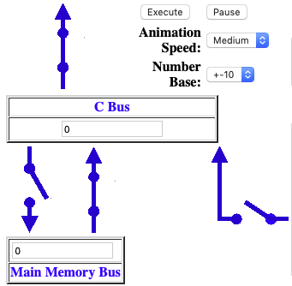
Start
Here
Go
Counter
Clockwise

Slide 2
