Slide 1
MA4 – Memory Hierarchy & Processor Cache
COMP 256 – Dickinson College
Prof. Braught
Spring 2023

Slide 2
The Stored Program Architecture
Program/Data must be in the Main Memory (RAM) to be executed/processed.
Instruction Cycle
Fetch
Decode
Execute
Notes:
Recall the stored program architecture.
- This is our baseline
- everything we discuss will be based on this architecture.
With the Stored Program Architecture:
- The program and its tata MUST be in main memory.
Typically it is stored long term on disk
- so it needs to be loaded into memory to be used.
- When you double click an icon
- you are asking your OS to move the program into main memory.
- When you choose ”File open”
- you are asking the program to bring data into main memory to be processed.
Back in the day…
- programs and data were loaded from punch cards or paper tape
- as you saw in some of the videos you’ve watched
Once a program is in memory it is executed
- Fetch / Decode / Execute
- over and over and over again
- one instruction after the other
- with branching.
That is the foundation for everything.
- Today and next class we’ll look at a few ways to improve or expand upon that.

Slide 3
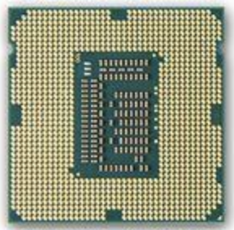
Performance Improvements
Better Technology
Moore’s Law
Better Design
12 - Memory Hierarchy & Processor Cache
13 - Processor Architectures (Parallelism & Pipelining)
Better Software
COMP 232 / COMP 332
Image from: https://en.wikipedia.org/wiki/
Manchester_Mark_1
https://commons.wikimedia.org/
wiki/File:Intel_C4004.jpg
https://wccftech.com/intels-3rd-generation-ivy-
bridge-core-i5-processor-pitted/
Notes:
The stored program architecture is still the way machines work.
How do we improve their performance to get from the EDSAC/EDVAC/Mark1/etc to today?
Three primary paths…
Better Technology:
- Moore’s Law – better / faster / smaller transistors
- More transistors enabled more complex designs that enhance performance.
Better Designs:
- Memory and Caching - today
- Better processor design – next class.
Better Software:
- other classes

Slide 4



Use the system information utility on your computer to find the following specifications including units:
# of Processors (CPUs)
Number of Cores
Processor Speed
RAM
Cache L1 / L2 / L3
HDD / SSD Size
Others?
Apple menu
About this Mac
System Report…
Desktop
This PC
Properties…
Notes:
How many processors does your machine have?
How many cores?
What speed is the processor?
How much ram?
Etc…
You may not find all of them…
- see what you can find in 2-3 minutes.
- compare with a neighbor if you find most of it.
Mac Icon:
https://commons.wikimedia.org/wiki/File:Finder_Icon_macOS_Big_Sur.png
Windows Icon:
https://commons.wikimedia.org/wiki/File:Windows_icon.svg

Slide 5
There were different units used in the system specs that we found. What is the size of each of the following units?
Hertz (Hz)
Gigahertz (GHz)
Kilobyte (KB)
Megabyte (MB)
Gigabyte (GB)
Terabyte (TB)
Others?
Notes:
Do some quick web searches and see what you come up with.
Draw a distinction between powers of 2 and powers of 10.
- Powers of 10 are typically used for
- Hz
- Hard Disk Drive space (HDD)
- Powers of 2 are typically used for
- Main memory (RAM) sizes
- Cache sizes

Slide 6
Motivating the Memory Hierarchy: Cost/Performance Tradeoffs
Tradeoff
Use small amounts of fast/expensive memory and large amounts of slow/cheap memory.
Notes:
Systems have many different types of memory
- CPU at the top
- contains registers and the cache (more in a bit)
- SRAM – static ram
- DRAM
- Dynamic RAM
- or just RAM.
- The main memory
- Disk drives
- SSD – solid state drive
- HDD – Hard disk drive
External Storage
- Tape / CD / DVD
Have different amounts of each type of storage
- reflecting tradeoffs between Cost and Performance
- Cost:
- The types of memory at the bottom cost less per unit of storage (i.e. $/GB or $/MB)
- The types at the top cost more per unit of storge.
- Performance:
- Capacity and Speed
- Capacity
- We have more of the cheaper stuff and less of the expensive stuff.
- Speed
- The more expensive stuff is faster than the cheaper stuff.
As we pay more we get faster but we can afford less of it.
So to balance this we’ll have small amounts of very fast memory and large amounts of slower memory.
Then we can keep the things we need quickly and often in the smaller faster more expensive places
- Programs and data we are currently using
- in the RAM
- Programs we use often
-on the SSD or HDD
And keep the things we need less often and less quickly in the slower, larger, cheaper places
- Backups
- on Tape drives o

Slide 7
Memory Hierarchy Terminology
Notes:
Add some more terminology to this slide.
- Memory vs Storage
- largely the same as Volatile / Non-Volatile
- Volatile = temporary – erased when the power is lost
- The programs you are running and the data you are working on are no longer in RAM when you turn the computer off.
- You’ve probably experienced this.
- Power outage or crash and didn’t save
- Non-volatile = persistent
- Data and programs are still there when you turn your computer back on.
- This is the stuff that is saved on you disk drives
- This is why you save things!
- On-Chip / Off-Chip
- On – Part of the CPU chip itself.
- Built from some of those 40-billion transistors
- Off – Separate chips
- Significant speed difference.
- On-Line / Off-Line
- On - Always accessible – like your SSD
- Off - must be mounted – like a thumb drive.

Slide 8

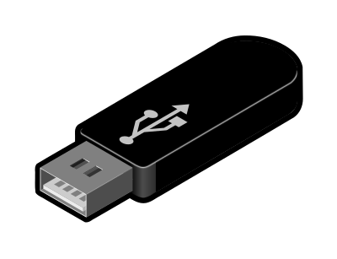




Memory/Storage Access Types
Memory / Storage can also be classified by the time required to access a specific location or piece of data:
Random Access
R/W time is independent of its location (RAM, Registers, Cache, SSD)
Sequential Access
R/W Time is almost entirely dependent upon its location (Tape)
Direct Access
R/W Time is partially dependent upon the location (HDD/CD/DVD)
Images from: openclipart.org
Notes:
Another way that memory/storage can be classified
- Random (Random Access Memory) - any address – same time
- Also for registers / cache / SSD
- For example in K&S it did not matter
- Which register a value was stored in it took the same amount of time to get it.
- That is it didn’t take longer to get a value from R3 than it did from R0
- Similarly – takes the same amount of time to move a value from from a register to MM[31] as it would to move it to MM[0].
- Not much in the world works this way because it takes time to and space to store things.
- Sequential
- Imagine a dictionary that is not in alphabetical order.
- To get the definition of a specific word, you have to start at the beginning and scan
- The time to get the definition of a particular word would be almost entirely depend on where it is located in the book.
- Tapes work this way… scan from start (Remember VCR?)
- can fast-forward but not jump ahead.
- Direct
- Like an actual dictionary
- can jump close to the right place, then scan from there.
- CD/DVD – skip to track then scan
- HDD – is similar (close enough for now).

Slide 9

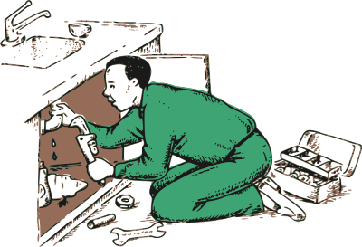

Processor Cache: A Metaphor
ALU
Main Memory
Registers
Cache
Notes:
As we get to more and more complex ideas in computing
We will use metaphors as a way of understanding and explaining the abstractions involved without digging into the details.
- I just did it with the dictionary.
We have actually done this already… from way back…
- Transistors don’t really have a switch in them…
- But we didn’t want to look at all of the chemistry and physics involved…
- So we used the switch as a metaphor to understand them as an abstraction.
We will be doing this quite a bit going forward…
- Right now to understand what Processor Cache is and why we have it.
Let’s think about the way a Plumber would work…
- When there is ja ob…
- Load van at the shop with everything he might for the job.
- Get to site, loads toolbox with the things he thinks he’s most likely to use
- Toolbox is smaller so can’t take everything in the truck.
- As he works, he gets tools from the toolbox
- Those he’s going to use again he keeps within reach
- He then mostly uses the tools that are within reach to do the work.
- If he needs a different tool
- he’ll move it from the toolbox to within reach and use it.
- If too many things are cluttering up the work area
- he’ll put some of them that he’s done with back into the toolbox
- If he finds he doesn’t have something he needs in the toolbox
- he’ll go back to the van
- swap out some tools from the toolbox and put new ones in
Because he has the toolbox he is able to work much more quickly than without it.
- Without it he would be back and forth to the van all the time
- That would take more time.
The toolbox is the processor cache.
Shop = Disk Storage – lots of it but slow and far away.
Van = Main Memory – Faster and closer but smaller than the shop.
Toolbox = Cache – Faster and closer but even smaller
Work Area = Registers – Fastest but very small (e.g. K&S had 4, many CPUs have 32, 64 or maybe 128)
Plumber’s Hands = ALU – doing the actual work.

Slide 10
Motivating Processor Cache: The Memory Bottleneck
Bottleneck
Notes:
Makes sense in the real world….
Do we need it in the computer…
Table shows:
- rate at which CPU can execute an instruction
- rate at which Memory can provide instructions to be execute or data to be operated on.
- 1986 the CPU could get every instruction and piece of data it needed from MM right when it needed it.
- Over time CPU speeds have increased more than memory speeds.
- by 2018 – the CPU can process instructions and data 30 times faster than the memory can provide them.
- So if the CPU were to request a number to add, it would have to wait 30 cycles for it to show up from memory.
So why not just build all of the main memory out of cache technology on the CPU chip.
- Not enough transistors and it would cost too much.
So this creates a bottleneck between Main memory and the CPU.
Cache helps to eliminate this bottleneck
- getting data and instructions to the CPU faster
- in a way that is technologically feasible and at a reasonable cost.

Slide 11
Processor Cache Memory
Processor Cache: Smaller, faster, more expensive memory that the CPU can access more quickly than Main Memory (RAM).
The cache holds copies of data and instructions from main memory that are likely to be needed soon.
Data and/or instructions
likely to be
needed soon
Cached copy
Notes:
Keep it simple….
- Because the cache is faster than the RAM,
- When the data or instruction is actually needed
- the CPU can get it more quickly from the cache than if it had to go to main memory.
- Like the Plumber going to his toolbox instead of to the Van.
Many systems will have multiple levels of cache
- This is the different levels that you may have seen earlier.
- Each level gets faster, but smaller and more expensive to build.
- We will see a little more about the levels next time.
- Started out being off of the CPU chip as shown.
- Now there tends to be multiple levels of cache on the on the CPU chip.
- Moore’s law gave engineers lots and lots more transistors to use.
- part of what they are used for is to build this cache.

Slide 12
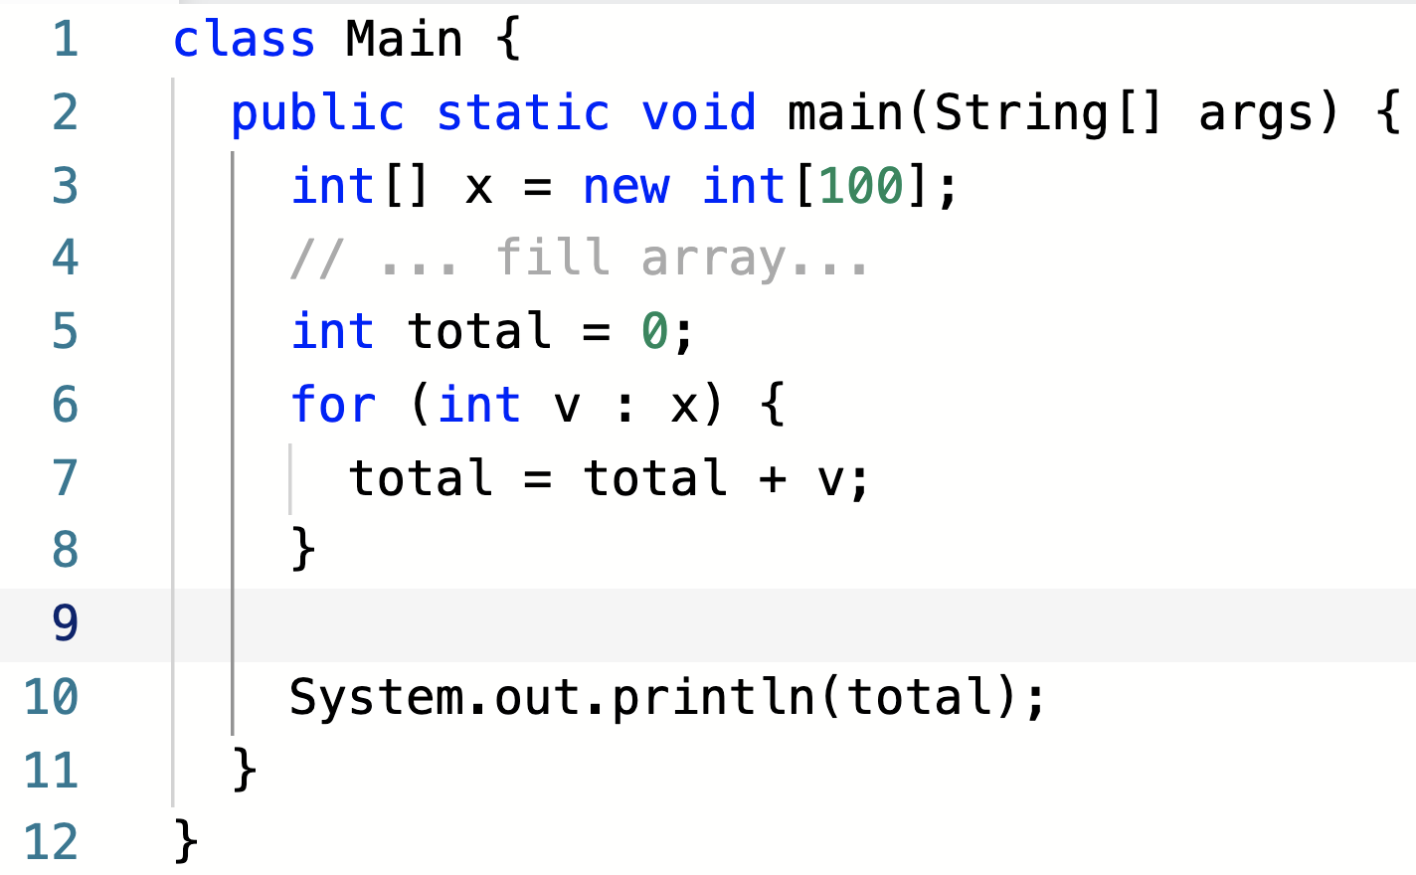
How Can it Know?
Consider the highlighted code fragment.
Which data and which instructions will be needed soon?
Notes:
The plumber is pretty smart and has lots of experience.
- He/she knows what tools are likely to be needed for a job
- and can pre-load them into the toolbox.
But how can the computer know what instructions or data will be needed soon?
- tricky question…
- what could I possibly mean or be looking for here.
- brainstorm it out with neighbors
- make some guesses
- do they make sense?

Slide 13
Principles of Locality
Temporal Locality
When a data or instruction is used, it is likely to be used again soon.
Spatial Locality
When a data or instruction is used, those nearby are likely to be used soon.
Notes:
In general, the computer can’t know
- it is general purpose.
- it could be running any program that does anything.
But as we just saw there are some general patterns that tend to hold true.
- So it uses those and sort of cheats…
Principle: Things that have been used recently used are likely to be used again soon.
- for example:
- the variables v and total
- the instructions for the for loop
- the instruction for adding v to total
- They are used over and over again.
- This doesn’t just happen in this program but in most…
- Most programs use lots of loops.
- This principle is called ”Temporal Locality”
- When a data or instruction is used it is likely to be used again soon.
Principle: Things that are near each other are likely to be used soon.
- if we use x[0] then we are likely to use x[1], x[2], x[3]… soon.
- similarly for x[60] and x[61], x[62], x[63]…
- this is not just in this program but in general.
- lots of programs scan through arrays.
- when we execute the for statement, we are likely to execute the next statement next
- we usually we go to the next statement - total = total + v
- not always… but usually
- not just in this program but in general
- Remember the default action in fetch/decode/execute is to go to the next instruction
- unless there is a branch.
- This principle is called “Spatial Locality”
- When a data or instruction that is used those nearby are likely to be used soon.

Slide 14
What does it do?
When an instruction or data is accessed, a block of surrounding instructions or data is copied to the cache.
CPU
Main
Memory
The requested
data or instruction
Cache
Cached
copy of surrounding
data or instructions
Notes:
Recall that the cache is faster than the main memory.
- So now when we need an instruction or data again it can be retrieved more quickly than if we had to go to main memory.
- like the plumber getting the tool from the toolbox instead of going to the van.
- Similarly, when we need a nearby data or instruction it can also likely be retrieved more quickly than going to main memory.
- like the plumber having a few different wrenches of different sizes in the toolbox.

Slide 15
Cache Hits and Cache Misses
Main
Memory
Cache Miss
CPU
Cache
Cache Miss
Cache
Hit
Notes:
Some vocabulary…
When an instruction or piece of data (yellow) is requested
- The cache is checked
- It is not found there so we have to go to Main Memory to get it.
- That is called a Cache Miss
- On a cache miss the
- data or instruction (yellow) is retrieved from main memory.
- data or instruction and a surrounding block (orange) is copied to the cache.
If a nearby data or instruction (blue) is requested
- The cache is checked
- It is found there so we do not have to go to main memory to get it.
- That is called a Cache Hit
- The data or instruction is retrieved directly from the cache (much faster).
Same cycle is repeated again for another cache miss (red).
This is like the Plumber checking his tool box.
- If he does not find the tool he needs, he has to go to the van (cache miss) - slow
- If he does find the tool he needs, no trip to the van (cache hit) – fast.
If there is time we can discuss:
- Recall that the cache is much faster but also much smaller than main memory
- So it cannot hold everything that is in the main memory.
- So often when we have a cache miss
- We will have to remove some data and instructions from the cache to make room for the new ones.
- This is like the plumber’s toolbox – it cannot hold everything that is in the van.
- How might you decide what to remove?

Slide 16


Acknowledgments
Slide Template From:
https://creativecommons.org/licenses/by/4.0/
Slide Content Licensed as:
Creative Commons Attribution-NonCommercial-ShareAlike 4.0 International License.
Notes:
Note: Individual images may be covered by their own licensing agreements and were incorporated here under fair use. Their use in this slide deck does not change or alter their licensing.

Slide 17
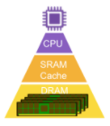
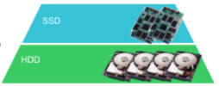
Cost
Performance
REG
Speed
Capacity
Tertiary (Tape / Optical)
Image adapted from: https://www.rambus.com/blogs/mid-when-memory-and-storage-converge/

Slide 18
Memory and Storage
Memory (Volatile)
CPU Registers
Main Memory (RAM)
Processor Cache
Storage (Non-Volatile)
Solid State Drives (SDD)
Disk Drives (HDD)
CD/DVD
Tape Backups
Notes:
Terms are a little fuzzy in practice.
Sometimes it will all be called memory and sometimes it will all be called storage
Have to pay attention to context.
I’ll try to stick with the distinction here.
- memory – volatile
- storage – non-volatile

Slide 19
Cost
Performance
REG
On-Chip
Memory
Off-Chip
Volatile
Speed
Non-Volatile
Capacity
Storage
On-Line
Off-Line
Tertiary (Tape / Optical)
Image adapted from: https://www.rambus.com/blogs/mid-when-memory-and-storage-converge/

Slide 20
Main
Memory
CPU
IR / GP
Registers
Cache

Slide 21
CPU
Main
Memory
Cache

Slide 22
x
5
7
…
3
9
0
1
98
99

