Slide 1
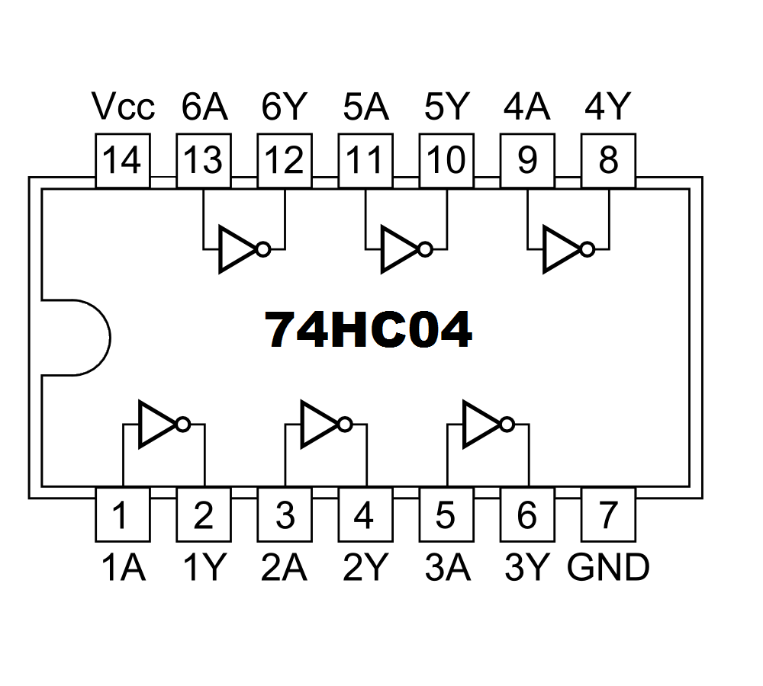
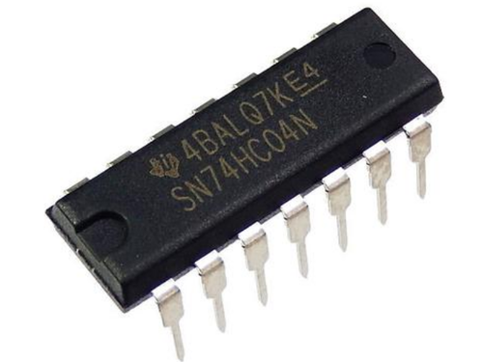

$$Z=\overline{A}$$
A Z
0 1
1 0
A
Z
A
Z
CMOS Circuit
Truth Table
Schematic Symbol

Slide 2
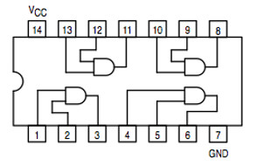
74HC08

Slide 3
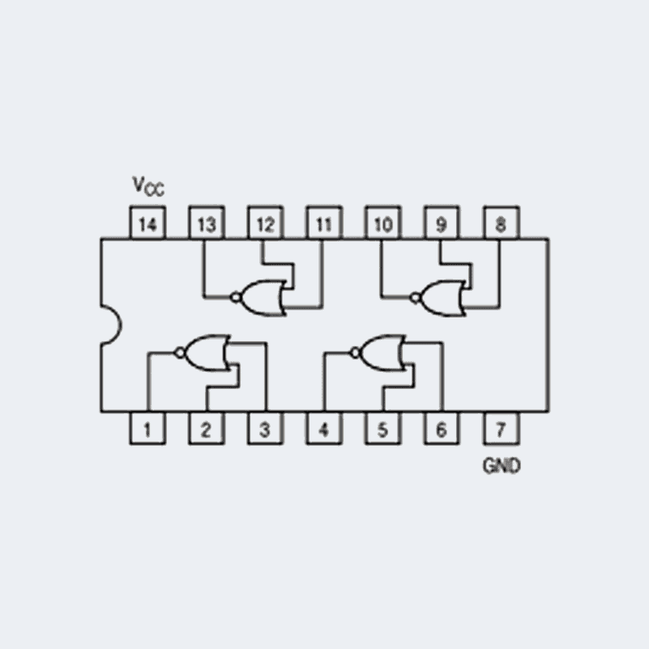
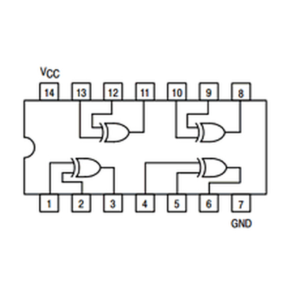
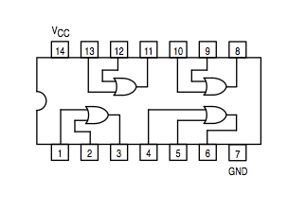
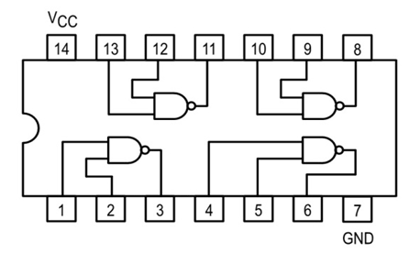
74HC00
74HC02
74HC32
74HC86

Slide 4
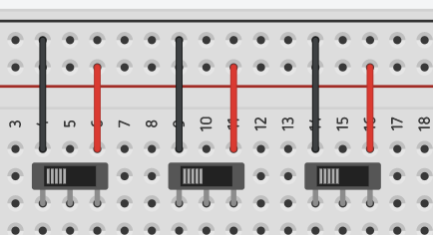
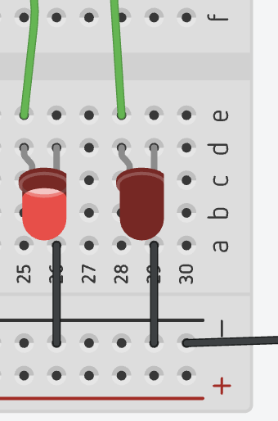
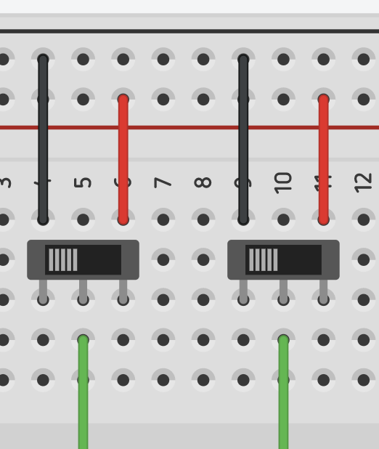
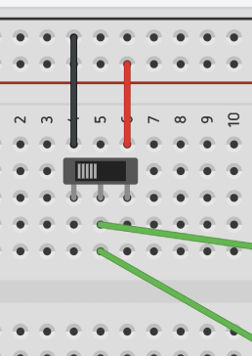
C
S
X
Y
Z
Connect to the X input of S circuit
A
B
Connect to the X input of C circuit

Slide 5
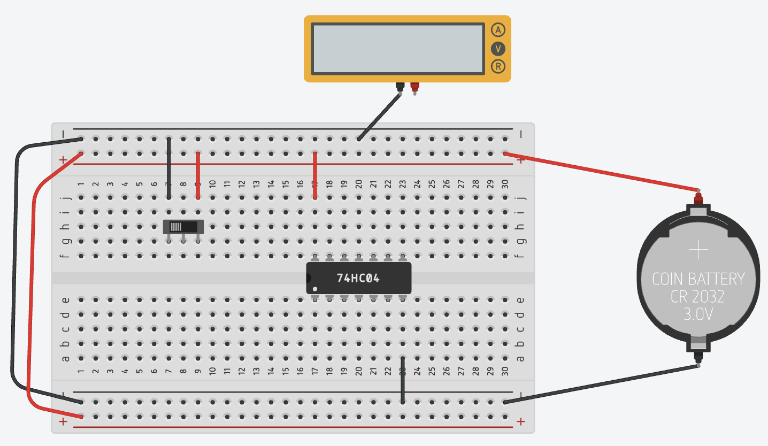

Slide 6







NOT
AND
OR
XOR
A
Z
A
A
A
B
Z
B
Z
B
Z
$$Z=\overline{A}$$
$$Z=AB$$
$$Z=A+B$$
$$Z=A⊕B$$
A Z
0 1
1 0
A B Z
0 0 0
0 1 0
1 0 0
1 1 1
A B Z
0 0 0
0 1 1
1 0 1
1 1 1
A B Z
0 0 0
0 1 1
1 0 1
1 1 0
NAND
NOR
XNOR
A
A
A
B
Z
B
Z
B
Z
A B Z
0 0 1
0 1 0
1 0 0
1 1 0
$$Z=\overline{AB}$$
$$Z=\overline{A+B}$$
$$Z=\overline{A⊕B}$$
A B Z
0 0 1
0 1 1
1 0 1
1 1 0
A B Z
0 0 1
0 1 0
1 0 0
1 1 0
A B Z
0 0 1
0 1 0
1 0 0
1 1 1

