Slide 1
WA5 – Back-End: Databases
COMP 256 – Dickinson College
Prof. Braught
Spring 2023

Slide 2
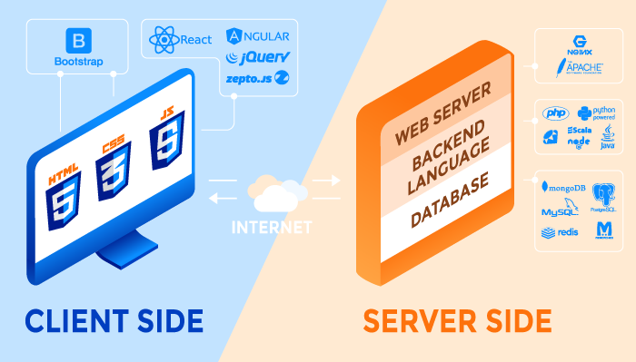

Typical Elements of a Web Application
http
https
Front
End
Web APIs
Back
End
Image from: https://rubygarage.org/blog/technology-stack-for-web-development
Notes:
Today Databases
Skipping over backend languages
- will come back to those next time
- they are often used to connect to a database so it makes sense to do DB first.
The role of the database is to hold and provide access to the data that the web application will need.
- All of the news articles
- The posts
- The videos
- Pretty much whatever is not static content is stored in a database somewhere.

Slide 3
Databases
“A database is any collection of data, or information, that is specially organized for rapid search and retrieval by a computer.” - Britanica.com
A database management system (DBMS) “serves as an interface between the database and its end users or programs, allowing users to retrieve, update, and manage how the information is organized and optimized. - Oracle.com
Notes:
A database can be anything that stores and organizes data.
A DBMS is the set of tools that lets the user
- search, update and manage that information
So the database can be essentially thought of as the files that hold the data.
- how is the data organized into those files
- where are they stored on the disk ect
The DMBS is the set of programs that the user can use to access the data.
Very often the two go together:
- A DMBS is used to create a database
- so the database is uniquely coupled to the DMBS
Some “databases” that you may have heard of:
- Oracle / MySQL / MongoDB / etc
- are really DBMSs
- The provide the tools and programs that allow management of a database.

Slide 4
Types of Databases / DBMSs
SQL: Structured Query Language
Relational Databases (RDBMS)
Data is structured as tables (entities) and relationships between them.
Oracle / MySQL / MariaDB
NoSQL (not only SQL) Databases
Non-tabular - data is stored as key/value pairs, documents, graphs, etc.
Often as collections of JSON-like objects
MongoDB / Cassandra / Ignite
“See-quell”
Rhymes with equal
Notes:
There are two broad categories of databases / DMBSs
- They store and structure their data in different ways.
Relational Databases
- These databases structure their data using tables (or entites) and relationships.
- We’ll see a lot more about what that means in a bit.
- Relational databases are sometimes called SQL databases
- That is because they use the SQL language to create, search and modify the data.
- SQL stands for Structured Query Language
- You will sometimes hear SQL pronounced as “See-quell” (to rhyme with “equal”)
NoSQL Databases
- These databases store their data in ways other than as tables as is the case in Relational Databases.
- key/value pairs or JSON-Like structures are very common.
- So Non-relational may have been a better name.
- But noSQL as a differentiator from the traditional relational model is catchy.
- However, a bunch of these databases are multimodal and can also to relational models using SQL
- So NoSQL has evolved to stand for Not Only SQL.
Just an interesting note on part of the motivation for the creation of NoSQL databases:
“NoSQL databases emerged in the late 2000s as the cost of storage dramatically decreased. Gone were the days of needing to create a complex, difficult-to-manage data model simply for the purposes of reducing data duplication. Developers (rather than storage) were becoming the primary cost of software development, so NoSQL databases optimized for developer productivity.” – from MongoDB site.

Slide 5
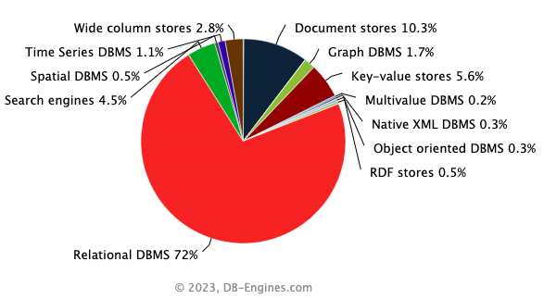
Database Market Share
Notes:
We are going to only focus on Relational or SQL databases in this class period.
- They are a little easier to get started with because.
- Their tabular form makes them more intuitive.
- SQL is a well formed and standardized language for relational databases.
- so if you learn a little SQL it works in Oracle, MySQL, Maria DB, Postgress, Microsoft Access, etc…
- learning one NoSQL database may not help you with another.
As of April 2023:
- Top 4 are SQL and 7 of top 10 most used databases are SQL (https://db-engines.com/en/ranking)
- Relational model up ~1% from prior year.
- Eventually it will be worth knowing both
- for now we can think of it at a high level as an abstraction…
- A DB and a DBMS (SQL or NoSQL) is just a way for us to get data to make our pages dynamic on the server side.

Slide 6
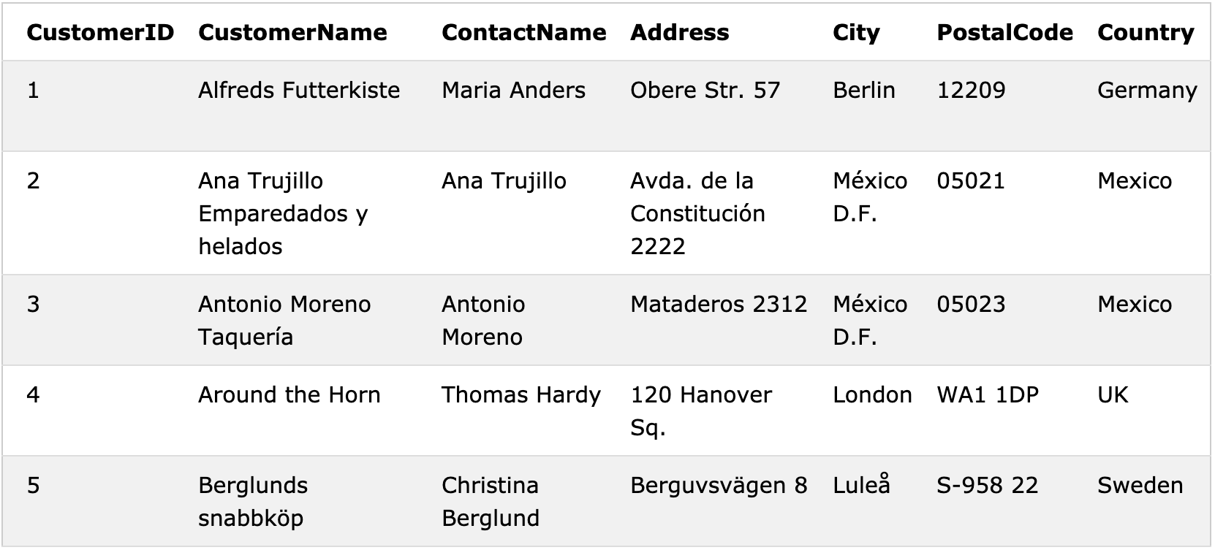
Tables / Entities in Relational (SQL) Databases
Relational databases use tables to represent entities
(i.e. people, places,
things).
Customers
CompanyName
ALFKI
Column /
Attribute
ANATR
Key
ANTON
AROUT
Row / Record
BERGS
Images and examples fromhttps://www.w3schools.com/sql/default.asp
Notes:
In a relational database the data is organized into tables.
- The data in each table represents a collection of similar people, places, things
- the people, places or things are called entitles.
- For example, if we were running a restaurant supply company we might have a table like this one to represent customers.
- Every row (or record) in the table represents an individual customer.
- E.g. Around the Horn is a customer.
- Every column (or attribute) in the table indicates something in particular about that customer.
- E.g. Around the Horn is located in the City of London
- Also, its address is at 120 Hanover Square, in the country of UK and the name of the contact there is Thomas Hardy
- Typically, one attribute is designated as the key
- Every record has a unique value for the key.
- Here the key is the CustomerID attribute
- In this case it is a 5 character string, but it is often just a number.
- Usually, but not always the key will be the first attribute or column.
- Any other (non-key) attributes may be repeated.
- So there might be two customers with the same CompayName or the same Contact or the same PostalCode or Country
- Which should make good sense since there is no reason they couldn’t
- and it is quite likely that there would be multiple customers from the same city or country.

Slide 7
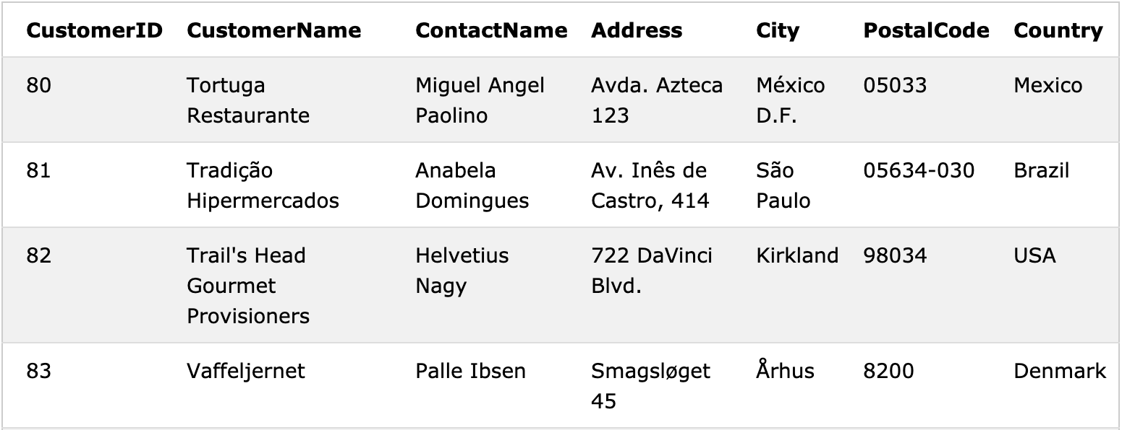
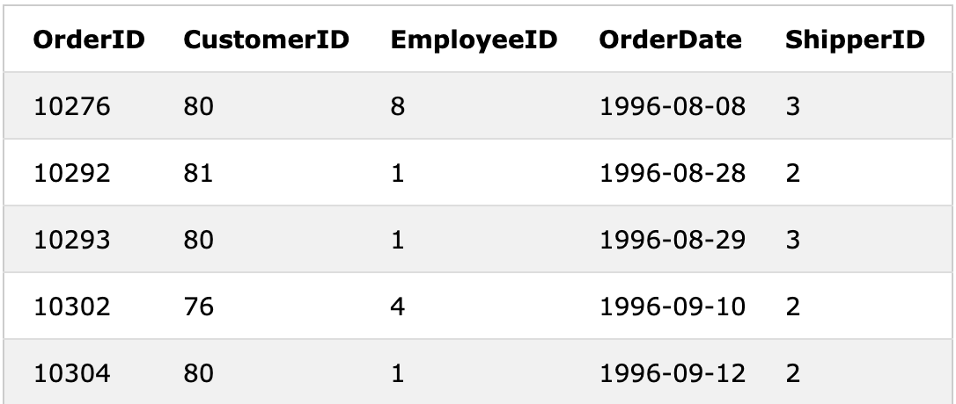
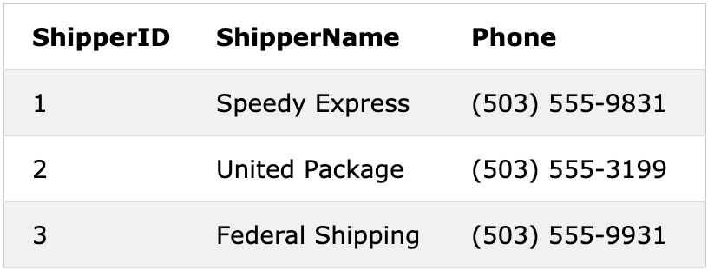
Relational (SQL) Database Tables
Customers
CompanyName
TORTU
TRADH
TRAIH
Orders
ShipVia
VAFFE
Shippers
TORTU
CompanyName
TRADH
TORTU
SUPRD
TORTU
Notes:
Databases typically have multiple tables to represent the different entities that are important in the application.
For a restaurant supply company it is likely that there would also be tables for:
- Orders
- information about things that the customers have ordered from the supply company.
- when they ordered it, which employee handled the order, which company was used to ship it, ect…
- Shippers
- Information about companies that the supply company has used to ship orders
- Name phone number etc.
Remember each table has a key attribute:
- Orders – the key is OrderID and it is just an integer that uniquely identifies the order.
- Shippers – the key is ShipperID and again, it is just an integer that uniquely identifies the shipping company.

Slide 8

Answering Questions with a Relational (SQL) DB
In what city and country is Tradição Hipermercados located?
On what dates did Tortuga Restaurante place orders?
Who should be contacted to see if the order shipped on September 12th was correct?
Which companies have had orders shipped to them by Federal Shipping?
To which cities has United Package shipped orders?
Use the tables on the previous slide to answer the questions to the right.
Describe how you found the information to answer each question.
Notes:
Think through them, talk them out with neighbors.
Try to be as precise as possible about how the answers to 2-5 are done.

Slide 9
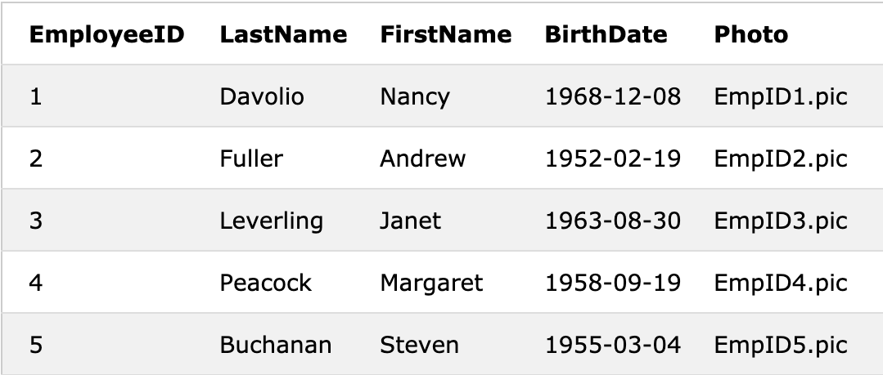
Relations connect Entities
Foreign
Keys
Orders
Customers
Employees
Shippers
CompanyName
Notes:
What you were doing to figure out the answers to #2-5 was using the relations
- A relation expresses a relationship between the entities represented by the tables
- For example:
- An Order is placed by a Customer
- Or an Order was processed by an Employee
- Or an Order was shipped by a Shipper.
The key from one table that appears in another table establishes a relation between the tables.
- For example:
- The CustomerID key from Customers appears in the Orders table to indicate which customer placed the order.
- The EmployeeID from Employees appears in the Orders table to indicate which employee processed the order.
- The ShipperID from Shippers appears in the Orders table to indicate which company shipped the order.
- Note that on this one the name of the attribute in Orders is different than it is in the Shippers table.
- That is okay as along as we know which table to use it to reference.
The key that appears in another table as an attribute is called a “Foreign Key”
- It is just an attribute that holds a key from another table
- It tells us how to find all of the related information.
- E.g. The CustomerID foreign key in Orders tells us how to find the information about the Customer that placed the order.

Slide 10
SQL: Structured Query Language
SQL is an “an ANSI (American National Standards Institute) standard language” … “for storing, manipulating and retrieving data stored in a relational database.” - Tutorialspoint
Basic SQL Statements:
SELECT - extracts data from a database
FROM - specifies the data on which to operate
WHERE – filters the specified data
JOIN – combines tables for more complex operations
UPDATE - updates data in a database
DELETE - deletes data from a database
INSERT INTO - inserts new data into a database
CREATE TABLE – make a new table in the database
Notes:
SQL or Structured Query Language is the language that is used to ask questions of a relational data base.
SQL has a highly Standardized core language,
- so every RDBMS does the basics,
- but then each one also adds it own twists and features.
Some of the Basic SQL operations that all RDBMS will support are listed on this slide.
- There are a lot more and a lot of variations of each.
- We are going to look at a small sub-set of these to get a feel for how an RDBMS operates and how it can be used.
- To get into how to create one, how to design it, how to organize it you’ll want to take
- COMP378 – Database Systems
- DATA200 – Data Systems for Data Analytics
Specifically, we will look at:
- SELECT, FROM, WHERE and JOIN
- We’ll see some examples now
- You’ll practice them in the HW
- The HW will also have pointers to some of the others as extras if you are interested.

Slide 11
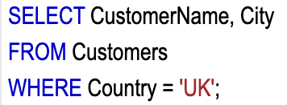
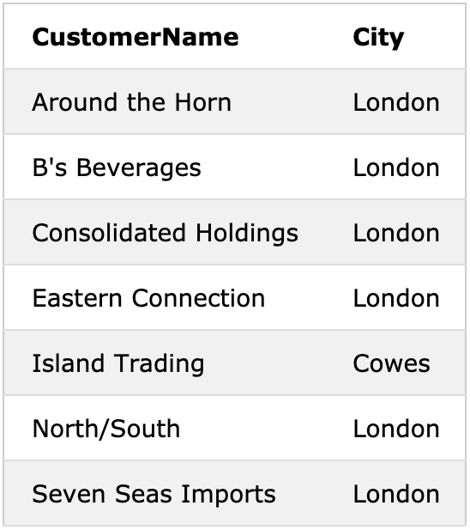
The SELECT Statement
What are the names and cities of all UK customers?
CompanyName, City
Result
Table: Customers
CompanyName
Notes:
The SELECT statement is used to pick (i.e. select/choose/filter) data that meets some specified criteria.
- Or it is used to answer questions…
- For example, the question here:
- What are the names and cities of all customers that are in the UK?
The SELECT statement contains 3 main parts:
- SELECT specifies which attributes we are interested in.
- FROM specifies where those attributes should come from.
- WHERE specifies the conditions that must be met for a record to be chosen.
The SELECT statement may be easier to understand if we look at it out of order…
- FROM where to we want to get the data?
- In this case, we want to get it from the Customers table.
- WHERE the records meet what conditions?
- In this case, we want the records where the country is UK.
- Note that we use single quotes here for the string.
- Double quotes also work just fine in sqlite.
- SELECT what attributes from those matching records?
- In this case, we want the CompanyName and the City
Note that:
- SQL keywords are NOT case sensitive: select is the same as SELECT
- Though it is considered good form to write these in all caps.
- Table and Attribute names are also not case sensitive (at least in sqlite3)
- Though it is considered good form to write these in a case that matches the attribute name in the table.
- Some database systems require a semicolon at the end of each SQL statement (sqlite3 does!)

Slide 12
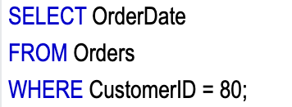
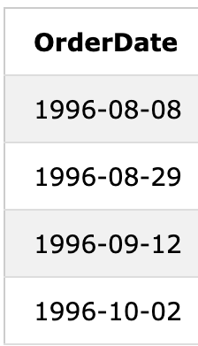
The SELECT Statement
On what dates did the customer TORTU place orders?
Result
Table: Orders
‘TORTU’;
Notes:
Just another little example, similar to the last one.
Here we want to know all of the dates on which TORTU places an order.
- So we will
- Select the OrderDate attribute
- From the Orders table
- In the rows WHERE the CustomerID attribute is TORTU.
It’s worth mention that while this is simple, it would be more likely to be asked as:
- On what dates did Tortuga Restaurante place orders?
- Then we would have to have a way to first get the CustomerID and then the OrderDate
- We’ll see how we do that in just a bit when we discuss JOIN

Slide 13
Running SQL Statements
Use the COMP256Web Container
In a Terminal Window use the command:
sqlite3 /db/Northwind.db
You will see an SQL command prompt:
sqlite>
Enter SQL Statements
Can use multiple lines
Terminate statements with a ;
Use .quit to exit
Use Ctrl+C a few times if you get stuck
Notes:
Demo of some of the statements that we just saw.
Show how multiple lines can be used.
Just end last line with ;
SELECT CompanyName,City
FROM Customers
WHERE Country='UK';
SELECT OrderDate
FROM Orders
WHERE CustomerID='TORTU';

Slide 14
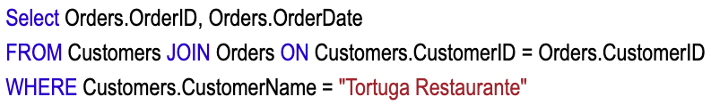
The JOIN Statement
What are the dates and order IDs that were placed by “Tortuga Restaurante”?
CompanyName
Table: Customers
Table: Orders
Notes:
This is essentially the query we did just a bit ago using the CustomerID ‘TORTU’
But now instead of assuming we know the CustomerID we need to do it based on the CompanyName.
- You might image a drop down on a page giving a list of all of the ComanyNames
- Then the user could choose one company name to search for.
- To be user friendly we would want them to pick the company name, not the CustomerID
To do this we need to combine the data from two tables as you did earlier.
This is where the JOIN statement comes in.
- JOIN allows us to combine the data from two (or more) tables to answer more complex questions.
Here the data we need is in the Customers and Orders tables
- From customers we’ll need to find the record with the CustomerName
- From that record we can find the CustomerID
- The CustomerID can then be used to find the records in the Orders tabe for the restaurant.
The way this works in an RDBMS with a JOIN is as follows:
- In the FROM statement we don’t provide just one table
- Instead, we provide a combination of tables defined by JOIN
Here this is the statement: FROM Customers JOIN Orders ON Customers.CustomerID = Orders.CustomerID
What this means is:
- Every record in Customers is matched with the records in Orders where the CusomerID’s match.
- Notice that we specify this using ON Customers.CustomerID = Orders.OrdrerID
- This makes it clear which attributes from the different tables must match.
- For example:
- The first row in Customers, is matched with all of the rows in Orders where the CustomerID is ‘TORTU’
- For the second row in Customers, it is matched with all of the rows in Orders where the CusomterID is ‘TRADH’

Slide 15
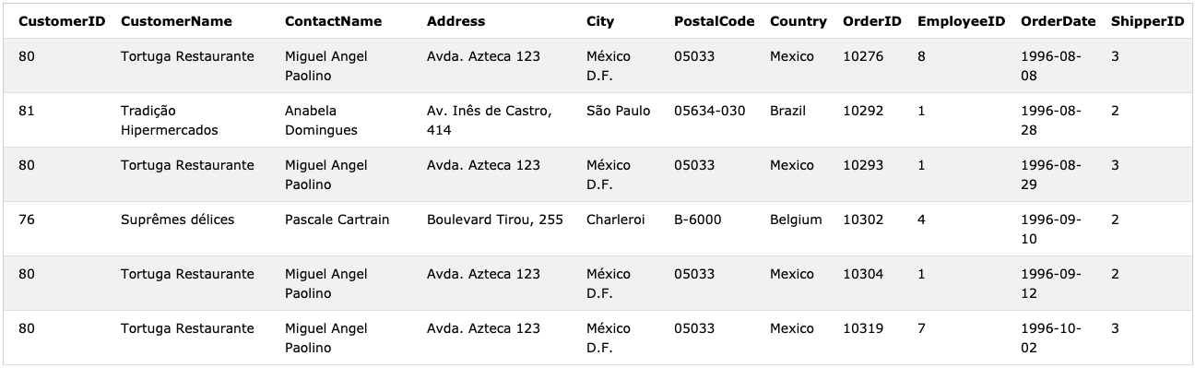
The JOIN Statement
What are the dates and order IDs that were placed by “Tortuga Restaurante”?
CompanyName
CompanyName
TORTU
TRADH
Customers
Orders
TORTU
SUPRD
TORTU
TORTU
Notes:
Once those matches are done the RDBMS effectively has a new table with both sets of data.
- This new table has one row / record for every match.
- That is for the CustomerID ‘TORTU’ the data from Customers is repeated once for each matching record in Orders.
- This associates the customer information with the order.
May seem a little inefficient
- But two things to note:
- there are generally efficient algorithms for doing this.
- Often we won’t necessarily just want data from orders.
- Usually we will want both customer information and order information
- E.g. Find the names of the restaurants that placed orders in October 2012.

Slide 16
The JOIN Statement
What are the dates and order IDs that were placed by “Tortuga Restaurante”?
CompanyName
CompanyName
TORTU
TRADH
TORTU
SUPRD
TORTU
TORTU
Notes:
Once the JOINed table is created the WHERE statement can be applied.
Here we choose all of the records
WHERE Customers.CompanyName = ‘Tortuga Restaurante”
This is really just like doing a WHERE on a single table
- Here it is just FROM the JOINed table instead of from a single table.
Note: Used double quotes here.
- Would be better to be consistent within you own code.

Slide 17
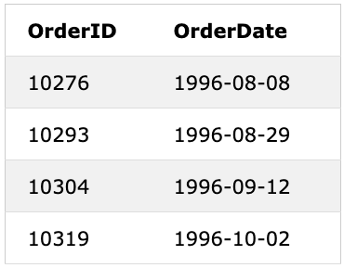
The JOIN Statement
What are the dates and order IDs that were placed by “Tortuga Restaurante”?
CompanyName
CompanyName
Ï
TORTU
TRADH
TORTU
SUPRD
TORTU
TORTU
Notes:
Then from those chosen rows
- We SELECT the OrderID and OrderData from the Orders part of the table.
- Note: Here I used Select by mistake in the statement.
- It works fine, but it would be better style to have used SELECT
What if we’d wanted the restaurant name also?
- SELECT Orders.OrderID, Orders.OrderDate, Customers.CompanyName
SQL Queries can become much more complicated than this and can answer very complex questions about the data.
- I’d encourage you to look at
- COMP378 – Database Systems
- DATA200 - Database Systems and Data Management for Data Analytics
We can also run this query in sqlite in our container:
SELECT Orders.OrderID, Orders.OrderDate
FROM Customers JOIN Orders ON Customers.CustomerID=Orders.CustomerID
WHERE Customers.CompanyName='Tortuga Restaurante';

Slide 18
Write SQL statements to answer the following questions using our sample database.
What are the first and last names of the employees that have shipped orders to the customer with CustomerID SPURD?
On which dates was the shipping company Speedy Express used?
Notes:
SELECT LastName, FirstName
FROM Employees JOIN Orders ON Employees.EmployeeID == Orders.EmployeeID
WHERE Orders.CustomerID == "SUPRD";
SELECT OrderDate
FROM Orders JOIN Shippers ON Orders.ShipVia == Shippers.ShipperID
WHERE Shippers.CompanyName == "Speedy Express";

Slide 19
Sample Database
Orders
Customers
Employees
Shippers
CompanyName
Notes:
Just here for reference for the questions on the previous slide.

Slide 20


Acknowledgments
Slide Template From:
https://creativecommons.org/licenses/by/4.0/
Slide Content Licensed as:
Creative Commons Attribution-NonCommercial-ShareAlike 4.0 International License.
Notes:
Note: Individual images may be covered by their own licensing agreements and were incorporated here under fair use. Their use in this slide deck does not change or alter their licensing.

