Slide 1
15 – Assembly Language Programs
COMP 256 – Dickinson College
Prof. Braught
Spring 2022

Slide 2
Program Execution
Huge Idea: Use programs to convert instructions for high-level language machines into machine language instructions.
Compiler, Assembler, Interpreter, Virtual Machine
pay=salary+bonus;
High-Level Language Machine
pay=salary+bonus;
Compiler
Compiler
Translation
Interpreter
ASM
Interpretation
Hybrid Approach
Byte
Code
Assembler
Virtual Machine
R0 ← R1 + R2
Machine Language Machine
Notes:
Last time we saw that there were 3 different approaches to running HLL programs
We discussed translation, interpretation and a hybrid approach.
You’ll be getting some more experience with interpretation
- by writing an interpreter for a simple HLL in an upcoming lab.
For the rest of this topic in class
- we’ll turn our attention to the translation process.
- by learning more about translation and interpretation you’ll better understand the hybrid approach
- we will not be spending much time on it directly.
- but feel free to ask questions about it at any point.

Slide 3

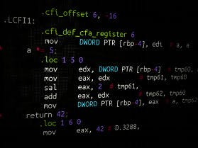
Language Translation
In our translation model a compiler translates high-level language programs to assembly language. An assembler then converts that assembly language to machine language.
Assembly (ASM) Language
(or intermediate language)
Source Code Program
High-Level Language
Source Code Program
Machine Language Executable Program
Compiler
Assembler
High-Level Language Machine
Assembly Language Machine
Machine Language Machine
Images from: computerhope.com and https://www.hackster.io/LiLShReDdeR/introduction-to-assembly-language-with-freescale-451d29
Notes:
So we will be focusing on translation:
- We will do this by playing the role of the compiler
- We’ll look at HLL code
- We will translate it into assembly language
- We will see how many of the things we do in HLL are done in assembly language
- if/for/while/arrays/objects/functions/recursion
- Once we’ve “compiled” the HLL code into Assembly Language
- We’ll use an assembler
- The assembler will read our assembly language source code program as input
- and turn it into an executable machine language program
- We will then use a machine simulator (like the K&S) to execute the ML programs.
In a later lab you’ll learn how an assembler works by writing your own.
- it will translate a simple assembly language
- into machine language that will run on the K&S computer.

Slide 4
Assembly Language Programming
"He who hasn't hacked assembly language as a youth has no heart. He who does as an adult has no brain." John Moore
Uses:
Precise control of the system
Highly optimized performance
E.g. Operating systems, device drivers, real-time control systems, game engines
Reinforce our understanding how computers really work
Notes:
Before we begin:
A thought from John Moore
CS Prof at the Citidel and author of a textbook on compiler design
So someone that clearly works with assembly language…
That said, I kind of enjoy assembly language programming…
- so I’m not sure what that says about me.
- But I find the simplicity of the instructions and the more direct connection to the machine appealing and fun.
- So, if you find you enjoy it too, do what I do and just ignore this guy!
- And if you don’t necessarily enjoy it then know that you won’t need to do it for long
- but that it is a good learning exercise and will give you important perspective as a computer scientist.

Slide 5
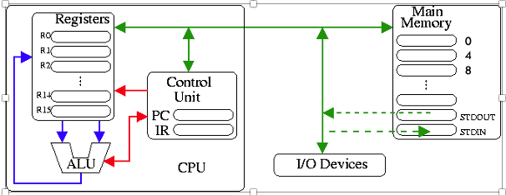
The Machine
Expanded Knob & Switch … a simplified MIPS machine and assembly language.
Larger
Main Memory
16 Registers
32-bit word size
R0-R11 General Use
R12-R15 Reserved
Memory Mapped
Input/Output
Notes:
MIPS commercial processor architecture through mid 20-teens.
- Highly influential on the design of other processors.
- Has evolved, but principles remain the same in newer processors.
Main differences from Knob and Switch
- more registers
- each holds 32 bits – recall that is the “word size”
- R0-11 – General Purpose Registers
- You can use these however you want
- They are just like R0-R3 in the Knob and Switch computer.
- R12-15 – Reserved Registers
- Each of these will have a special purpose
- We will get to them soon.
- For now, you won’t use any of them in your computations.
Lots of Main Memory:
- Each byte has an address
- We’ll be working with words (i.e. 32 bits or four bytes at a time.)
- So, the addresses are 0, 4, 8, 12 instead of 0, 1, 2, 3 which refer to the individual bytes)
This machine has a rudimentary ability to read input from the user and print output
- Memory mapped Input/Output
- We will do input/output by by accessing designated memory locations
- The machine hardware then intercepts those accesses and directs them to the right I/O device.
- More on this in the activities.

Slide 6
Assembly Language: A First Example
// HLL
int A=10;
int B=20;
int C=0;
C = A + B;
* Assembly Language
A: .word 10 * MM[A] ← 10
B: .word 20 * MM[B] ← 20
C: .word 0 * MM[C] ← 0
* Program code starts here.
LOAD R1 A * R1 ← MM[A]
LOAD R2 B * R2 ← MM[B]
ADD R3 R1 R2 * R3 ← R1 + R2
STORE R3 C * MM[C] ← R3
HALT
Notes:
First example
- Examples will often be setup like this.
- We’ll have a HLL program on the left
- and then we’ll translate it into assembly language on the right.
- I.e. We are playing the role of the compiler.
I’ll give you a quick, high-level overview of the assembly here
Then we’ll pick that apart and get all of the details on the next few slides.
The big features:
- comments start with *
- variable declarations A:, B:, C:
- correspond to global variables in the HLL.
- set aside 1 word (4 bytes, 32 bits) for each value.
- The comments use our shorthand notation to describe what the ASM does in terms of the machine.
- These are here to help you learn
- but are not typical of useful comments for anyone who knows assembly language programming.
- program code
- Move the values from main memory at A and B to registers 1 and 2
- Add those together and put the result in R3.
- Put that result back into main memory at C
- STOP
The Assembly language instructions share similarities to ML instructions.
- They have an OpCode
- We just use a word instead of bits.
- E.g. LOAD or ADD or STORE
- They have operands
- We just use registers and names instead of bits
- E.g. R1, R2, A, B, C

Slide 7
Assembly Language: A First Example
Main Memory
0:
4:
…:
36:
40:
44:
48:
52:
56:
…:
ML
Program Instructions
Data
// HLL
int A=10;
int B=20;
int C=0;
C = A + B;
* Assembly Language
A: .word 10 * MM[A] ← 10
B: .word 20 * MM[B] ← 20
C: .word 0 * MM[C] ← 0
* Program code starts here.
LOAD R1 A * R1 ← MM[A]
LOAD R2 B * R2 ← MM[B]
ADD R3 R1 R2 * R3 ← R1 + R2
STORE R3 C * MM[C] ← R3
HALT
Notes:
Now let’s look more closely at what is happening.
To run an assembly program
- it has to be translated into ML by an assembler.
- and then loaded into the main memory.
When an assembler does the translation
- it creates an executable ML file.
- the exact format of that file depends on the operating system being used.
- but typically…
- The machine language instructions come first
- They are then followed by the global data for the program.
This is consistent with the way we worked with the K&S.
- The ML program instructions were placed into memory at address 0
- Then we put the data later in the memory.

Slide 8
Assembly Language: A First Example
Main Memory
0:
4:
…:
36:
40:
A 44: 10
B 48: 20
C 52: 0
56:
…:
ML
Program Instructions
Labels
// HLL
int A=10;
int B=20;
int C=0;
C = A + B;
* Assembly Language
A: .word 10 * MM[A] ← 10
B: .word 20 * MM[B] ← 20
C: .word 0 * MM[C] ← 0
* Program code starts here.
LOAD R1 A * R1 ← MM[A]
LOAD R2 B * R2 ← MM[B]
ADD R3 R1 R2 * R3 ← R1 + R2
STORE R3 C * MM[C] ← R3
HALT
A label is a memory address!
A is 44
MM[A] is 10
Notes:
So here
- The value 10 is stored at address 44
- Just because the program needs 44 bytes for its instructions.
- If it had needed 60 then 10 would have been stored at addrss 60.
- The value 20 is stored at address 48
- The value 0 is stored at address 52.
********* Super Important ***********
in HLL we often think of 10 as being stored in the variable A
In assembly we have to think about this a little differently.
A, B, C are called Labels
A label is a **** memory address ****
- So A is the memory address 44
- The value “10 is stored at memory address A” or 44.
Similarly:
B is the memory address 48 and the value 20 is stored there.
C is the memory address 52 and the value 0 is stored there.
The shorthand in the comments emphasizes this.
10 is not in A but is in MM[A].
May just seem confusing now.
- But training yourself to think this way now will make things easier later later.
Note:
- I will be using specific locations for MM[A] – e.g. 44
- but this is just to make things concrete in the illustrations
- When writing the program we’ll never actually need to know that A is address 44
- We will just know that it is stored at address A.
- The concrete values just make easier to see it and think about how it is actually working.
- In fact, not needing to know those addresses is one of the things that the Assembly Language abstraction hides from us that the ML abstraction did not.

Slide 9
Assembly Language: A First Example
Main Memory
0:
4:
…:
36:
40:
A 44: 10
B 48: 20
C 52: 0
56:
…:
ML
Program Instructions
// HLL
int A=10;
int B=20;
int C=0;
C = A + B;
* Assembly Language
A: .word 10 * MM[A] ← 10
B: .word 20 * MM[B] ← 20
C: .word 0 * MM[C] ← 0
* Program code starts here.
LOAD R1 A * R1 ← MM[A]
LOAD R2 B * R2 ← MM[B]
ADD R3 R1 R2 * R3 ← R1 + R2
STORE R3 C * MM[C] ← R3
HALT
Registers
R0: 0
R1: 10
R2: 0
R3: 0
Notes:
Now let’s look at how this program will execute
Load the value from MM[A] into R1.
Go to memory address 44, get the value 10, put it into R1.
Really the same type of thing our ML did, but now
- instead of writing 1’s and 0’s
- we can write what we mean …
- Load the value from memory address A into R1.

Slide 10
Assembly Language: A First Example
Main Memory
0:
4:
…:
36:
40:
A 44: 10
B 48: 20
C 52: 0
56:
…:
ML
Program Instructions
// HLL
int A=10;
int B=20;
int C=0;
C = A + B;
* Assembly Language
A: .word 10 * MM[A] ← 10
B: .word 20 * MM[B] ← 20
C: .word 0 * MM[C] ← 0
* Program code starts here.
LOAD R1 A * R1 ← MM[A]
LOAD R2 B * R2 ← MM[B]
ADD R3 R1 R2 * R3 ← R1 + R2
STORE R3 C * MM[C] ← R3
HALT
Registers
R0: 0
R1: 10
R2: 20
R3: 0
Notes:
Load the value from MM[B] into R2.
Go to memory address 48, get the value 20, put it into R2.

Slide 11
Assembly Language: A First Example
Main Memory
0:
4:
…:
36:
40:
A 44: 10
B 48: 20
C 52: 0
56:
…:
ML
Program Instructions
// HLL
int A=10;
int B=20;
int C=0;
C = A + B;
* Assembly Language
A: .word 10 * MM[A] ← 10
B: .word 20 * MM[B] ← 20
C: .word 0 * MM[C] ← 0
* Program code starts here.
LOAD R1 A * R1 ← MM[A]
LOAD R2 B * R2 ← MM[B]
ADD R3 R1 R2 * R3 ← R1 + R2
STORE R3 C * MM[C] ← R3
HALT
Registers
R0: 0
R1: 10
R2: 20
R3: 30
Notes:
Add the value in R1 to the value in R2 and put the result in R3.

Slide 12
Assembly Language: A First Example
Main Memory
0:
4:
…:
36:
40:
A 44: 10
B 48: 20
C 52: 30
56:
…:
ML
Program Instructions
// HLL
int A=10;
int B=20;
int C=0;
C = A + B;
* Assembly Language
A: .word 10 * MM[A] ← 10
B: .word 20 * MM[B] ← 20
C: .word 0 * MM[C] ← 0
* Program code starts here.
LOAD R1 A * R1 ← MM[A]
LOAD R2 B * R2 ← MM[B]
ADD R3 R1 R2 * R3 ← R1 + R2
STORE R3 C * MM[C] ← R3
HALT
Registers
R0: 0
R1: 10
R2: 20
R3: 30
Notes:
Store the value in R3 into MM[C]
So put the value 30 into memory location 52.

Slide 13
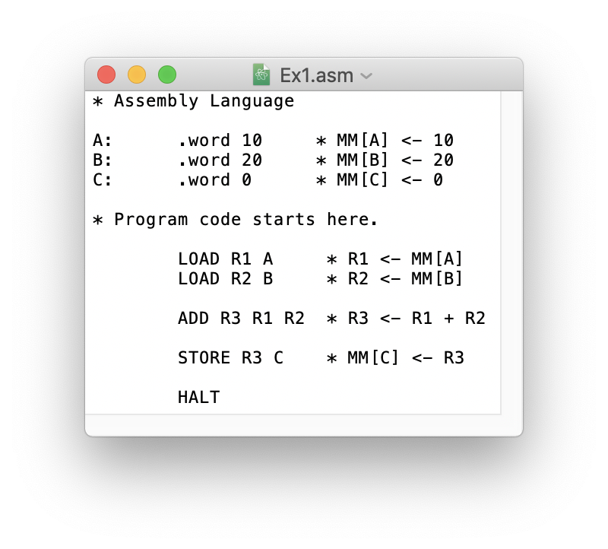
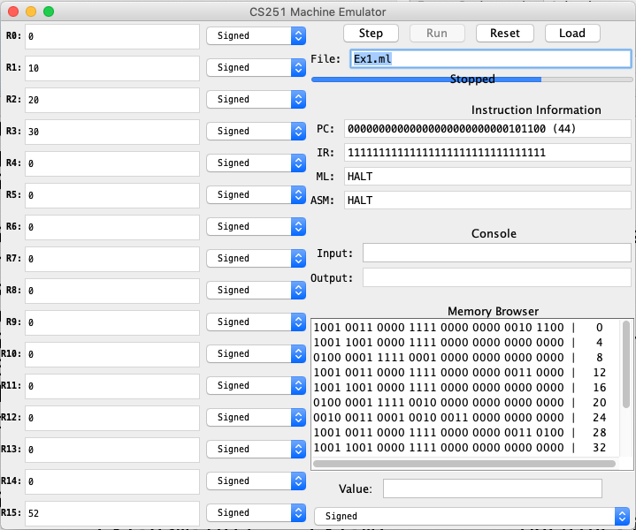
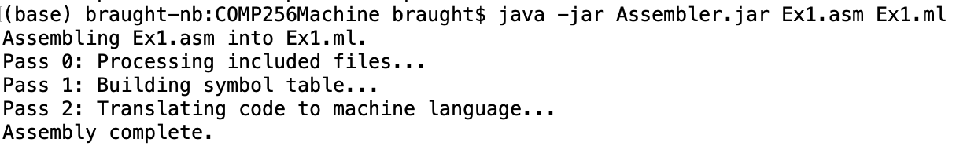
Editor, Assembler and Machine Demo
Notes:
Time permitting…
- Details are also in screen casts that are linked in the activities
- So you don’t have to memorize this.

Slide 14
Assembly Language Terminology
Notes:
Type directive… allocates space for a word (32-bits)
- others for bytes and half words
Instructions, like when we discussed ML also have
Opcodes – tells what operation to perform
Operands – tells what the operation will be performed on.

Slide 15
Register to Register Instructions
A register to register instruction operates on values in the registers and stores the result in a register.
Instruction Example Meaning Comments
--------------------------------------------------------------------
ADD R R R ADD R1 R2 R3 R1 ← R2 + R3
SUB R R R SUB R1 R2 R3 R1 ← R2 - R3
AND R R R AND R1 R2 R3 R1 ← R2 & R3 Bitwise AND
OR R R R OR R1 R2 R3 R1 ← R2 | R3 Bitwise OR
NOT R R NOT R1 R2 R1 ← ~R2 Bitwise NOT
SHL R R SHL R1 R2 R1 ← R2 << 1 LSb = 0
SHR R R SHR R1 R2 R1 ← R2 >>> 1 MSb = 0
MOV R R MOV R1 R2 R1 ← R2 Copy
Notes:
Not going to talk about all of these.
What I want is for you to understand how to read this reference.
A full reference will be given in the activities.
Register to Register Instructions.
The ADD that we saw in the example is an example of a Register to Register instruction.
- Just like any other language there are rules about what you are allowed to write
- Each instruction has a format
- here the operands must be registers (Typically R0-R11)
- Might be tempted to put in a number in place of R2 or R3.
- Will not work.
- We will see how to do that in a moment.
- Requires a different type of instruction.
- The order in which they appear is critical as given by the meaning
SUB, AND, OR are similar to K&S.
- This machine has a more sophisticated ALU
- So it can perform more operations
- You’ll get experience with the others in the activities.

Slide 16
Direct Addressing Mode Instructions
In a direct addressing mode instruction, the label is used (directly) as a memory address.
Instruction Example Meaning Comments
--------------------------------------------------------------------
LOAD R L LOAD R1 X R1 ← MM[X] Direct Mode
STORE R L STORE R1 X MM[X] ← R1 Direct Mode
Notes:
The LOAD and STORE that we have used are examples of direct addressing mode instructions.
LOAD:
- Moves a value from MM to a register
- Operands must be a register (typically R0-R11) followed by a label.
- will not work the other way around,
- Similar to register to register you may be tempted to put in a number instead of the label.
- will not work
- We will see how to do that in a moment.
STORE
- Same format
- Operands must be a register (typically R0-R11) followed by a label.
- Moves a value from a register to MM.

Slide 17
Immediate Addressing Mode Instructions
In an immediate addressing mode instruction, the value of the final operand is preceded by a # and is used as a literal value (i.e. “immediately”).
Instruction Example Meaning Comments
--------------------------------------------------------------------
ADD R R # ADD R1 R2 #231 R1 ← R2 + 231 Immediate Mode
SUB R R # SUB R1 R2 #1 R1 ← R2 - 1 Immediate Mode
AND R R # AND R1 R2 #0xF00F R1 ← R2 & 0xF00F Immediate Mode
OR R R # OR R1 R2 #b1001 R1 ← R2 | b1001 Immediate Mode
LOAD R # LOAD R1 #27 R1 ← 27 Immediate Mode
Notes:
I said we can’t use specific numbers with the Register to Register or Direct Addressing Mode instructions.
If you want to use a specific value:
- Add 231
- Subtract 1
- Put 27 into a register
Then you need to use an Immediate Addressing Mode Instruction.
We haven’t seen an example of these yet
- but they aren’t too hard to get your head around.
- They just allow the final operand to be a literal value instead of a register.
- But you must use the # symbol
- And only the final operand is allowed to be a number.
You’ll get some practice with these in the Activities.

Slide 18

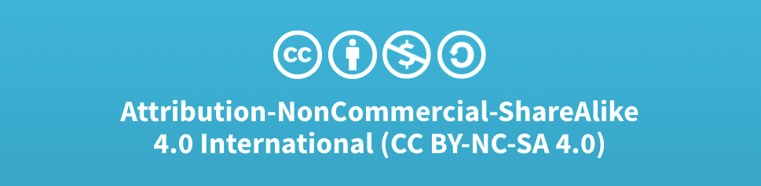
Acknowledgments
Slide Template From:
https://creativecommons.org/licenses/by/4.0/
Slide Content Licensed as:
Creative Commons Attribution-NonCommercial-ShareAlike 4.0 International License.

Slide 19
Type Directive
(32 bit word)
Initial
Values
Labels
Comments
// HLL
int A=10;
int B=20;
int C=0;
C = A + B;
* Assembly Language
A: .word 10 * MM[A] ← 10
B: .word 20 * MM[B] ← 20
C: .word 0 * MM[C]
* Program code starts here.
LOAD R1 A * R1 ← MM[A]
LOAD R2 B * R2 ← MM[B]
ADD R3 R1 R2 * R3 ← R1 + R2
STORE R3 C * MM[C] ← R3
HALT
Variable
Declarations
Program
Instructions
OpCodes
Operands

Slide 20
Input and Output
// HLL
int X;
int Z;
Read X;
Z = 2*X-1;
Print Z;
* Assembly Language
X: .word
Z: .word
* Program code starts here.
LOAD R1 STDIN * R1 ← MM[STDIN]
STORE R1 X * MM[X] ← R1
ADD R2 R1 R1 * R2 ← 2* R1
SUB R2 R2 #1 * R2 ← R2 - 1
STORE R2 Z * MM[Z] ← R2
STORE R2 STDOUT * MM[STDOUT] ← R2
HALT

Slide 21
Download the Assembler and Machine Simulator
Make a folder COMP256ASM in your Documents folder.
Download the following files into your COMP256ASM folder:
The Assembler:
https://github.com/dickinson-comp256/AsmMachine/raw/main/Assembler/bin/Assembler.jar
The Machine Simulator:
https://github.com/dickinson-comp256/AsmMachine/raw/main/Machine/bin/Machine.jar

Slide 22
Run the Assembler and Machine Simulator
Open a command line interface:
Mac: Applications ➔ Utilities ➔ Terminal.app
Win: Press Win + X (or right-click the Start button) and choose Command Prompt from the menu.
Change to your COMP256ASM folder:
Mac: cd Documents/COMP256ASM
Win: cd My Documents/COMP256ASM
Run the Assembler:
java –jar assembler.jar
Run the Machine Simulator:
java –jar machine.jar

