Slide 1
S
S
S
P
P
P
G
0
G
1
G
D
D
D
D
D
D
N
N
N
G
0
G
1
G
S
S
S

Slide 2
D
Resistor
C
C
NPN
NPN
B
E
B
E
E
Capacitor
Q
Ground

Slide 3


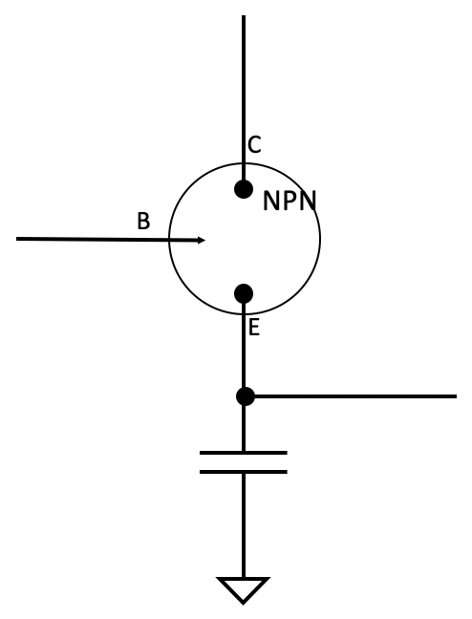
0
0
1
1
1
0
D
D
0
D
0
D
D
1
D
1
1
E
Q
0
0
E
Q
0
E
Q
1
E
Q
1
0
E
Q
0
E
Q
(A)
(B)
(C)
(D)
(E)
(F)
0
0
1
1
1
0
1
0
0
1
0
0
0
0
0
0
(i)
(ii)
(iii)
(iv)
(v)
(vi)

Slide 4
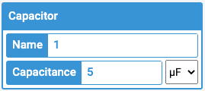
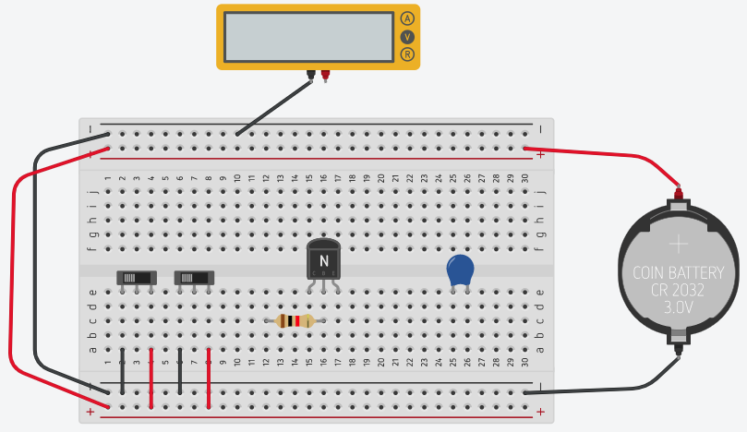
E
D
Resistor
Capacitor

Slide 5
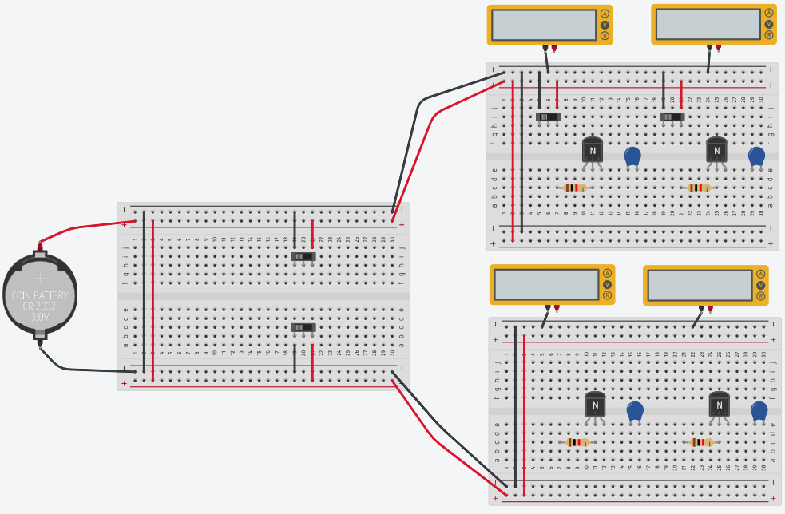
D₁
D₀
Address 0
bit_{0,1}
bit_{0,0}
E₀
E₁
Address 1
bit_{1,1}
bit_{1,0}

Slide 6
D₁
D₀
E
bit_{0,1}
E
bit_{0,0}
Address 0
E₀
bit_{1,1}
bit_{1,0}
Address 1
E
E
E₁

