Slide 1
MA2 – A Machine Language Machine
COMP 256 – Dickinson College
Prof. Braught
Spring 2023

Slide 2

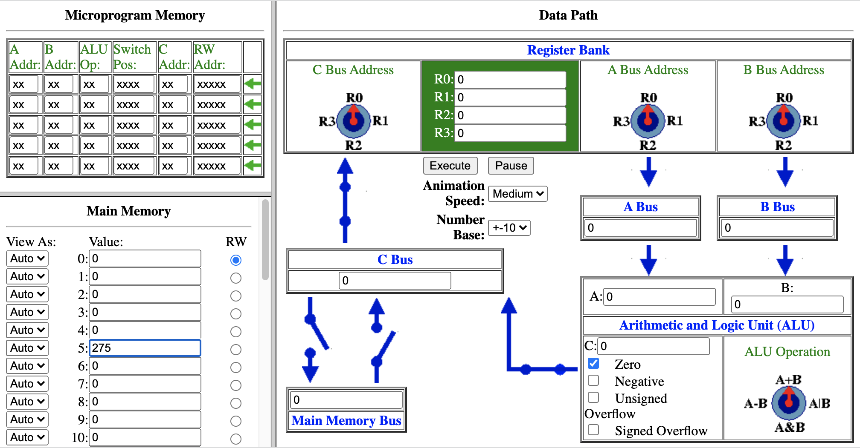
Motivating the Machine Language Abstraction
Write a microprogram for the K&S computer that will double the value in memory address 5 and place it memory address 6.
https://dickinson-comp256.github.io/Knob-And-Switch-Computer/micromachine.html
Notes:
A little warmup exercise and a chance to review the microprogramming from the homework.
- Don’t need to finish… just get one or two instructions done.
- Ask: What operations did you use?
- Describe them in words.
There are many different solutions.
- Not essential that you get the one on the next slides.

Slide 3
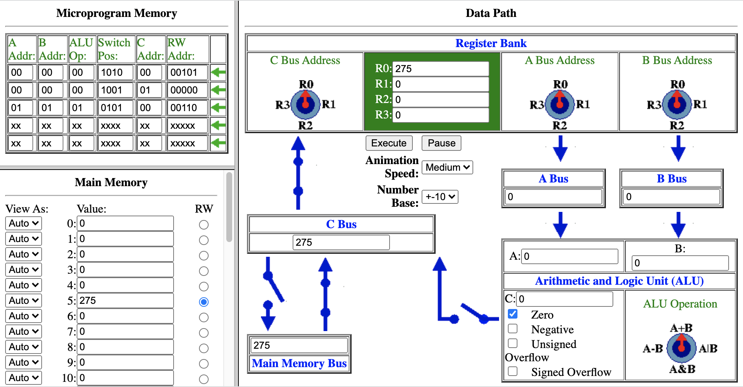
Motivating the Machine Language Abstraction
Write a microprogram for the K&S computer that will double the value in memory address 5 and place it memory address 6.
https://dickinson-comp256.github.io/Knob-And-Switch-Computer/micromachine.html
Move value from memory address 5 to R0
R0 ← MM[5]
Convenient Shorthand
Notes:
To come up with the highlighted instruction we had to think about:
- values for A and B and the ALU operation
- switch positions
- But what we really want to do is:
- Move MM[5] to R0.
- So there are lots of details that we had to think about that don’t really matter to us in doing what we want to do.
hummm…. What was that abstraction thing again…
- It can let us focus on information that matters to us
- and ignore the details that don’t.
Well what matters here when trying to perform this operation...
- We need to move data from a memory address to a register
- So we need to think about
- The memory address containing the data
- The destination register for the data
- There is no point in us thinking about the rest of it
- R0, R1, ALU don’t matter to us for this operation
- And even though the switch positions matter
- They are implementation details
- They have to be set, but again, I just want to move data from memory to a register
- Why do I have to think about switches?
- It would be great if we didn’t have to worry about them either.
So really we just want to say:
- Move MM[5] into Register 0.
- and not worry about anything else.
We’ll use a shorthand to specify the operations…
- Here R0 <- MM[5] is a convenient way to write what we want
- Means copy the contents of main memory address to register 0.
- Writing it this way also emphasizes that we only need to focus on the relevant information.

Slide 4
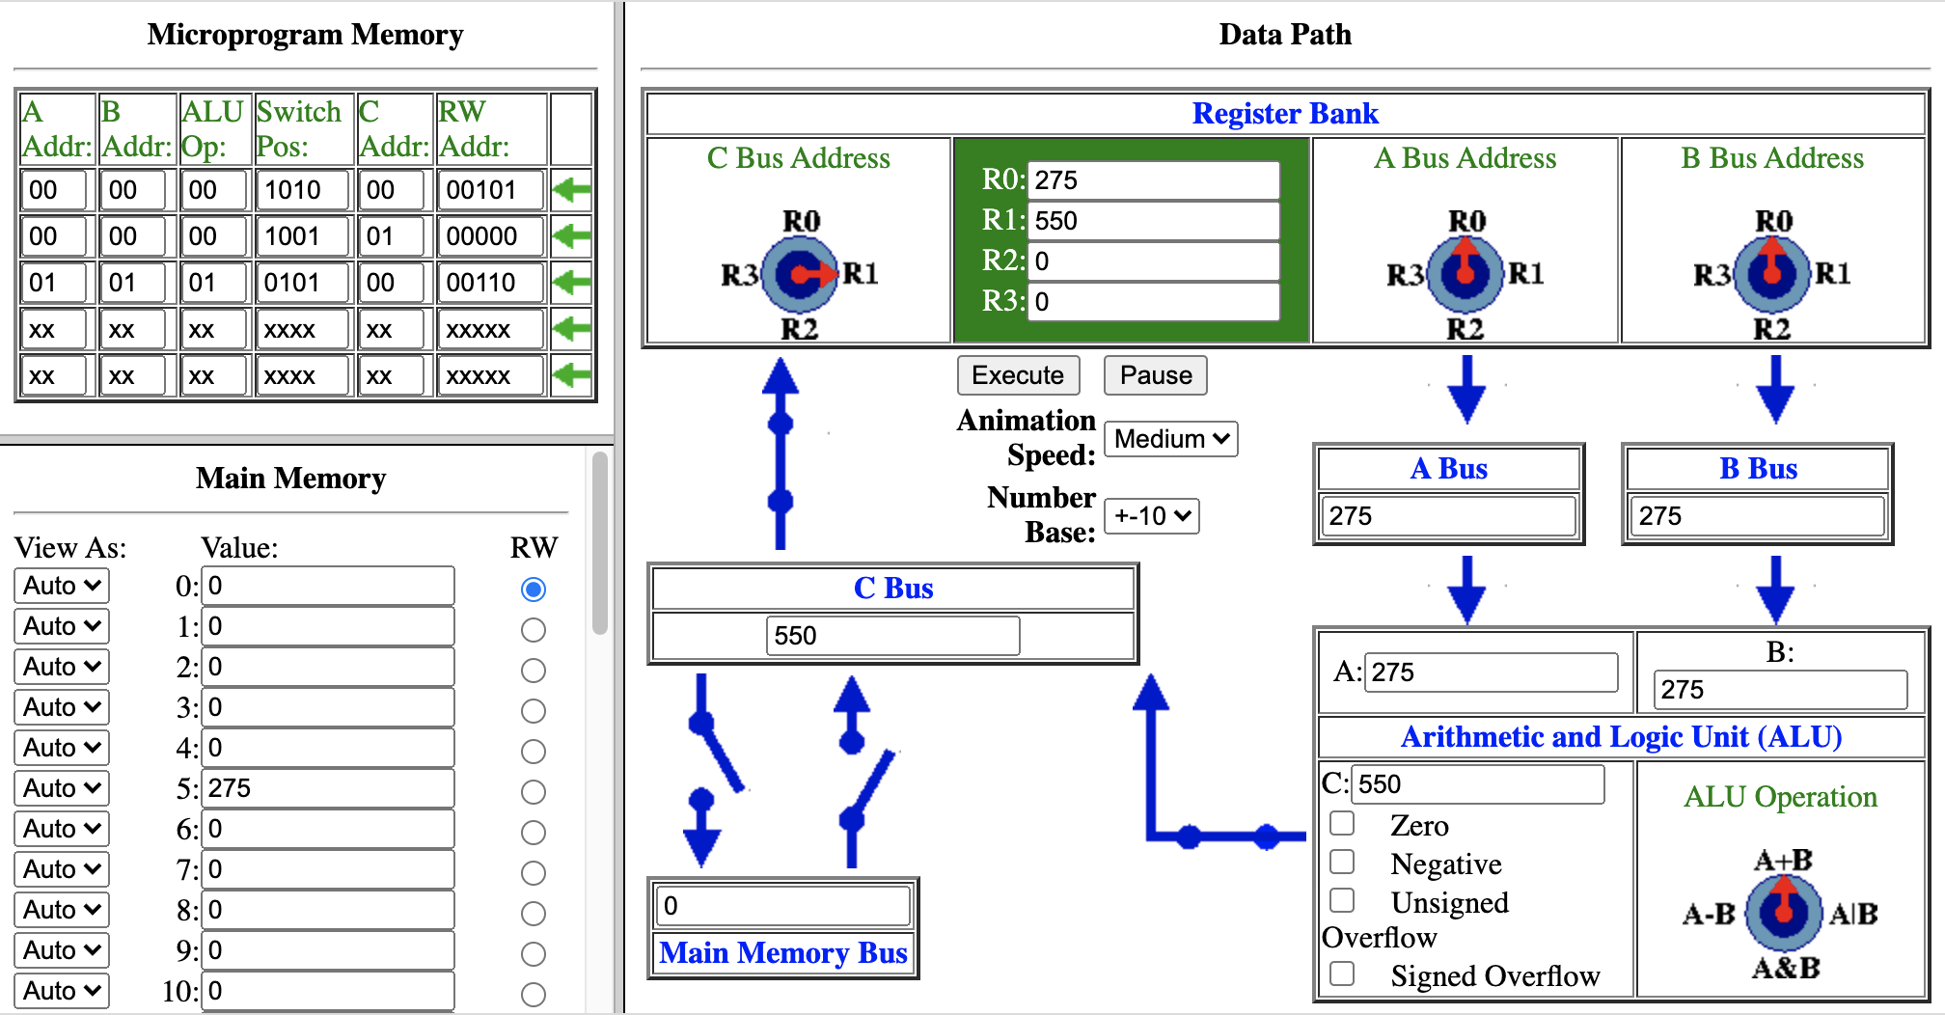
Motivating the Machine Language Abstraction
Write a microprogram for the K&S computer that will double the value in memory address 5 and place it memory address 6.
https://dickinson-comp256.github.io/Knob-And-Switch-Computer/micromachine.html
Move value from memory address 5 to R0
R0 ← MM[5]
Add R0 to itself and put the result in R1
R1 ← R0+R0
Notes:
The information that is relevant to us is the 3 registers involved and the ALU operation.
- R0, R0 for A and B
- A+B for the ALU
- R1 for the result
The switches still matter, but …
- But again, If we could just know we want to add 2 registers and put the result back into a register and not worry about the switches that would be better.
The fact that we had to think about a memory address though is not good…
- It is completely irrelevant to this operation.
- But at the microinstruction level of abstraction we have to put one in anyway.
Maybe we are starting to get the idea that an abstraction here would be nice…
A good abstraction will:
- let us focus on which registers we want to add and where to put the result
- let us ignore the other stuff.
We can use a similar shorthand here:
- R1 <- R0 + R0
- Add R0 to R0 and put the result into R1.

Slide 5

Motivating the Machine Language Abstraction
Write a microprogram for the K&S computer that will double the value in memory address 5 and place it memory address 6.
https://dickinson-comp256.github.io/Knob-And-Switch-Computer/micromachine.html
Move value from memory address 5 to R0
R0 ← MM[5]
Add R0 to itself and put the result in R1
R1 ← R0+R0
Move the value in R1 to memory 6.
MM[6] ← R1
Notes:
Here we go again…
- You get the idea…
What is relevant to us here is
- We want to copy the value of R1
- into Main memory at address 6.
Our shorthand here is:
- MM[6] <- R1
- Copy the value of R1
- Into main memory address 6.

Slide 6
Machine Language (ML) Instructions
ML Instructions are an abstraction!
R0 ← MM[5]
R1 ← R0+R0
All K&S ML
instructions are
16 bits long
RC ← MM
RC
MM
1000 0001 0
00
00101
OpCode
Operands
RC ← RA+RB
RC
RA
RB
1010 0001 00
01
00
00
OpCode
Operands
Notes:
The abstraction that we’ve been hinting at is called Machine Language
- abbreviated ML
- The main idea here is to
- express the operation we want to perform using 1’s and 0’s
- but avoid having to specify the stuff we don’t care about.
- this will let us focus more on what we are trying to do
- because we don’t have to think about stuff that doesn’t matter
- e.g. switch positions.
Each of the operations we’ve been looking at (and lots of others) have corresponding machine language instruction.
For the K&S all of the ML instructions will be patterns of 16 bits.
Those bits are broken into 2 main parts:
- OpCode – indicates the operation to be performed.
- Operands – indicate the data to be used in the operation.
OpCode
- There is a unique pattern of bits for each operation that the computer can perform.
- These are specified by Computer Architect and circuits are built to process them.
- The architect will have reasons for choosing the patterns are used
- But we don’t need to care just as long as we know what they are.
- Programmers then use these OpCodes as an ABSTRACTION
- So that we do not need to know the inner workings of the machine.
- Don’t need to know the switch positions.
- Don’t need to think about irrelevant details (e.g. the memory address when doing ADD)
Operands
- indicate the data to be used in the operation.
- The number and size of the operands will vary based on what is needed by the operation.
- R0 <- MM[[5] has two operands
- One specifies the C register in 2 bits.
- One specifies the memory addres in 5 bits.
- R1 <- R0 + R0 has three operands
- Two bits each for the C, A and B registers.
There are a few examples here to get the big idea…
- R0 <- MM[5] is expressed in the K&S ML as 1000 0001 0 00 00101
- R1 <- R0 + R0 is expressed in the K&S ML as 1010 0001 00 01 00 00
- If you look at those you may notice some of the relevant information…
- In R0 <- MM[5]
- 00 is going to indicate R0
- 00101 is going to indicate MM[5]
- In R1 <- R0 + R0
- 01 is going to indicate R1
- 00 and 00 is going to indicate R0 and R0
- The other bits (the OpCode) indicate which operation we are performing.
- The computer designer would have picked these patterns.
- So 1000 0001 0 always means move a value from memory to a register.
- and 1010 0001 00 always means add two registers and put the result in a register.
ML instructions are the next level up the abstraction hierarchy from microinstructions
- They let us focus on what is relevant to our task
- registers, memory addresses, ALU operation.
- while ignoring details that are irrelevant to our task.
- switch positions
- memory address sometimes,
- source registers sometimes.
- destination register sometimes,

Slide 7
K&S Machine Language Reference
Data Movement Instructions
Arithmetic and Logic Instructions
RC ← MM
RC
MM
RC ← RA + RB
RC
RA
RB
1000 0001 0
xx
xxxxx
1010 0001 00
xx
xx
xx
MM ← R
R
MM
RC ← RA - RB
RC
RA
RB
1000 0010 0
xx
xxxxx
1010 0010 00
xx
xx
xx
RC ← R
RC
R
RC ← RA & RB
RC
RA
RB
1001 0001 0000
xx
xx
1010 0011 00
xx
xx
xx
Halt
RC ← RA | RB
RC
RA
RB
1010 0100 00
xx
xx
xx
1111 1111 1111 1111
Notes:
The K&S is a small computer.
It has a very limited number of machine language instructions.
There are Data Movement Instructions that move data
- From a memory address to a register (RC <- MM)
- From a register to a memory address (MM <- R)
- Recall we put the same register on both A and B and used OR to do this.
- Which is why this instruction says R and not RA or RB.
- From a register to another register (RC <- R)
Note that ”Data Movement” is a bit of a misnomer
- These instructions actually copy the data
- It is not actually removed from its original spot
Notice that the pattern of bits for each instruction is different
- To move data from MM into a register
- We use the first instruction.
- The opcode is 1000 0001 0
- The operands specify the register and the memory address
- To move data from a register to MM
- We use the second instruction.
- The opcode is 1000 0010 0
- The operands specify the register and the memory address.
There are different instructions for Arithmetic and Logic operations
- To subtract
- We use the second instruction
- The opcode is 1010 0010 00
- The operands specify the destination and the source registers.
There is one more special instruction we need to know now.
- Halt
- This is always the last instruction in the program
- It stops the computer
- like a shutdown.

Slide 8
Machine Language Programs
Write a machine language program for the K&S computer that performs the computation: MM[7] = MM[8] + MM[9] And then halts.
Operation
R0 ← MM[8]
Notes:
Talk through…
What do we need to do in order to accomplish this?
- Define the sequence of operations that will accomplish the task.
- Here’s the first one…
- Write the rest of them out using our shorthand…
- We’ll then discuss them…
- Then once we have that we’ll turn them into Machine Language.

Slide 9
Machine Language Programs
Write a machine language program for the K&S computer that performs the computation: MM[7] = MM[8] + MM[9] And then halts.
Operation
Machine Language Instruction
1000 0001 0 00 01000
R0 ← MM[8]
R1 ← MM[9]
R2 ← R0 + R1
MM[7] ← R2
HALT
Notes:
The next step is to translate each one of those operations into the corresponding ML
- Find the ML instruction that will accomplish the task.
- Write down its OpCode
- Fill in its operands.
Do the first one:
- It is moving something from memory to a register.
- Go back to Reference…
- Find the instruction RC <- MM
- Its opcode is 1000 0001 0
- Its operands are:
- RC in 2 bits – so 00 for R0
- MM is the memory address in 5 bits – so 01000 for address 8.
Work out the next four instructions.

Slide 10
Machine Language Programs
Write a machine language program for the K&S computer that performs the computation: MM[7] = MM[8] + MM[9] And then halts.
Operation
Machine Language Instruction
1000 0001 0 00 01000
1000 0001 0 01 01001
1010 0001 00 10 00 01
1000 0010 0 10 00111
1111 1111 1111 1111
R0 ← MM[8]
R1 ← MM[9]
R2 ← R0 + R1
MM[7] ← R2
HALT
Notes:
These came directly from the reference:
R1 <- MM[9]
- a lot like the first one… same instruction so same OpCode
- The operands are different
- RC in 2 bits is 01 for R1
- MM in 5 bits is 01001 for address 9.
R2 <- R0 + R1
- Here we need an arithmetic instruction
- RC <- RA + RB
- The OpCode is 1010 0001 00
- The operands are:
- RC (the destination) in 2 bits is 10 for R2
- RA in 2 bits is 00 for R0
- RB in 2 bits is 01 for R1
MM[7] <- R2
- This is the instruction MM <- R for moving data from a register to memory
- The OpCode is 1000 0010 0
- The operands are:
- R the register to get the value from in 2 bits is 10 for R2
- MM the memory address to put it in, in 5 bits is 00111 for address 7.
The last instruction is the halt.
- Its opcode is all 1’s and it has no operands.

Slide 11
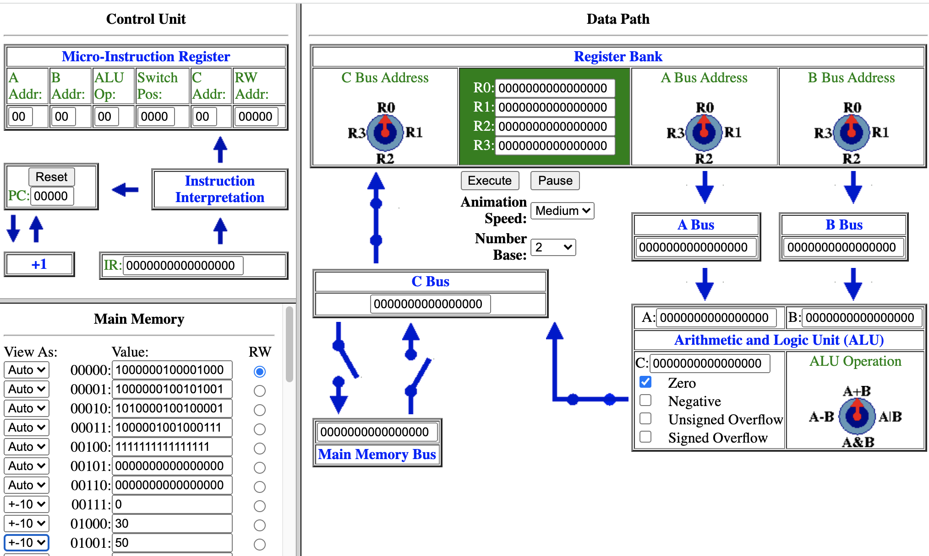
Running K&S Machine Language Programs
https://dickinson-comp256.github.io/Knob-And-Switch-Computer/machine.html
2. Enter the ML program in binary starting at address 0
3. Enter the data for the program at the necessary addresses in base 10.
1. Set the machine to operate in base 2
Notes:
Running a Machine Language Program.
- Use the Machine Language Machine link above.
- or the link in the slide above.
1. Set the machine to operate in base 2
- This will make it easy for us to enter our ML
- And will let us see the ML instructions.
2. Enter Machine Language (ML) instructions into the main memory.
- Start at address 0
- Enter each ML instructions in binary in subsequent addresses.
3. Enter the data we need into the main memory
- Can be in whatever cell we want as long as it doesn’t interfere with the program.
- Auto setting matches main setting in datapath so we would have to do this in binary.
- But +-10 is usually the more convenient for data
- So, you can change the individual memory cells to +-10.
- It is of course still two’s complement binary behind the scenes, but it is easier for us to look at in decimal.
Note: Don’t do the demo here, its coming later…

Slide 12
Running K&S Machine Language Programs
https://dickinson-comp256.github.io/Knob-And-Switch-Computer/machine.html
Notes:
Control Unit is new to this version of the machine.
- It is a hardware circuit that controls the the execution of ML programs stored in memory.
It does the work of running the ML instructions
- takes the ML instructions one by one.
- translates each one into the appropriate microinstruction to configure the machine.
But…
- The key here is we don’t have to think about the microinstruction any more.
- it is the circuits in the control unit that do it for us.
- it implements our abstraction.
- it is what lets us think about ML instead of the machine configuration.
- it does that work, that translation for us.

Slide 13
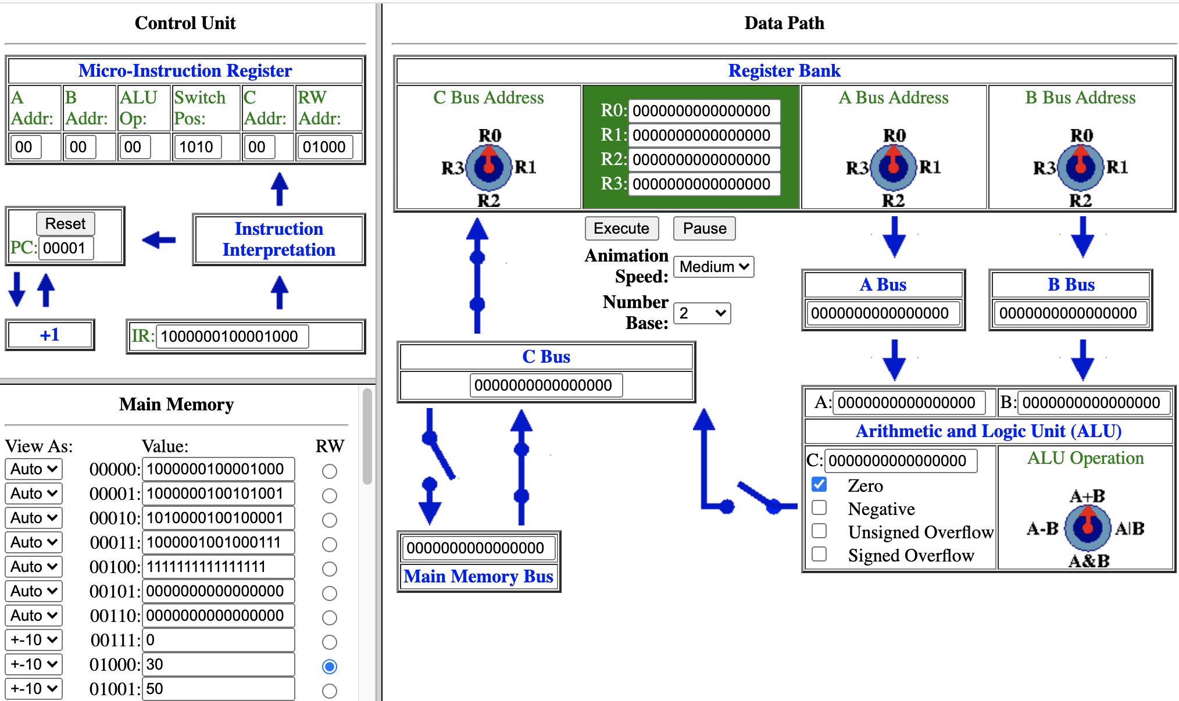
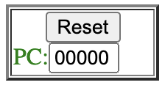
Running K&S Machine Language Programs
https://dickinson-comp256.github.io/Knob-And-Switch-Computer/machine.html
PC: Program
Counter
IR: Instruction
Register
Notes:
Let’s pick the control unit apart and see how it does what it does.
The main parts are:
- The Program Counter (PC)
- The Instruction Register (IR)
- The Instruction Interpretation Unit
The Program Counter
- Abbreviated PC
- Holds the memory address of the instruction that is to be executed.
- Starts at 00000
- which is why we put the first instruction of our program at zero.
The Instruction Register
- Abbreviated IR
- Holds the machine language instruction that is being executed.
- The address in the PC is used to get the instruction from the memory location.
- So because PC = 0 the ML instruction at MM[0] has ben moved to the IR.
The Instruction interpretation Unit
- This is a circuit that
- takes the bits of the ML instruction in the IR as input
- generates the microinstruction(s) needed to carry out the operation
- The microinstruction that is generated configures the machine
- This is exactly like it did before, but now we don’t have to write it.
- instead we wrote the ML, which is nicer because we can ignore the irrelevant details.
- Once configured, the machine executes the instruction.
As the instruction is being executed:
- The PC is incremented and becomes 00001
- That way it has the address of the next instruction in the program.
- And that instruction will be the next one that is fetched into the IR
This process repeats over and over until a HALT instruction is encountered.
- The HALT instruction causes the machine to stop.

Slide 14

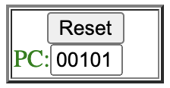
Demo
Demo of the K&S running the machine language program.
https://dickinson-comp256.github.io/Knob-And-Switch-Computer/machine.html
Pro Tip:
Don’t forget to reset the PC when you want to re-run your program!
Notes:
Load in the ML program
- typed in advance
- but demo typing a few.
As it runs watch:
- PC blinks
- The ML instruction at the address in the PC moves to the IR
- The ML instruction in the IR is translated into a microinstruction
- The machine is configured
- The instruction is executed
- e.g. R0 <- MM[8]
- As that happens the PC is incremented (i.e. has 1 added to it)
- so it is ready for the next instruction.
- Repeats over and over and over again.
Notice that the PC has the address after the HALT (e.g. 5)
- So need to reset that when you want to execute again.
- Otherwise the program will begin executing with the instruction at address 5.
- Which is not supposed to be an instruction…
- But the computer doesn’t know that… it just sees a pattern of bits.
- When you put that address in the PC you are telling the computer to interpret it as an instruction.
- Note: 0000 0000 0000 0000 is called NOP for No Operation.
- Just tells the computer to do nothing for that instruction.

Slide 15
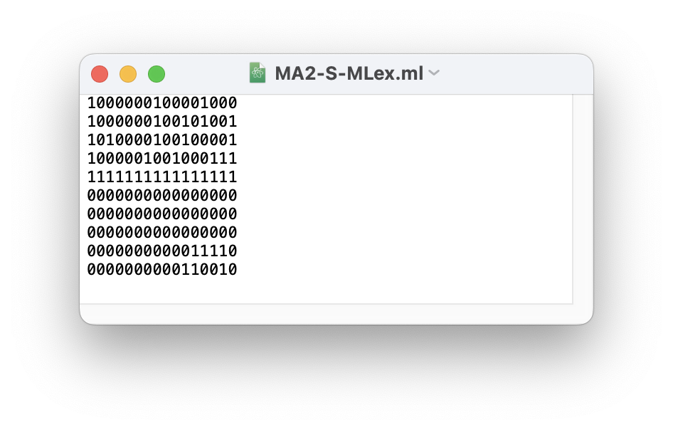
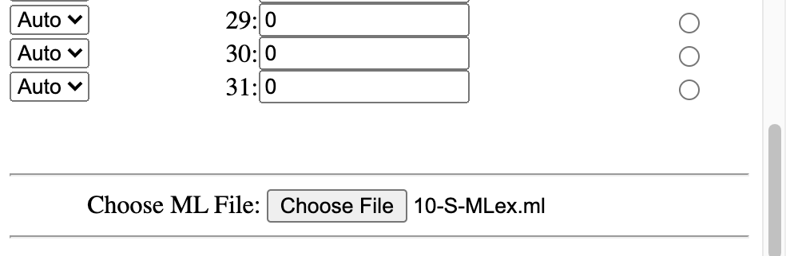
Editing ML Programs
Pro Tip:
You can edit your ML programs in a text editor and load them into the K&S!
MA2-S-MLex.ml
Notes:
Note:
- You can also write the ML in a plain ascii text editor
- Notepad on Windows
- TextEdit on Mac
- To use TextEdit you need to open preferences and set it to use plain text for new files
- Then create a new file and edit there.
- Eclipse
- VSCode / VSCodium
- Then you can load that file into the memory using the button at the bottom of the memory.
- A few quirks:
- Must have a blank line at the bottom.
- Must reload page, then reload the file, to get it to update.
Simply write the ML and any data into the file with one line per memory address.
- Note the rows of 0000000000000000 following HALT
- These are for addresses 5,6,7
- Then come the values for address 8 (30) and 9 (50).
1000000100001000
1000000100101001
1010000100100001
1000001001000111
1111111111111111
0000000000000000
0000000000000000
0000000000000000
0000000000011110
0000000000110010

Slide 16
Try It
https://dickinson-comp256.github.io/Knob-And-Switch-Computer/machine.html
Write a machine language program for the K&S computer that will place the complement of (i.e. -1 times) the value in memory address 10 into memory address 11.

Slide 17

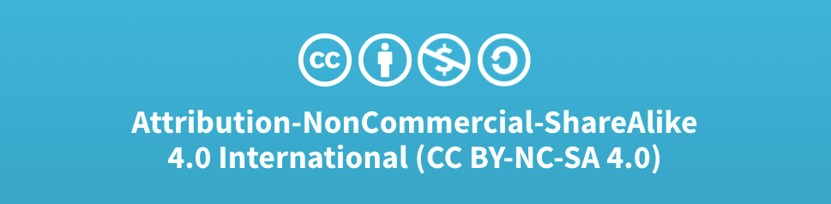
Acknowledgments
Slide Template From:
https://creativecommons.org/licenses/by/4.0/
Slide Content Licensed as:
Creative Commons Attribution-NonCommercial-ShareAlike 4.0 International License.
Notes:
Note: Individual images may be covered by their own licensing agreements and were incorporated here under fair use. Their use in this slide deck does not change or alter their licensing.

Slide 18
K&S Machine Language Reference
Data Movement Instructions
Arithmetic and Logic Instructions
RC ← MM
RC
MM
RC ← RA + RB
RC
RA
RB
1000 0001 0
xx
xxxxx
1010 0001 00
xx
xx
xx
MM ← R
R
MM
RC ← RA - RB
RC
RA
RB
1000 0010 0
xx
xxxxx
1010 0010 00
xx
xx
xx
RC ← R
RC
R
RC ← RA & RB
RC
RA
RB
1001 0001 0000
xx
xx
1010 0011 00
xx
xx
xx
Halt
RC ← RA | RB
RC
RA
RB
1010 0100 00
xx
xx
xx
1111 1111 1111 1111

