Slide 1
LA2 – Assembly Language Programs
COMP 256 – Dickinson College
Prof. Braught
Spring 2023

Slide 2
Program Execution
Huge Idea: Use programs to convert instructions for high-level language machines into machine language instructions.
Compiler, Assembler, Interpreter, Virtual Machine
pay=salary+bonus;
High-Level Language Machine
pay=salary+bonus;
Compiler
Compiler
Translation
Interpreter
ASM
Interpretation
Hybrid Approach
Byte
Code
Assembler
Virtual Machine
R0 ← R1 + R2
Machine Language Machine
Notes:
Last time we saw that there were 3 different approaches to running HLL programs
We discussed translation, interpretation and a hybrid approach.
You’ve gotten some more experience with interpretation
- At least started writing an interpreter for the Silli HLL in lab.
For the rest of this topic in class (LA2-LA6)
- we’ll focus our attention on the translation process.
We won’t spend any significant time on the Hybrid Approach
- it may come up in passing here and there
- but by better understanding translation and interpretation you’ll better understand it
- that said feel free to ask questions about it at any point.

Slide 3

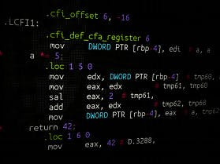
Language Translation
In our translation model a compiler translates high-level language programs to assembly language. An assembler then converts that assembly language to machine language.
Assembly (ASM) Language
(or intermediate language)
Source Code Program
High-Level Language
Source Code Program
Machine Language Executable Program
Compiler
Assembler
High-Level Language Machine
Assembly Language Machine
Machine Language Machine
Images from: computerhope.com and https://www.hackster.io/LiLShReDdeR/introduction-to-assembly-language-with-freescale-451d29
Notes:
So we will be focusing on translation:
- We will do this by playing the role of the compiler
- We’ll look at HLL code
- We will translate it into assembly language
- We will see how many of the things we do in HLL are done in assembly language
- if/for/while/arrays/objects/functions/recursion
- Once we’ve “compiled” the HLL code into Assembly Language
- We’ll use an assembler
- The assembler will read our assembly language source code program as input
- and turn it into an executable machine language program
- We will then use a machine simulator (like the K&S) to execute the ML programs.

Slide 4
Assembly Language Programming
"He who hasn't hacked assembly language as a youth has no heart. He who does as an adult has no brain." John Moore
Uses:
Precise control of the system
Highly optimized performance
E.g. Operating systems, device drivers, real-time control systems, game engines
Reinforce our understanding how computers really work
Notes:
Before we begin:
A thought from John Moore
- CS Prof at the Citidel (Military College of South Carolina) and author of a textbook on compiler design
- So, someone that clearly works with lower level languages and likely assembly language too…
- So, take that with a grain of salt.
That said, I kind of enjoy assembly language programming…
- so I’m not sure what that says about me.
- But I find the simplicity of the instructions and the more direct connection to the machine appealing and fun.
- So, if you find you enjoy it too, do what I do and just ignore this guy!
- And if you don’t necessarily enjoy it then know that you won’t need to do it for long
- but that it is a good learning exercise and will give you important perspective as a computer scientist.

Slide 5
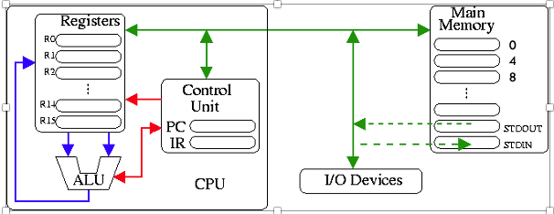
The Machine
Expanded Knob & Switch
Simplified MIPS-like architecture & assembly language.
Larger
Main Memory
16 Registers
32-bit word size
R0-R11 General Use
R12-R15 Reserved
Memory Mapped
Input/Output
32-bit ALU
Two’s Complement
Integer Arithmetic
Notes:
This is the machine that we will be programming in assembly.
Main differences from Knob and Switch
- more registers
- each holds 32 bits – recall that is the “word size”
- R0-11 – General Purpose Registers
- You can use these however you want
- They are just like R0-R3 in the Knob and Switch computer.
- R12-15 – Reserved Registers
- Each of these will have a special purpose
- We will get to them soon.
- For now, you won’t use any of them in your computations.
The ALU
- Operates on 32 bit values.
- All arithmetic operations are done on 32-bit two’s complement values.
Lots of Main Memory:
- Each byte has an address
- We’ll be working with words (i.e. 32 bits or four bytes at a time.)
- So, the addresses are 0, 4, 8, 12 instead of 0, 1, 2, 3 which refer to the individual bytes)
- 32-bit memory addresses
- So up to 2^32 bytes of memory – in theory…
- practically we’ll never use more than a few hundred bytes.
This machine has a rudimentary ability to read input from the user and print output
- Memory mapped Input/Output
- We will do input/output by by accessing designated memory locations
- The machine hardware then intercepts those accesses and directs them to the right I/O device.
- More on this in the activities.
The architecture and assembly language is a simplified version of the MIPS machine.
- commercial processor architecture through mid 20-teens.
- Used in routers, game systems (Nintendo / Playstation)
- Still has a significant presence in the embedded processor market.
- Clean and elegant – great for studying the principles of processor design.
- Was not burdened with backward compatibility like intel.
- So used extensively in education.
- MIPS = Microprocessor without Interlocked Pipelined Stages

Slide 6
Assembly Language: A First Example
// HLL
int A=10;
int B=20;
int C=0;
C = A + B;
* Assembly Language
A: .word 10 * MM[A] ← 10
B: .word 20 * MM[B] ← 20
C: .word 0 * MM[C] ← 0
* Program code starts here.
LOAD R1 A * R1 ← MM[A]
LOAD R2 B * R2 ← MM[B]
ADD R3 R1 R2 * R3 ← R1 + R2
STORE R3 C * MM[C] ← R3
HALT
Notes:
Our first example
- Examples will often be setup like this.
- We’ll have a HLL program on the left
- and then we’ll translate it into assembly language on the right.
- I.e. We are playing the role of the compiler.
I’ll give you a quick, high-level overview of the assembly here
Then we’ll pick that apart and get all of the details on the next few slides.
The big features:
- comments start with *
- variable declarations A:, B:, C:
- correspond to global variables in the HLL.
- set aside 1 word (4 bytes, 32 bits) for each value.
- The comments use our shorthand notation to describe what the ASM does in terms of the machine.
- These are here to help you learn
- but are not typical of useful comments for anyone who knows assembly language programming.
- program code
- Move the values from main memory at A and B to registers 1 and 2
- Add those together and put the result in R3.
- Put that result back into main memory at C
- STOP
The Assembly language instructions share similarities to ML instructions.
- They have an OpCode
- We just use a word instead of bits.
- E.g. LOAD or ADD or STORE
- They have operands
- We just use registers and names instead of bits
- E.g. R1, R2, A, B, C

Slide 7
Assembly Language: A First Example
Main Memory
0:
4:
…:
36:
40:
44:
48:
52:
56:
…:
ML
Program Instructions
Data
// HLL
int A=10;
int B=20;
int C=0;
C = A + B;
* Assembly Language
A: .word 10 * MM[A] ← 10
B: .word 20 * MM[B] ← 20
C: .word 0 * MM[C] ← 0
* Program code starts here.
LOAD R1 A * R1 ← MM[A]
LOAD R2 B * R2 ← MM[B]
ADD R3 R1 R2 * R3 ← R1 + R2
STORE R3 C * MM[C] ← R3
HALT
Notes:
Now let’s look more closely at what is happening.
To run an assembly program
- it has to be translated into ML by an assembler.
- and then loaded into the main memory.
When an assembler does the translation
- it creates an executable ML file.
- the exact format of that file depends on the operating system being used.
- but typically…
- The machine language instructions come first
- They are then followed by the global data for the program.
This is consistent with the way we worked with the K&S.
- The ML program instructions were placed into memory at address 0
- Then we put the data later in the memory.

Slide 8
Assembly Language: A First Example
Main Memory
0:
4:
…:
36:
40:
A 44: 10
B 48: 20
C 52: 0
56:
…:
ML
Program Instructions
Labels
// HLL
int A=10;
int B=20;
int C=0;
C = A + B;
* Assembly Language
A: .word 10 * MM[A] ← 10
B: .word 20 * MM[B] ← 20
C: .word 0 * MM[C] ← 0
* Program code starts here.
LOAD R1 A * R1 ← MM[A]
LOAD R2 B * R2 ← MM[B]
ADD R3 R1 R2 * R3 ← R1 + R2
STORE R3 C * MM[C] ← R3
HALT
A label is a memory address!
A is 44
MM[A] is 10
Notes:
So here
- The the assembler determined that the program would require 44 bytes.
- It then started putting data immediately after that.
- So, the value 10 is stored at address 44
- It is stored as a 32 bit two’s complement value.
- Note, if the program had needed 60 bytes
- then the value 10 would have been stored at address 60 instead.
- This global data comes immediately after the instructions.
- The value 20 is stored at address 48
- 4 bytes later because we have allocated a word (32 bits, 4-bytes) to A.
- Then the value 0 is stored at address 52.
********* Super Important ***********
In a HLL we often think of 10 as being stored in the variable A
In assembly we have to think about this a little differently.
A, B, C are called Labels
A label is a **** memory address ****
- So A is the memory address 44
- The value “10 is stored at memory address A” or 44.
Similarly:
- B is the memory address 48 and the value 20 is stored there.
- B = 48 and MM[B] = 20
- C is the memory address 52 and the value 0 is stored there.
- C = 52 and MM[C] = 0
The shorthand in the comments emphasizes this.
- 10 is not in A!
- 10 is in MM[A].
May just seem overly particular at this point…
- But this distinction becomes very important later.
- So training yourself to think this way now will help to make things easier later.
Note:
- I will be using specific locations for MM[A] – e.g. 44
- but this is just to make things concrete in the illustrations
- When writing the program we’ll never actually need to know that A is address 44
- We will just know that it is stored at address A.
- The concrete values just make easier to see it and think about how it is actually working.
- In fact, not needing to know those addresses is one of the things that the Assembly Language abstraction hides from us that the ML abstraction did not.

Slide 9
Assembly Language: A First Example
Main Memory
0:
4:
…:
36:
40:
A 44: 10
B 48: 20
C 52: 0
56:
…:
ML
Program Instructions
// HLL
int A=10;
int B=20;
int C=0;
C = A + B;
* Assembly Language
A: .word 10 * MM[A] ← 10
B: .word 20 * MM[B] ← 20
C: .word 0 * MM[C] ← 0
* Program code starts here.
LOAD R1 A * R1 ← MM[A]
LOAD R2 B * R2 ← MM[B]
ADD R3 R1 R2 * R3 ← R1 + R2
STORE R3 C * MM[C] ← R3
HALT
Registers
R0: 0
R1: 10
R2: 0
R3: 0
Notes:
Now let’s look at how this program will execute
We want to
- add the values of the HLL variables A and B
- put the result into the HLL variable C
So we need to get the values of the HLL variables A and B into registers.
- In assembly:
- We load the value from MM[A] into R1.
- Remember - The value of HLL variable A is stored at memory address A (44)
- So LOAD R1 A says to go to memory address 44, get the value 10, put it into R1.
Really the same type of thing our ML did, but now
- instead of writing 1’s and 0’s
- we can write what we mean …
- Load the value from memory address A into R1.

Slide 10
Assembly Language: A First Example
Main Memory
0:
4:
…:
36:
40:
A 44: 10
B 48: 20
C 52: 0
56:
…:
ML
Program Instructions
// HLL
int A=10;
int B=20;
int C=0;
C = A + B;
* Assembly Language
A: .word 10 * MM[A] ← 10
B: .word 20 * MM[B] ← 20
C: .word 0 * MM[C] ← 0
* Program code starts here.
LOAD R1 A * R1 ← MM[A]
LOAD R2 B * R2 ← MM[B]
ADD R3 R1 R2 * R3 ← R1 + R2
STORE R3 C * MM[C] ← R3
HALT
Registers
R0: 0
R1: 10
R2: 20
R3: 0
Notes:
Now load the value from the HLL variable B into R2
- The value of the HLL variable B is stored at memory address B.
- So we load the value from MM[B] into R2.
- Go to memory address 48, get the value 20, put it into R2.
Notice that the LOAD instruction
- takes a value from a memory address specified using a Label
- and copies it into a register.

Slide 11
Assembly Language: A First Example
Main Memory
0:
4:
…:
36:
40:
A 44: 10
B 48: 20
C 52: 0
56:
…:
ML
Program Instructions
// HLL
int A=10;
int B=20;
int C=0;
C = A + B;
* Assembly Language
A: .word 10 * MM[A] ← 10
B: .word 20 * MM[B] ← 20
C: .word 0 * MM[C] ← 0
* Program code starts here.
LOAD R1 A * R1 ← MM[A]
LOAD R2 B * R2 ← MM[B]
ADD R3 R1 R2 * R3 ← R1 + R2
STORE R3 C * MM[C] ← R3
HALT
Registers
R0: 0
R1: 10
R2: 20
R3: 30
Notes:
Add the value in R1 to the value in R2 and put the result in R3.

Slide 12
Assembly Language: A First Example
Main Memory
0:
4:
…:
36:
40:
A 44: 10
B 48: 20
C 52: 30
56:
…:
ML
Program Instructions
// HLL
int A=10;
int B=20;
int C=0;
C = A + B;
* Assembly Language
A: .word 10 * MM[A] ← 10
B: .word 20 * MM[B] ← 20
C: .word 0 * MM[C] ← 0
* Program code starts here.
LOAD R1 A * R1 ← MM[A]
LOAD R2 B * R2 ← MM[B]
ADD R3 R1 R2 * R3 ← R1 + R2
STORE R3 C * MM[C] ← R3
HALT
Registers
R0: 0
R1: 10
R2: 20
R3: 30
Notes:
Now we need to put the result into the HLL variable C.
- So we store the value 30 that is in R3 into MM[C]
Notice that the STORE instruction:
- takes a value from a register
- and copies it into the main memory address specified by a label.
- STORE is the opposite of LOAD.

Slide 13
Assembly Language Terminology
Notes:
Labels are assigned to memory addresses by the assembler.
Type directives say how much space should be set aside
- .word allocates space for a word (32-bits)
- there are other type directives that we’ll see later for allocating different amoutns of space.
Instructions, just like in ML have
Opcodes – tells what operation to perform
Operands – tells what the operation will be performed on.
Comments in our assembly language
- begin with a *
- May be an entire line
- Or may just be the end of a line

Slide 14
Addressing Modes
Register to Register Instructions operates on values in registers and stores the result in a register.
ADD R3 R1 R2 * R3 ← R1 + R2
Direct Addressing Mode instructions use a label that specifies the memory address of the value to use.
LOAD R1 A * R1 ← MM[A]
STORE R3 C * MM[C] ← R3
Immediate Addressing Mode instructions precede the final operand by a #, which indicates that the given literal value is to be used.
SUB R7 R4 #32 * R7 ← R4 – 32
AND R5 R5 #0x00FF * R5 ← R5 & 0x00FF
LOAD R10 #85 * R10 ← 85
Notes:
Instructions in assembly can be categorized by how their operands refer to the data that they use.
- This is called the addressing mode of an instruction.
We will see a number of different addressing modes in the coming classes.
The program we have looked at today used two addressing modes:
- Register to Register
- Direct Addressing Mode
Register to Register
- the instruction indicates the registers that contain the data on which to operate.
- the values used in the operation are contained in those registers
- e.g. ADD R3 R1 R2
- This adds the value in R1 to the value in R2 and puts the resulting value into R3.
Direct Addressing Mode
- The instruction uses a label
- Recall that a label is a memory address.
- That label indicates the memory address where the value to be used is located.
- E.g. LOAD R1 A
- The value at memory address A is put into R1.
- E.g. STORE R3 C
- The value in R3 is stored into memory address C.
Immediate Addressing Mode
- This one didn’t appear in our program but you will encounter it in the homework.
- These instructions specify literal values to be used in the operation.
- E.g. SUB R7 R4 #32
- Subtract the value 32 from the value in R4 and put the result into R7.
- The value 32 is used because it is preceded by #
- E.g. AND R5 R5 #0x00FF
- Values can be specified in hex if that is more convenient.
- E.g. LOAD R10 #85
- Immediate addressing mode is often useful to get a known value into a register.
NOTE: All immediate addressing mode instructions only allow the final operand to be #
- So: ADD R5 #12 R2 is not a valid instruction.

Slide 15
Reference:
Format: R = Register L = Label # = Immediate Value
Notes:
Just a reference to the instructions that we can understand so far.
We’ll add to this over the coming classes.
These instructions are also in the full reference that is linked on the course page.
The important points here are:
- The formats are not flexible.
- These are the formats.
- If it says R then you must put a register there.
- If it says L then you must use a label there.
- If it says # then you must use a literal value there (e.g. #231)
- The Example shows a possible use of the format
- Can replace registers or labels or literal values with whatever you need to use.
- As long as you follow the format.
- The meaning uses the same shorthand notation that we used with the K&S.

Slide 16
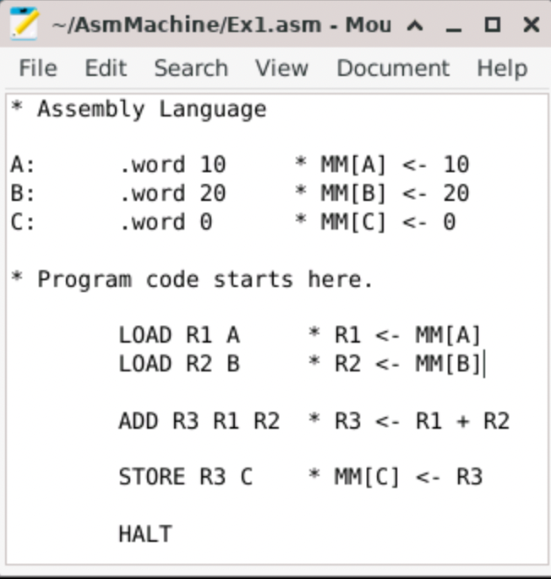
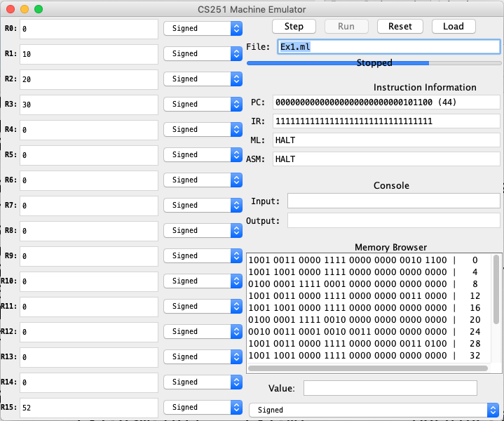
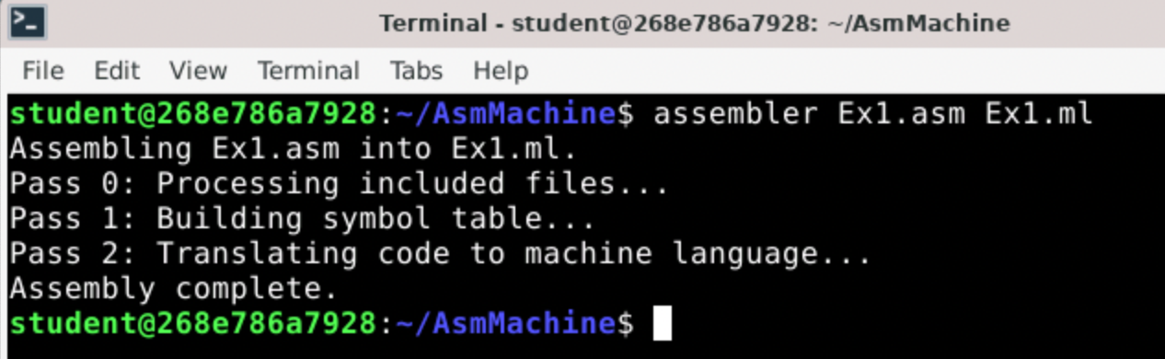
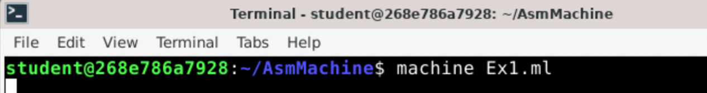
Editor, Assembler and Machine
Notes:
The container you created at the end of LA1 has
- an assembler for our assembly language
- a machine simulator
Rather than doing a demo
- We’ll take the remaining time to try this out…

Slide 17
Activity
Start Comp256Assembly container
Copy the sample program from slide 6 into Mousepad.
Save the program as Ex1.asm
Assemble the program into Ex1.ml
assembler Ex1.asm Ex1.ml
Run Ex1.ml in the machine
machine Ex1.ml
Click Run button
Observe the results in the registers.

Slide 18
Activity
Translate the following HLL program into assembly language, assemble it and run it:
int X=20;
int Y=50;
int Z=30;
Z = (X+Y)-(Y+Z);

Slide 19

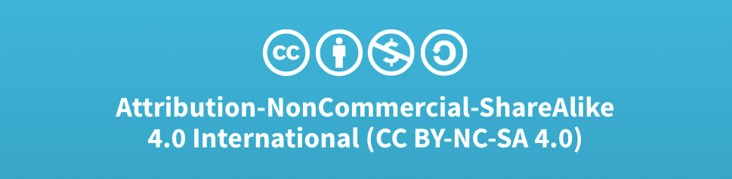
Acknowledgments
Slide Template From:
https://creativecommons.org/licenses/by/4.0/
Slide Content Licensed as:
Creative Commons Attribution-NonCommercial-ShareAlike 4.0 International License.
Notes:
Note: Individual images may be covered by their own licensing agreements and were incorporated here under fair use. Their use in this slide deck does not change or alter their licensing.

Slide 20
Register to Register Instructions
A register to register instruction operates on values in the registers and stores the result in a register.
Instruction Example Meaning Comments
--------------------------------------------------------------------
ADD R R R ADD R1 R2 R3 R1 ← R2 + R3
SUB R R R SUB R1 R2 R3 R1 ← R2 - R3
AND R R R AND R1 R2 R3 R1 ← R2 & R3 Bitwise AND
OR R R R OR R1 R2 R3 R1 ← R2 | R3 Bitwise OR
NOT R R NOT R1 R2 R1 ← ~R2 Bitwise NOT
SHL R R SHL R1 R2 R1 ← R2 << 1 LSb = 0
SHR R R SHR R1 R2 R1 ← R2 >>> 1 MSb = 0
MOV R R MOV R1 R2 R1 ← R2 Copy
Notes:
Not going to talk about all of these.
What I want is for you to understand how to read this reference.
A full reference will be given in the activities.
Register to Register Instructions.
The ADD that we saw in the example is an example of a Register to Register instruction.
- Just like any other language there are rules about what you are allowed to write
- Each instruction has a format
- here the operands must be registers (Typically R0-R11)
- Might be tempted to put in a number in place of R2 or R3.
- Will not work.
- We will see how to do that in a moment.
- Requires a different type of instruction.
- The order in which they appear is critical as given by the meaning
SUB, AND, OR are similar to K&S.
- This machine has a more sophisticated ALU
- So it can perform more operations
- You’ll get experience with the others in the activities.

Slide 21
Direct Addressing Mode Instructions
In a direct addressing mode instruction, the label is used (directly) as a memory address.
Instruction Example Meaning Comments
--------------------------------------------------------------------
LOAD R L LOAD R1 X R1 ← MM[X] Direct Mode
STORE R L STORE R1 X MM[X] ← R1 Direct Mode
Notes:
The LOAD and STORE that we have used are examples of direct addressing mode instructions.
LOAD:
- Moves a value from MM to a register
- Operands must be a register (typically R0-R11) followed by a label.
- will not work the other way around,
- Similar to register to register you may be tempted to put in a number instead of the label.
- will not work
- We will see how to do that in a moment.
STORE
- Same format
- Operands must be a register (typically R0-R11) followed by a label.
- Moves a value from a register to MM.

Slide 22
Immediate Addressing Mode Instructions
In an immediate addressing mode instruction, the value of the final operand is preceded by a # and is used as a literal value (i.e. “immediately”).
Instruction Example Meaning Comments
--------------------------------------------------------------------
ADD R R # ADD R1 R2 #231 R1 ← R2 + 231 Immediate Mode
SUB R R # SUB R1 R2 #1 R1 ← R2 - 1 Immediate Mode
AND R R # AND R1 R2 #0xF00F R1 ← R2 & 0xF00F Immediate Mode
OR R R # OR R1 R2 #b1001 R1 ← R2 | b1001 Immediate Mode
LOAD R # LOAD R1 #27 R1 ← 27 Immediate Mode
Notes:
I said we can’t use specific numbers with the Register to Register or Direct Addressing Mode instructions.
If you want to use a specific value:
- Add 231
- Subtract 1
- Put 27 into a register
Then you need to use an Immediate Addressing Mode Instruction.
We haven’t seen an example of these yet
- but they aren’t too hard to get your head around.
- They just allow the final operand to be a literal value instead of a register.
- But you must use the # symbol
- And only the final operand is allowed to be a number.
You’ll get some practice with these in the Activities.

Slide 23
Type Directive
(32 bit word)
Initial
Values
Labels
Comments
// HLL
int A=10;
int B=20;
int C=0;
C = A + B;
* Assembly Language
A: .word 10 * MM[A] ← 10
B: .word 20 * MM[B] ← 20
C: .word 0 * MM[C]
* Program code starts here.
LOAD R1 A * R1 ← MM[A]
LOAD R2 B * R2 ← MM[B]
ADD R3 R1 R2 * R3 ← R1 + R2
STORE R3 C * MM[C] ← R3
HALT
Variable
Declarations
Program
Instructions
OpCodes
Operands

Slide 24
Input and Output
// HLL
int X;
int Z;
Read X;
Z = 2*X-1;
Print Z;
* Assembly Language
X: .word
Z: .word
* Program code starts here.
LOAD R1 STDIN * R1 ← MM[STDIN]
STORE R1 X * MM[X] ← R1
ADD R2 R1 R1 * R2 ← 2* R1
SUB R2 R2 #1 * R2 ← R2 - 1
STORE R2 Z * MM[Z] ← R2
STORE R2 STDOUT * MM[STDOUT] ← R2
HALT

