Slide 1
OSA6 - Threads
COMP 256 – Dickinson College
Prof. Braught
Spring 2023

Slide 2
Process Review
CPU
PC:76
Logical Memory
Page Table
Registers
A program is a list of instructions.
Static
Just the code & data segments
A process is a program that is in a state of execution.
Dynamic
Heap, Stack, Registers, PC
Process context
All of the information that would be needed to suspend the process (“deep freeze it”) and then restart (”thaw”) it right where it left off.
0:
2^{m}-1:
ML
R0:20
R1:141
R2:12
R3:0
…
R14:141
Data
Heap
Empty
Stack
Notes:
This is review of what we learned about programs and processes.
Recall:
- A program is just the instructions and global data.
- The program is not running.
- So it is static:
- Its variables do not have values, there is no current point of execution.
- It has no values in registers, it is not even in memory.
- A process is a program that is currently in a state of execution.
- The process has a context.
- That context is all of the dynamic information
- It is what needs to be saved or restored when we context switch from or to this process.
- All of this context will be changing as the program executes.
- It is dynamic.
- The process has been loaded into memory
- It will have a page table indicating which pages are in which page frames.
- The page table will change as page faults occur and pages are swapped into and out of the physical memory.
- Its variables have values.
- The values in the variables will change as the process statements execute.
- It has specific values in registers
- The values in the registers will change as the instructions execute.
- There is a specific point at which it is executing (i.e. a PC value or a current instruction).
- The PC will change as the program moves through the instructions and branches and jumps.

Slide 3
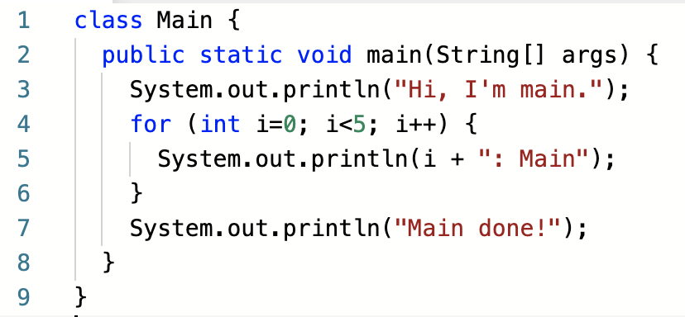
A Thread of Execution
CPU
PC:76
A context captures the state of a process at a point in time, and over time it traces a Thread of Execution through the program.
Page Table
Registers
R0:20
R1:141
R2:12
R3:0
…
R14:141
Program at: https://repl.it/@braughtg/MainThreadEx
Notes:
Consider the program….
When running the program is a process
- it has a context
- That context describes the “state” of the process at a given point it time.
- It describes the process in sufficient detail that it can be suspended and then resumed later.
As the program executes
- The context will change
- The PC will change
- The variable i will be created on the stack
- The PC will change and the machine will fetch/decode/execute
- The registers will change
- The contents of the page table might also change.
That changing context ”Traces a thread of execution” through the program.
Note: The context shown in the CPU box don’t change because I just haven’t animated that.
- but those things would clearly change as the program executes.

Slide 4

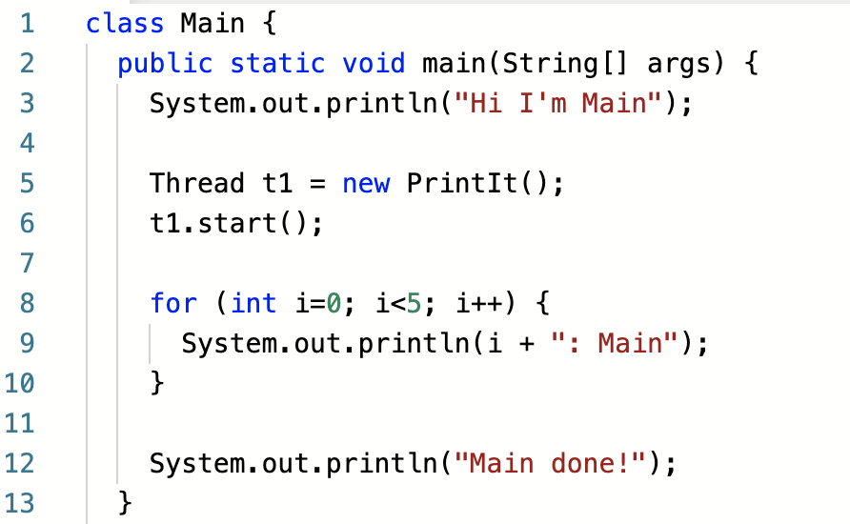
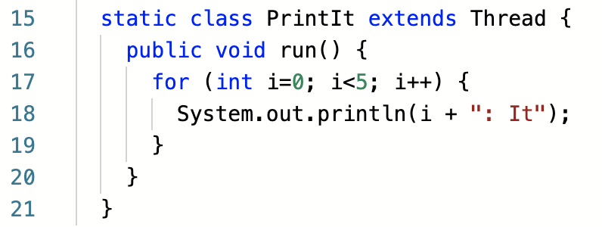
Multiple Threads of Execution
Creating multiple threads of execution within a single process. requires multiple contexts.
Each instance of the Thread class creates a new execution context for the run() method when the start() method is called.
Program at: https://repl.it/@braughtg/TwoThreads
Notes:
This is the same program as before with a few added statements.
- These statements create a new thread of execution.
The statement new PrintIt creates new object that is sub-class of Thread
- Thread is class provided by Java.
- The thread class contains a method named run() that we override.
- Oher languages have similar ways to create threads.
- The names and syntax are just a little different.
Calling start() on a Thread
- creates a new execution context.
- That context will execute the run() method that is defined in the Thread.
- Creating a new execution context is similar to creating a new process.
- It is done via a system call to the OS
- That is, the code in the start() method makes a system call.
- But a whole process is not created:
- because the Thread is in the same program, its code and data are already loaded into memory.
- And the OS already has a PCB for the process.
- But some additional information will be needed and we’ll get to that in a little bit.

Slide 5

Multiple Threads of Execution
Creating multiple threads of execution within a single process. requires multiple contexts.
Run this program multiple times. What do you notice about the outputs?
Program at: https://repl.it/@braughtg/TwoThreads
Notes:
Run the program here and observe the output that it generates.
- Run it a few times until we see a few different outputs.
- what can we notice about the different outputs?
- Be sure to see one where “Main done!” is not last.
Now, let’s understand why we see what we see.

Slide 6
Multiple Threads of Execution
Creating multiple threads of execution within a single process. requires multiple contexts.
You should assume that independent threads may execute in any order, unless we force them to do otherwise.
Program at: https://repl.it/@braughtg/TwoThreads
Notes:
What we are seeing is the independent execution contexts of the main thread and the PrintIt thread.
We may notice that:
- The line “Hi I’m Main” is always first.
- This is because the PrintIt thread has not yet been started and the main thread is the only one able to run.
- After the PrintIt thread is started there will be two threads that are ready to run.
- The OS will then use multiprogramming to switch back and forth between them.
- The scheduler will move these execution contexts (i.e. threads) from the ready state to the running state and back.
- The order in which these switches happen is operating system and circumstance dependent.
- There are other things going on in the system that affect how much main or PrintIt can accomplish in its time slice.
- Seems unfair… but it’s not worth the trouble in a general computing system to try to fix it.
- In some other types of OS, for example an OS for real-time systems where it is super important that each thread get its full time slice this would be different.
- But it doesn’t much matter if your Word, Web browser, -mail reader get a full time slice every time.
- So the complexity is not added.
Tip: When running multiple threads, it is best to assume that the instructions can run in any order.
- We will see later that we can impose an order if it is important to us.

Slide 7
Multiple Threads of Execution
Hi I'm Main
0: Main
1: Main
0: It
1: It
Creating multiple threads of execution within a single process. requires multiple contexts.
2: Main
3: Main
2: It
3: It
4: It
4: Main
Main done!
Program at: https://repl.it/@braughtg/TwoThreads
Notes:
Let’s look in more detail at the execution of our multi threaded program.
- When the process starts
- The main thread is the only execution context (represented by the green dot)
- The OS scheduler will eventually pick the main thread to run.
- When that happens, main’s context is switched onto the CPU
- The green dot traces out main’s thread of execution (the red line)
- main prints “Hi I’m Main”
- main then makes a system call to create a new thread of execution for PrintIt.
- PrintIt it gets its own context (represented by the blue dot)
- That dot will trace out the thread of execution for the thread
- main makes a system call to start the thread t1
- This just causes t1 to be put into the ready queue
- main might continue to run a little while longer because it’s time slice is not up yet
- in this example we assume that main prints out its 0 and 1 lines
- When main’s time slice is up
- We’ll assume the OS schedules t1 to run, and it does a context switch
- The t1 thread will run – the blue dot will trace out t1’s thread of execution (blue line)
- here t1 prints out its 0 and 1 lines
- When t1’s time slice is up
- OS scheduler will run again, assume it selects the main thread to run and performs a context switch
- There could be other processes (or threads from other processes) that run in between.
- But eventually the main thread will get a turn.
- In this time slice, we’ll assume main gets to print its 2 and 3 lines
- When main’s time slice is up
- The OS will again run the scheduler and context switch, and we’ll assume the scheduler picks t1
- again possibly with other processes in between
- t1 this time prints its 2, 3 and 4 lines
- t1 then reaches its end and makes a system call to terminate
- The scheduler eventually picks main and context switches
- main prints its 4 and done lines.
- the Main thread reaches its end and makes a system call to terminate.
- Because main is the last thread in the process this also terminates the process.
Notice similarities to some of the different orderings that we saw when running the program.
- This is not the only possible order.
- There are lots of them.

Slide 8
The OS View: Managing / Context Switching Threads
Logical Memory
TCB:main
0:
2^{m}-1:
ML
PC:76
PCB
Registers
Process Context (PCB):
Shared by threads:
Program/Data/Heap
Page Table
Files / devices
Thread Context (TCB):
Each thread has:
PC
Registers
Stack
PID:139
R0:20
R1:141
R2:12
R3:0
…
R14:141
Data
Page Table
Heap
TCB:PrintIt
Proc Info:
Empty
Files:
Threads:
main
PrintIt
PC:893
Registers
it:Stack
R0:3
R1:5
R2:75
R3:0
…
R14:19
Empty
main:Stack
Notes:
How does that all work at the internal OS level?
Basically, each PCB now will have references to a Thread Control Block (TCB) for each thread.
- The PCB holds all of the information that is shared by all threads in the process.
- Eg. A Process Identifier (PID)
- The page table for mapping virtual addresses to physical addresses.
- Information about files the process has open
- Links to a Thread Control Block for each thread.
- The TCB for a thread holds the individual context for that thread of execution.
- PC: Which instruction is it executing
- The register values for that execution context.
- This is really just like we were thinking about the different processes up until this point.
- It is just that threads share some stuff.
- The program/data/heap segments, a logical memory space, page table, etc.
- So now we would think about the TCB’s as what is being moved between the states instead of TCBs
- e.g. TCB’s move between Ready / Running / Wating / etc.
- This makes sense because threads are now the things that run, request I/O, wait, etc…

Slide 9
The Metaphor
College Metaphor
Hardware:
rooms, equipment
Program:
class, team, student
OS:
faculty, staff, coaches
Notes:
A class may have multiple groups working independently on an activity
- If the class is a process then each each group is like a thread
- each group is executing the same program – i.e. the activity
- but each group may be working at a different pace, so may be at a different point in the activity
- One group may be running the code in the function “question #1”
- While another is running in the function “question #3”
- This is like the main thread and the PrintIt threads.
- Or each group could be working on different data
- They might all be running the “question #1” function
- But each group may be using different values in their computations.
- This would be like having multiple copies of the PrintIt thread running.
- Each one may be at a different palace with different register / local variable values / different parameters
Faculty as the OS will coordinate the groups
- maybe calling on each to report out in turn
- maybe letting each use the whiteboard in turn
- This is like the timesharing and scheduling.
Notice that each thread has its own copies of some resources:
- Registers, stack, PC, etc…
- Like the activity sheet and the point at which they are working.
But other things are shared across threads (i.e. one for the whole process) - activity (program & data segment)
- Like the classroom, whiteboard etc.
- They are the hardware that is owned by the process, shared by the threads
- I.e. one for the whole class and shared by the groups.
Note:
- This really Is what was happening on the previous

Slide 10
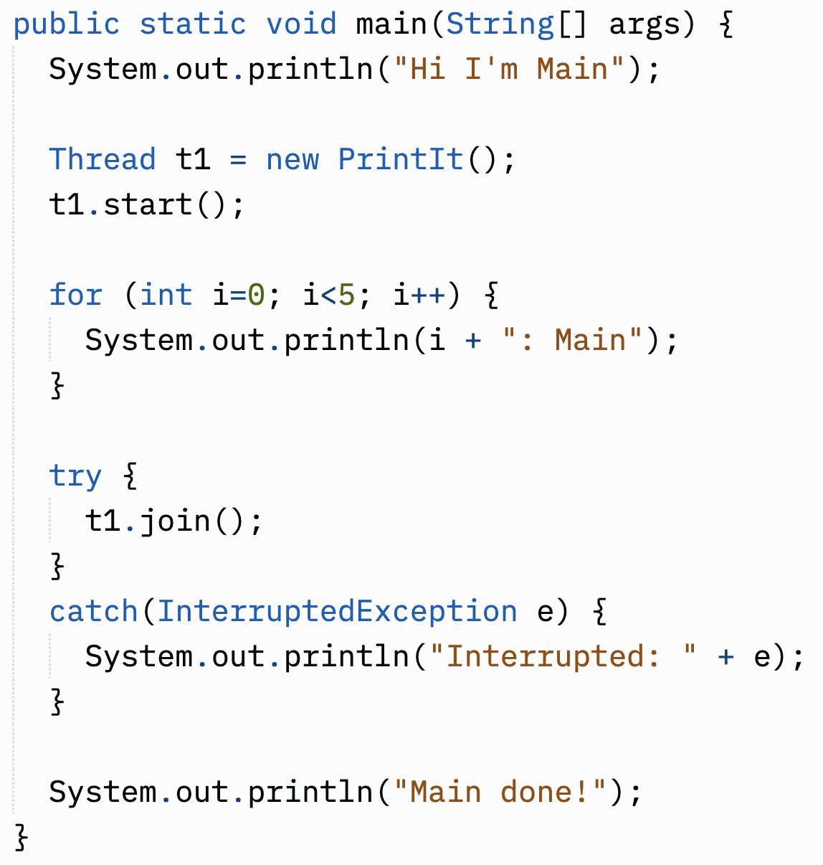
Waiting for a Thread
How will this join affect the output produced by this program?
Thread.join()
The calling thread (main here) waits for the thread on which join is invoked (t1 here) to complete.
main will pause here and wait for t1 to complete
Program at: https://replit.com/@braughtg/ThreadJoin
Notes:
The Thread class defines a method name join.
- When join is called on a thread
- the thread that calls it pauses and waits for the thread on which join is called to complete.
- So here main has called join on thread t1.
- Thus, the main thread will pause and wait for t1 to complete.
The effect in this case will be that the line “Main done!” will never be printed before t1 completes.
- So “Main done!” will always be the last thing that is printed.
Open it in repl and run it a few times to confirm your hypothesis.

Slide 11
Common Thread use Patterns
Parallelization
Multiple threads all concurrently performing the same computation but on different parts of the data.
Specialization
Multiple threads each concurrently performing a different computation on the the same or different parts of the data.
Notes:
Parallelization:
- Compute the total of all of the values in an array.
- Divide the array into chunks
- Use a separate thread to compute the total of each chunk.
- Sum those totals together at the end.
- This is also what happens in your browser when you open multiple tabs.
- Each tab is performing the same computation
- Loading and displaying a web page.
- The data is different
- The page being loaded and displayed is different.
- Web servers do something similar
- Every request that comes in for a page is handled by a thread.
- That thread goes and gets the requested page and returns its.
- Same computation, different data.
Specialization:
- Find the max and min and average of an array.
- Use separate threads for finding the max, the min and the average.
- Each thread processes the entire array.
- But each thread does a different computation.
- Your web browser may also do this.
- Once tabs are loaded what is happening in those tabs may be different.
- One may be playing video
- Another may be showing a static HTML page
- Another may be running a webapp that is waiting for you interact with it.
- Different threads each doing something different.
You’ll see a little of this in the homework and more in the next lab.

Slide 12

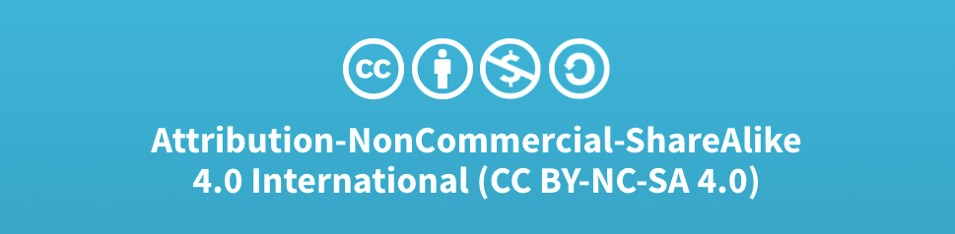
Acknowledgments
Slide Template From:
https://creativecommons.org/licenses/by/4.0/
Slide Content Licensed as:
Creative Commons Attribution-NonCommercial-ShareAlike 4.0 International License.
Notes:
Note: Individual images may be covered by their own licensing agreements and were incorporated here under fair use. Their use in this slide deck does not change or alter their licensing.

