Slide 1
20 - Operating System Abstractions
COMP 256 – Dickinson College
Prof. Braught
Spring 2022
Image from: https://www.mychoicesoftware.com/blogs/
news/why-do-so-many-companies-use-windows-os

Slide 2
What we know so far…
How a machine built from transistors can perform computations expressed by a program written in a high-level language…
Language abstractions
Machine abstractions
Data abstractions
Hardware abstractions
Provides:
A foundation for future learning:
Understanding of fundamental concepts
Intuition and insight
Notes:
Pretty Impressive!
Language abstractions
- Interpreted / Translated
- HLL program can be translated into ASM
- We did it by hand, but not hard to imagine a program that does it.
- ASM is assembled into ML
Machine abstractions
- ML executed by a stored program machine (program and data in main memory)
- fetch/decode/execute
Data abstractions
- allow us to interpret the patterns of 1’s and 0’s as information.
- integers/decimal numbers/characters/colors/sounds/etc.
Hardware abstractions
- CPU and memory are logic circuits
- Logic circuits are built using logic gates
- Logic gates are built using transistors
- Transistors are controlled by voltages representing 0’s and 1’s.

Slide 3
Our Current Position…
The ML program, data and stack are in the main memory starting at address 0.
Only one CPU (w/ one core)
Only one program counter (PC) and only one instruction register (IR).
So, only one program can run at a time.
Notes:
CPU can have cache, multiple pipelined cores.
All of that is transparent and is hidden detail
we won’t worry about it at the level of abstraction we will be using to talk about operating systems.
This was the model until about the late 1980’s – at least for desktop computers
Some main frame computers had progressed to the point where they could run multiple programs.

Slide 4
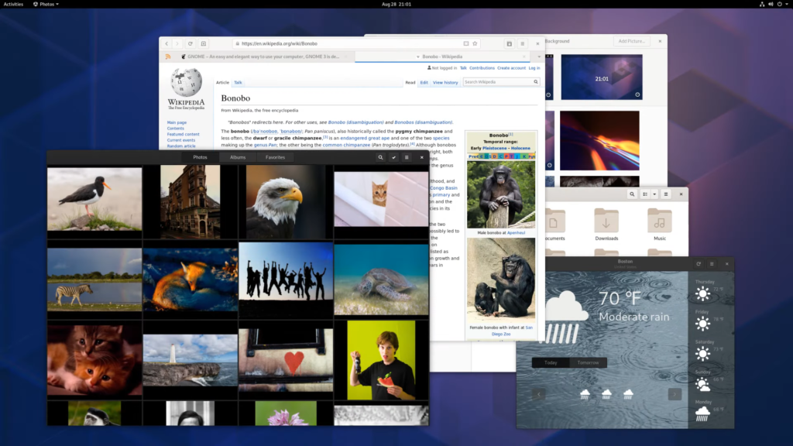
So…
How do we get from that… to what we are used to?
Image from: https://www.debugpoint.com/2019/09/gnome-desktop-environment-release-3-34/
Notes:
Used to multiple programs running concurrently (at the same time)
All sharing the computer’s resources
- Multiple programs running at the same time
- The CPU… runs one instruction at a time.
- switches rapidly from one program to the other
- any instruction executed must be in main memory
- Programs must share the system resources
- Only one CPU – just talked about that…
- Only one main memory – different programs in different parts
- Only one Network card (browser + weather)
- Only one Disk drive (finder + images)
- Has as to be “Fair”
- Each program gets the time it needs.
- Has to be “Protection”
- programs can’t mess with each other without permission
- browser can’t look at memory or files that belong to the mail program
A chasm of complexity…
- between what we know about the machine’s we’ve studied so far
- and what we are used to…
The abstractions created by the OS bridge that chasm.
- abstractions will bridge it!

Slide 5

Operating System Abstractions
Operating systems abstractions bridge the gap between the physical hardware and the user / program experience.
A CPU can run only one program a time, but users will seem to run multiple programs simultaneously.
There is only one main memory, but every program will seem to have its own, and it can appear to be larger than RAM.
Disks just store blocks of bytes, but users interact with files and directories (folders).
A program seems to have a single path of execution from start to finish, but multiple parts of a program can run simultaneously.
Photo by: Steven Gerner, https://www.flickr.com/photos/
sgerner/16477700444/in/photostream/
Image from: https://www.supinfo.com/articles/single/
4344-introduction-to-operating-systems
Notes:
Just some more examples to drive home the point.
We will consider 4 main abstractions…
Makes the point that the abstractions sometimes are
- for the user
- multiprogramming
- files/directories
- for the programs
- seems like it has its own memory.

Slide 6
The Operating System
An operating system (OS) is a collection of software (programs) that manages (shares and protects) system resources (CPU, memory, I/O devices) creating an environment in which programs can be executed in a convenient and efficient manner.
Adapted from: Operating System Concepts (8th Edition)
By Silberschatz, Galvin and Gagne.
Notes:
Let’s look at and unpack some definitions of an operating system
- there are lots of them.
Collection of software:
- So it is just programs…
- Written mostly in HLL (typically C) and some assembler
- Translated into an executable program in ML.

Slide 7
The Operating System
An operating system (OS) is a collection of software (programs) that manages (shares and protects) system resources (CPU, memory, I/O devices) creating an environment in which programs can be executed in a convenient and efficient manner.
Adapted from: Operating System Concepts (8th Edition)
By Silberschatz, Galvin and Gagne.
Notes:
Manages:
- shares and protects
- multiple programs or users of a computer
- Only one RAM or one disk
- must be shared
- one program’s data must be protected from another.

Slide 8
The Operating System
An operating system (OS) is a collection of software (programs) that manages (shares and protects) system resources (CPU, memory, I/O devices) creating an environment in which programs can be executed in a convenient and efficient manner.
Adapted from: Operating System Concepts (8th Edition)
By Silberschatz, Galvin and Gagne.
Notes:
Convenient:
- For user: point and click, files and directories
- For programs: libraries to easily make requests for shared or protected resources.
Efficient:
- Users can accomplish tasks quickly. (find, directories/folders/applications/copy/paste)
- CPU time is spent running program instructions
There is a Tradeoff here:
- Time spent making things nice for the user, is time not spent running programs

Slide 9
The Operating System
An operating system (OS) is the [collection of] program[s] that, after being initially loaded into the computer by a boot program, manages all of the other application programs in a computer. The application programs make use of the operating system by making requests for services through a defined application program interface (API). In addition, users can interact directly with the operating system through a user interface, such as a command-line interface (CLI) or a graphical UI (GUI).
Adapted from: https://whatis.techtarget.com/definition/operating-system-OS
Notes:
Here again, the OS is just a collection of programs… that manages…
- manages = shares + protectes
Application Programs – user programs – stuff you run.

Slide 10
The Operating System
An operating system (OS) is the [collection of] program[s] that, after being initially loaded into the computer by a boot program, manages all of the other application programs in a computer. The application programs make use of the operating system by making requests for services through a defined application program interface (API). In addition, users can interact directly with the operating system through a user interface, such as a command-line interface (CLI) or a graphical UI (GUI).
Adapted from: https://whatis.techtarget.com/definition/operating-system-OS
Notes:
Here it is talking about user interaction.
- A little more of that trade off here…
- GUI easy to use for the new or general user.
- CLI faster and more efficient for many tasks for experienced users (COMP 190)
- And any machine cycles spent
- Generating, updating, displaying the GUI
- Are cycles not spent running programs that do actual work
- They make the machine easier to use, possibly more useful
- By making it easier to run multiple programs
- But every one of those programs will run more slowly.

Slide 11
The Operating System
An operating system (OS) is the [collection of] program[s] that, after being initially loaded into the computer by a boot program, manages all of the other application programs in a computer. The application programs make use of the operating system by making requests for services through a defined application program interface (API). In addition, users can interact directly with the operating system through a user interface, such as a command-line interface (CLI) or a graphical UI (GUI).
Adapted from: https://whatis.techtarget.com/definition/operating-system-OS
Notes:
Some new stuff in this definition too:
The OS is loaded by the “boot program”
The Boot Program is the first program that runs when the computer turns on
- One of its jobs is to get the OS into the main memory
- So that it can run.
- Related to the phrases “Boot or Reboot” the computer.
- You’ll learn more about that in a separate video as part of the activities.

Slide 12
The Operating System
An operating system (OS) is the [collection of] program[s] that, after being initially loaded into the computer by a boot program, manages all of the other application programs in a computer. The application programs make use of the operating system by making requests for services through a defined application program interface (API). In addition, users can interact directly with the operating system through a user interface, such as a command-line interface (CLI) or a graphical UI (GUI).
The System Call Interface
Adapted from: https://whatis.techtarget.com/definition/operating-system-OS
Notes:
Here it is talking about one of the main OS abstractions
The API
- it is a way for a running program to make a request of the OS
- to ask the OS to do something for the program that it is not allowed to do for itself.
- If the OS is controlling how the resources are shared and protecting programs from each other
- then those programs must ask the OS to do some things for them
- For example, getting more memory, or reading or writing a file.
- If programs could do these things on their own
- Then the OS would be unable to stop them from breaking the rules
- One program could just read another’s memory or write to another’s files.
This API provided by the OS is called the System Call Interface
- It is how programs will request OS services.

Slide 13
A Metaphor: A College
Imagine a college as a computing system (hardware + programs + operating system).
In this metaphor:
The campus buildings, classrooms, equipment, tools, machinery are like the computer hardware.
The classes, teams, organizations and students are like the application programs (i.e. user programs) that can be run on the computer.
The administration, faculty, staff, coaches are like the operating system.
Notes:
Hardware is the physical resources used by the programs
The OS are the programs that manage (share and protect) the resources.
APPLICATION and USER programs…

Slide 14
Some Key OS Abstractions via the College Metaphor
Hardware:
rooms, equipment
User Program:
class, team, student
OS:
faculty, staff, coaches
A Process: An executing program.
Multiprogramming: The ability to execute multiple programs simultaneously.
System Call Interface: Requests for OS services to ensure sharing and protection.
Virtual Memory: The illusion that each process had its own main memory (larger than RAM).
Device Stack: Simplified and consistent access to diverse devices.
Multithreading: The illusion of executing multiple parts of a single program simultaneously.
Notes:
Process:
- Process is a program that is running/executing…
- Note a program may or may not be executing (class/team)
- a class not being offered this semester or a sport that is out of season
- there is a lot of additional information when the program is executing
- where the players are on the field/court during a game, what are they doing.
- what is on the board during a class / what is the prof. saying
Multiprogramming:
- There are multiple classes that meet in a room
- All of them are executing
- but not all of them meet simultaneously
- The hardware is switched from one to the other so in some sense they are all running at the same time.
System Calls:
- When programs what to use a shared resource they must request it via the OS
- For example to reserve a room
- contact staff
- That staff ensures the resource is shared fairly
- To get a transcript
- contact the registrar
- the registrar ensures that the resource is protected
Virtual Memory:
- The library w/ interlibrary loan
- It’s like each student has a complete library at their disposal
- If the book is out, you place a hold and you get it (it just takes a little longer)
- Also the library appears to have way more books than it actually does (inter library loan)
- If the book isn’t actually here, it takes a little longer, you still get it (it just takes a little longer)
Device Stack:
- Make a request that a repair be made
- The person making the request does not need to worry about the specific tools to be used
- Where they are on campus or who will complete the repair.
- The request is handed off to the “system” which knows and manages those details.
Multi-Threading:
- While a team or a class might be a program
- Each team / class has individual members
- each doing their part - e.g. goalie, forward, etc.
- like multiple parts of a program executing simulaneously
- think multiple browser tabs – one playing video, one showing a page
- both are part of the browser program
- executing simultaneously
- Very similar to multiprogramming, but code is in the same program.
Will visit each one in greater detail in the coming days.

Slide 15
Essential Points
Stored Program Machine
Program and data must be in main memory to execute.
Fetch/decode/execute (PC and IR)
A CPU can run only one program at a time.
One PC and one IR
So…
If the OS running, user programs are not running
If a user program is running, the OS is not running, and no other user programs are either.
Notes:
Keep these in mind through the entire OS unit!

Slide 16
Booting the OS
Notes:
How do we kick the whole thing off…

Slide 17
Getting started…
When the computer powers on….
The main memory is empty
Volatile storage
The OS is a ML program
Typically stored on disk.
Notes:
But could be on
- CD/DVD
- USB
- Even a remote network drive.

Slide 18
Getting started…
The OS is a ML program…
Stored program architecture.
So, to run, the OS must be in memory.

Slide 19
Getting started…
Need to:
Load OS into main memory.
Set PC to first instruction.
Fetch/decode/execute
Bootstrapping the OS
“booting” the computer
PC
Notes:
Where we need to get to to get the OS running.
It has to be somewhere in memory,
With the PC pointing at its first instruction.
From there, the fetch/decode/execute cycle will take over.
This process of moving the OS from disk into memory and getting it running is called bootstrapping.

Slide 20
Hardware Support
The ROM
Read Only Memory
Non-volatile
Small
ML Programs
Notes:
In order to do this we need some hardware support.
Read Only – cannot be changed.
Non-Volatile – persists across power cycles.
Small – cannot hold very large programs
Allows the manufacturer to load it with some small programs and data.

Slide 21
Hardware Support
The ROM
Read Only Memory
Non-volatile
Small
Address Remapping
ML Programs
Notes:
To allow the programs on the ROM to be used… they would have to be in main memory
But instead of copying them there…
Address remapping:
The addresses in the hashed range don’t actually exist in the RAM.
Instead, when an address in the ROM range is sent to memory
The hardware is build so that the value is actually retrieved from the corresponding location on the ROM chip.

Slide 22
The BIOS
The BIOS
Basic Input Output System
Notes:
The ML Program in the ROM is called the BIOS
- It provides the starting point for getting the OS up and running.
POST – Power on self test (more in a minute)
I/O Functions
- ML functions that can be called to do basic input and output operations
- Keyboard, Mouse, Screen
- Read/Write Disk, Network
- Simple graphics
Bootstrap (more in a minute)

Slide 23
The Boot Process
The BIOS
POST: Power On Self Test
PC
Notes:
Computer is hardwired to set the PC to the first instruction of the POST
The POST displays the startup screen
- they are all a little different… you may have seen one.
- Most OS generally mostly hide them from you…
- check memory, disks, etc
- provides opportunity to enter a configuration tool
At end, POST does a JUMP to the address of the bootstrap program

Slide 24
The Boot Process
The BIOS
POST: Power On Self Test
bootstrap
PC
Notes:
In a simple world the bootstrap program would just load the OS into main memory and off we’d go
But the bootstrap is small
And generally the process of loading the OS is complicated
- Different OS’s are different sizes
- Different OS’s organize the data differently on disk
- Require different initialization processes
- doing all of that for all OS’s in a small fixed program is not possible.
So a more complicated process is used to…
- the bootstrap small and simple
- the machine flexible enough to load any OS

Slide 25
The Boot Process
The BIOS
POST: Power On Self Test
bootstrap
MBR: bootloader
Stage2: bootloader
PC
Notes:
So instead we keep the bootstrap simple
and add two additional programs:
The MBR or stage 1 boot loader program
- Always located in the MBR or the first readable location on the disk.
- Small 512 bytes in size
The Stage2: bootloader program
- much larger program that is OS specific
- Knows
- how info is organized on the disk
- where the OS located
- how big it is
- what needs to be done to set it up.
-

Slide 26
The Boot Process
PC
The BIOS
POST: Power On Self Test
bootstrap
Loads & JUMPs to MBR
MBR: bootloader
Stage2: bootloader
Notes:
Uses the I/O Functions in the BIOS
- To find the first readable location (sector)
- Read the MBR bootloader program that is there
- Load it into memory
- Then JUMP to that location.

Slide 27
The Boot Process
The BIOS
POST: Power On Self Test
bootstrap
Loads & JUMPs to MBR
MBR: bootloader
Loads & JUMPs to Stage2 bootloader
Stage2: bootloader
PC
Notes:
The bootloader is small 512 bytes… so not much code.
It just knows where to find the stage 2 bootloader and how large it is
It uses the I/O Functions to:
- Load the entire stage 2 loader into memory
- JUMP to it

Slide 28
The Boot Process
The BIOS
POST: Power On Self Test
bootstrap
Loads & JUMPs to MBR
MBR: bootloader
Loads & JUMPs to Stage2 bootloader
Stage2: bootloader
Loads & JUMPs to the OS
OS runs a login program
PC
Notes:
The stage 2 bootloader is OS specific
It knows how the info is organized on disk
So it can find the OS program (the kernel)
Load it into memory
Do some simple initialization
JUMP to the OS startup code.
Then off and running…
- OS initializes
- eventually puts up the login screen.
- or passcode, or finger print or whatever…
-

Slide 29
Recap
The OS is a machine language program.
The bootstrap (or boot) process loads the OS program (kernel) into main memory and starts it executing.
Bootstrapping depends on ML programs in the BIOS
POST, I/O Routines, bootstrap
Three steps:
bootstrap loads MBR bootloader
MBR bootloader loads stage 2 bootloader
Stage 2 bootloader loads OS

Slide 30

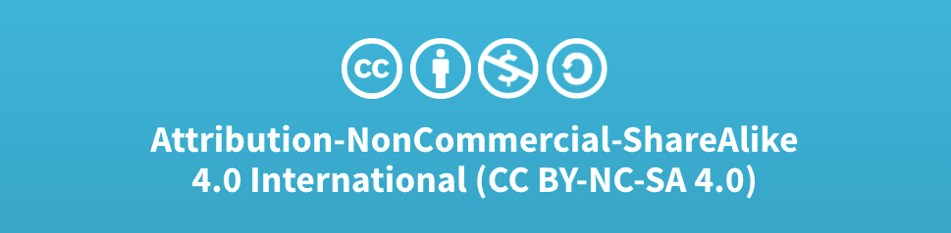
Acknowledgments
Slide Template From:
https://creativecommons.org/licenses/by/4.0/
Slide Content Licensed as:
Creative Commons Attribution-NonCommercial-ShareAlike 4.0 International License.
Notes:
Note: Individual images may be covered by their own licensing agreements and were incorporated here under fair use. Their use in this slide deck does not change or alter their licensing.

Slide 31
CPU
Main Memory
ML
Program Instructions
PC
0:
4:
8:
12:
…:
…:
…:
General Purpose Registers
IR
Control Unit
Program Data
ALU
Stack
Input/ Output

Slide 32
Main
Memory
(RAM)
0x0…000
MBR: bootloader
ROM Chip
BIOS
BIOS Code
POST
Operating System
I/O Functions
bootstrap
Stage2: bootloader
Disk Drive
MBR: bootloader
Stage2: bootloader
Operating System
0xF…FFF

