Slide 1
MA4 – Memory Hierarchy & Processor Cache
COMP 256 – Dickinson College
Prof. Braught
Spring 2023

Slide 2
The Stored Program Architecture
Program/Data must be in the Main Memory (RAM) to be executed/processed.
Instruction Cycle
Fetch
Decode
Execute
Notes:
Recall the stored program architecture.
- This is our baseline
- everything we discuss will be based on this architecture.
With the Stored Program Architecture:
- The program and its tata MUST be in main memory.
Typically it is stored long term on disk
- so it needs to be loaded into memory to be used.
- When you double click an icon
- you are asking your OS to move the program into main memory.
- When you choose ”File open”
- you are asking the program to bring data into main memory to be processed.
Back in the day…
- programs and data were loaded from punch cards or paper tape
- as you saw in some of the videos you’ve watched
Once a program is in memory it is executed
- Fetch / Decode / Execute
- over and over and over again
- one instruction after the other
- with branching.
That is the foundation for everything.
- Today and next class we’ll look at a few ways to improve or expand upon that.

Slide 3
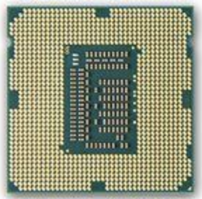
Performance Improvements
Better Technology
Moore’s Law
Better Design
MA3 - Memory Hierarchy & Processor Cache
MA4 - Processor Architectures (Parallelism & Pipelining)
Better Software
COMP 232 / COMP 332
Image from: https://en.wikipedia.org/wiki/
Manchester_Mark_1
https://commons.wikimedia.org/
wiki/File:Intel_C4004.jpg
https://wccftech.com/intels-3rd-generation-ivy-
bridge-core-i5-processor-pitted/
Notes:
The stored program architecture is still the way machines work.
How do we improve their performance to get from the EDSAC/EDVAC/Mark1/etc to today?
Three primary paths…
Better Technology:
- Moore’s Law – better / faster / smaller transistors
- More transistors enabled more complex designs that enhance performance.
Better Designs:
- Memory and Caching - today
- Better processor design – next class.
Better Software:
- other classes

Slide 4



Use the system information utility on your computer to find the following specifications including units:
# of Processors (CPUs)
Number of Cores
Processor Speed
RAM
Cache L1 / L2 / L3
HDD / SSD Size
Others?
Apple menu
About this Mac
System Report…
Desktop
This PC
Properties…
Notes:
How many processors does your machine have?
How many cores?
What speed is the processor?
How much ram?
Etc…
You may not find all of them…
- see what you can find in 2-3 minutes.
- compare with a neighbor if you find most of it.
Mac Icon:
https://commons.wikimedia.org/wiki/File:Finder_Icon_macOS_Big_Sur.png
Windows Icon:
https://commons.wikimedia.org/wiki/File:Windows_icon.svg

Slide 5
There were different units used in the system specs that we found. What is the size of each of the following units?
Hertz (Hz)
Gigahertz (GHz)
Kilobyte (KB)
Megabyte (MB)
Gigabyte (GB)
Terabyte (TB)
Others?
Notes:
Do some quick web searches and see what you come up with.
Draw a distinction between powers of 2 and powers of 10.
- Powers of 10 are typically used for
- Hz
- Hard Disk Drive space (HDD)
- Powers of 2 are typically used for
- Main memory (RAM) sizes
- Cache sizes

Slide 6
Motivating the Memory Hierarchy: Cost/Performance Tradeoffs
Tradeoff
Use small amounts of fast/expensive memory and large amounts of slow/cheap memory.
Notes:
Systems have many different types of memory
- CPU at the top
- contains registers and the cache (more in a bit)
- SRAM – static ram
- DRAM
- Dynamic RAM
- or just RAM.
- The main memory
- Disk drives
- SSD – solid state drive
- HDD – Hard disk drive
External Storage
- Tape / Optical (CD / DVD)
A system will have different amounts of each type of storage
- The amounts reflect a tradeoff between Cost and Performance
- Cost:
- The types of memory at the bottom cost less per unit of storage (i.e. $/GB or $/MB)
- The types at the top cost more per unit of storge.
- Performance:
- There are two dimensions to performance here: Capacity and Speed
- Capacity is the amount of data or program instructions the memory can hold.
- Speed
- Speed is how quickly data or instructions can be read from or written to the memory.
If we pay more we get faster memories but we can afford less of it.
- So, to balance this systems have small amounts of very fast memory and large amounts of slower memory.
Then we can keep the things we need quickly and often in the smaller faster more expensive places
- Programs and data we are currently using are kept in the RAM, the Cache and the registers.
- Programs we use often but are not using right now are kept on the SSD or HDD
We then keep the things we need less often and less quickly in the slower, larger, cheaper places
- Archived versions of old data or information is kept on Tape/Optical drives
- Backups of large HDD/SSD drives are often kept on tape drives.

Slide 7
Memory Hierarchy Terminology
Notes:
This slide covers some more terminology associated with the memory hierarchy.
- Memory vs Storage
- largely the same as Volatile / Non-Volatile
- Volatile memory is temporary – its contents are erased when the power is lost
- The programs you are running and the data you are working on are no longer in RAM when you turn the computer off.
- You’ve probably experienced this.
- If there is a power outage or your machine crashes and you hadn’t saved recently.
- Though, many programs now have autosave to help mitigate these events.
- Non-volatile storage is persistent
- The data and programs saved to non-volatile storage are still there when you turn your computer off and back on.
- This is the stuff that is saved on your disk drives
- This is why you save things!
- On-Chip / Off-Chip
- Memory that is on-chip is part of the CPU chip itself.
- Built from some of those 40-billion transistors
- Memory / storage that is off chip is either on separate chips or external I/O devices.
- There is a substantial speed difference between on chip and off chip.
- That is on chip cache and registers are dramatically faster than off chip cache and RAM
- On-Line / Off-Line
- On-line memory/storage is always accessible
- You do not need to do anything special to access it
- This is like your ram, hard disk or solid state drive
- When the computer is on it is there.
- Off-line memory/storage must be connected in some way
- This is called “mounting” the storage
- An external drive that has to be plugged in
- A CD/DVD that has to be put in the drive
- A USB thumb drive that has to be plugged in.
- etc…

Slide 8

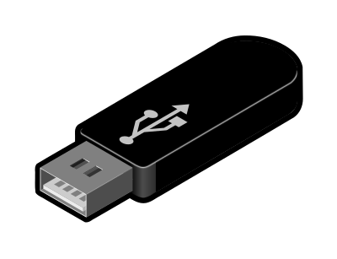




Memory/Storage Access Types
Memory / Storage can also be classified by the time required to access a specific location or piece of data:
Random Access
R/W time is independent of its location (RAM, Registers, Cache, SSD)
Sequential Access
R/W Time is almost entirely dependent upon its location (Tape)
Direct Access
R/W Time is partially dependent upon the location (HDD/CD/DVD)
Images from: openclipart.org
Notes:
Access type is another way that memory/storage can be classified
- Random Access
- In a random access memory the value at any location can be retrieved in the same amount of time.
- For example in K&S it did not matter
- Which register a value was stored in it took the same amount of time to get it.
- That is it didn’t take longer to get a value from R3 than it did from R0
- Similarly – takes the same amount of time to move a value from from a register to MM[31] as it would to move it to MM[0].
- Not much in the world works this way because it takes time to and space to store things.
- The main memory, registers, cache and SSD’s are random access.
- Note the main memory is often called RAM
- That is because it is a random access memory
- But it is not the only random access memory in a system!
- Sequential Access
- With sequential access memories / storage the time to access a piece of data or instruction depends almost entirely on where it is stored.
- Imagine a dictionary that is not in alphabetical order.
- To get the definition of a specific word, you have to start at the beginning and scan word by word.
- The time to get the definition of a particular word would be almost entirely depend on where it is located in the book.
- Tapes work this way… scan from start (Remember VCR tapes?)
- You can fast-forward but not jump ahead.
- Direct Access
- Direct access is sort of in between random and sequential access.
- With direct access memory, the time is partially dependent upon where the data is stored.
- This is kind of like an actual dictionary
- You can jump directly to somewhere near the right place and then you scan from there.
- This is what you do with a CD/DVD or digital music player, you skip to a desired track then scan within the song.
- A HDD is similar to that (close enough for now).

Slide 9

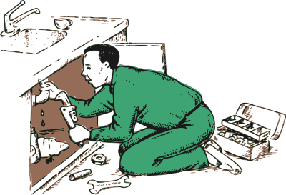

Processor Cache: A Metaphor
ALU
Main Memory
Registers
Cache
Notes:
As we get to more and more complex ideas in computing
We will use metaphors as a way of understanding and explaining the abstractions involved without digging into the details.
- I just did it with the dictionary.
We have actually done this already… from way back…
- Transistors don’t really have a switch in them…
- But we didn’t want to look at all of the chemistry and physics involved…
- So we used the switch as a metaphor to understand them as an abstraction.
- We did it in the lab with the boxes to understand memory cells.
We will be doing this quite a bit going forward…
- Right now we are going to use a metaphor to understand what Processor Cache is and why we have it.
Let’s think about the way a Plumber would work…
- When there is job to be done the plumber…
- Loads the van at the shop with everything they think they might for a wide variety of jobs.
- Gets to site, loads a toolbox with the things from the van they think are most likely to be needed for this job.
- Toolbox is smaller than the van though, so they can’t take everything in the truck.
- As they work, they get tools from the toolbox
- Those tools they are going to use again are keep within easy reach
- They then mostly uses the tools that are within reach to do the work.
- If they need a different tool
- They’ll move it from the toolbox to within reach and use it.
- If too many things are cluttering up the work area
- They’ll put some of them that are unlikely to be used again soon back into the toolbox
- If they find that something that is needed is not in the toolbox
- They’ll go back to the van and swap out some tools from the toolbox that are unlikely to be needed again for new ones that are needed.
Because the plumber has the toolbox they is able to work much more quickly than without it.
- Without it they would be back and forth to the van all the time
- That would be much slower.
The toolbox is like the processor cache.
The Shop
- Is like the Disk Storage (HDD/SDD)
- There is lots of it but slow and far away.
The Van
- Is like the Main Memory
- It is much closer and faster the shop but it is also smaller than the shop.
The Toolbox
- Is like the Processor Cache
- It is much closer and faster than the van, but it is even smaller
The Work Area
- is like the CPU Registers
- it is the fastest place to get a tool from, but it is very small (e.g. K&S had 4, many CPUs have 32, 64 or maybe 128)
The Plumber’s Hands
- Are like the ALU
- It is where the actual work is getting done.

Slide 10
Motivating Processor Cache: The Memory Bottleneck
Bottleneck
Notes:
Makes sense in the real world….
Do we need it in the computer?
Table shows:
- the rate at which CPU can execute an instruction
- the rate at which Memory can provide instructions to be execute or data to be operated on.
- The ratio between the two:
- 1 to 1 – in 1986 the CPU could get every instruction and piece of data it needed from MM right when it needed it.
- Over time CPU speeds have increased more than memory speeds.
- by 2018 – the CPU can process instructions and data 30 times faster than the memory can provide them.
- So if the CPU were to request a number to add, it would have to wait 30 cycles for it to show up from memory.
So why not just build all of the main memory out of cache technology on the CPU chip.
- Not enough transistors and it would cost too much.
So this creates a bottleneck between Main memory and the CPU.
Cache helps to eliminate this bottleneck
- getting data and instructions to the CPU faster
- in a way that is technologically feasible and at a reasonable cost.

Slide 11
Processor Cache Memory
Processor Cache: Smaller, faster, more expensive memory that the CPU can access more quickly than Main Memory (RAM).
The cache(s) holds copies of data and instructions from main memory that are likely to be needed soon.
Data and/or instructions
likely to be
needed soon
Cached copy
Notes:
Most simply…
- Because the cache is faster than the RAM,
- When the data or instruction is actually needed
- If a copy of that data or instruction is in the cache then
- the CPU can get it more quickly than if it had to go to main memory.
- This is like the Plumber getting a tool from the the toolbox instead of the Van.
Many systems will have multiple levels of cache
- This is the different levels that you may have seen earlier.
- Each level gets faster, but smaller and more expensive to build.
- We will see a little more about the levels next time.
- Started out being off of the CPU chip as shown.
- Now there tends to be multiple levels of cache on the on the CPU chip.
- Moore’s law gave engineers lots and lots more transistors to use.
- part of what those transistors are used for is to build this cache.

Slide 12
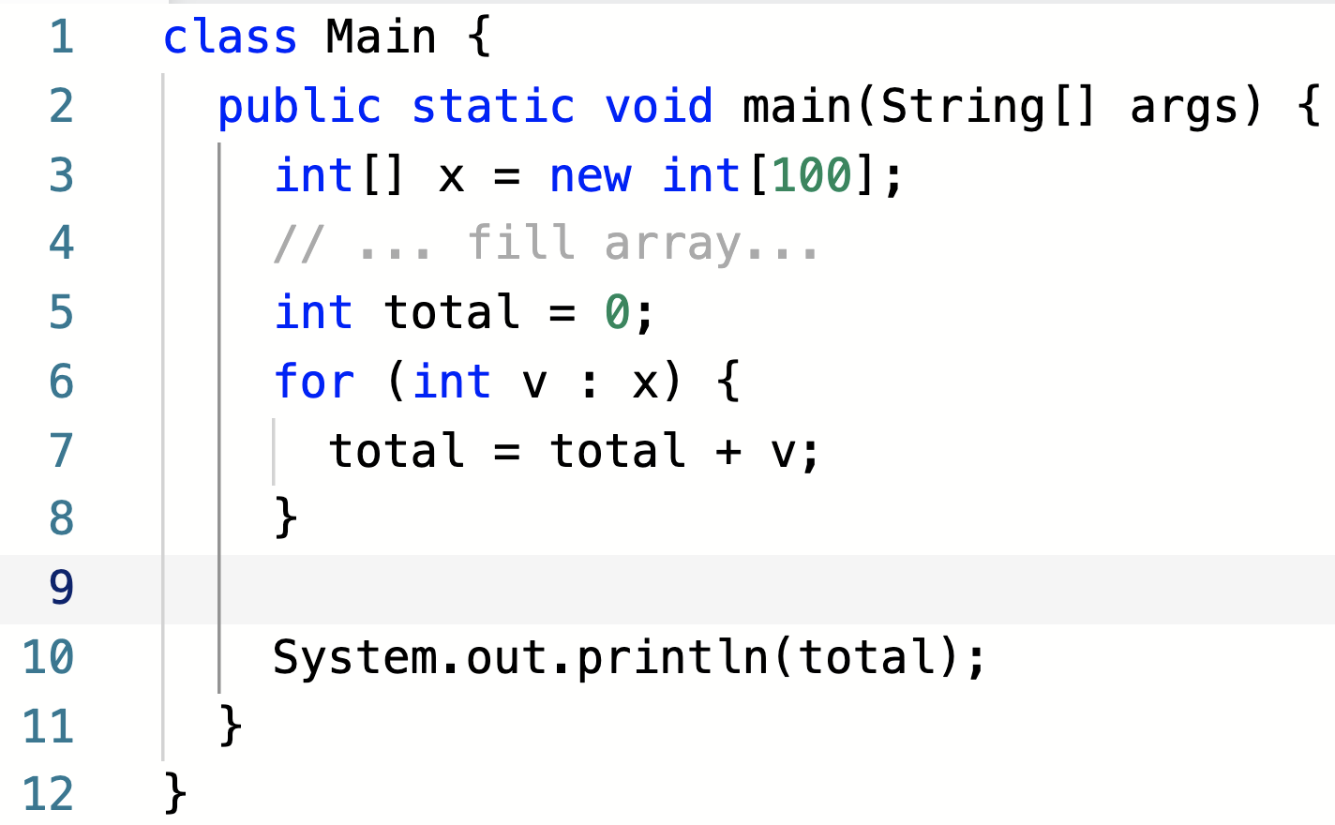
How Can it Know?
Consider the highlighted code fragment.
Which data and which instructions will be needed soon?
Notes:
The plumber is pretty smart and has lots of experience.
- They knows what tools are likely to be needed for a job
- and can pre-load them into the toolbox.
But how can the computer know what instructions or data will be needed soon?
What do you think… which data and instructions will be needed soon?
- This is a bit of a tricky question…
- what could I possibly mean or be looking for here.
- brainstorm it out with neighbors
- make some guesses
- do they make sense?

Slide 13
Principles of Locality
Temporal Locality
When a data or instruction is used, it is likely to be used again soon.
Spatial Locality
When a data or instruction is used, those in nearby memory locations are likely to be used soon.
Notes:
In general, the computer can’t know what it will need soon for sure!
- it is general purpose.
- it could be running any program that does anything.
But as we just saw there are some general patterns that tend to hold true.
- The cache is built to leverage those common patterns…
Temporal Locality:
- Things that have been used recently used are likely to be used again soon.
- When a data or instruction is used it is likely to be used again soon.
- for example:
- the variables v and total
- the instructions in the body of for the for loop
- the instruction for adding v to total
- They are used over and over again.
- This doesn’t just happen in this program but in most programs…
- Programs typically use lots of loops.
Spatial Locality:
- Things that are near each other are likely to be used close in time.
- When a data or instruction is used those nearby are likely to be used soon.
- if we use x[0] then we are likely to use x[1], x[2], x[3]… soon.
- similarly for x[60] and x[61], x[62], x[63]…
- this is not just in this program but it is true in most programs.
- lots of programs scan through arrays.
- when we execute the for statement, we are likely to execute the next statement next
- we usually we go to the next statement - total = total + v
- not always… but usually
- not just in this program but in general
- Remember the default action in fetch/decode/execute is to go to the next instruction
- unless there is a branch.
These two principles are why cache works…

Slide 14
How does it work?
When an instruction or data is accessed, a block of surrounding instructions or data is copied to the cache.
CPU
Main
Memory
The requested
data or instruction
Cache
Cached
copy of surrounding
data or instructions
Notes:
So now how does it work:
- The idea is really quite simple, but amazingly effective.
- When a piece of data or an instruction is used a copy of it, and a surrounding block of data/instructions are copied into the cache.
- That way
- if that data or instruction is needed again it is in the cache (temporal locality)
- if a data or instruction that is nearby is needed it is in the cache (spatial locality)
Recall that the cache is faster than the main memory.
- So now when we need an instruction or data again it can be retrieved more quickly than if we had to go to main memory.
- like the plumber getting the tool from the toolbox instead of going to the van.
- Similarly, when we need a nearby data or instruction it can also likely be retrieved more quickly than going to main memory.
- like the plumber having a few different wrenches of different sizes in the toolbox.
- might not know just which one is needed, so tries a few that are close to the right size until the right one is found.

Slide 15
Cache Hits and Cache Misses
Main
Memory
Cache Miss
CPU
Cache
Cache Miss
Cache
Hit
Notes:
Some vocabulary associated with caching…
Cache Miss:
- When an instruction or piece of data (yellow) is requested
- The cache is checked
- It is not found there so we have to go to Main Memory to get it.
- That is called a Cache Miss
- On a cache miss the
- data or instruction (yellow) is retrieved from main memory.
- data or instruction and a surrounding block (orange) is copied to the cache.
Cache Hit:
- If a nearby data or instruction (blue) is requested
- The cache is checked
- It is found there so we do not have to go to main memory to get it.
- That is called a Cache Hit
- The data or instruction is retrieved directly from the cache (much faster).
The animations show the same cycle is repeated again for another cache miss (red).
This is like the Plumber checking their tool box.
- If they does not find the tool he needs, they has to go to the van (cache miss) - slow
- If they does find the tool they needs, no trip to the van (cache hit) – fast.
If there is time we can also discuss this issue:
- Recall that the cache is much faster but also much smaller than main memory
- So it cannot hold everything that is in the main memory.
- So often when we have a cache miss
- We will have to remove some data and instructions from the cache to make room for the new ones.
- This is like the plumber’s toolbox – it cannot hold everything that is in the van.
- How might you decide what to remove?

Slide 16


Acknowledgments
Slide Template From:
https://creativecommons.org/licenses/by/4.0/
Slide Content Licensed as:
Creative Commons Attribution-NonCommercial-ShareAlike 4.0 International License.
Notes:
Note: Individual images may be covered by their own licensing agreements and were incorporated here under fair use. Their use in this slide deck does not change or alter their licensing.

Slide 17
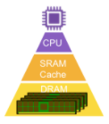
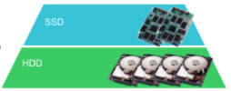
Cost
Performance
REG
Speed
Capacity
Tertiary (Tape / Optical)
Image adapted from: https://www.rambus.com/blogs/mid-when-memory-and-storage-converge/

Slide 18
Memory and Storage
Memory (Volatile)
CPU Registers
Main Memory (RAM)
Processor Cache
Storage (Non-Volatile)
Solid State Drives (SDD)
Disk Drives (HDD)
CD/DVD
Tape Backups
Notes:
Terms are a little fuzzy in practice.
Sometimes it will all be called memory and sometimes it will all be called storage
Have to pay attention to context.
I’ll try to stick with the distinction here.
- memory – volatile
- storage – non-volatile

Slide 19
Cost
Performance
REG
On-Chip
Memory
Off-Chip
Volatile
Speed
Non-Volatile
Capacity
Storage
On-Line
Off-Line
Tertiary (Tape / Optical)
Image adapted from: https://www.rambus.com/blogs/mid-when-memory-and-storage-converge/

Slide 20
Main
Memory
CPU
IR / GP
Registers
Cache

Slide 21
CPU
Main
Memory
Cache

Slide 22
x
5
7
…
3
9
0
1
98
99

