Slide 1
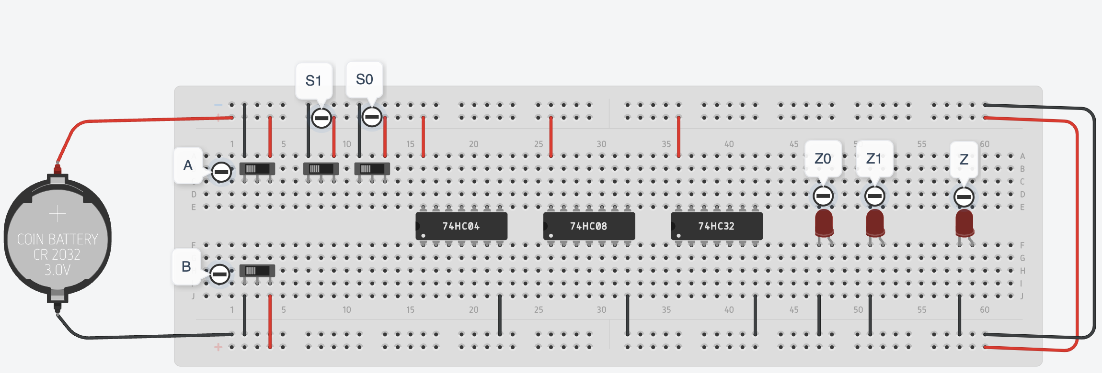
Instruction
Inputs
NOT
74HC04
AND
74HC08
OR
74HC32
Outputs

Slide 2







NOT
AND
OR
XOR
A
Z
A
A
A
B
Z
B
Z
B
Z
$$Z=\overline{A}$$
$$Z=AB$$
$$Z=A+B$$
$$Z=A⊕B$$
A Z
0 1
1 0
A B Z
0 0 0
0 1 0
1 0 0
1 1 1
A B Z
0 0 0
0 1 1
1 0 1
1 1 1
A B Z
0 0 0
0 1 1
1 0 1
1 1 0
NAND
NOR
XNOR
A
A
A
B
Z
B
Z
B
Z
A B Z
0 0 1
0 1 0
1 0 0
1 1 0
$$Z=\overline{AB}$$
$$Z=\overline{A+B}$$
$$Z=\overline{A⊕B}$$
A B Z
0 0 1
0 1 1
1 0 1
1 1 0
A B Z
0 0 1
0 1 0
1 0 0
1 1 0
A B Z
0 0 1
0 1 0
1 0 0
1 1 1

Slide 3
S₀
X
A
P
Z₀
B
Q
Y
C
X
P
R
Q
Y

Slide 4
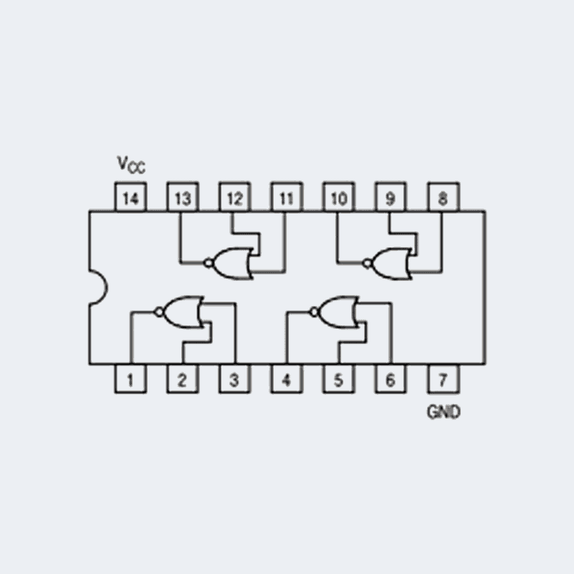
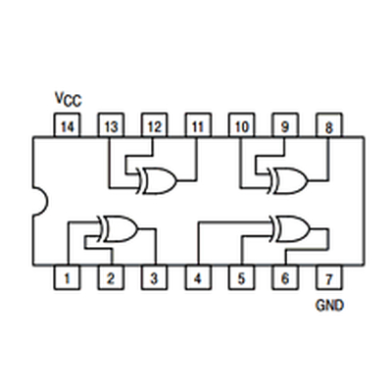
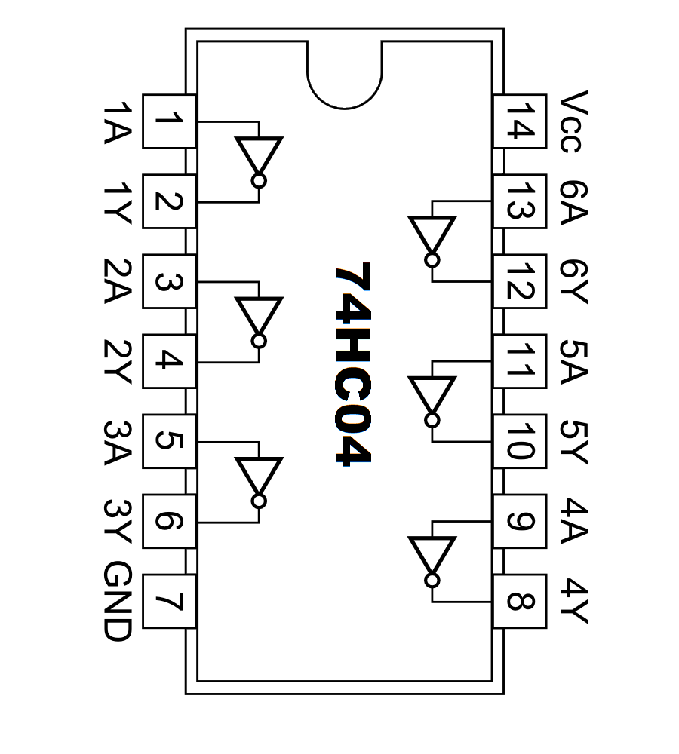
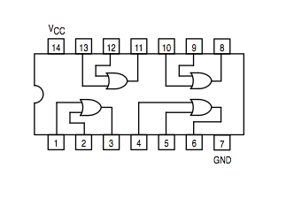
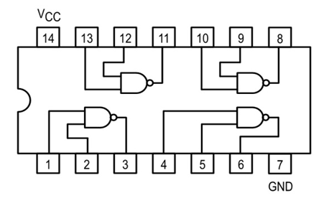
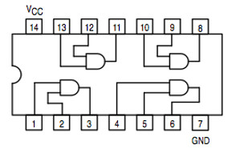
74HC00
74HC02
74HC08
74HC86
74HC32

