Slide 1
03 – Logic Gates to Logic Circuits
COMP 256 – Dickinson College
Prof. Braught
Spring 2023
Notes:
Last class we saw:
- How we interpret electrical signals as 1’s and 0’s
- How CMOS transistors work (as an abstraction)
- How multiple transistors can be combined into CMOS circuits
- You got a little practice with electrical signals and CMOS circuits in the lab as well.
In the activity for today you saw:
- How those circuits can be thought of as logical operations.
- Like AND, OR, NOT, NAND, etc…
Today we’ll look at
- How we can combine those logic gates into logic circuits
- That can perform more complex computations
- And how we can represent those computations in a number of different ways.

Slide 2







The Basic Logic Operations
NOT
AND
OR
XOR
A
Z
A
A
A
Schematic
Symbol
B
Z
B
Z
B
Z
$$Z=\overline{A}$$
$$Z=AB$$
$$Z=A+B$$
$$Z=A⊕B$$
Logic
Expression
A Z
0 1
1 0
A B Z
0 0 0
0 1 0
1 0 0
1 1 1
A B Z
0 0 0
0 1 1
1 0 1
1 1 1
A B Z
0 0 0
0 1 1
1 0 1
1 1 0
Truth
Table
NAND
NOR
XNOR
A
A
A
Each logic operation has three equivalent representations:
a schematic symbol (gate)
a logic expression,
or a truth table.
B
Z
B
Z
B
Z
$$Z=\overline{AB}$$
$$Z=\overline{A+B}$$
$$Z=\overline{A⊕B}$$
A B Z
0 0 1
0 1 1
1 0 1
1 1 0
A B Z
0 0 1
0 1 0
1 0 0
1 1 0
A B Z
0 0 1
0 1 0
1 0 0
1 1 1
Logic Gate Schematic Symbols from: https://www.tes.com/en-us/teaching-resource/logic-gate-symbols-for-powerpoint-11139006å
Notes:
Three equivalent ways of representing the logic operations
- Saw these in the activities due today.
- So won’t cover each in detail.
Do basics then just point out complements.
- AND – 1 only when both inputs are 1
- OR – 1 when one or the other or both inputs are 1
- XOR – Exclusive OR
- 1 when exactly one or the other of the inputs is 1.
Complements:
- NAND – NOT AND
- is 1 when AND is 0
- NOR – NOT OR
- XNOR – NOT XOR
- Short name is a bit odd (Seems should be NXOR but it isn’t)
Point out NOT Bars in logic expressions. (different notations !, ~, ‘, etc)
Discuss NOT bubbles on schematics.
The main point here is that there are 3 equivalent representations.
What we do today is
- Look at how we can combine gates to do more interesting things.
- And at how we can used and move between these three equivalent representations.

Slide 3

Logic Gates are Abstractions
Logic gates are an abstraction for a configuration of transistors that compute a logic function.
Relevant: Inputs and the function being computed.
Irrelevant: The actual transistor circuit.
NOT
A
Z
$$Z=\overline{A}$$
A Z
0 1
1 0
Notes:
Doesn’t matter to us as users of a gate what transistors are inside
- at least most of the time.
In fact, there are many other technologies that could be used to build a NOT gate:
- Even electromechanical relays or vacuum tubes.
- Check that Wikipedia page on Inverter that you looked at in the HW for today
- It shows a number of different transistor based implementations of NOT gates.
- We focus on CMOS because it is probably the easiest to understand and also the most commonly used.

Slide 4
Combinational Logic Circuits
A Combinational Logic Circuit is a collection of logic gates that are wired together to perform a computation.
Combinational Logic circuits compute Boolean Functions.
A Boolean Function is a function that maps as collection of Boolean input(s) (i.e. true/false, 1/0, +3V/ground) to a Boolean output.
Schematic
Diagram
A
0
1
0
Z
1
0
B
Notes:
The drawing of a combinational logic circuit (or just logic circuit for short) is called a schematic diagram.
- So if you see logic circuit or schematic diagram they are referring to the same thing.
If we apply logic values at the inputs…
The logic gates each transform their inputs into the appropriate output
Those outputs are routed further along in the circuit
Until a final output is generated.
Don’t have to memorize the truth tables at this point.
- But use the reference on the earlier slide!
- Linked on the course web page.
What we will see is that once we have some facility with these types of circuits
We can design them to do specific computations that are useful to us.
- e.g. addition, multiplication, etc…
The term Boolean Function is a function from a collection of Boolean inputs to a Boolean output.
- Boolean values – inputs or outputs - are just true(1) or false(0)
- Named for George Boole who wrote the “Laws of Thought” in the early 1800’s that describe this kind of logic.

Slide 5

Logic Circuits to Truth Tables
The Boolean function computed by any logic circuit can be represented by a truth table.
The Truth Table lists all possible combinations of the inputs to the function and indicates the resulting output.
A B Z
0 0
0 1
1 0
1 1
A
Z
0
B
What output will be generated for the input 1 0?
Notes:
As for logic gate a logic circuit will have three equivalent representations.
- circuit, truth table, expression
To do so…
- list all of the possible input combinations.
- Apply one to the inputs and propagate it through to find the output.
We saw the 0,1 (Row 2) on the last slide so we know its output will be 1.
Ask them to do Row 3.
- compare with neighbor
- confirm

Slide 6
Logic Circuits to Truth Tables
The Boolean function computed by any logic circuit can be represented by a truth table.
The Truth Table lists all possible combinations of the inputs to the function and indicates the resulting output.
1
0
A B Z
0 0
0 1
1 0
1 1
A
1
Z
0
0
0
0
1
B
0
Notes:
Just the solution for input 1,0
And then the other two as well for reference.
In general, I will include solution slides.
Sometimes we will look at them, sometimes we will not.
They are primarily here to give you a chance to review and test yourself later.

Slide 7





Logic Circuits to Logic Expressions
The Boolean function computed by a combinational logic circuit can also be expressed by a Logic Expression.
$$C=\overline{A}$$
$$D=AB$$
C
A
Z
$$Z=\overline{C+D}$$
D
B
$$Z=\overline{\overline{A}+D}$$
$$Z=\overline{\overline{A}+AB}$$
Notes:
Now we have seen that we can represent behavior of a circuit as a truth table
Since our three representations (logic circuit, truth table, logic expression) are equivalent
- We can also represent logic circuits using an expression.
Substitution Method:
- Label each intermediate result with a new variable.
- Write an expression for each intermediate variable in terms of the inputs
- Write an expression for the output in terms of the intermediate variables.
- Perform substitution until the output expressed in terms of the inputs.

Slide 8
Logic Circuits to Logic Expressions
We’ll call this method of finding the Logic Expression for a Logic Circuit the Substitution Method
Label intermediate results
Write expressions for each label
Write the output in terms of labels
Use substitution to express the output in terms of the inputs.
Use the substitution method to find a logic expression for this logic circuit.
P
S
Q
Notes:
You might be able to do one like this without the intermediate steps and without substitution.
But it doesn’t take too many more gates to make it impossible to “just see” the answer.
Practice the process, so that you will be able to apply this to more complex logic circuits.
Also, way less likely to make mistakes if you follow the process and move in smaller steps.

Slide 9




Logic Circuits to Logic Expressions
We’ll call this method of finding the Logic Expression for a Logic Circuit the Substitution Method
Label intermediate results
Write expressions for each label
Write the output in terms of labels
Use substitution to express the output in terms of the inputs.
Use the substitution method to find a logic expression for this logic circuit.
$$X=\overline{P+Q}$$
$$Y=PQ$$
P
X
$$S=X+Y$$
S
$$S=\overline{P+Q}+PQ$$
Q
Y
Notes:
Another slide for your reference if you want to review/practice again later.
If there are more inputs, and more gates there will be…
- more intermediate labels
- more substitution

Slide 10
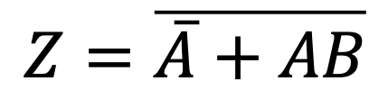
Logic Expressions to Logic Circuits
We can do a Direct Implementation of a Boolean function described by a logic expression as logic circuit.
$$Z=\overline{\overline{A}+AB}$$
A
Z
B
Notes:
Given a logic expression We’ll build a circuit that expresses the same Boolean function.
We can build it up piece by piece to create a Direct Implementation:
- Find all input variables and add them to the circuit.
- Identify terms in the expression that map to logic gates
- Add them to the circuit
- Combine those results with additional logic gates
Notice last two gates could also have been combined into a NOR.

Slide 11

Equivalent Representations
Any Boolean Function can be expressed equivalently
as a Logic Circuit (a.k.a. Schematic Diagram),
as a Truth Table,
or as a Logic Expression.
?
✔
$$Z=\overline{\overline{A}+AB}$$
✔
✔
X
✔
Notes:
You should be getting a pretty good sense by now that these representations are all equivalent.
- We have done some of these… and all are possible
- Logic circuit to truth table.
- Logic circuit to logic expression
- Logic expression to truth table.
- We didn’t do it but we can get from logic expression to truth table
- One way is to go to a logic circuit and then to the truth table using what we know.
- Can also do it directly and you will in the activity.
- Not all are routinely done.
- Truth table to circuit is possible but usually not done directly.
- Instead we go around the other way.
- Truth table to expression (haven’t seen that yet, but we will in a moment).

Slide 12
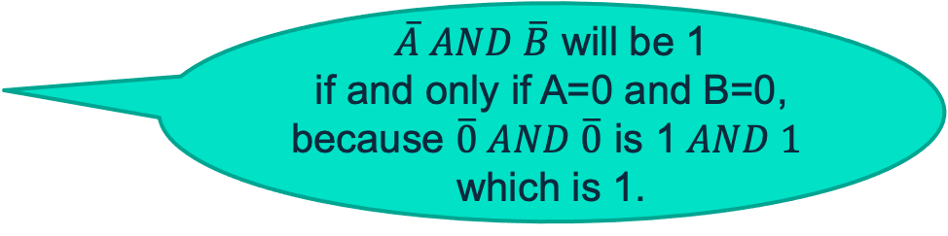
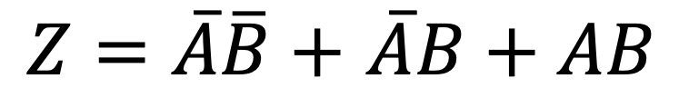
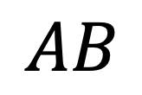
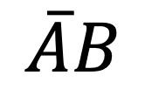
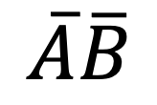
Truth Table to SOP Logic Expression
A logic expression in sum-of-products (SOP) form can readily be derived from a truth table.
$\overline{A} AND \overline{B}$ will be 1 if and only if A=0 and B=0, because $\overline{0} AND \overline{0}$ is 1$AND 1$ which is 1.
$$\overline{A}\overline{B}$$
$$\overline{A}B$$
$Z=\overline{A}\overline{B}+$ $\overline{A}B+AB$
$$AB$$
Notes:
What we need is an expression for Z that is a 1 when
- A=0 and B=0 (i.e. when AB = 00)
or when
- AB is 01
or when
- AB is 11
but not when
- AB is 10
To do that we produce a term using A and B that will be 1 when A=0 and B=0.
- That term is NOT A AND NOT B
- If A=0 then NOT A = 1
- Similarly if B=0 then NOT B = 1
- We know that 1 AND 1 is 1 (Refer to reference slide for logical functions earlier)
- So NOT A AND NOT B will be 1 only when A=0 and B=0.
We do the same thing for the other places where there is a 1
Then we use OR to put them together.
So Z will be 1 when
- NOT A AND NOT B = 1
- OR when NOT A AND B = 1
- OR when A AND B = 1

Slide 13
Truth Table to SOP Logic Expression
A logic expression in sum-of-products (SOP) form can readily be derived from a truth table.
Give a logic expression in SOP form for output P of the Boolean function expressed by this truth table.
Notes:
First term is: (NOT R) AND S AND T
The Short Cut here is to:
- Write out a term with all of the inputs – R S T
- Do this for each row where the output (P) is a 1.
- Combine them with an OR (+) operation.
- P = R S T + R S T + R S T
- Then for each R S T term
- If the corresponding input is a 0
- Invert the term (i.e. make R into NOT R)
- this causes the 0 input to be a 1
- and collectively this makes the whole term a 1
- because the inputs 0 inputs are inverted into 1’s
- the 1 inputs remain a 1
- all the 1’s are ANDed together to produce a 1.
- For the first term we get
- NOT R AND S AND T
- For the second it is
- R AND NOT S AND T
- For the third it is
- R AND S AND T

Slide 14




SOP Logic Expression to a Schematic
A Logic Expression in SOP form can be converted directly to an equivalent logic circuit.
$Z=\overline{A}\overline{B}+$ $\overline{A}B+AB$
A
B
$$\overline{A}\overline{B}$$
$$\overline{A}B$$
Z
$$AB$$
Notes:
SOP form is particularly nice because it gives a very straight forward way to construct a logic circuit.
The process is:
- Pick out the inputs and draw a vertical line for each.
- Add a NOT gate to get the inversion of each input
- Add an AND gate for each term in the SOP expression
- Connect its input to the appropriate inputs to compute the term.
- E.g. The first AND has NOT A and NOT B as its inputs.
- Add an OR to combine all of the product terms together to get the output.

Slide 15
Extending the AND/OR Gates
The AND and OR gates have natural extensions to more than two inputs.
AND – output will be 1 if all inputs are 1, and 0 otherwise.
OR – output will be 1 if at least 1 input is 1, and 0 otherwise.
Notes:
May have noticed on last slide an OR with 3 inputs…
Similarly, if our product terms had A, B and C in them
Then we would need AND gates with 3 inputs.
Both AND and OR extend to any number of inputs.
- The output of the AND will be 1 if and only if all of the inputs are 1.
- If any input to an AND is 0, then the output is also 0.
- The output of the OR will be 1 if any input is a 1.
- The only time the output of an OR is 1, is if all of the inputs are 0.

Slide 16

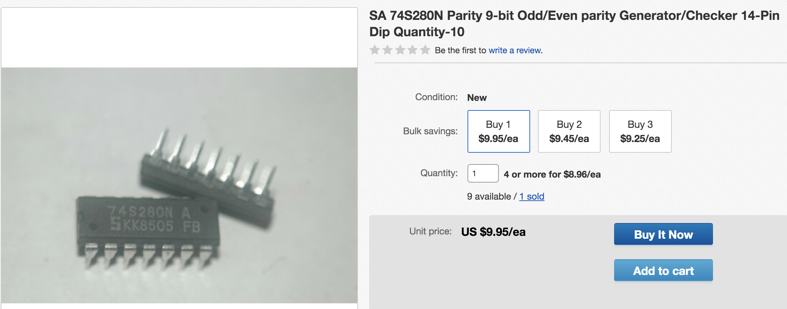
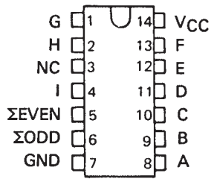
Abstracting Logic Circuits
Logic circuits can be packaged into abstractions called integrated circuits.
9 Bit even/odd parity generator/checker
https://www.ti.com/lit/ds/sdls152/sdls152.pdf (for the curious)
Image from: http://www.yd-tech.com.tw/product_info.php/
products_id/63503
Notes:
Relevant information is a description of what each input and output does.
Irrelevant, which gates and further, which transistors are used and how they are connected.
For example, this chip computes two Boolean functions:
- EVEN = 1 if an even number the inputs A-L are 1’s
- ODD = 1 if an odd number of the inputs A-L are 1’s
Don’t need to know the details of how it works, just how to use it!
- But just for fun, you’ll build a small version of the EVEN part of this circuit in the activities.

Slide 17


Acknowledgments
Slide Template From:
https://creativecommons.org/licenses/by/4.0/
Slide Content Licensed as:
Creative Commons Attribution-NonCommercial-ShareAlike 4.0 International License.
Notes:
Note: Individual images may be covered by their own licensing agreements and were incorporated here under fair use. Their use in this slide deck does not change or alter their licensing.

Slide 19
NOT
AND
OR
XOR
A
Z
A
A
A
B
Z
B
Z
B
Z
$$Z=\overline{A}$$
$$Z=AB$$
$$Z=A+B$$
$$Z=A⊕B$$
A Z
0 1
1 0
A B Z
0 0 0
0 1 0
1 0 0
1 1 1
A B Z
0 0 0
0 1 1
1 0 1
1 1 1
A B Z
0 0 0
0 1 1
1 0 1
1 1 0
NAND
NOR
XNOR
A
A
A
B
Z
B
Z
B
Z
A B Z
0 0 1
0 1 0
1 0 0
1 1 0
$$Z=\overline{AB}$$
$$Z=\overline{A+B}$$
$$Z=\overline{A⊕B}$$
A B Z
0 0 1
0 1 1
1 0 1
1 1 0
A B Z
0 0 1
0 1 0
1 0 0
1 1 0
A B Z
0 0 1
0 1 0
1 0 0
1 1 1

Slide 20
1
S
P
G
D
A
Z
D
N
G
S
0

Slide 21
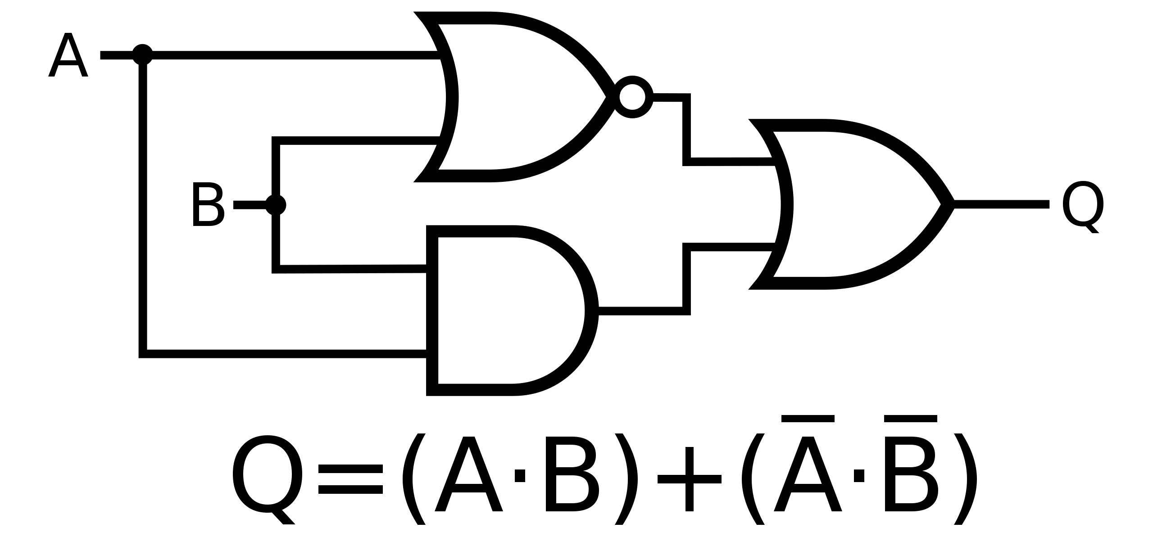
A
Z
B
P
S
Q
Officer781, CC BY-SA 4.0 <https://creativecommons.org/licenses/by-sa/4.0>, via Wikimedia Commons

Slide 22
R S T P
0 0 0 0
0 0 1 0
0 1 0 0
0 1 1 1
1 0 0 0
1 0 1 1
1 1 0 0
1 1 1 1

