Slide 1
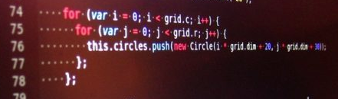
16 – Branching and Looping
COMP 256 – Dickinson College
Prof. Braught
Spring 2022
Image from: http://w34.co/no-arrays-javascript/

Slide 2
Our Assembly Language So Far
Machine:
16 Registers
R0-R11 general purpose
32-bit word size
Memory Mapped I/O
Data Allocation
Type directives
.word
Instructions:
Data Movement
LOAD / STORE
Arithmetic
ADD / SUB / SHL / etc…
Addressing Modes:
Register to Register
ADD R3 R1 R4
Direct Addressing Mode
LOAD R2 X
Immediate Addressing Mode
SUB R3 R7 #1
Notes:
This is just a recap of the relevant facts from the previous class.
- If anything doesn’t look familiar it would be worth reviewing #15.

Slide 3
Motivating Branches
Compute the absolute value of x:
…
if (x < 0) {
x = -x;
}
…
Notes:
If x is negative make it positive.
Otherwise do nothing.
In HLL we would just write the simple if statement.
In the machine language we will need a branch instruction.
- Something that changes the PC so that we skip over the x = -x if the value is not negative.
So, we need assembly language instructions that translate into the branching instructions we saw in ML.

Slide 4
A Branching Example
Labels are used to identify the address (i.e. the target) for a branch.
e.g. XLTZ / XPOS
//HLL
int x;
Read x
if (x < 0) {
x = -x;
}
Print x
* Assembly Language
X: .word 0
LOAD R0 STDIN
STORE R0 X
BNEG R0 XLTZ * X < 0?
JUMP XPOS
* MM[X] ← -MM[X]
XLTZ: NOT R0 R0 * X ← ~X
ADD R0 R0 #1 * X ← X + 1
STORE R0 X
XPOS: STORE R0 STDOUT
HALT
Notes:
We read X from STDIN – from the keyboard
Put it into the address X
Then we implement the logic for the If statement
- If x is negative we branch to the body of the loop.
- Otherwise we jump over the body to the end of the loop.
Notice:
- In ASM we can just specify the register to check.
- Unlike ML where we had to do some operation in the ALU to set the flags
- Turns out the assembler takes care of that for us when it creates the machine language.
- It will generate ML instructions that do the following…
- R1 - R0
- If Negative PC <- SKIPIF
- If Zero PC <- SKIPIF
- So one ASM instruction may turn into multiple ML instructions.
- But we don’t have to care about it.
- That is a detail that is hidden from up by the Assembly Language Abstract Machine.
The body of the loop takes advantage of two’s complement representation to find –X
- It flips the bits with NOT
- Then it adds 1 using an Immediate Addressing Mode instruction.

Slide 5
Generalized if Statement Structure
//HLL
…
if (condition) {
… if body …
}
…
* Assembly Language
…
Branch to IFBODY if condition is TRUE
JUMP to ENDIF
IFBODY: … ASM for if body …
ENDIF: …
Notes:
We can give a general structure that can be used to implement any if statement.
There is nothing special about the IFBODY or ENDIF labels…
- in fact you could only use them once!
- So if you have multiple if statements you’ll need to use different labels.
- usually it is better to use meaningful names as we did in the prior example.
Note: There are lots of other ways to implement an if statement
- This is just a good template to use
- When you encounter any if statement you can do it this way.

Slide 6
All the Branching Instructions
Notes:
BNEG example of checking a single register.
- BPOS, BZERO, BNZERO, BODD, BEVEN
BLEQ two registers – comparison
- BEQ, BNEQ, BGT, BGEQ, BLT
- A BLT might be BLEQ if you don’t like tomatoes or bacon ;)
JUMP unconditional branch.

Slide 7

Challenge
//HLL
int x;
int y;
Read x
Read y
if (x >= y) {
y = x + 5
}
Print y
Translate this HLL program into assembly language.
Assemble and run it on the machine simulator.

Slide 8
Challenge 2
//HLL
int x;
int y;
Read x
Read y
if (x != y) {
x = y;
}
else {
x = y + 1
}
Print x
If you finish the first one, try to translate this HLL program into assembly language.
Assemble and run it on the machine simulator.

Slide 9
Challenge
//HLL
int x;
int y;
Read x
Read y
if (x >= y) {
y = x + 5
}
Print y
* Assembly Language
X: .word 0
Y: .word 0
LOAD R0 STDIN
STORE R0 X
LOAD R1 STDIN
STORE R1 Y
BGEQ R0 R1 SETY * X >= Y
JUMP PRINTY
SETY: ADD R1 R0 #5 * Y ← X + 5
STORE R1 Y
PRINTY: STORE R1 STDOUT
HALT

Slide 10
for Loop Example
Compute the sum of the numbers from 1 up to and including n.
//HLL
int n;
int sum=0;
Read n
for (i=1; i<=n; i++) {
sum = sum + i;
}
Print sum
Condition
Update
Initialization
Loop
Body
Notes:
Let’s look at an example of a for loop.
Recall for loop parts…
- initialization... Once before loop
- condition… each time before loop
- if condition is true the loop body is executed
- if condition is false the loop body is skipped.
- update… at end of each loop

Slide 11
Generalized for Loop Structure
Loop conditions are often checked at the bottom of the loop in assembly language.
//HLL
…
for (init; condition; update) {
… loop body …
}
…
* Assembly Language
…
… init …
JUMP COND
TOP: … loop body …
… update …
COND: Branch to TOP if condition is TRUE.
…
Notes:
Here is the general structure for a for loop.
- Anytime you see a for loop in your code you can do this…
Typically, what is done with loops is to move the condition to the bottom of the loop.
- We check if the loop condition is true
- If it is then we jump back to the top and do the loop body.
- At the end of the loop body we do the update
- Then we check the condition again.
Again, it may seem a little odd to do it that way
- But ultimately it just make the code a little simpler.
- It also happens to reduces control hazards in the instruction pipeline
- as compared to implementing it in a more straight forward way.

Slide 12
for Loop Example
int n;
int sum=0;
Read n
for (i=1; i<=n; i++) {
sum = sum + i;
}
Print sum
N: .word
SUM: .word 0
LOAD R0 STDIN * Read n
STORE R0 N
* ...init...
LOAD R1 #1 * R1 is i
LOAD R2 SUM * R2 is temporary sum
JUMP COND
* ...loop body...
TOP: ADD R2 R2 R1 * sum = sum + i
* ...update...
ADD R1 R1 #1 * i++
COND: BLEQ R1 R0 TOP * i <= N
STORE R2 SUM
STORE R2 STDOUT
HALT

Slide 13
Tracing the for Loop Example
Main Memory
0:
4:
…:
92:
96:
N 100: ?
SUM 104: 0
…:
ML
Program Instructions
N: .word
SUM: .word 0
LOAD R0 STDIN * Read n
STORE R0 N
* ...init...
LOAD R1 #1 * R1 is i
LOAD R2 SUM * R2 is temporary sum
JUMP COND
* ...loop body...
TOP: ADD R2 R2 R1 * sum = sum + i
* ...update...
ADD R1 R1 #1 * i++
COND: BLEQ R1 R0 TOP * i <= N
STORE R2 SUM
STORE R2 STDOUT
HALT
Registers
R0: ?
R1: ?
R2: ?
(N)
(i)
(SUM)
Console
STDIN:
STDOUT:
5

Slide 14
Tracing the for Loop Example
Main Memory
0:
4:
…:
92:
96:
N 100: 5
SUM 104: 0
…:
ML
Program Instructions
N: .word
SUM: .word 0
LOAD R0 STDIN * Read n
STORE R0 N
* ...init...
LOAD R1 #1 * R1 is i
LOAD R2 SUM * R2 is temporary sum
JUMP COND
* ...loop body...
TOP: ADD R2 R2 R1 * sum = sum + i
* ...update...
ADD R1 R1 #1 * i++
COND: BLEQ R1 R0 TOP * i <= N
STORE R2 SUM
STORE R2 STDOUT
HALT
Registers
R0: 5
R1: ?
R2: ?
(N)
(i)
(SUM)
Console
STDIN:
STDOUT:
5
Notes:
Read the 5 from STDIN
Place it into R0
And then into MM[X]

Slide 15
Tracing the for Loop Example
Main Memory
0:
4:
…:
92:
96:
N 100: 5
SUM 104: 0
…:
ML
Program Instructions
N: .word
SUM: .word 0
LOAD R0 STDIN * Read n
STORE R0 N
* ...init...
LOAD R1 #1 * R1 is i
LOAD R2 SUM * R2 is temporary sum
JUMP COND
* ...loop body...
TOP: ADD R2 R2 R1 * sum = sum + i
* ...update...
ADD R1 R1 #1 * i++
COND: BLEQ R1 R0 TOP * i <= N
STORE R2 SUM
STORE R2 STDOUT
HALT
Registers
R0: 5
R1: 1
R2: 0
(N)
(i)
(SUM)
Console
STDIN:
STDOUT:
Notes:
Load R1 with the value 1 to initialize i
Use R2 as sum so we don’t have to load it from memory every time.

Slide 16
Tracing the for Loop Example
Main Memory
0:
4:
…:
92:
96:
N 100: 5
SUM 104: 0
…:
ML
Program Instructions
N: .word
SUM: .word 0
LOAD R0 STDIN * Read n
STORE R0 N
* ...init...
LOAD R1 #1 * R1 is i
LOAD R2 SUM * R2 is temporary sum
JUMP COND
* ...loop body...
TOP: ADD R2 R2 R1 * sum = sum + i
* ...update...
ADD R1 R1 #1 * i++
COND: BLEQ R1 R0 TOP * i <= N
STORE R2 SUM
STORE R2 STDOUT
HALT
Registers
R0: 5
R1: 1
R2: 0
(N)
(i)
(SUM)
Console
STDIN:
STDOUT:
Notes:
Jump to the condition
Check R1 <= R0?
- True 1 <= 5
- Branch back to top!

Slide 17
Tracing the for Loop Example
Main Memory
0:
4:
…:
92:
96:
N 100: 5
SUM 104: 0
…:
ML
Program Instructions
N: .word
SUM: .word 0
LOAD R0 STDIN * Read n
STORE R0 N
* ...init...
LOAD R1 #1 * R1 is i
LOAD R2 SUM * R2 is temporary sum
JUMP COND
* ...loop body...
TOP: ADD R2 R2 R1 * sum = sum + i
* ...update...
ADD R1 R1 #1 * i++
COND: BLEQ R1 R0 TOP * i <= N
STORE R2 SUM
STORE R2 STDOUT
HALT
Registers
R0: 5
R1: 1
R2: 0
(N)
(i)
(SUM)
Console
STDIN:
STDOUT:

Slide 18
Tracing the for Loop Example
Main Memory
0:
4:
…:
92:
96:
N 100: 5
SUM 104: 0
…:
ML
Program Instructions
N: .word
SUM: .word 0
LOAD R0 STDIN * Read n
STORE R0 N
* ...init...
LOAD R1 #1 * R1 is i
LOAD R2 SUM * R2 is temporary sum
JUMP COND
* ...loop body...
TOP: ADD R2 R2 R1 * sum = sum + i
* ...update...
ADD R1 R1 #1 * i++
COND: BLEQ R1 R0 TOP * i <= N
STORE R2 SUM
STORE R2 STDOUT
HALT
Registers
R0: 5
R1: 1
R2: 1
(N)
(i)
(SUM)
Console
STDIN:
STDOUT:

Slide 19
Tracing the for Loop Example
Main Memory
0:
4:
…:
92:
96:
N 100: 5
SUM 104: 0
…:
ML
Program Instructions
N: .word
SUM: .word 0
LOAD R0 STDIN * Read n
STORE R0 N
* ...init...
LOAD R1 #1 * R1 is i
LOAD R2 SUM * R2 is temporary sum
JUMP COND
* ...loop body...
TOP: ADD R2 R2 R1 * sum = sum + i
* ...update...
ADD R1 R1 #1 * i++
COND: BLEQ R1 R0 TOP * i <= N
STORE R2 SUM
STORE R2 STDOUT
HALT
Registers
R0: 5
R1: 1
R2: 1
(N)
(i)
(SUM)
Console
STDIN:
STDOUT:

Slide 20
Tracing the for Loop Example
Main Memory
0:
4:
…:
92:
96:
N 100: 5
SUM 104: 0
…:
ML
Program Instructions
N: .word
SUM: .word 0
LOAD R0 STDIN * Read n
STORE R0 N
* ...init...
LOAD R1 #1 * R1 is i
LOAD R2 SUM * R2 is temporary sum
JUMP COND
* ...loop body...
TOP: ADD R2 R2 R1 * sum = sum + i
* ...update...
ADD R1 R1 #1 * i++
COND: BLEQ R1 R0 TOP * i <= N
STORE R2 SUM
STORE R2 STDOUT
HALT
Registers
R0: 5
R1: 2
R2: 1
(N)
(i)
(SUM)
Console
STDIN:
STDOUT:

Slide 21
Tracing the for Loop Example
Main Memory
0:
4:
…:
92:
96:
N 100: 5
SUM 104: 0
…:
ML
Program Instructions
N: .word
SUM: .word 0
LOAD R0 STDIN * Read n
STORE R0 N
* ...init...
LOAD R1 #1 * R1 is i
LOAD R2 SUM * R2 is temporary sum
JUMP COND
* ...loop body...
TOP: ADD R2 R2 R1 * sum = sum + i
* ...update...
ADD R1 R1 #1 * i++
COND: BLEQ R1 R0 TOP * i <= N
STORE R2 SUM
STORE R2 STDOUT
HALT
Registers
R0: 5
R1: 2
R2: 1
(N)
(i)
(SUM)
Console
STDIN:
STDOUT:
Notes:
Check condition again…
- R1 <= R0
- 2 <= 5 - True
- back to to the top

Slide 22
Tracing the for Loop Example
Main Memory
0:
4:
…:
92:
96:
N 100: 5
SUM 104: 0
…:
ML
Program Instructions
N: .word
SUM: .word 0
LOAD R0 STDIN * Read n
STORE R0 N
* ...init...
LOAD R1 #1 * R1 is i
LOAD R2 SUM * R2 is temporary sum
JUMP COND
* ...loop body...
TOP: ADD R2 R2 R1 * sum = sum + i
* ...update...
ADD R1 R1 #1 * i++
COND: BLEQ R1 R0 TOP * i <= N
STORE R2 SUM
STORE R2 STDOUT
HALT
Registers
R0: 5
R1: 2
R2: 1
(N)
(i)
(SUM)
Console
STDIN:
STDOUT:

Slide 23
Tracing the for Loop Example
Main Memory
0:
4:
…:
92:
96:
N 100: 5
SUM 104: 0
…:
ML
Program Instructions
N: .word
SUM: .word 0
LOAD R0 STDIN * Read n
STORE R0 N
* ...init...
LOAD R1 #1 * R1 is i
LOAD R2 SUM * R2 is temporary sum
JUMP COND
* ...loop body...
TOP: ADD R2 R2 R1 * sum = sum + i
* ...update...
ADD R1 R1 #1 * i++
COND: BLEQ R1 R0 TOP * i <= N
STORE R2 SUM
STORE R2 STDOUT
HALT
Registers
R0: 5
R1: 3
R2: 3
(N)
(i)
(SUM)
Console
STDIN:
STDOUT:

Slide 24
Tracing the for Loop Example
Main Memory
0:
4:
…:
92:
96:
N 100: 5
SUM 104: 0
…:
ML
Program Instructions
N: .word
SUM: .word 0
LOAD R0 STDIN * Read n
STORE R0 N
* ...init...
LOAD R1 #1 * R1 is i
LOAD R2 SUM * R2 is temporary sum
JUMP COND
* ...loop body...
TOP: ADD R2 R2 R1 * sum = sum + i
* ...update...
ADD R1 R1 #1 * i++
COND: BLEQ R1 R0 TOP * i <= N
STORE R2 SUM
STORE R2 STDOUT
HALT
Registers
R0: 5
R1: 3
R2: 3
(N)
(i)
(SUM)
Console
STDIN:
STDOUT:
Notes:
3 <= 5
- True
- Back to top
- Do it again
- Make
- R2 3 + 3 = 6
- R1 3 + 1 = 4

Slide 25
Tracing the for Loop Example
Main Memory
0:
4:
…:
92:
96:
N 100: 5
SUM 104: 0
…:
ML
Program Instructions
N: .word
SUM: .word 0
LOAD R0 STDIN * Read n
STORE R0 N
* ...init...
LOAD R1 #1 * R1 is i
LOAD R2 SUM * R2 is temporary sum
JUMP COND
* ...loop body...
TOP: ADD R2 R2 R1 * sum = sum + i
* ...update...
ADD R1 R1 #1 * i++
COND: BLEQ R1 R0 TOP * i <= N
STORE R2 SUM
STORE R2 STDOUT
HALT
Registers
R0: 5
R1: 4
R2: 6
(N)
(i)
(SUM)
Console
STDIN:
STDOUT:
Notes:
4 <= 5
- True
- Back to top and do it again
- Make
- R2 = 6 + 4 = 10
- R1 = 4 + 1 = 5

Slide 26
Tracing the for Loop Example
Main Memory
0:
4:
…:
92:
96:
N 100: 5
SUM 104: 0
…:
ML
Program Instructions
N: .word
SUM: .word 0
LOAD R0 STDIN * Read n
STORE R0 N
* ...init...
LOAD R1 #1 * R1 is i
LOAD R2 SUM * R2 is temporary sum
JUMP COND
* ...loop body...
TOP: ADD R2 R2 R1 * sum = sum + i
* ...update...
ADD R1 R1 #1 * i++
COND: BLEQ R1 R0 TOP * i <= N
STORE R2 SUM
STORE R2 STDOUT
HALT
Registers
R0: 5
R1: 5
R2: 10
(N)
(i)
(SUM)
Console
STDIN:
STDOUT:
Notes:
5 <= 5
- True
- Back to top and do it again
- Make
- R2 = 10 + 5 = 15
- R1 = 5 + 1 = 6

Slide 27
Tracing the for Loop Example
Main Memory
0:
4:
…:
92:
96:
N 100: 5
SUM 104: 0
…:
ML
Program Instructions
N: .word
SUM: .word 0
LOAD R0 STDIN * Read n
STORE R0 N
* ...init...
LOAD R1 #1 * R1 is i
LOAD R2 SUM * R2 is temporary sum
JUMP COND
* ...loop body...
TOP: ADD R2 R2 R1 * sum = sum + i
* ...update...
ADD R1 R1 #1 * i++
COND: BLEQ R1 R0 TOP * i <= N
STORE R2 SUM
STORE R2 STDOUT
HALT
Registers
R0: 5
R1: 6
R2: 15
(N)
(i)
(SUM)
Console
STDIN:
STDOUT:
Notes:
6 <= 5
- False….
- Don’t go to top… just continue

Slide 28
Tracing the for Loop Example
Main Memory
ML
Program Instructions
0:
4:
…:
92:
96:
N 100: 5
SUM 104: 15
…:
N: .word
SUM: .word 0
LOAD R0 STDIN * Read n
STORE R0 N
* ...init...
LOAD R1 #1 * R1 is i
LOAD R2 SUM * R2 is temporary sum
JUMP COND
* ...loop body...
TOP: ADD R2 R2 R1 * sum = sum + i
* ...update...
ADD R1 R1 #1 * i++
COND: BLEQ R1 R0 TOP * i <= N
STORE R2 SUM
STORE R2 STDOUT
HALT
Registers
R0: 5
R1: 6
R2: 15
(N)
(i)
(SUM)
Console
STDIN:
STDOUT:
15
Notes:
Put R2 into MM[SUM]
Display R2

Slide 29

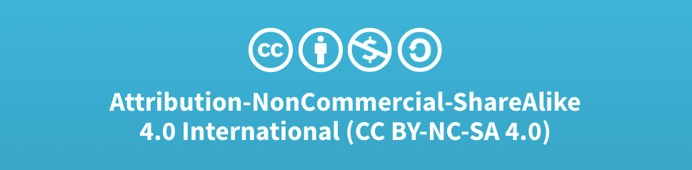
Acknowledgments
Slide Template From:
https://creativecommons.org/licenses/by/4.0/
Slide Content Licensed as:
Creative Commons Attribution-NonCommercial-ShareAlike 4.0 International License.
Notes:
Note: Individual images may be covered by their own licensing agreements and were incorporated here under fair use. Their use in this slide deck does not change or alter their licensing.

Slide 30
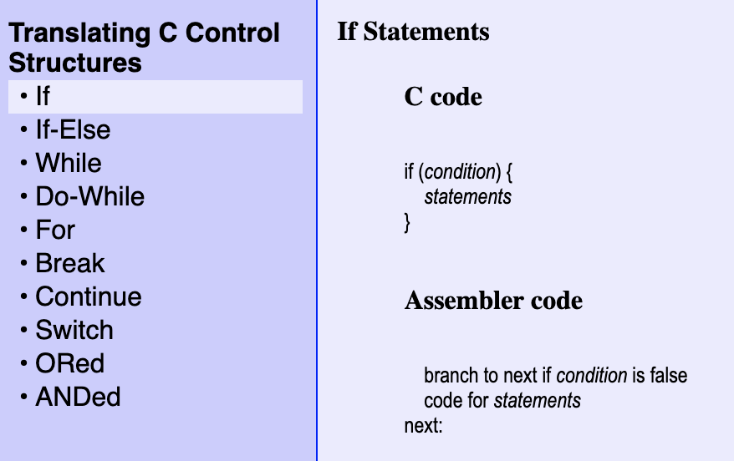
The General the if Structure
Notes:
This is the resource you’ll use in the activities.
It shows
- the HLL construct at the top (C)
- And the ASM structure at the bottom.
Very much the same as what we just saw.
- But it gives a template that can be used to build any of the different HLL structures.

