Slide 1
WA6 – Back-End Dynamic Content
COMP 256 – Dickinson College
Prof. Braught
Spring 2023

Slide 2
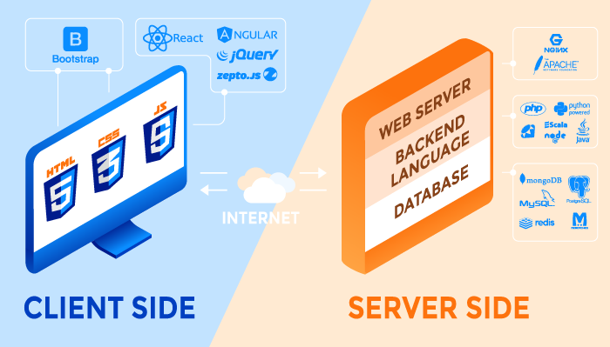

Typical Elements of a Web Application
http
https
Front
End
Web APIs
Back
End
Image from: https://rubygarage.org/blog/technology-stack-for-web-development
Notes:
Today Back-end languages
The web server as we have seen it
- serves up html/css/JavaScript in response to requests from the front-end.
- That has been static content in the web pages (.html files) thus far.
But we saw when looking at API’s is that some requests contain dynamic content.
- We saw we can request weather data for a zip code
- the server will not have a separate file for each zip code sitting there
- it generates that information dynamically by running programs.
- And almost always those programs get their data from a database.
- As we saw last class getting data from the database (at least and RDBMS) uses SQL.

Slide 3
Back-End Content
Static:
Files (HTML / CSS / JS / Images / Sounds / Videos / text / JSON / XML / etc.)
Read from a file and served, as is, back to the requestor
Dynamic:
Content (HTML / CSS / JS / Images / Sounds / Videos / text / JSON / XML / etc.)
Does not exist in a file
Generated as output from a back-end program
Frequently involving a database
Everyone gets the same files.
Customizable e.g. date, location, profile, query parameters etc. The content served is created specifically for each request.
Notes:
So, we can divide back-end content into two broad categories:
Static
Dynamic
Static Content: Web server serves static content all on its own.
- These are just files that sit on the server
- They contain HTML/CSS/JS source code
- They may be images, sounds, videos or JSON/XML etc
- they are sent back to the client as is.
- The URLs from the client requests a specific file
- Server receives the request
- reads the file
- returns the result
- This is what the web server you will be writing in lab does.
- Cannot be customized or changed on the fly (i.e. everyone gets the same thing)
Dynamic Content: Web server hands off the request to a program that is run on the server.
- That program processes the request and generates a response
- The content of the response can be, and often is, exactly the same type of stuff as static content.
- But here the content here does not entirely exist in a file
- Instead, the back-end program runs and produces the content
- This allows the content to be customized to each request.
- using date / time / location / profiles / query parameters, etc…
- Typically, the running program uses a database to get the information it uses to generate the response.
All of the content types are the same.
- just where it comes from is different
- Static – it is just read from a file as is.
- Dynamic – it is generated by a running back-end program
- Which might include reading some content from a file and adapting.

Slide 4
Back-End Dynamic Content
Dynamic content on the back-end is generated by applications that run on the server in response to requests.
Three approaches:
Page Generation
Server Pages
API Endpoint Handlers
Notes:
As just described dynamic back-end content is generated by a program running on the server.
There are three general ways in which this is accomplished:
- Page Generation
- Server Pages
- API Endpoint Handlers
We’ll look at each of these.
- We will briefly see Page Generation and Server Pages
- Really just want the concept
- We’ll dig more into API Endpoint Handlers
- This is the most common approach used for modern web applications.

Slide 5
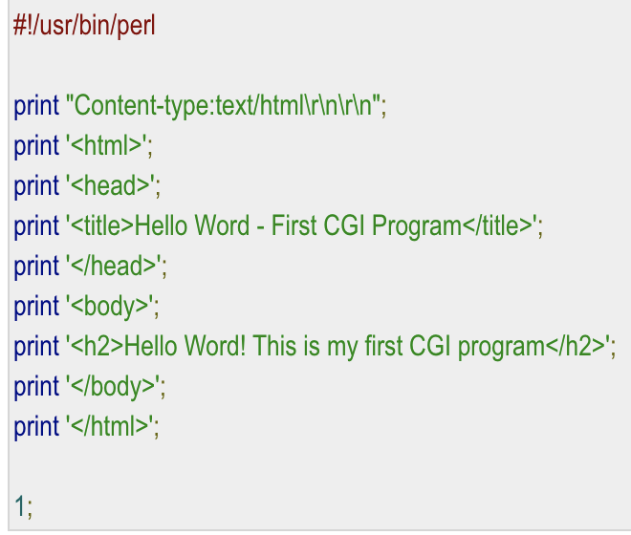
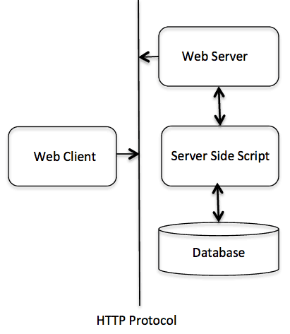
Page Generation
With page generation a program/script run on the server that outputs an entire web page.
Common Gateway Interface (CGI)
CGI Scripts (Bash/Perl)
Java Servlets
CGI
Notes:
Page generation is the oldest technique for creating dynamic content
- Nearly as old as the web.
- The most basic way to do this is called CGI
- Common Gateway Interface
- that is a way by which a web server will recognize certain URL’s as programs to be run rather than pages to return.
- When the server receives a request for one of these URLs
- it simply runs the program
- returns whatever output the program generates as the response.
- The program can do whatever it needs to do.
- Perform a computation
- Read files
- Access a database
- etc…
The example here is in the language Perl that is common for these scripts.
- But they can literally be written in any language
The CGI Figure illustrates this process:
- A client sends a request for a url
- if the server recognizes that URL as a program to run instead of for a static page
- The server will make a system call to OS asking it to run the script corresponding to the URL
- May be run as a process or maybe a thread – depends on the specific tech being used.
- That script may then use database to get content for the page.
- The script generates a full HTML page including any content from the database.
Java Servlets are the same idea
- the mechanism is a little different
- but they are a java class that generates a web page as its output.
- server plug-ins know how to find and run the Java class.
As you can imagine it gets to be quite tedious writing these pages…
- That’s where server pages come in…

Slide 6
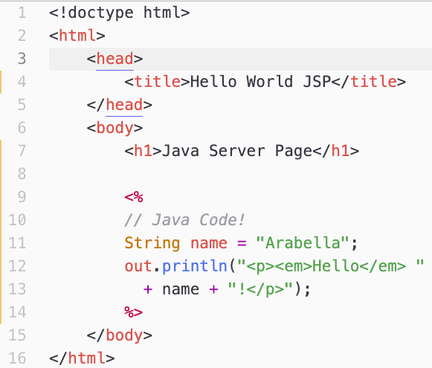
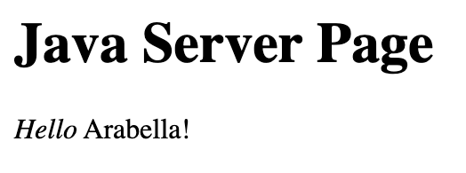
Server Pages
<% … %>
JSP Tags
With server pages a script is embedded into an HTML source file (using special tags) and the output generated by the script becomes part of the page.
Java Server Pages (JSP)
Active Server Pages (ASP)
PHP Hypertext Preprocessor (PHP)
Notes:
With server pages you embed small bits of script inside of otherwise static pages.
When a client requests a server page
- The server processes the page
- It runs any bits of embedded script
- and then substitutes the output of the script for the script source code in the HTML page.
- This saves the developer from writing print statements for the entire page as they had to with page generation,.
Notice: out.println(…)
- not System.out.println(…)
- out is just the name of the object that JSP uses to capture the printed output.
- I would have called it JSP.out, but that’s just me.
- System.out is still the object that prints to the terminal window.
Demo:
- Show source code in the container.
- Show page loaded in the browser
- Show the page source…
- Notice that the script code does not appear
- The server inserted the generated output and then served the page.
Server Pages are a nice Abstraction:
- They let the developer focus on the dynamic parts of the page
- While ignoring how the full page is generated.
The example shown here is available in our container as: www/jsp1.jsp

Slide 7
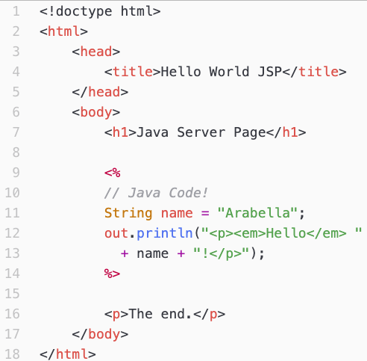
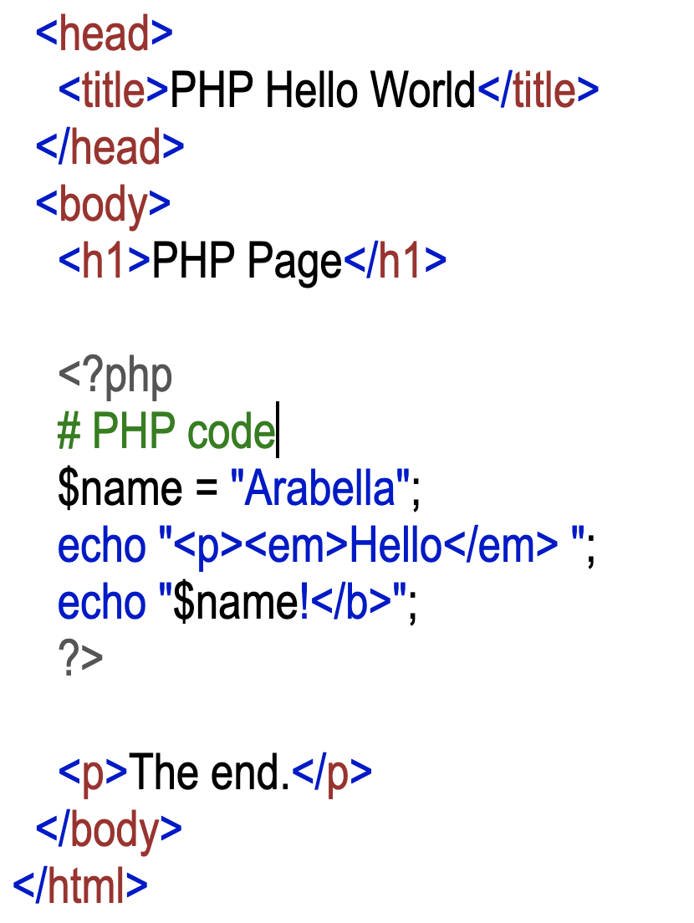
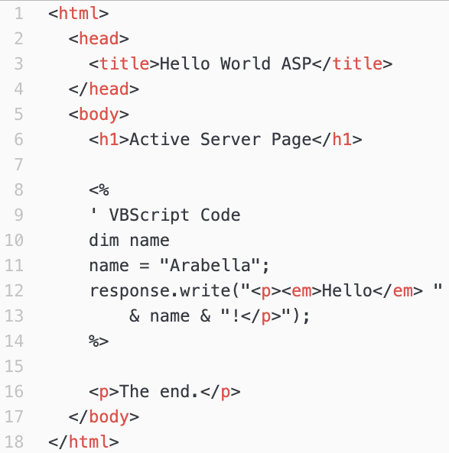
Some Server Page Technologies
JSP
PHP
ASP
Notes:
There are lots of different Server Page technologies.
But they are all fundamentally the same…
- They just embed scripts within otherwise static HTML code.
- The Server just runs the stuff in the script tags and substitutes the output that it generates into the HTML page that is returned.
- JSP: Java Server Pages
- is just as we saw on the prior slide.
- PHP does the same thing
- It just uses different tag
- and uses PHP language syntax
- e.g. echo instead of out.println
- ASP: Active Server Pages
- A Microsoft Product that worked in their web server.
- Uses the same tag as JSP
- But the embedded script is written in VisualBasic Script (VBScript)
- here they use response.write(…).
There are a few more complex examples of a JSP in our container if you are interested:
- nameJSP.html and jsp2.jsp
- nameJSP.html uses a web form to send query parameters to the jsp2.jsp page.
- the jsp2.jsp page then uses embedded Java to incorporate those query parameters into the page content.
- companyJSP.html and jsp3.jsp
- companyJSP.html uses a web form to allow the user to specify a country
- It passes that country to jsp3.jsp as a query parameter
- jsp3.jsp uses the query parameter to build an SQL statement that accesses the sample database.
- That SQL query returns a page that lists the names of all of the customers in the specified country.

Slide 8
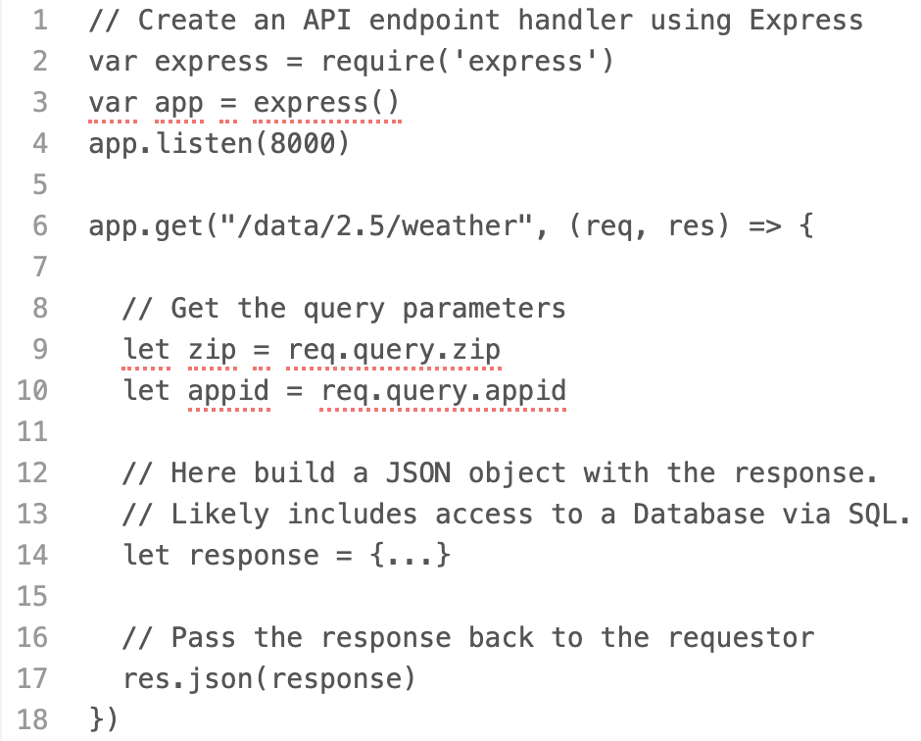
API Endpoint Handlers
In API Endpoint Handling the query string is routed, based on the service, to a function that generates the response.
Node.js/Express (JavaScript)
Others API libraries:
Laravel (PHP)
Flask / Django (Python)
Spring (Java)
ASP.NET (C#)
Notes:
We have seen API endpoints from the client/front-end
- A request in the form of a URL is sent to the server
- The server responds with some data
- Often in JSON format.
- We saw this when we used the OpenWeather API
- We sent a request to:
- The server: api.openweathermap.com
- The endpoint on that server: /data/2.5/weather
- With query parameters specifying what we wanted and our API key giving us authorization to get it.
Today we’ll look at how API requests can be processed on the back-end and how they interact with a database.
Here we have an example of what an endpoint would looks like using the Node.js / Express framework.
- Node.js and Express are just a programs and libraries that make it easy to write API handlers in JavaScript.
- Basically, for every endpoint you add a function that processes it.
The orange highlight (line 6) shows how we define an endpoint (i.e. service) in Express:
- Here we are adding code that will process requests that comes to /data/2.5.weather
- The Express framework ensures that the function receives the req and res parameters
- The req parameter is an object that the function can use to get information about the request.
- The res parameter is an object that helps the function return the result to the client.
- These are provided by the Express framework
- The details of how that happens are hidden from the developer at this level of abstraction.
The blue highlight (lines 9-10) shows how the function would access the values of the query parameters:
- req.query.zip would get the value 17013,us
- req.query.appid would get the long hexadecimal value of appid
- Again the details of how that happens are hidden from the developer at this level of abstraction.
The function would then use those query parameter values to help it build a JSON object to return
It then returns that JSON object by passing it to res.json(…)
- The function res.json(…) is also provided by the Express framework
- The developer doesn’t need know know where it came from
- Just that when a JSON object is passed to it, that object is returned to the client as the response.
There are tons of other libraries and frameworks for writing API handlers
- One or more for just about any language you want.
- They all do essentially the same thing.
- Get the query parameters
- Generate JSON (or XML or whatever)
- Return it to the client
Abstraction:
- All the frameworks just ensure that that the request gets to the right function,
- And that the response gets sent back to the client making the request.
- So that the developer doesn’t have to think about those details
- And can focus just on processing the API request.
- I.e. accessing the database and generating the JSON

Slide 9
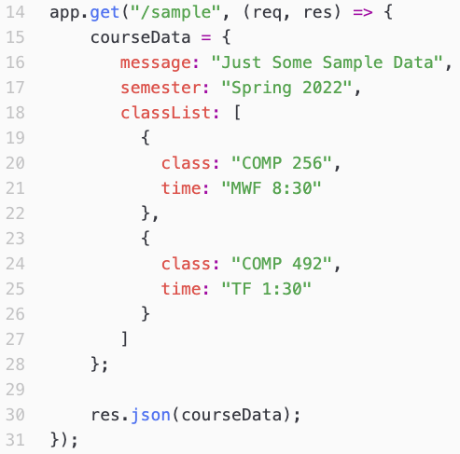
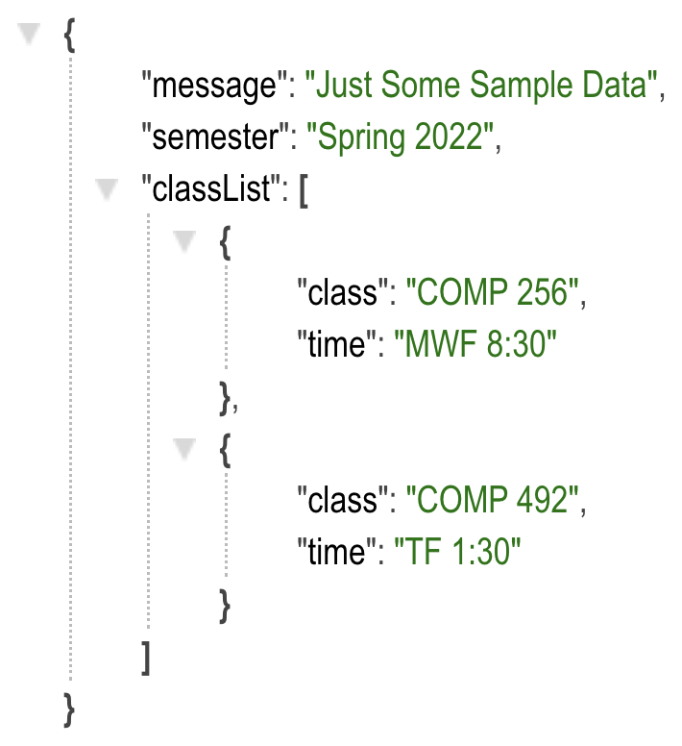
A /sample API Endpoint The Back-end Code
(code in api/server.js)
Visit: https://localhost:8000/sample
Demo!
Notes:
Here is an example of how an endpoint can be created in Express.
- Start with a demo of this in the container.
- The point is just a first example
- We’ll see one that does something more interesting and dynamic in a minute.
The app.get function allows us to define an endpoint
- Shown highlighted in orange (line 14)
- Here we are defining the /sample endpoint.
- app.get is part of the the Express framework
- Express ensures that the function we are creating receives the parameters req and res
- req is an object representing the request that was received
- It includes the query parameters.
- res is an object representing the response
- It provides the way for us to send the response back to the client.
The majority of the code in the function creates the response.
- Shown highlighted in blue (lines 15-28)
- Here it just creates a static JSON object (coruseData)
Then the JSON object that was created is returned to the requestor.
- Shown highlighted in green (line 30).
- The res.json() function sends the JSON object back to the client as the response.
We can see this in our container if we put the URL for a request to /sample into the browser:
- http://localhost:8000/sample
- The result is that the JSON object created in the server code is returned as the response.
- This is just like when we called the Open Weather API and saw the response.
- Except now we can see the back-end code that generates the JSON.
- We’ll see a more sophisticated example where the JSON is dynamic from a database shortly.
Note: The :8000 here directs the request to the API handlers instead of to the web server at :8080.
- The 8080 or 8000 is called the port
- It is like a sub-address within the web server (hardware)
- Think of it like an apartment number within a building.
- The building (server) has a main street address (e.g. localhost)
- Then within the building there are apartments (e.g. web server at 8080 and api handlers at 8000).
- We don’t normally need a port number when connecting to a web site or api (e.g. dickinson.edu)
- This is because if one is not specified a default port is used.
- Most servers run on the default port (80) for web servers
- We use 8080 so that we don’t conflict with that default for our practice container.
You can find the code for this endpoint in our container in the file: api/server.js

Slide 10
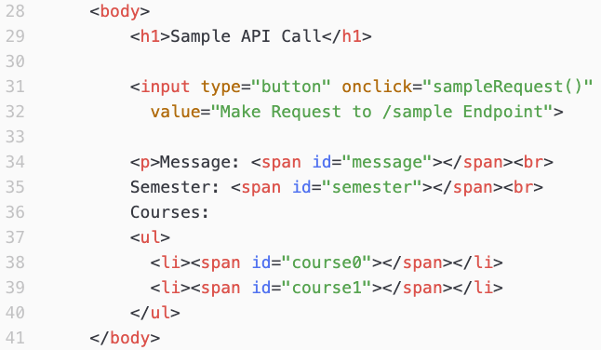
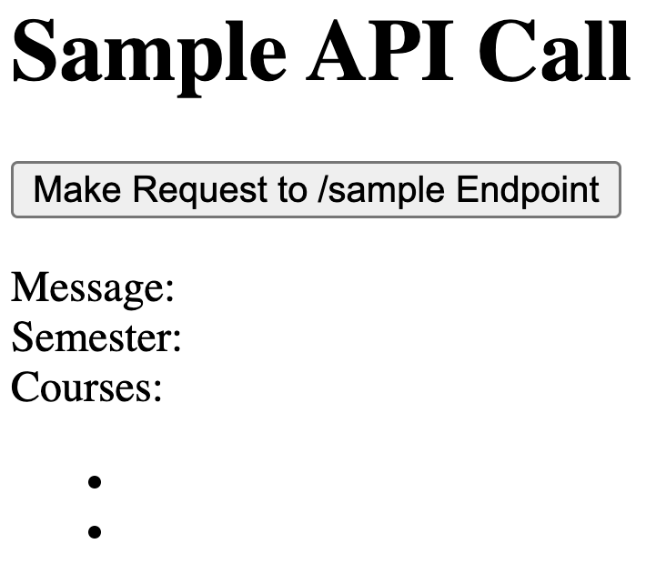
A /sample API Endpoint The HTML Code
(code in www/api2.html)
Demo!
Notes:
Now that we have an API endpoint that returns the data we can make an HTML page that makes a request to that endpoint.
Start with a demo of the page in the container.
Here is a page that will make a call to the /sample API
- When the button is clicked the page will send the API request
- When the response is received
- The JavaScript in the page will update the DOM to include the content.
The orange highlight shows the HTML code for the button.
- It includes the call to the sampleRequest() function
- That is the function that makes the request and renders the result
- It is given on the next slide.
The blue highlight shows the HTML code for the rest of the page.
- There are span’s for the message, semester and each course.
- each one has an id attribute that will allows the JavaScript to insert content from the JSON response.
- This is just like we saw in the Web API’s class period.
You can find the code for this page in our container in the file: comp256/api2.html

Slide 11
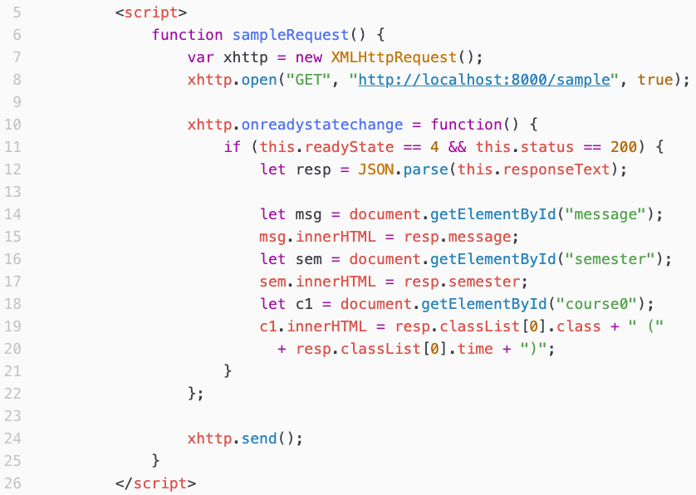
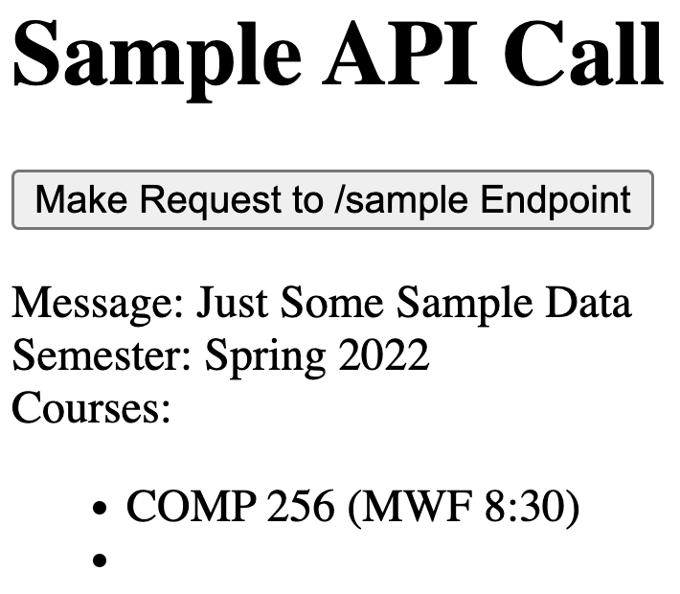
A /sample API Endpoint The Front-end Code (www/api2.html)
Notes:
We saw that when the button is clicked it will call the sampleRequest() function.
- That function is shown here.
- The code in this function
- In the orange highlighted parts:
- Makes the API request using AJAX (See WA4 for a review)
- Sends the request
- In the blue highlighted parts:
- Processes the JSON response and places content from the JSON into the DOM.
- This uses the same techniques that we saw in the WA4 class on Web APIs.
- Here:
- We get the span element with the id ”message”
- set its innerHTMl (content) to be the message field of the JSON response
- That is “Just Some Sample Data” - go back 2 slides to see the JSON again to refresh your memory.
- We then get the span element with the id “semester”
- set its innerHTML to be “Spring 2022”, from the semester field of the JSON response
- Finally, we get the li element with the id course0
- we set its innerHTML to be a new string built from the fields in class[0] in the JSON response
- The class field and the time field are combined to produce the content for the li element.
- This illustrates that it is possible to use the JSON content in any way we want.
- We are not limited to just using the individual fields.
You can find the code for this function in our container in the file: www/api2.html
Notice that the given code only displays one of the two courses.
How would we modify the code to display the second course?

Slide 12
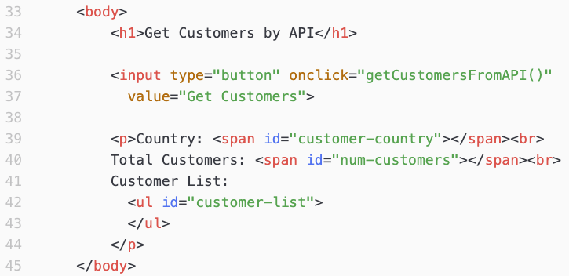
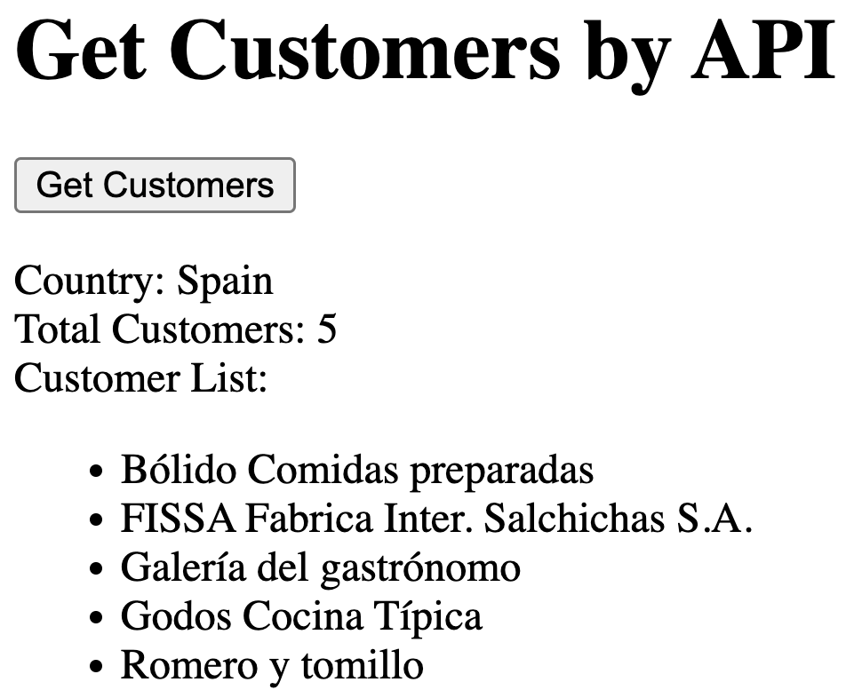
An API Endpoint that uses SQL The Front-end HTML
(www/api3.html)
Demo!
Notes:
The /sample example illustrated how an API endpoint can return a JSON object and how a web page with JavaScript can make a request and then use the JSON response that it receives. This was a nice first example but did not actually contain any dynamic content.
Just like with other API’s we can make a page to make a request of the /customers/bycountry API endpoint.
- Start with a demo in the container.
The orange highlight
- shows the HTML code for creating the button.
- The getCusomtersFromAPI function is called when the button is clicked.
- The code for that function is on the next slide.
The blue highlight
- Shows the HTML code that creates the elements that will be used to display the results of the request.
- There are span elements with id’s
- to display the country (customer-country) and
- to display the total number of customers.
- There is a ul element (customer-list)
- This list is initially empty, because we don’t know how many customers there are.
- Eventually it will a list element (li) for each customer.
- these li elements will be created and added to the DOM by the getCustomersFromAPI function
- This is just like what we did when adding foods to the list in the JavaScript homework.
You can find the code for this page in our container in the file: comp256/api3.html

Slide 13
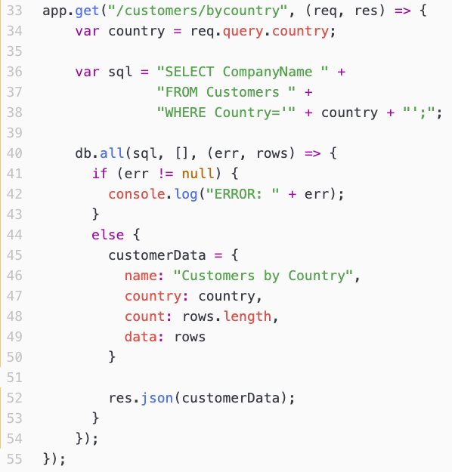
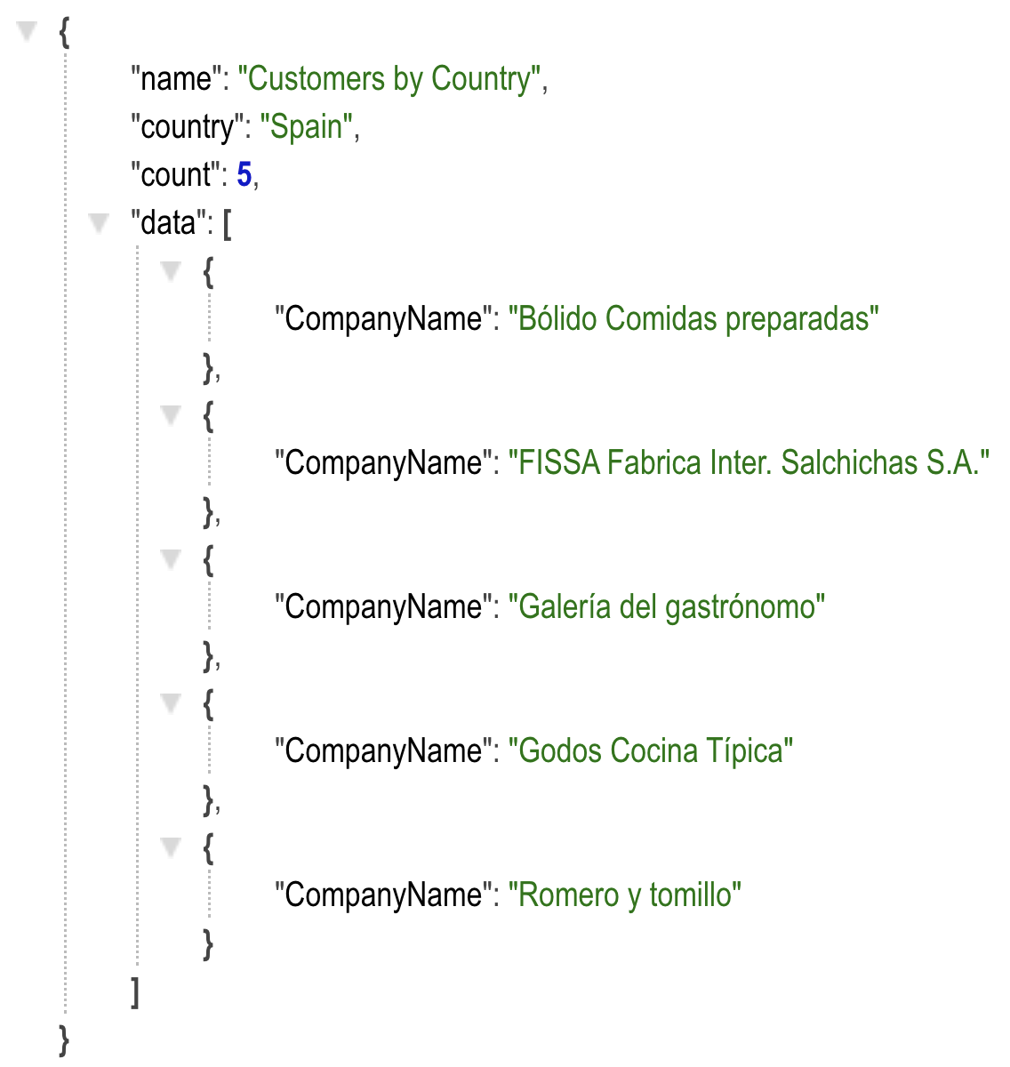
An API Endpoint that uses SQL The Back-end Code (api/server.js)
Visit:
http://localhost:8000/customers/bycountry?country=Spain
Notes:
Let’s now see how an API endpoint can use data from a database to generate its response.
The orange highlight
- Shows that we are creating an endpoint for /customers/bycountry
- We can make a request to that end point in a browser just like we had for Open Weather and /sample
- When we do we get a JOSN response.
- That response is what was generated by the rest of the code in the endpoint function.
- If we change the value in the country query parameter to say UK or US
- then we will get the list of customers from those locations.
- Notice that the JSON response contains one object for each customer in the country.
- So we can see that the API request hander is generating dynamic content based on the request.
The purple highlight
- Shows how we get the value of the country from the query parameters
- Using the requests on the right, the country variable in the JavaScript would be Spain (or UK or US)
The yellow highlight
- Shows how we can construct a string containing an SQL query.
- It looks pretty much like the SQL queries you were entering into the sqlite prompt in the previous assignment.
- We just have to be careful when building the string
- Make sure there are spaces between CompanyName and FROM and between Customers and WHERE
- Be careful to place ‘ ‘ around the country (e.g. ‘Spain’).
The green highlight
- uses an object (db) to ask that the SQL statement be executed using the database
- db.all(sql, [], …)
When that SQL statement completes
- The code inside the { … } is executed
- This is asynchronous, like we saw on the client side with making the request.
- This code does not execute right away, but it waits until the SQL request has been processed by the database.
- The code inside the {…}
- Checks to see if an error occurred (e.g. the SQL statement was invalid).
- If there was it prints that information to the terminal
- If there was no error then the code
- Builds the JSON object that will be the response.
- Some of this is just creating fields and assigning values
- E.g. “name”: “Customers by Country”,
- E.g. “country”: country,
The blue highlight
- uses the rows parameter
- the db.all function ensures that rows is an array that contains all of the results from the SQL query.
- the rows array contains one object for each record selected by the SQL statement.
- In the example here, rows will contain 5 objects because there are 5 customers in Spain.
- Looking at the JSON on the right
- the “count”: field has the value 5
- This is because the rows array contained 5 records and “count” was set to rows.length
- the ”data”: field is an array containing 5 objects
- This is because the “data” field was set to be the rows array.
- Each object in the “data” array contains a field for the ”CompanyName”
- Because that is what was selected in the SQL statement.
You can find the code for this function in our container in the file: northwindAPI/server.js
How would we modify this code if we also wanted to have the objects in the ”data” field in the JSON response contain the City where the customer is located?
- Hint: The attributes that are selected by the SQL become fields in the objects in rows.

Slide 14
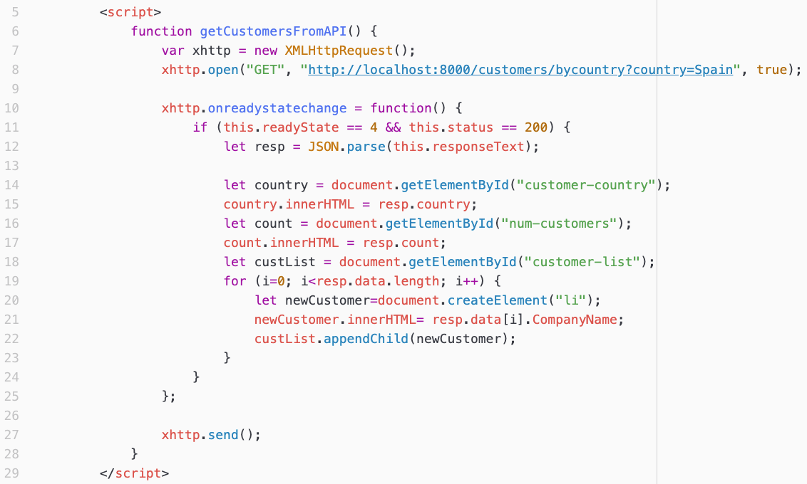
An API Endpoint that uses SQL The Front-end Code
(www/api3.html)
Notes:
The JavaScript to make the API request and to process the response, is very similar to past examples.
The orange highlight
- Shows code that is run when the button is clicked.
- It creates the API request to the /customers/bycountry endpoint with the query parameter country=Spain.
- then it sends it (xhttp.send()).
The blue highlight
- Is the code that runs (asynchronously) when the response is returned from the server.
- It gets the span with the id “customer-country”
- sets its innerHTML from the “country” field of the JSON response.
- It gets the span with the id “num-customers”
- sets its innerHTML from the “count” field of the JSON response.
- It gets the ul element with the id “customer-list”
- For every element of the data array in the JSON response
- create a new li element
- set its innerHTML to be the name of the customer.
- add that new li element as a child of the ul element in the DOM.
- So in the end, the ul element will have one li for each of the customers in the data array.
- when those are added the browser will re-render the page and the customer names appear in the page.
You can find the code for this function in our container in the file: comp256/api3.html
Imagine the JSON response contains the City for each customer as well.
- What would we need to to to display the city name for the customers?
- Hint: Its a lot like how the class times were handled in the /sample example earlier.

Slide 15

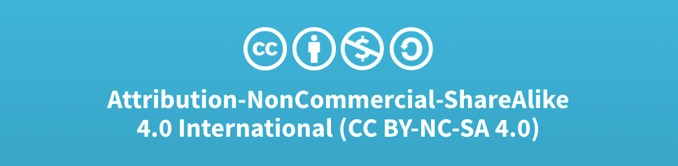
Acknowledgments
Slide Template From:
https://creativecommons.org/licenses/by/4.0/
Slide Content Licensed as:
Creative Commons Attribution-NonCommercial-ShareAlike 4.0 International License.
Notes:
Note: Individual images may be covered by their own licensing agreements and were incorporated here under fair use. Their use in this slide deck does not change or alter their licensing.

