Slide 1

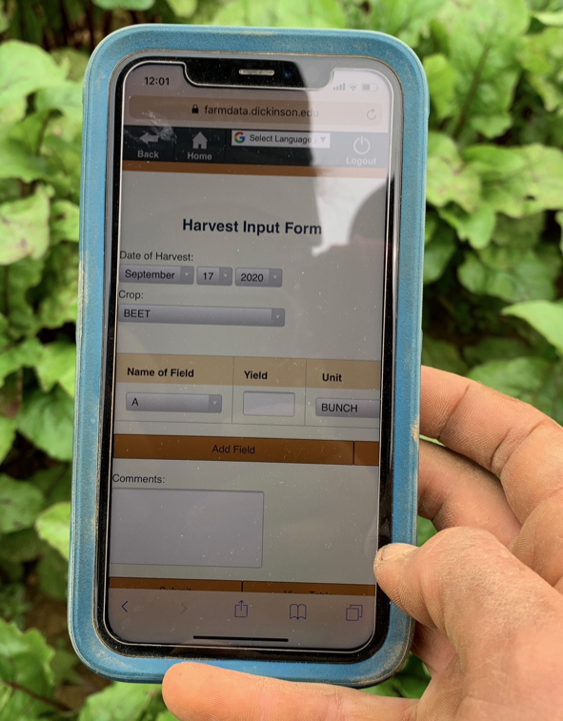
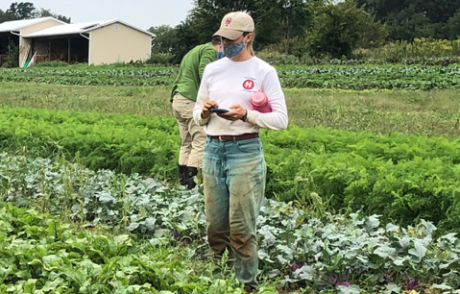
03 – Vue Data Binding Spike
COMP 290 – Dickinson College
Slides by Prof. Braught
Edited by John MacCormick

Slide 2
FarmData2 Technology Stack
Drupal
FarmOS
HTML
Vue.js
JavaScript
FarmOS API / Axios
Bootstrap / CSS
Cypress
Notes:
Vue.js + a little JavaScript - Spike 03
Vue.js + more JavaScript – Spike 04

Slide 3
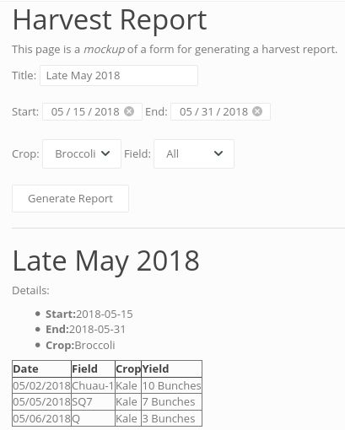
Demo What You Will Be Building
Notes:
Looks the same… but behaves differently.
- Title is linked
- Dates are linked – sort of…
- start and end are not coordinated.
- Crop is linked
- Table is not yet linked
But also what you can’t see…
- List of crops, list of fields, data in the table
- all produced by code from a JavaScript object rather than by hard coding in HTML
- One step closer to making the site live with real data

Slide 4
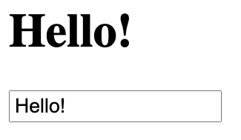
Demo A spike for your spike.
Notes:
Try stuff in a really simple example
Then apply it to your Harvest Report spike

Slide 5
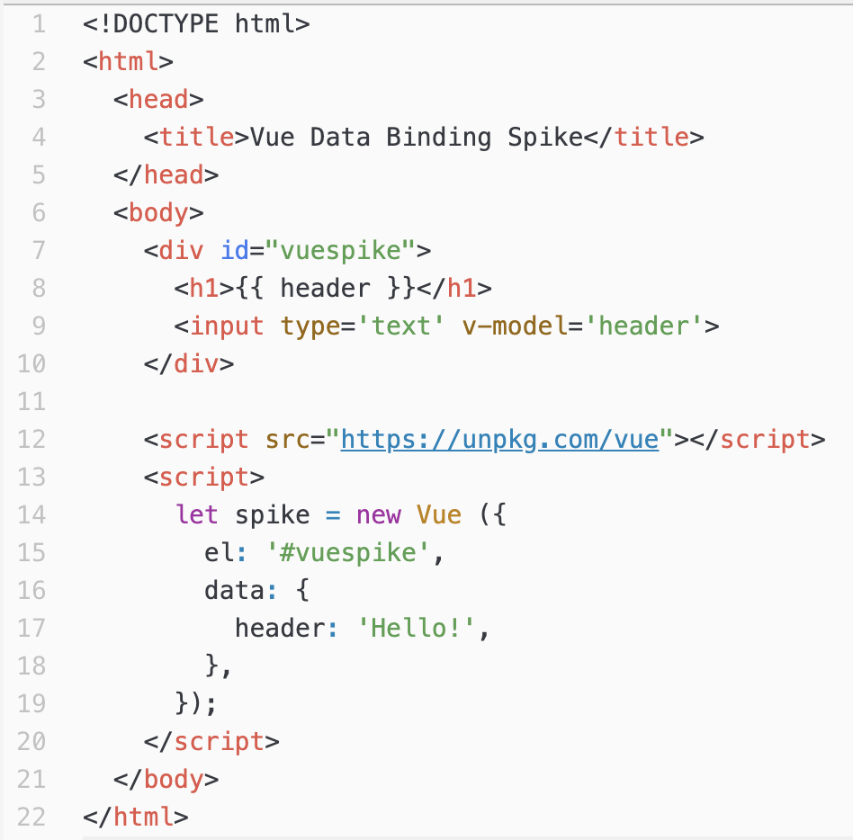
Vue.js Data Binding
Notes:
Key idea –
- connected header and text field through value in a JavaScript object
- I want to give you some intuition about how this works
- Working through the activity and the tutorials will fill in the details…
So, if the text field changes…
- that changes the object…
- and that changes the header…
But much more powerfully…
- If the object is changed by code
- e.g. loaded with data from the database
- then the values displayed will change too!!!
- Not getting there today, but we will soon.

Slide 6
The HTML <div> Element & Vue Content
Notes:
Sometimes we just need to group stuff together so we can address it as a unit.
But we don’t want it in a list or a paragraph or a header or anything else.
We just want a way group things
The <div> tag does that for us.
Here for Vue it allows us to identify the HTML that will use Vue
- id is a name for the whole div
- matches the, el value below.
- means that the data here will apply to the content in that div.

Slide 7
The <script> Tag & The Vue.js Library
Notes:
The <script> tag is used to include JavaScript code in a page.
It can be used to bring in an external library
- using the src attribute.
- here it pulls in the Vue.js library from an on-line (unpkg.com) site that serves libraries.
- Sort of like docker hub for javascript libraries

Slide 8
The Vue Instance is a JavaScript Object
Notes:
let – define a javascript variable
- spike is a reference to an object of type Vue
- new Vue ( ); - calls constructor
- { }
- Syntax for creating an object in JavaScript.

Slide 9
JavaScript Objects are made up of Properties and Values
Property
Value
Notes:
Property = Field in Java
Colon
Value
This one is a string, but can have numbers or other objects.

Slide 10
JavaScript Objects are made up of Properties and Values
Property
Value
Notes:
Here the property is another object.

Slide 11
Property: Value Pairs are Separated by Commas.
Notes:
Quirky convention in Vue-land where there is a comma after the final Property:Value pair too.
Basically prevents you from forgetting to include if when you add another Property:Value pair.
- This is a hear me now, believe me later thing!

Slide 12
DevTools & Vue DevTools
DevTools and the Vue DevTools are essential testing and debugging tools!
Demo!
Notes:
Open DevTools
- Show spike object (type spike return, open object)
- Show $data element
- Change $data.header element
Use command line:
- spike.$data.header = “new messge”
Show syntax error in Vue instance
- omit comma between new property.
Great for JS/HTML and works on any page, and any browser.
VueDev Tools is way better for interacting with the Vue Instance!
- Show in simple spike.
Then show in FarmData2
- Glimpse of where this is going…
- Can modify VueInstance… and UI is automatically updated.
- The power comes when we start using JavaScript to modify the VueInstance rather than doing it by hand!
- Next week’s Activity!

Slide 13
College Farm field trip next week
Meet in Kaufman parking lot near DPS by 1:25pm
We depart at 1:30pm sharp
We will be back on campus by 3pm
Notes:
Future Software Dev Topics:
- Open Source Business Models
- Agile Software Development
- Writing Commit messages and Pull Requests
Social/Legal/Ethical issues
- Diversity, Inclusion and Equity in COMP / Open Source
What are you interested in?
- Tech related to software dev?
- Current SLE issues?

Slide 14

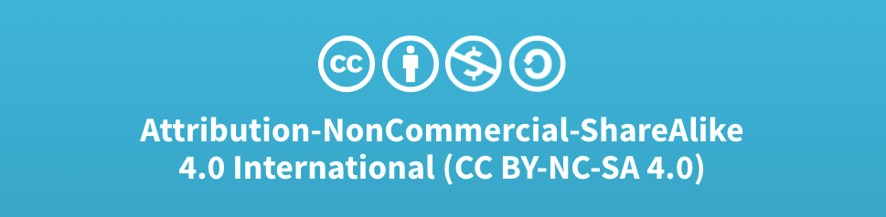
Acknowledgments:
Slide Template From:
https://creativecommons.org/licenses/by/4.0/
Slide Content Licensed as:
Creative Commons Attribution-NonCommercial-ShareAlike 4.0 International License.

