Slide 1

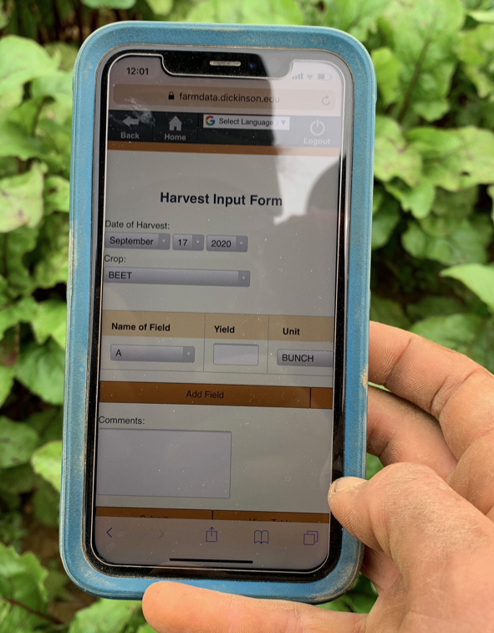
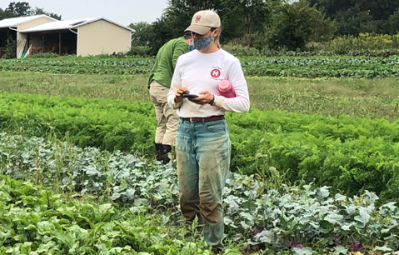
02 – HTML Technology Spike
COMP 290 – Dickinson College
Slides by Prof. Braught
Edits by John MacCormick

Slide 2
FarmData2 Technology Stack
Drupal
FarmOS
HTML
JavaScript
FarmOS API / Axios
Vue.js
Bootstrap / CSS
Cypress

Slide 3
Technology Spikes
A Technology Spike is an Agile Software Development technique where time is set aside to learn new technologies, experiment with a new tool, language, library, and/or evaluate alternative approaches.
Has minimum essential functionality
Keep it simple & focused
Kept separate from the project
Don’t let experimental code leak into the project.
Trash it and write it clean.
Notes:
We will read more about Agile Software Development as we go along.
But when a team runs into a part of the project where they are unsure how to proceed they will often create a spike.
A basic example that has the minimum essential properties of the project
The spike will let them figure out how to do new things, evaluate different approaches
Separate from the project so experimental stuff doesn’t leak into the project
Keep the project clean – only put it in once you know how to do it – then write it clean.

Slide 4
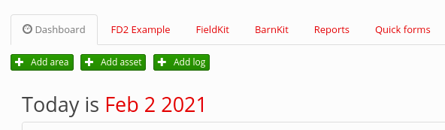
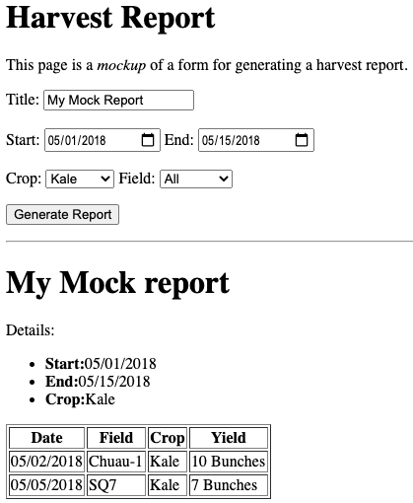
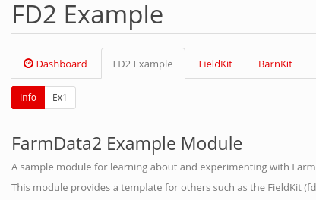
FarmData2 HTML Spike
Notes:
Do a screen share of FarmData running live to see the tabs ad the FD2 Example with sub-tabs.

Slide 5
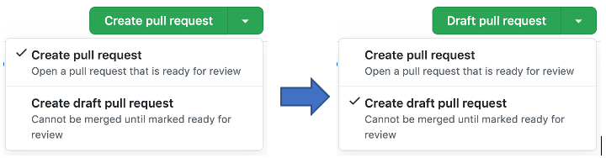
Draft Pull Requests
Like a pull request, but for code not ready to be merged into the upstream yet.
We will use these so that I can easily see and run your work by pulling your branches from the upstream.
Projects use them when someone starts working on a feature that will require time / discussion / review.

Slide 6
HTML
Basic HTML
HTML Forms
HTML Tables

Slide 7
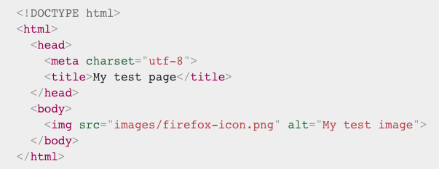
HTML in 1 Minute:
Notes:
Tags
Attributes
That’s about it

Slide 8
Advice for all assignments
Read carefully
Investigate
Occasional extra research is needed (search engines, tutorials, etc.)
Think
Iterate
and ask for help

Slide 9
What’s Next
Two assignments due:
FDS 03, midnight Monday
MP1, 8am Wednesday

Slide 10

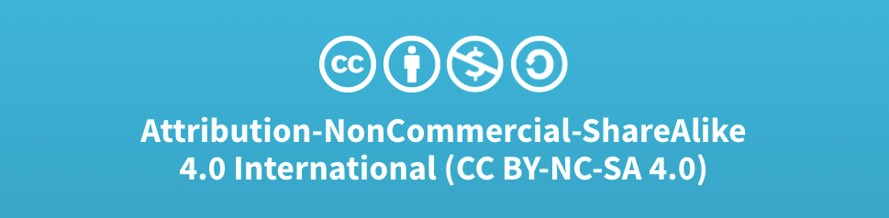
Acknowledgments:
Slide Template From:
https://creativecommons.org/licenses/by/4.0/
Slide Content Licensed as:
Creative Commons Attribution-NonCommercial-ShareAlike 4.0 International License.

