Slide 1

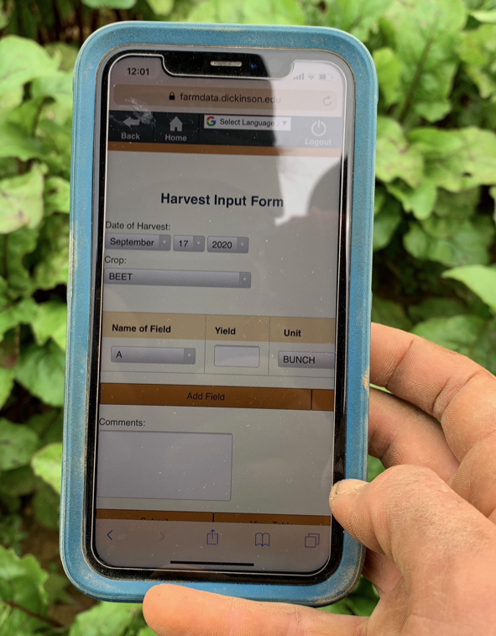

05 – Web APIs and Axios Library Spike
COMP 290 – Dickinson College
Slides by Prof. Braught
Edited by John MacCormick

Slide 2
FarmData2 Technology Stack
Drupal
FarmOS
HTML
Vue.js
JavaScript
Web APIs / Axios
FarmOS API
Bootstrap / CSS?
Cypress?
Notes:
Move Vue.js + more JavaScript – Spike 04

Slide 3
FDS5 Questions
What issues did you encounter?
How did you resolve them?
Any questions on:
Vue Events?
JavaScript?

Slide 4
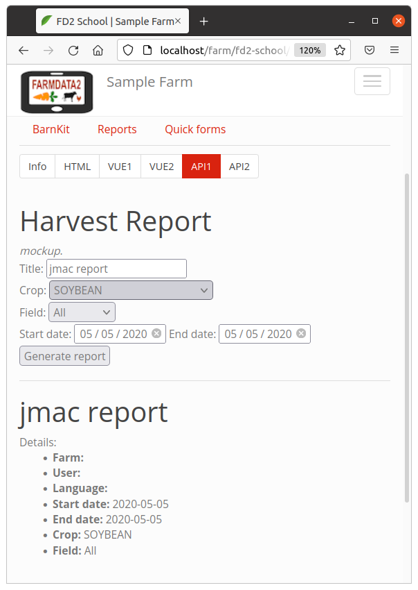
Demo: Getting some real data
Notes:
Looks the same… but behaves differently.
Do the DEMO.
Notice no report initially.
Dates cannot be set to illegal values
- e.g. start after the end or vice versa.
- Dynamic…
Click Generate report
- Makes blank report (see message)
- Click again…
- Shows one row
- Then another, and another
Notice the total Yield calculation.
Delete buttons...
- Notice total yield is dynamic.
Note: Still not live data – Next week!!!
- Show delete and click generate again…
- duplicate… but yield is still right..
Show the Vue DevTools as we work with it.
- The showReport property
- The rows of the table being added

Slide 5
Web APIs
A Web Application Programming Interface (API) allows client-side code to access and manipulate server-side resources through a well-defined set of API endpoints (i.e. URLs).

Slide 6
REST APIs
REST – Representational State Transfer
Set of API design conventions.
Fast and Lightweight
Runs over HTTP (Hypertext Transfer Protocol)
Stateless
Cacheable

Slide 7
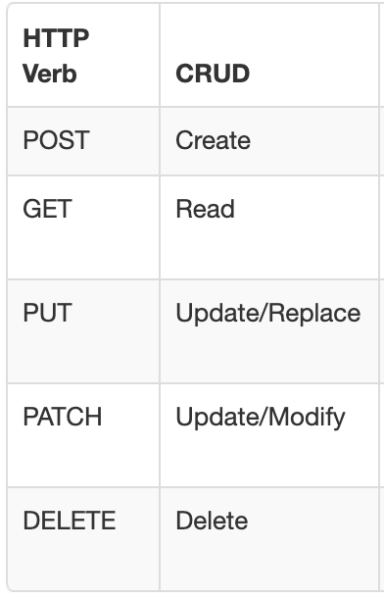
HTTP Request Methods:
The HTTP provides request methods that are used to build REST API’s.
CRUD – alternative formulation of operations in a non-protocol specific way.
Notes:
https://restfulapi.net/http-methods/

Slide 8
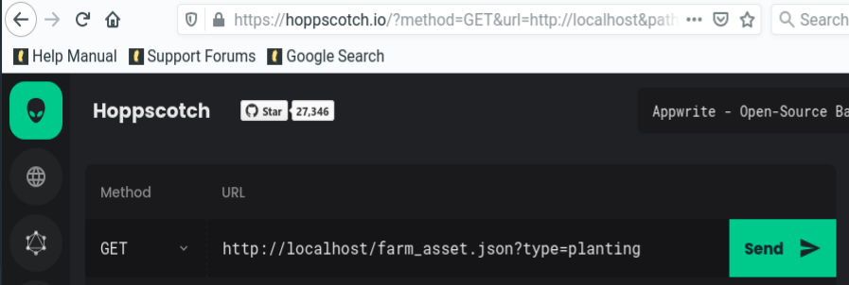
Sample API and Demo
Rick and Morty:
https://rickandmortyapi.com/api
The Hoppscotch Application
﻿https://hoppscotch.io

Slide 9

The Axios Library
Axios is a JavaScript library for making and processing API requests.
let spike = new Vue ({
el: '#axiosspike',
data: {
currencies: null,
…
},…
axios.get('https://api.exchangeratesapi.io/latest')
.then(response => {
this.currencies = response.data.rates;
}
);

Slide 10
Vue Lifecycle Hooks
Lifecycle hooks are methods that are run as a Vue instance enters or leaves different states.
created
mounted
updated
destroyed
…
let spike = new Vue ({
el: '#axiosspike’,
data: { …
},
created() { …
<initialization code>
},
methods: { …
},
});

Slide 11
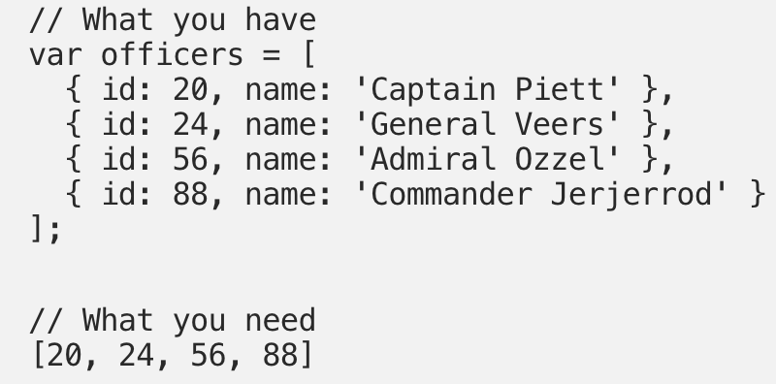
JavaScript Map Example
https://medium.com/poka-techblog/simplify-your-javascript-use-map-reduce-and-filter-bd02c593cc2d

Slide 12
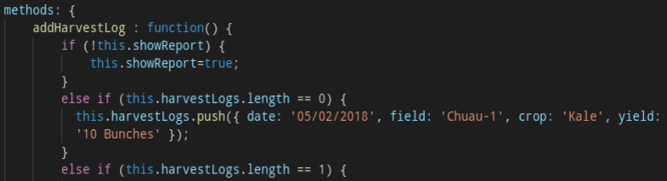
Remember this…
Don’t forget this…

Slide 13

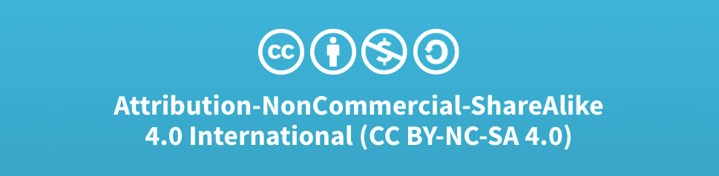
Acknowledgments:
Slide Template From:
https://creativecommons.org/licenses/by/4.0/
Slide Content Licensed as:
Creative Commons Attribution-NonCommercial-ShareAlike 4.0 International License.

