Slide 1
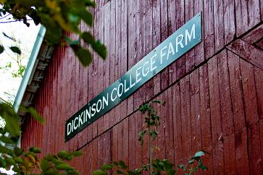
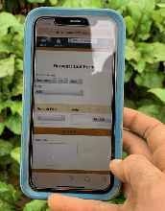
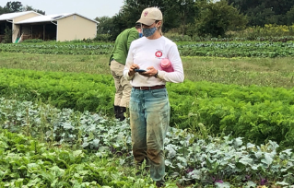
06 – farmOS / FarmData2 API Spike
COMP 290 – Dickinson College
Prof. Braught
Spring 2023

Slide 2
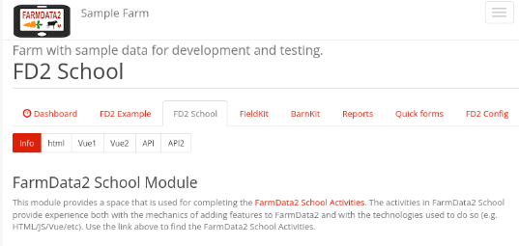
FD2School Activity Sub-tabs
Activities - Technology Spikes
02 - HTML
03 – JavaScript & Vue Data Binding
04 - Vue Events and JavaScript Functions
05 - Web APIs
06 – FarmData2 / farmOS API
07 - End-to-End Testing (Cypress)
08 - FarmData2 Patterns
Notes:
HTML
- Essentially how to place content on the page.
JavaScript and Vue Data Binding
- How to make that content dynamic
- Using the Vue.js framework.
Vue Events and JavaScript Functions
- How to make code you write to run when the user does something
- I.e. When the user clicks a button.
- How to make the page more responsive and user friendly.
Web API’s
- How to request data from a back-end database
- How to incorporate that data into the front-end user application.
FarmData2 / farmOS API
- How we will get data from farmOS / FarmData2

Slide 3
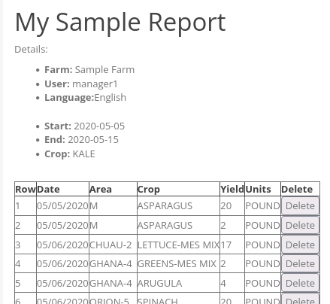
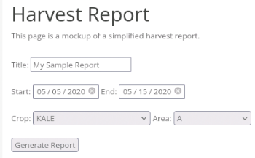
Demo
Notes:
Demo of the features you’ll add in this activity.
The form for setting up the report is as it was at the end of the the prior activity.
- The Crop and Area are populated from the database
- via the computed properties that use the maps from:
- Crop id t o Crop Name map
- Area id to area Name map
After this activity, when you click the Generate Report button
- The harvest report table will be loaded with rows that come from the database
- Real harvests that occurred on the Dickinson farm.

Slide 4
The farmOS / FarmData2 Data Model
Data in farmOS / FarmData2 is organized primarily using Assets and, Logs.
Assets represent things on the farm and exist in an Area.
Different types of Assets represent different things.
Plantings, Animals, Equipment, …
Logs represent events that occur on the farm.
Different type of Logs represent different events.
Seeding, transplanting, harvesting, tilling, fertilizing, …
Logs happen on a day
Logs affect Assets or Areas
Logs are performed by People, possibly using Equipment
Notes:
Talk a little about how farmOS and FarmData2 organizes the data.
A few examples:
- A seeding log represents planting of seeds for a specific crop in a specific area
- by the person who did it on the day they did it.
- This creates a Planting asset.
- A transplanting log represents the movement of a Planting asset from a greenhouse to a field
- by the person who did it on the day they did it.
- A harvesting log represents the removal of a Planting asset from a field.
- by the person who did it on the day they did it.
- modifies the Planting to indicate that it is “done” (i.e. no longer in a field).

Slide 5
The farmOS / FarmData2 Data Model
farmOS / FarmData2 uses a Taxonomy
A Taxonomy is a collection of Vocabularies.
A Vocabulary is a collection of related terms.
farmOS/FarmData has Vocabularies for:
Crops, Areas, Units, …
Vocabularies help to enforce data integrity.
Only Crops listed in the Crops Vocabulary can be used (i.e. planted, transplanted, harvested,…).
Only Areas listed in the Areas Vocabulary can be used.
Notes:
Some examples:
- A Planting asset will contain the ids of the Area and Crop that are planted.
- Those ids will indicate the vocabulary term representing the area or the crop.
This ensures that the Chuau greenhouse is always Chuau and not chuau or Chewau by mistake.
Similarly, it ensures that Broccoli is always Broccoli and not Brocolli by mistake.

Slide 6
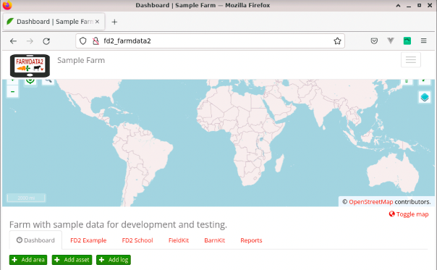
Drupal, farmOS, FarmData2
farmOS
FarmData2
Drupal
mariaDB
Notes:
When we refer to FarmData2 we are really referring to farmOS with the FarmData2 modules.
When talking about features that farmOS provides I’ll try to use farmOS
When talking specifically about features that FarmData2 adds to farmOS I will try to use FarmData2.
However, it is a little blurry
farmOS is open source and its licensing allows rebranding.
So FarmData2 presents as if all of farmOS and FarmData2 are one product.
- e.g. the logo up in the left.
The FarmData2 specific features appear (almost) exclusively in the tabs that we add
- FD2Example (only for developers and learning)
- FD2School (only for learning)
- FieldKit – features (primarily) for use on mobile devices in the field.
- BarnKit – features (primarily) for use on desktop in the barn.
Features accessed through other tabs or the “Hamburger Menu” are features provided by FarmOS.

Slide 7
farmOS / FarmData2 API
The farmOS / FarmData API provides endpoints for
Reading (GET), creating (POST) and updating (PUT) Assets, Logs and Vocabulary terms.
The available endpoints are documented at:
https://v1.farmos.org/development/api/
Notes:
We saw the /farm.json endpoint last time.

Slide 8
The FarmOSAPI Library
The FarmOSAPI library contains convenience functions that make it easier to interact with the APIs.
getCropIDToNameMap
getAreaIDToNameMap
getRecord
createRecord
updateRecord
deleteRecord
getAllPages
…
Notes:
You saw the getCropIDToNameMap and (possibly) the getAreaIDToNameMap in the last homework.
There are others for working with individual records (i.e. an Asset or a Log).
- get, create, update, delete
These are all documented in FarmData2 via the documentation that you generated in the last activity
- You will be using that documentation again in this activity.
Want to talk some more about the last function listed here
- getAllPages

Slide 9
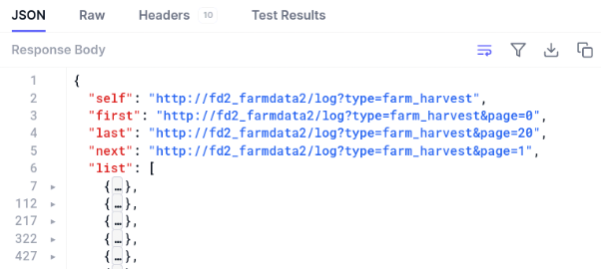
Multi-page Responses
When an API request returns a large amount of data it is broken into pages.
The initial response contains the first page of data and information about how to request the next page.
Notes:
So when requesting a collection of logs
- E.g. all of the harvest logs in a range of dates…
- the API may not give us all of the data at once…
Here we see a request that was for harvest logs over a large date range.
Responses that may contain multiple pages have some header information before the list of records.
The header information contains properties:
- self
- gives the URL of the API reequst that was used to make the request that returned this page of results.
- first
- gives the URL for an API request that will return the first page of results.
- last
- gives the URL for an API request that will return the last page of results.
- next
- gives the URL for an API request that will return the next page of results after this one.
So to get all of the results we would:
- Repeatedly use the next property to request the next page of results.
- Until self == last

Slide 10
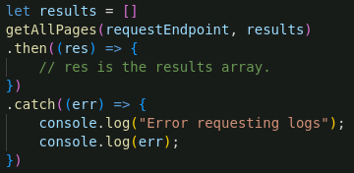
The getAllPages function:
Collecting all of the pages for a request can be tedious so the FarmOSAPI provides the getAllPages function.
Notes:
Given an endpoint and an existing array the getAllPages function
- add all of the records (logs, assets) that are returned on all pages to the array.
Always a good idea to indicate errors in some way.
- Here we log them to the console.
If the results array is actually in the data property of the Vue instance…
- we can omit the then because we don’t need to do anything
- When you implement your page you’ll see that Vue data binding will take care of everything.
- getAllPages adds each page of results to the array as it is returned from the server.
- because the array is in the data property of the Vue instance
- Vue will notice that the array has changed
- It will then update any computed properties that use the data and the page will re-render.
- This is just like what we saw with the crop and area dropdowns.
- This is extra nice when there are lots of results
- the page will be re-rendered each time a new page of results is added to the array.
- so we don’t have to wait for all of the pages to be returned before we see anything.

Slide 11
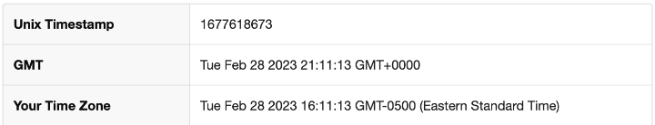
Time Stamps
farmOS / FarmData2 store dates using Unix Time Stamps.
A Unix Time Stamp is a 32-bit two’s complement integer representing the number of seconds since (or before) 00:00:00 January 1, 1970.
We use the dayjs library for manipulating dates.
MM/DD/YYYY → Timestamp
Timestamp → MM/DD/YYYY
Notes:
The HTML date components give us dates in MM/DD/YYYY format.
All farmOS/FarmData2 data is stored using timestamps.
- So to retrieve data by date we’ll need to use timestamps in our API requests.
- So we need to be able to convert MM/DD/YYYY dates into time stamps.
The Harvest table should display human readable dates.
- But the responses we get back will contain timestamps as dates.
- So we need to be able to convert time stamps into MM/DD/YYYY dates.
We will use the dayjs library to do this.
- More information in the activity.

Slide 12
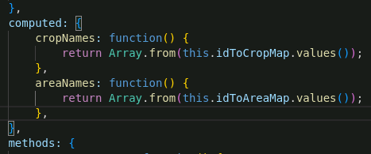
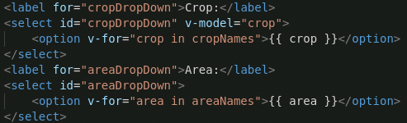
Computed Properties
A Computed Property in Vue is used to transform data in the Vue instance into a different format for rendering.
Function name is used like a property in the Vue data.
Never change Vue data in a computed property.
When data changes the computed property is updated.
Notes:
You saw computed properties in 05.
Worth a little clarification here as you’ll use them again in 06 and beyond.
In 05 you used this to transform the map from Crop ID to Crop Name into an array of crop names.
- the computed property returned the array of crop names.
- the HTML used that computed property in the v-for to populate the dropdown.
If the Vue Data changes
- that is noticed by Vue
- the computed property is recomputed
- the page is re-rendered using the new value of the computed property.
In this assignment you’ll
- request the full harvest log records from the API
- store them in the Vue instance data
- transform them into an array of values that match what is supposed to appear in the harvest table.

Slide 13
Practice Incremental Development
Work in very small increments.
Add a small bit of code
Find some way to verify that it works
Use the page
Use console.log
Use the DevTools
Use Vue DevTools
Notes:
If you add too much code it can be very difficult to determine where things went wrong if the page doesn’t work.
- Did you convert the MM/DD/YYYY to the timestamp correctly?
- If you’ve already tried to use it an make a request and put the data in the page and it doesn’t work then...
- Is the problem the conversion?
- The the request?
- How you processed the response?
- Better to do the conversion
- check that it works somehow
- console.log or DevTools
- Then create the request and somehow check that the URL is correct.
- again console.log or DevTools
- Then make the request and somehow check that we get the right data back
- Then put it into the page.
That way if something goes wrong you can be pretty sure it was the last thing.
- Super important when you are learning and using things that are new to you.
- Might be able to do bigger increments with more confidence as you get more practice.
- But … bigger increments… not no increments … is still a good practice.
The activities all along have been structured this way.
This week this is extra true.

Slide 14
What’s Next
Activity 06
Due next Wednesday at noon.
Reading and prepare for discussion.

Slide 15


Acknowledgments:
Slide Template From:
https://creativecommons.org/licenses/by/4.0/
Slide Content Licensed as:
Creative Commons Attribution-NonCommercial-ShareAlike 4.0 International License.

Slide 16
Summer Openings!!!
Two 8-week summer positions
FarmData2 Development
Includes stipend and (hopefully) housing.
First preference will be for 190/290 students
Applications due Friday 3/12.
Notes:
None in Summer 23.

