Slide 1
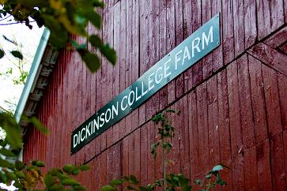
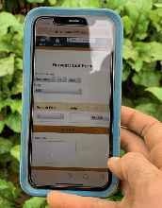
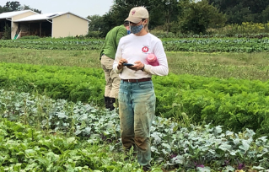
01 – Introduction and FarmData2 Install
COMP 290-02 – Dickinson College
Slides by Prof. Braught, with
adaptations by John MacCormick
Spring 2023

Slide 2
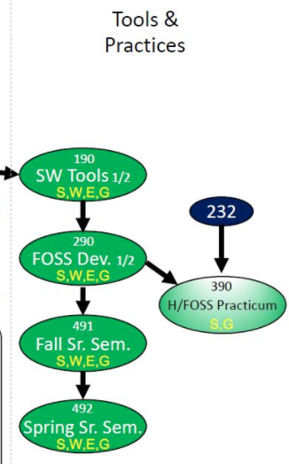
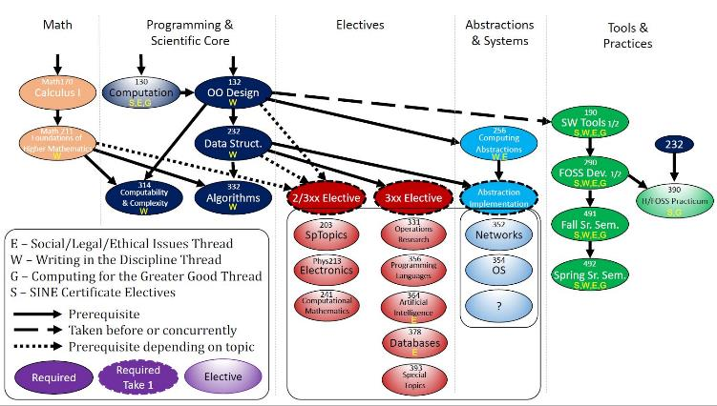
Curricular Context
Notes:
190…
- guided, detailed, building foundation, experience and skills
290
- You have those skills and experiences now.
- Shift to less specific more realistic experience of joining a project
- But with support of a class
- Provide experience of being part of a real project
- Real technologies, real tools, real users
- Similar to an internship or job experience in the classroom
- Great experience to tout in applying for internships
- If you are successful, will build GitHub resume too.
Preparation for 390 (if interested) and 491/492
- when you join and work on an H/FOSS project of interest
ALSO: S, W, E, G

Slide 3
290 Large-scale and Open Source Software Development
An introduction to large-scale software development through participation in a Humanitarian Free and Open Source Software (HFOSS) project. Readings and discussions will focus on FOSS and HFOSS philosophy, licensing, communication tools, project and community organization, and software engineering topics related to large-scale software development. Case studies of social, legal and ethical issues raised by computing and computing for the greater good will complement participation in the HFOSS project.
Notes:
Overarching goal is to have the experience of participating in a real-world project.
Real technologies, real tools, real clients and real users
That will be the central part of the course
- First half will be onboarding to the project
- learning the tools and technologies
- Improving independent leaning strategies for picking new things up on your own.
- Second half will be working in teams developing new features for the project.
Along with that…
- reading / discussions for breadth and perspective on FOSS and SWE
- readings for context (SLE / CGG)

Slide 4
Course Mechanics
Website/Syllabus/Schedule
Moodle
GitHub
Zulip
Notes:
Do overall course structure:
- intro / foundations
- Tech spikes
- Here point out learning new things…
- Identify key technologies we’ll learn.
- Project work
Why Vue: Vue provides higher customizability and hence is easier to learn than Angular or React. Further, Vue has an overlap with Angular and React with respect to the functionality like the use of components. Hence, the transition to Vue from either of the two is an easy option.
Also FarmOS is moving toward greater Vue integration.

Slide 5
FarmData2
!
Notes:
Just a little refresher on FarmData2:
- FarmData2 - This is a FOSS Project that we run here at Dickinson
- You saw FarmData2 in COMP190 and used it for a number of assignments.
- FarmData2 will be the centerpiece of this course.
- The overall goal of this course is to have you do work that advances the state of the FarmData2 project.

Slide 6
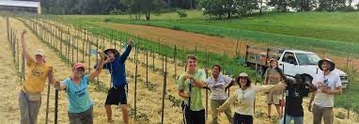
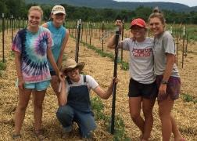
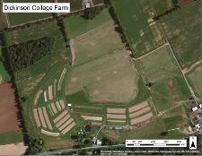
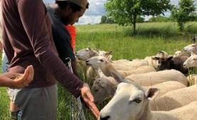
The Dickinson Farm
Dickinson’s College Farm is an 80-acre, USDA-certified organic farm and a living laboratory where students can gain distinctive, hands-on learning experiences.
Notes:
FarmData2 comes out of a collaboration with the Dickinson Farm.
If you haven’t been there
- look for an opportunity to go for an event.
- We will take a trip to the farm a little later this semester to see how the farm operates
- learn a little about their processes and vocabulary
- meet the farmer that is helping us with the FarmData2 application.

Slide 7
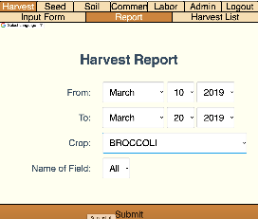
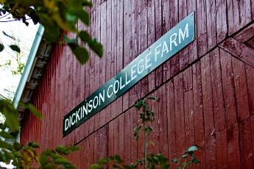
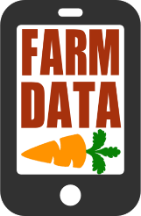
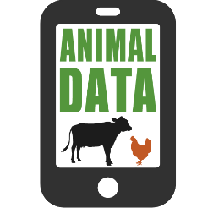
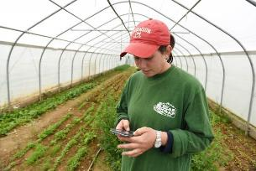
FarmData History:
Notes:
2011 collaboration between Prof. Tim Wahls and Matt Steiman at the College Farm
Over 5 years
Led to the development of two applications
Used in the field on mobile devices to record data about harvests, growth, pest control, and a host of other things
Used in the barn on desktop machines to plan harvests, track inventory and sales and to maintain records for organic certification.
2016 – We lost Tim to cancer
Development of FarmData and AnimalData stopped.
But interest from the College Farm and other farms that are also using the FarmData app has remained.

Slide 8
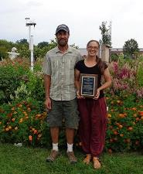
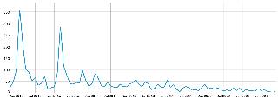
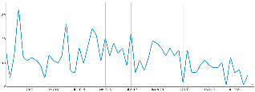


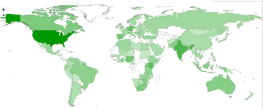
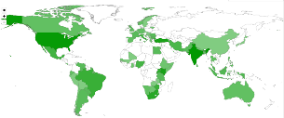





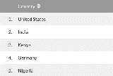

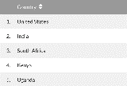

Local Clients, Global Communities
FarmData
AnimalData
Notes:
Matt (Farmer) & Jenn (Farm Manager)
- Tim and Matt talked about the application at a variety of conferences
- Raised awareness of it
- Don’t know how many active users there are
- but it’s been downloaded quite a number of times
- and all over the world.

Slide 9
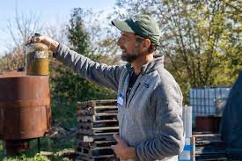
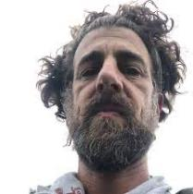
Matt Steiman, Livestock Operations Manager
Matt has been farming organic vegetables since 1993, working on farms in Colorado, California and Minnesota before settling in the Cumberland Valley. For five seasons, Matt managed Fulton Farm at Wilson College where he learned the ropes of running an educational CSA program, and also developed initial experience with renewable energy systems. Matt and Jenn then ran their own farm on rented ground for two seasons before signing on as the full-time farmers at Dickinson College in 2007. In addition to regular farm duties at the Dickinson Farm, Matt supervises equipment maintenance, irrigation, sheep and cattle, and also works extensively with solar energy projects and biodiesel fuel applications for the college.
Notes:
You’ll get to meet Matt in a few week when we visit the farm.
Then he’ll be back later in the semester to answer questions about some of your work.
Then hopefully he’ll join us at the end of the term for your final presentations.

Slide 10

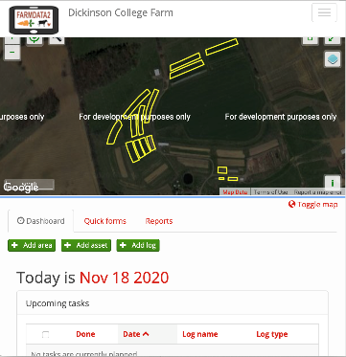
FarmData2
FarmData2 aims to update and combine FarmData and AnimalData, to create a single application that will support the operation and certification requirements for small organic farming operations.
A living FOSS project and community
Notes:
For about 3 years now, the CS department has been working on launching the FarmData2 FOSS project
It is a redesign and combination of FarmData and AnimalData
It is a FOSS project - open to the world.
- Lives on GitHub
- used in COMP 190 (as you know)
- at the center of this course
- Supports summer Software Development Internships
- typically 2 each summer (possibly not in 2023 though :(
- keep an eye open for the advertisement for those
- Academic year developer positions
- 1 or 2 per semester
- But FarmData2 is also a living FOSS project and community
- have had some developers from around the world chip in with contributions
- working toward engage students/courses from other colleges with organic farms as well.

Slide 11
FarmData2 Technology
FarmData2 is a modern web application:
Docker Containers
HTML/CSS/Javascript
Bootstrap
Vue.js
Cypress Testing
Express API
Notes:
This class will get you prepared to contribute to FarmData2:
It is built using a more modern tool set
- good experience for you
You will be learning and using some of the following technologies…
- If don’t know these… no worries… this class introduces everything you need to know.
- If you know some already from another class... No worries… you’ll get a little review and hopefully learn a little bit more.

Slide 12

Activity 01 – FarmData2 Developer Install
Goal: Get FarmData2 Up and Running
Activity Sheet will guide you, but you will be making use of the project documentation.
Uses git / Docker Desktop / TigerVNC Viewer (as in 190).
Use the fork: https://github.com/DickinsonCollege/FD2-School-FarmData2
Ask install questions on Zulip.
Notes:
Should be time to get started in class.

Slide 13
What’s Next
Read Syllabus
Ask questions on Moodle
Bring questions next time
Assignment FDS1
Due Monday 11:59 pm

Slide 14


Acknowledgments:
Slide Template From:
https://creativecommons.org/licenses/by/4.0/
Slide Content Licensed as:
Creative Commons Attribution-NonCommercial-ShareAlike 4.0 International License.

