Slide 1
Data center sustainability impacts
John MacCormick
September 2026

Slide 2
optional: watch
  "Real-World Effects of AI."
  Clarke Forum for Contemporary Issues panel session, February 26, 2026
  web, video

Slide 3
Electricity usage and greenhouse gas emissions
Typical ChatGPT query = 0.4 Wh (or 4 Wh with reasoning)
Toast bread or boil kettle = 30 Wh
Drive 1 mile in electric vehicle = 300 Wh

Slide 4
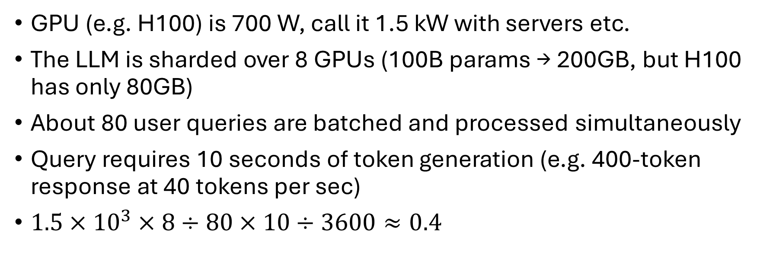
Optional: where does the 1 query = 0.4 Wh come from?
GPU (e.g. H100) is 700 W, call it 1.5 kW with servers etc.
The LLM is sharded over 8 GPUs (100B params → 200GB, but H100 has only 80GB)
About 80 user queries are batched and processed simultaneously
Query requires 10 seconds of token generation (e.g. 400-token response at 40 tokens per sec)
$1.5×{10}^{3}×8÷80×10÷3600≈0.4$
More details: Oviedo, Felipe, et al. "Energy use of AI inference, efficiency pathways, and test-time scaling." Joule (2026).
Note: The authors work at Microsoft Research. The work is published in a high-quality peer reviewed journal that is not associated with or funded by Microsoft.

Slide 5
Water usage
Most media reports focus on so called direct water usage, which is consumed by cooling at the data center site.
However, typical data centers have much higher indirect water usage, because water is needed for cooling at the power stations generating electricity for the data center.
  Typical ratio: 10x indirect vs direct
Wind and solar do not use water for cooling
  Therefore, using renewable energy reduces data center water consumption far more than any change to the cooling system
Details: Shehabi, A., Smith, S. J., Hubbard, A., Newkirk, A., Lei, N., Siddik, M. A., Holecek, B., Koomey, J. G., Masanet, E. R., & Sartor, D. A. (2024). 2024 United States data center energy usage report (LBNL-2001637). Lawrence Berkeley National Laboratory. https://doi.org/10.71468/P1WC7Q

