Slide 1
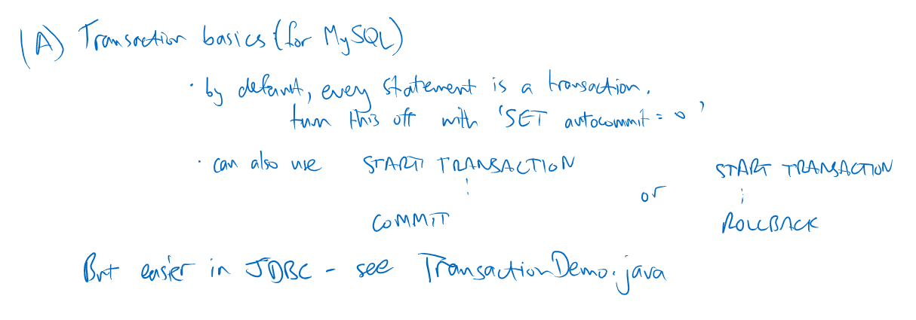
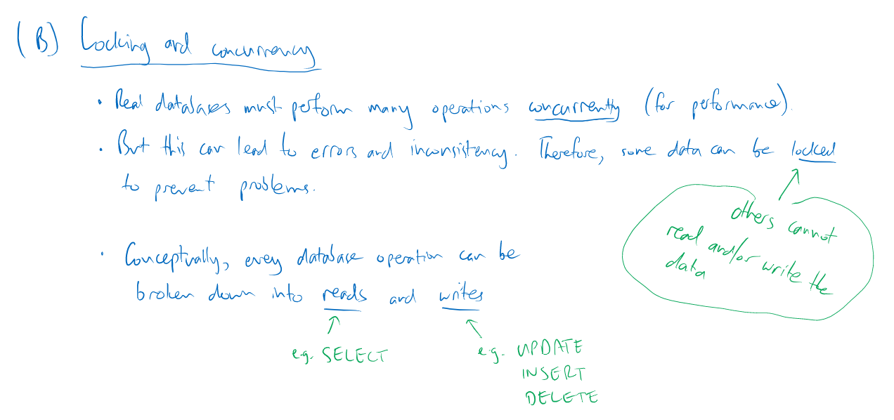

and Postgres
Postgres doesn’t allow SET; use BEGIN or equivalently START TRASACTION

Slide 2
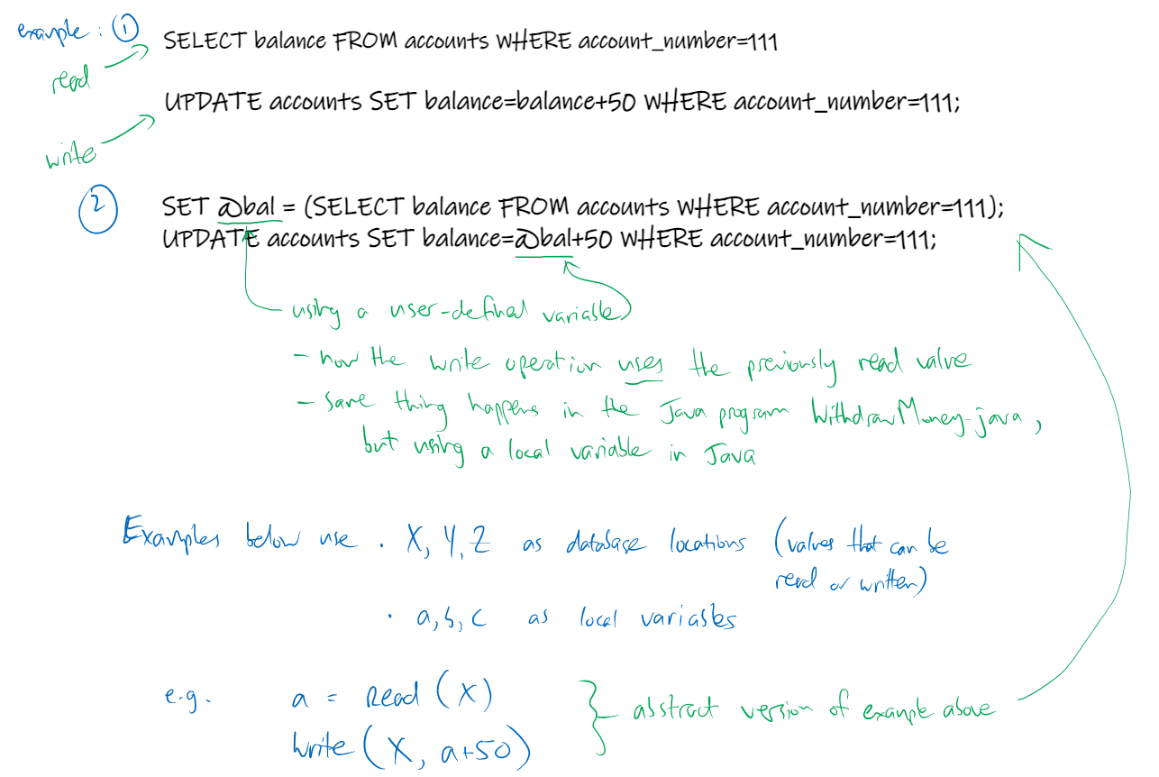
SET only works in MySQL, not Postgres

Slide 3
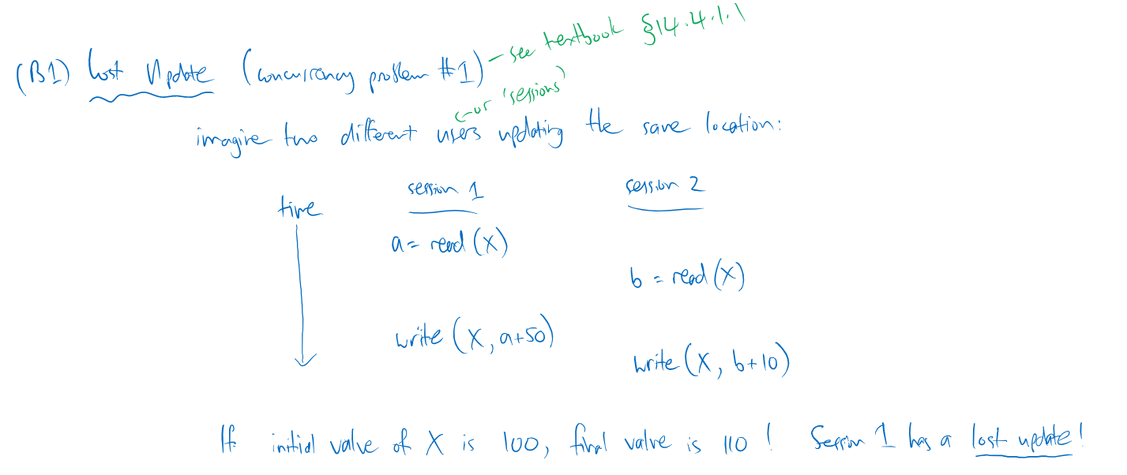
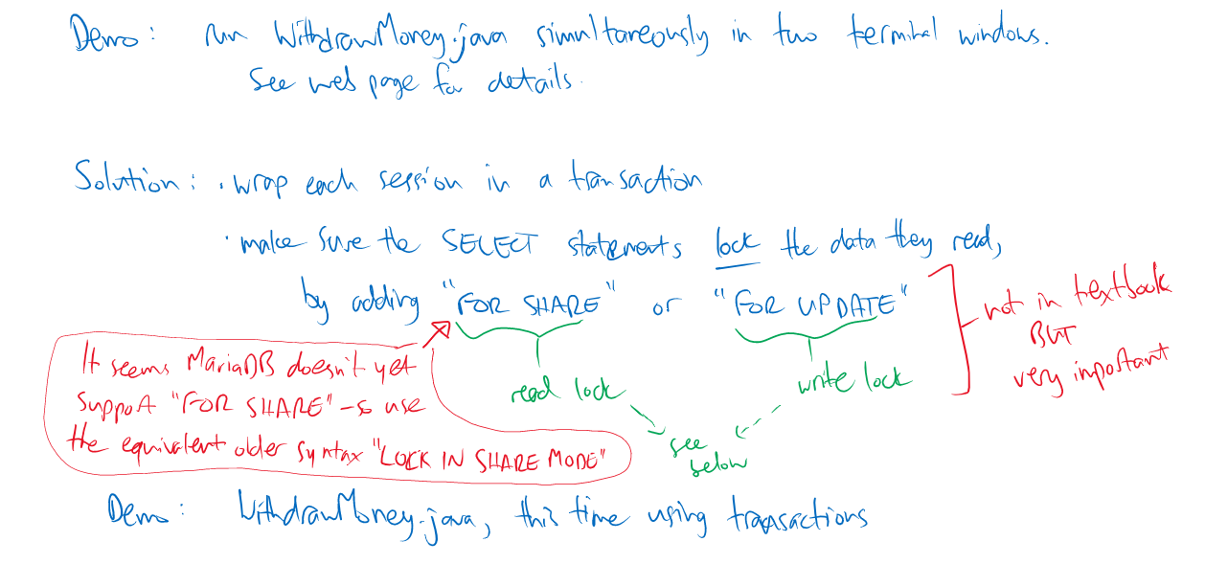

Postgres does support FOR SHARE and FOR UPDATE, just like MySQL

Slide 4

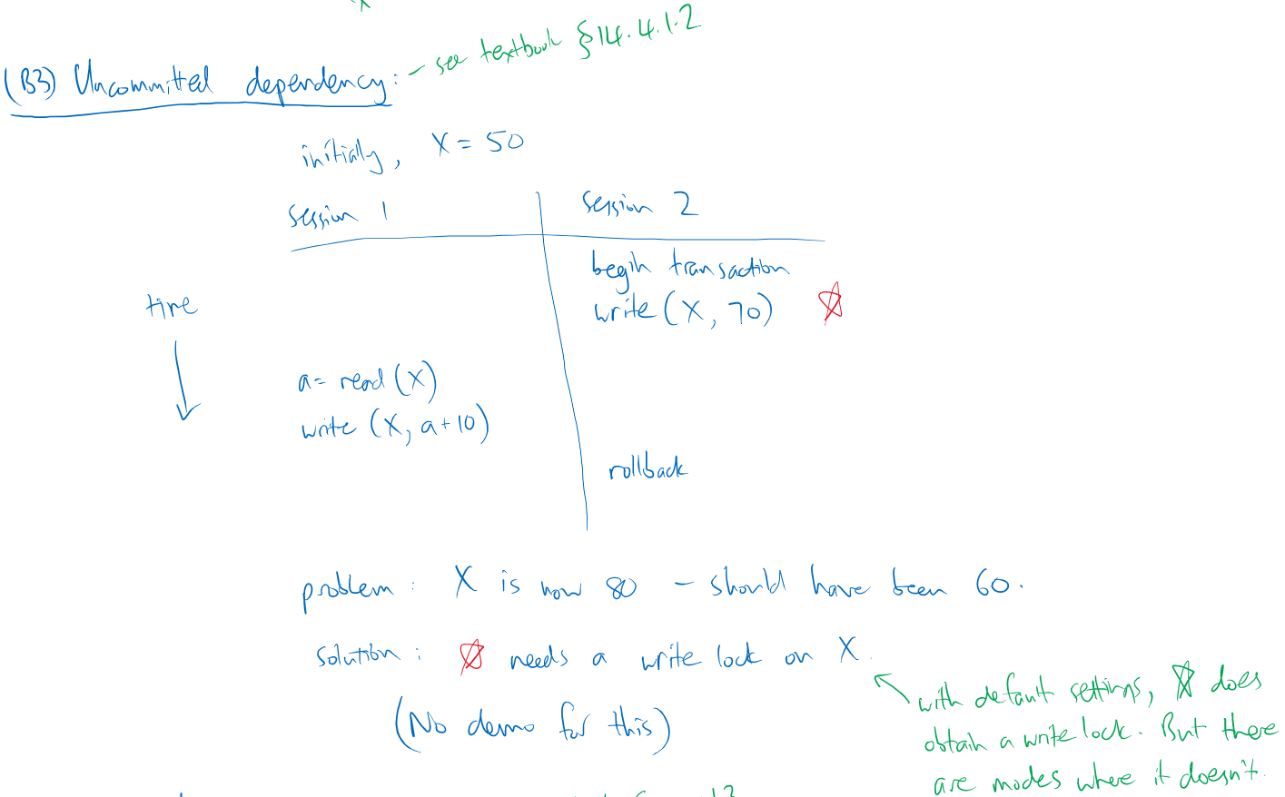

Slide 5
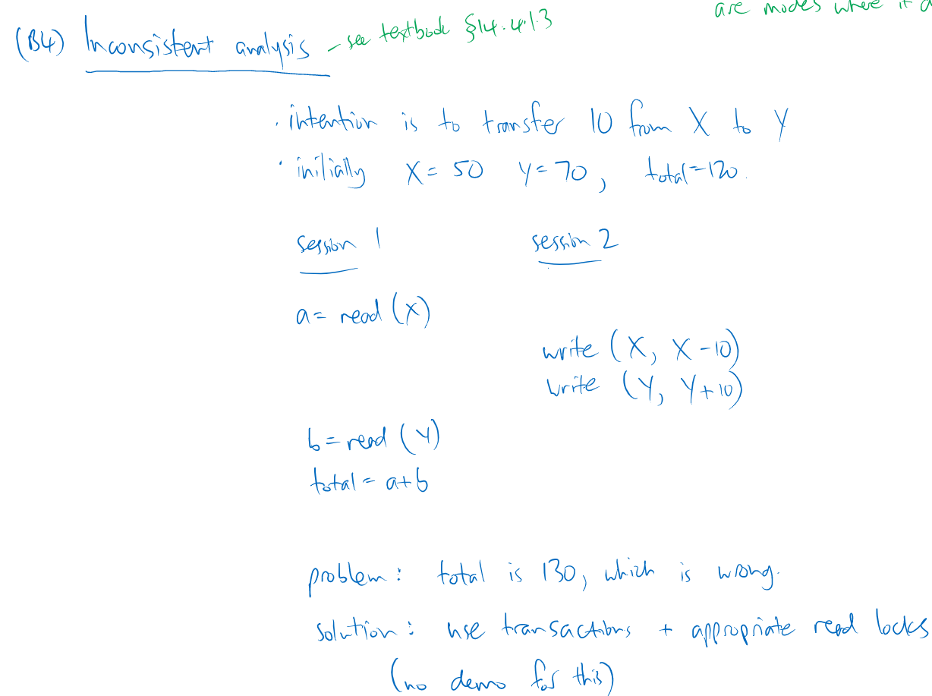

Slide 6

