Slide 1
NoSQL Databases
www.pdbmbook.com

Slide 2
NoSQL Databases (abbreviated version of slides by textbook authors, edited by J. MacCormick)

Slide 3
Introduction
The NoSQL movement
Key-Value stores
Tuple and Document stores
Column-oriented databases
Graph based databases
Other NoSQL categories

Slide 4
The NoSQL movement
RDBMSs put a lot of emphasis on keeping data consistent.
Entire database is consistent at all times (ACID)
Focus on consistency may hamper flexibility and scalability
As the data volumes or number of parallel transactions increase, capacity can be increased by
Vertical scaling: extending storage capacity and/or CPU power of the database server
Horizontal scaling: multiple DBMS servers being arranged in a cluster

Slide 5
The NoSQL movement
RDBMSs are not good at extensive horizontal scaling
Coordination overhead because of focus on consistency
Rigid database schemas
Other types of DBMSs needed for situations with massive volumes, flexible data structures and where scalability and availability are more important ➔ NoSQL databases

Slide 6
Tuple and Document Stores
Document stores store a collection of attributes that are labeled and unordered, representing items that are semi-structured
Example:
{
Title = "Harry Potter"
ISBN = "111-1111111111"
Authors = [ "J.K. Rowling" ]
Price = 32
Dimensions = "8.5 x 11.0 x 0.5"
PageCount = 234
Genre = "Fantasy"
}

Slide 7
Tuple and Document Stores
Most modern NoSQL databases choose to represent documents using JSON {
"title": "Harry Potter",
"authors": ["J.K. Rowling", "R.J. Kowling"],
"price": 32.00,
"genres": ["fantasy"],
"dimensions": {
"width": 8.5,
"height": 11.0,
"depth": 0.5
},
"pages": 234,
"in_publication": true,
"subtitle": null
}

Slide 8
Items with Keys
Most NoSQL document stores will allow you to store items in tables (collections) in a schema-less manner, but will enforce that a primary key be specified
E.g. Amazon’s DynamoDB, MongoDB ( _id )
Primary key will be used as a partitioning key to create a hash and determine where the data will be stored

Slide 9
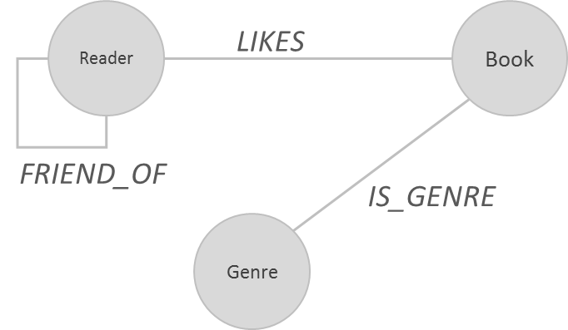
Exploring a Social Graph
Example: a social graph for a book reading club, modeling genres, books and readers

Slide 10
Exploring a Social Graph
CREATE (Bart:Reader {name:'Bart Baesens', age:32})
CREATE (Seppe:Reader {name:'Seppe vanden Broucke', age:30})
…
CREATE (Fantasy:Genre {name:'fantasy'})
CREATE (Education:Genre {name:'education'})
…
CREATE (b01:Book {title:'My First Book'})
CREATE (b02:Book {title:'A Thriller Unleashed'})
…
CREATE
(b01)-[:IS_GENRE]->(Education),
(b02)-[:IS_GENRE]->(Thriller),
…
CREATE
(Bart)-[:FRIEND_OF]->(Seppe),
(Bart)-[:FRIEND_OF]->(Wilfried),
…
CREATE
(Bart)-[:LIKES]->(b01), (Bart)-[:LIKES]->(b03), (Bart)-[:LIKES]->(b05), (Bart)-[:LIKES]->(b06),
…

Slide 11
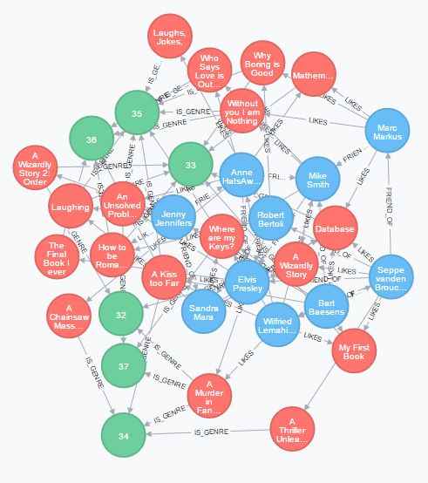
Exploring a Social Graph

Slide 12
Conclusion
The NoSQL movement
Key-Value stores
Tuple and Document stores
Column-oriented databases
Graph based databases
Other NoSQL categories

