Slide 1
NoSQL Databases
www.pdbmbook.com

Slide 2
NoSQL Databases (abbreviated version of slides by textbook authors, edited by J. MacCormick)

Slide 3
Introduction
The NoSQL movement
Key-Value stores
Tuple and Document stores
Column-oriented databases
Graph based databases
Other NoSQL categories

Slide 4
The NoSQL movement
RDBMSs put a lot of emphasis on keeping data consistent.
Entire database is consistent at all times (ACID)
Focus on consistency may hamper flexibility and scalability
As the data volumes or number of parallel transactions increase, capacity can be increased by
Vertical scaling: extending storage capacity and/or CPU power of the database server
Horizontal scaling: multiple DBMS servers being arranged in a cluster

Slide 5
The NoSQL movement
RDBMSs are not good at extensive horizontal scaling
Coordination overhead because of focus on consistency
Rigid database schemas
Other types of DBMSs needed for situations with massive volumes, flexible data structures and where scalability and availability are more important ➔ NoSQL databases

Slide 6
The NoSQL movement
NoSQL databases
Describes databases that store and manipulate data in other formats than tabular relations, i.e. non-relational databases (NoREL)
NoSQL databases aim at near linear horizontal scalability, by distributing data over a cluster of database nodes for the sake of performance as well as availability
Eventual consistency: the data (and its replicas) will become consistent at some point in time after each transaction

Slide 7
The NoSQL movement
 | Relational Databases | NoSQL Databases
Data paradigm | Relational tables | Key-value (tuple) based Document based Column based Graph based XML, object based Others: time series, probabilistic, etc.
Distribution | Single-node and distributed | Mainly distributed
Scalability | Vertical scaling, harder to scale horizontally | Easy to scale horizontally, easy data replication
Openness | Closed and open source | Mainly open source
Schema role | Schema-driven | Mainly schema-free or flexible schema
Query language | SQL as query language | No or simple querying facilities, or special-purpose languages
Transaction mechanism | ACID: Atomicity, Consistency, Isolation, Durability | BASE: Basically available, Soft state, Eventual consistency
Feature set | Many features (triggers, views, stored procedures, etc.) | Simple API
Data volume | Capable of handling normal-sized data sets | Capable of handling huge amounts of data and/or very high frequencies of read/write requests

Slide 8
Key-value Stores
Key-value based database stores data as (key, value) pairs
Keys are unique
Hash map, or hash table or dictionary

Slide 9
Key-value Stores
import java.util.HashMap;
import java.util.Map;
public class KeyValueStoreExample {
public static void main(String... args) {
// Keep track of age based on name
Map<String, Integer> age_by_name = new HashMap<>();
// Store some entries
age_by_name.put("wilfried", 34);
age_by_name.put("seppe", 30);
age_by_name.put("bart", 46);
age_by_name.put("jeanne", 19);
// Get an entry
int age_of_wilfried = age_by_name.get("wilfried");
System.out.println("Wilfried's age: " + age_of_wilfried);
// Keys are unique
age_by_name.put("seppe", 50); // Overrides previous entry
}
}

Slide 10
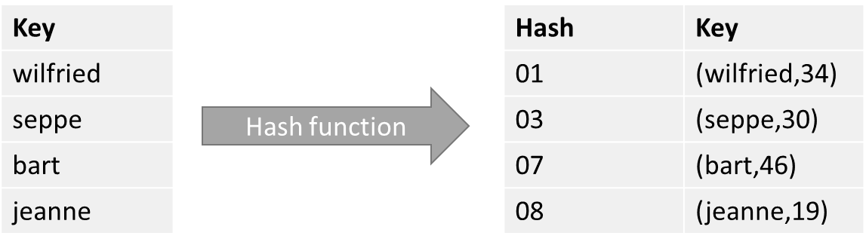
Key-value Stores
Keys (e.g., “bart”, “seppe”) are hashed by means of a so-called hash function
A hash function takes an arbitrary value of arbitrary size and maps it to a key with a fixed size, which is called the hash value.
Each hash can be mapped to a space in computer memory

Slide 11
Key-value Stores
NoSQL databases are built with horizontal scalability support in mind
Distribute hash table over different locations
Assume we need to spread our hashes over three servers
Hash every key (“wilfried”, “seppe”) to a server identifier
index(hash) = mod(hash, nrServers) + 1

Slide 12
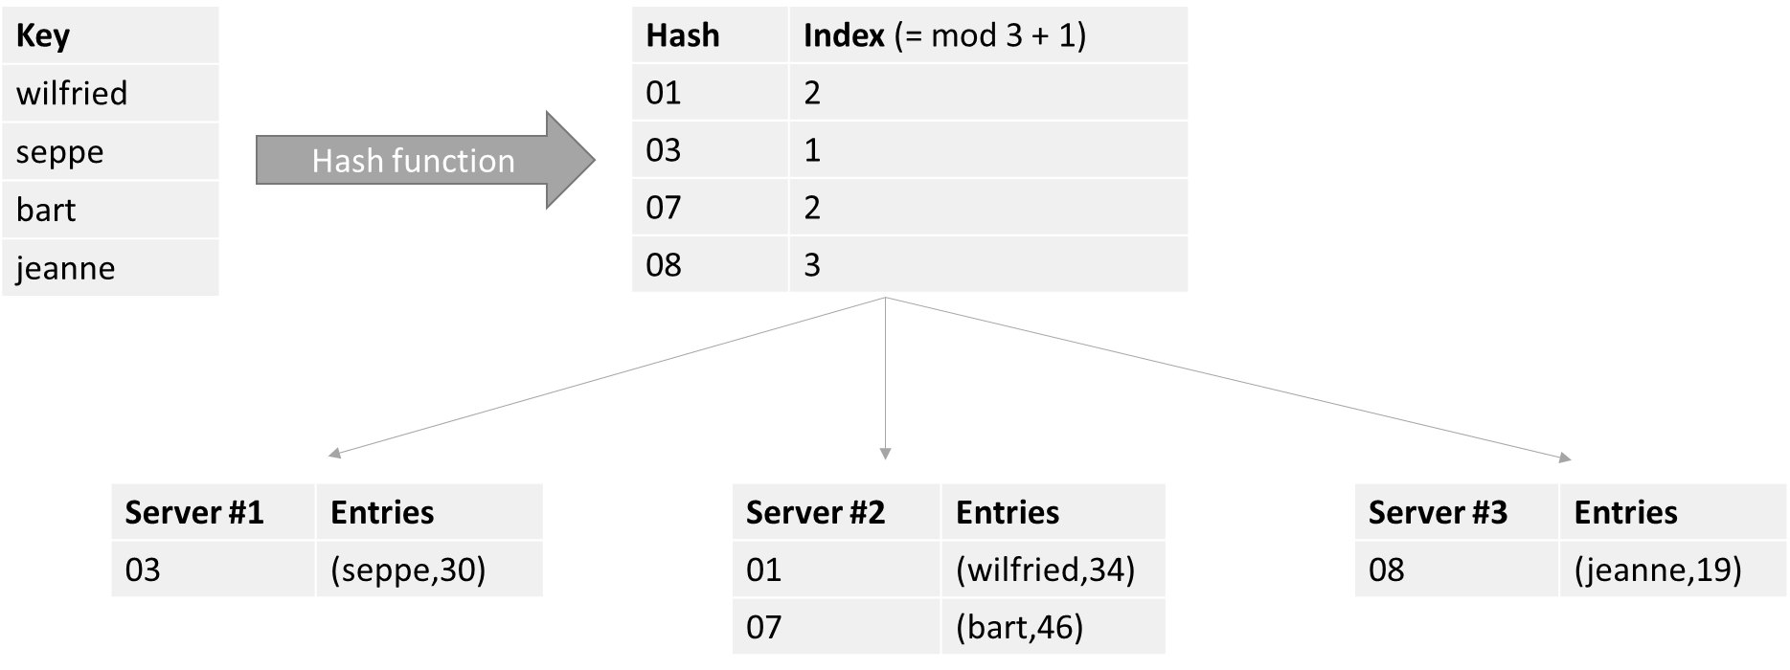
Key-value Stores
Sharding!

Slide 13
Key-value Stores
Example: Memcached
Implements a distributed memory-driven hash table (i.e. a key-value store), which is put in front of a traditional database to speed up queries by caching recently accessed objects in RAM
Caching solution

Slide 14
Key-value Stores
import java.util.ArrayList;
import java.util.List;
import net.spy.memcached.AddrUtil;
import net.spy.memcached.MemcachedClient;
public class MemCachedExample {
public static void main(String[] args) throws Exception {
List<String> serverList = new ArrayList<String>() {
{
this.add("memcachedserver1.servers:11211");
this.add("memcachedserver2.servers:11211");
this.add("memcachedserver3.servers:11211");
}
};

Slide 15
Key-value Stores
MemcachedClient memcachedClient = new MemcachedClient( AddrUtil.getAddresses(serverList));
// ADD adds an entry and does nothing if the key already exists
// Think of it as an INSERT
// The second parameter (0) indicates the expiration - 0 means no expiry
memcachedClient.add("marc", 0, 34);
memcachedClient.add("seppe", 0, 32);
memcachedClient.add("bart", 0, 66);
memcachedClient.add("jeanne", 0, 19);
// SET sets an entry regardless of whether it exists
// Think of it as an UPDATE-OR-INSERT
memcachedClient.add("marc", 0, 1111); // <- ADD will have no effect
memcachedClient.set("jeanne", 0, 12); // <- But SET will

Slide 16
[discussion of distributed hash tables]
Consistent hashing
Boxwood (distributed B-trees)
Kinesis (load-balanced hashing)

Slide 17
Tuple and Document Stores
A tuple store is similar to a key-value store, with the difference that it does not store pairwise combinations of a key and a value, but instead stores a unique key together with a vector of data
Example:
marc -> ("Marc", "McLast Name", 25, "Germany")
No requirement to have the same length or semantic ordering (schema-less!)

Slide 18
Tuple and Document Stores
Various NoSQL implementations do, however, permit organizing entries in semantical groups, (aka collections or tables)
Examples:
Person:marc -> ("Marc", "McLast Name", 25, "Germany")
Person:harry -> ("Harry", "Smith", 29, "Belgium")

Slide 19
Tuple and Document Stores
Document stores store a collection of attributes that are labeled and unordered, representing items that are semi-structured
Example:
{
Title = "Harry Potter"
ISBN = "111-1111111111"
Authors = [ "J.K. Rowling" ]
Price = 32
Dimensions = "8.5 x 11.0 x 0.5"
PageCount = 234
Genre = "Fantasy"
}

Slide 20
Tuple and Document Stores
Most modern NoSQL databases choose to represent documents using JSON {
"title": "Harry Potter",
"authors": ["J.K. Rowling", "R.J. Kowling"],
"price": 32.00,
"genres": ["fantasy"],
"dimensions": {
"width": 8.5,
"height": 11.0,
"depth": 0.5
},
"pages": 234,
"in_publication": true,
"subtitle": null
}

Slide 21
Tuple and Document Stores
Items with Keys
Filters and Queries
Complex Queries and Aggregation with MapReduce
SQL After all …

Slide 22
Items with Keys
Most NoSQL document stores will allow you to store items in tables (collections) in a schema-less manner, but will enforce that a primary key be specified
E.g. Amazon’s DynamoDB, MongoDB ( _id )
Primary key will be used as a partitioning key to create a hash and determine where the data will be stored

Slide 23
Filters and Queries
import org.bson.Document;
import com.mongodb.MongoClient;
import com.mongodb.client.FindIterable;
import com.mongodb.client.MongoDatabase;
import java.util.ArrayList;
import static com.mongodb.client.model.Filters.*;
import static java.util.Arrays.asList;
public class MongoDBExample {
public static void main(String... args) {
MongoClient mongoClient = new MongoClient();
MongoDatabase db = mongoClient.getDatabase("test");
// Delete all books first
db.getCollection("books").deleteMany(new Document());
// Add some books
db.getCollection("books").insertMany(new ArrayList<Document>() {{
add(getBookDocument("My First Book", "Wilfried", "Lemahieu", 12, new String[]{"drama"}));
add(getBookDocument("My Second Book", "Seppe", “vanden Broucke", 437, new String[]{"fantasy", "thriller"}));
add(getBookDocument("My Third Book", "Seppe", “vanden Broucke", 200, new String[]{"educational"}));
add(getBookDocument("Java Programming", "Bart", "Baesens", 100, new String[]{"educational"}));
}});

Slide 24
Filters and Queries
// Perform query
FindIterable<Document> result = db.getCollection("books").find(
and( eq("author.last_name", “vanden Broucke"),
eq("genres", "thriller"),
gt("nrPages", 100)));
for (Document r : result) {
System.out.println(r.toString());
// Increase the number of pages:
db.getCollection("books").updateOne(
new Document("_id", r.get("_id")),
new Document("$set", new Document("nrPages", r.getInteger("nrPages") + 100)));
}
mongoClient.close();}
public static Document getBookDocument(String title,
String authorFirst, String authorLast,
int nrPages, String[] genres) {
return new Document("author", new Document()
.append("first_name", authorFirst)
.append("last_name", authorLast))
.append("title", title)
.append("nrPages", nrPages)
.append("genres", asList(genres));}}

Slide 25
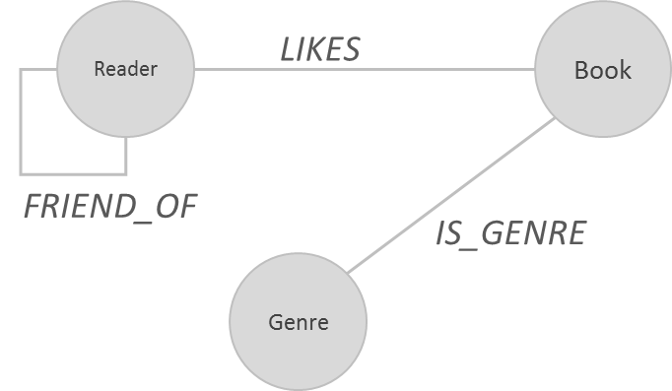
Exploring a Social Graph
Example: a social graph for a book reading club, modeling genres, books and readers

Slide 26
Exploring a Social Graph
CREATE (Bart:Reader {name:'Bart Baesens', age:32})
CREATE (Seppe:Reader {name:'Seppe vanden Broucke', age:30})
…
CREATE (Fantasy:Genre {name:'fantasy'})
CREATE (Education:Genre {name:'education'})
…
CREATE (b01:Book {title:'My First Book'})
CREATE (b02:Book {title:'A Thriller Unleashed'})
…
CREATE
(b01)-[:IS_GENRE]->(Education),
(b02)-[:IS_GENRE]->(Thriller),
…
CREATE
(Bart)-[:FRIEND_OF]->(Seppe),
(Bart)-[:FRIEND_OF]->(Wilfried),
…
CREATE
(Bart)-[:LIKES]->(b01), (Bart)-[:LIKES]->(b03), (Bart)-[:LIKES]->(b05), (Bart)-[:LIKES]->(b06),
…

Slide 27
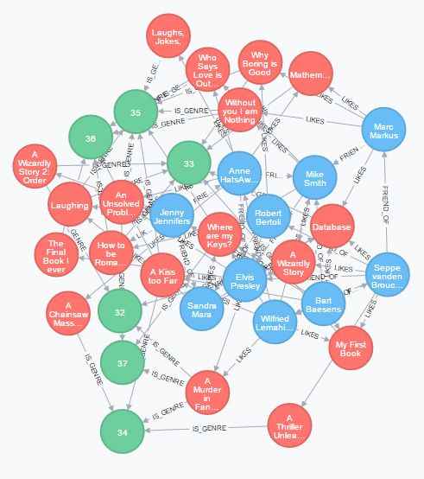
Exploring a Social Graph

Slide 28
Conclusion
The NoSQL movement
Key-Value stores
Tuple and Document stores
Column-oriented databases
Graph based databases
Other NoSQL categories

