Slide 1




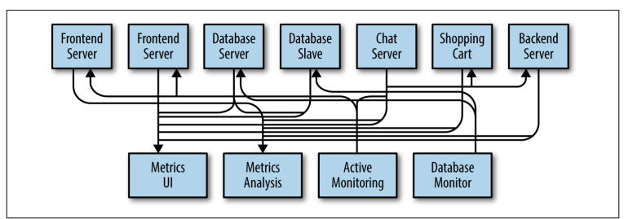
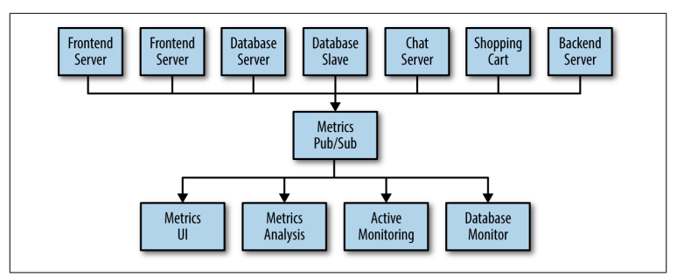
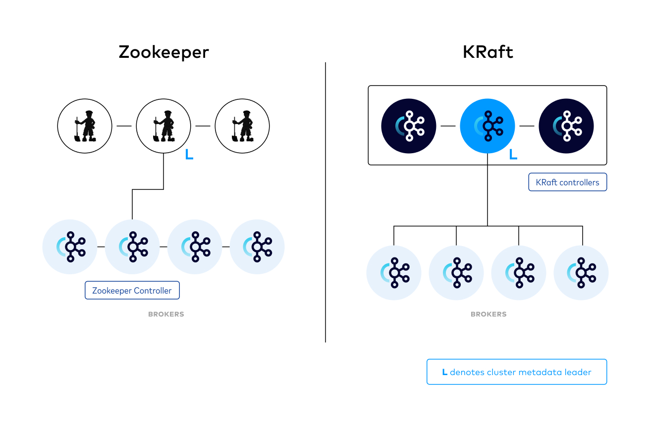
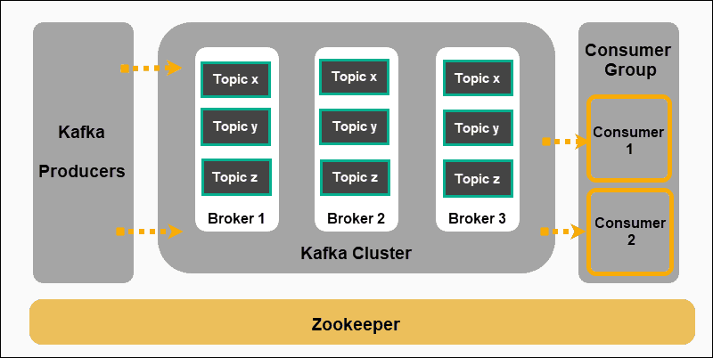
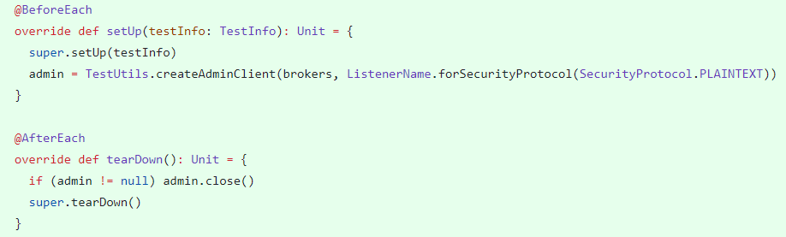
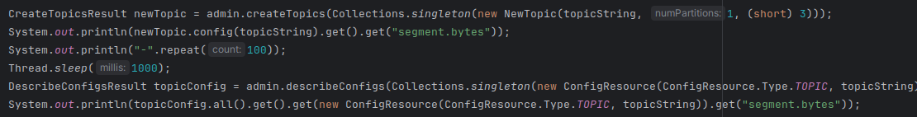
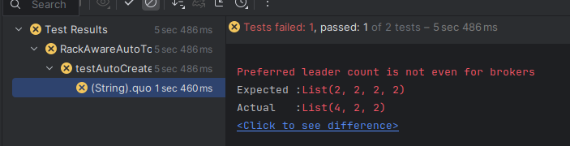
Apache Kafka
Dung Ha, Tap Dang
Comp 491/492
Introduction
What is Apache Kafka?
Host connections: hosts may need to make distinct individual connections to other hosts. This can be overwhelming.
Architecture:
Decouple producers and consumers by using a push-pull model
Provide persistence for message data within the messaging system to allow multiple consumers.
Optimize for high throughput of messages.
Allow for horizontal scaling of the system to grow as the data streams grew.
Producer (client): Producers create new messages (send data to be stored)
Consumer (client): Consumers read message (read data from storage)
Brokers and cluster:
A single Kafka server is called a broker
A Cluster is comprised of brokers which are individual servers that receive, store, and dispatch messages.
It used to manage the persistence and replication of messages of data.
Increase speed, durability, and scalability
Topic: A unit that stores related messages (data). Used by brokers. Messages will be arranged in order received
Messages: A unit of data that is sent by the producer and retrieved by consumers. They are stored in topics inside the brokers.
Metadata server:
Takes care of multiple “Distributed” aspects of the Kafka Cluster
Store cluster’s metadata, and consumer clients’ details
Centralized service for maintaining configuration information, and providing synchronization.
Zookeeper or Kraft
Zookeeper: Another software that takes care of the metadata and allow for administrative tasks. A cluster of servers can be created to handle these responsibilities.
Kraft: Essentially has the same responsibilities as a zookeeper cluster and can replace zookeepers. K-Raft servers are essentially the same as brokers but they do not store data from clients. They store metadate instead and task care of administrative actions.
KAFKA-16202 (Dung Ha)
Problem: If the broker hits a StorageException while handling a record from the producer, the producer prints the warning including the log: “due to org.apache.kafka.common.errors.KafkaStorageException: Disk error when trying to access log file on the disk.. Going to request metadata update now (org.apache.kafka.clients.producer.internals.Sender)”. There's an extra dot between disk and Going.
Solution:
Each default exception string (defaultExceptionString) may or may not have full stops.
Modify the Error class and add full stops to default exception strings that did not have them.
KAFKA-15747: KRaft support in DynamicConnectionQuotaTest
KAFKA-15714: KRaft support in DynamicNumNetworkThreadsTest
KAFKA-15722: KRaft support in RackAwareAutoTopicCreationTest
Problem: Kraft is a new feature of Kafka that tries to remove the dependency zookeeper to keep track of cluster metadata; instead, it manages metadata using its own server. There are a lot of test files that need to be updated so that they can be tested for Kafka cluster in both Zookeeper and Kraft mode.
Solution:
We try to migrate all functions in the test file so that they can be run in either mode. This can be done by using brokers instead of controllers, as controllers only appear when running in Zookeeper mode.
I created a universal admin manager before each test case and let it handle some key functions like creating, deleting, updating topics, etc. The admin client can be used in either Zookeeper or Kraft mode.
Some functions are not available for both modes, so we have to create a new function that is capable of running in either mode in order to fetch the data we need.
KAFKA-16211 (Dung Ha)
Problem: When creating a topic in KRaft cluster, a config value returned by createTopics() is different than what you get from describeConfigs().
Investigation: createTopics() returns the static configuration of the controller broker. Meanwhile, describeConfigs() when used to find topics’ configuration returns the static configuration of the least loaded broker (not necessarily the broker where the topic resides). In conclusion, describeConfigs() should not be used to directly inquire about a topic’s configuration.
Or Kraft Quorum
Challenges: For KAFKA-15722, the behavior when running in kraft mode is not consistent with zookeeper. We want to test that the topic created is aware that it needs to be evenly distributed to different servers on different racks. Kraft mode manages to pass the first test, which is that topics are evenly distributed to different racks; however, it does not guarantee that the replicas will be distributed evenly inside each rack. In short, each rack is guaranteed to have the same number of replicas, but each server inside each rack may not.
KAFKA-16190: Member should send full heartbeat when rejoining
Problem: This is a part of KIP-848: The Next Generation of the Consumer Rebalance Protocol, a new rebalance protocol proposed to the next version of kafka. The ticket require the heartbeat request builder should make sure that all fields are sent in the heartbeat request when the consumer rejoins (currently the HeartbeatRequestManager request builder is reset on failure scenarios, which should cover the fence+rejoin sequence).
Solution:
This can be done by checking the state of the consumer. If the state is JOINING, we will send every field in the heartbeat except for assigned partitions, as this will be reset when the consumer is rejoining..
Challenges:
Apache Kafka is a complex and interesting project. The difficulty of understanding it and contributing to the project was expected when selecting it.
The code base is huge. Several code files have 1000-5000 lines of code.
Lack of knowledge in bash scripting and build tools.
There are a lot of protocol that need to be learn
Reflection
What we’ve learned:
Skills in reading source code
Navigate in a large codebase
Linux Scripting
Knowledge of Distributed System
How to use Apache Kafka

