Slide 1


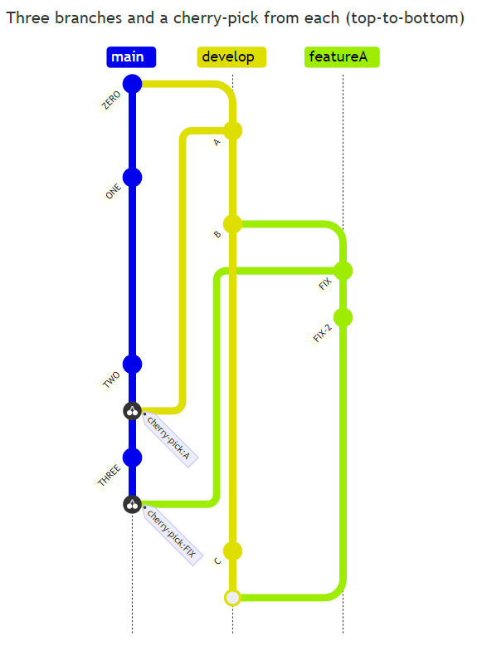

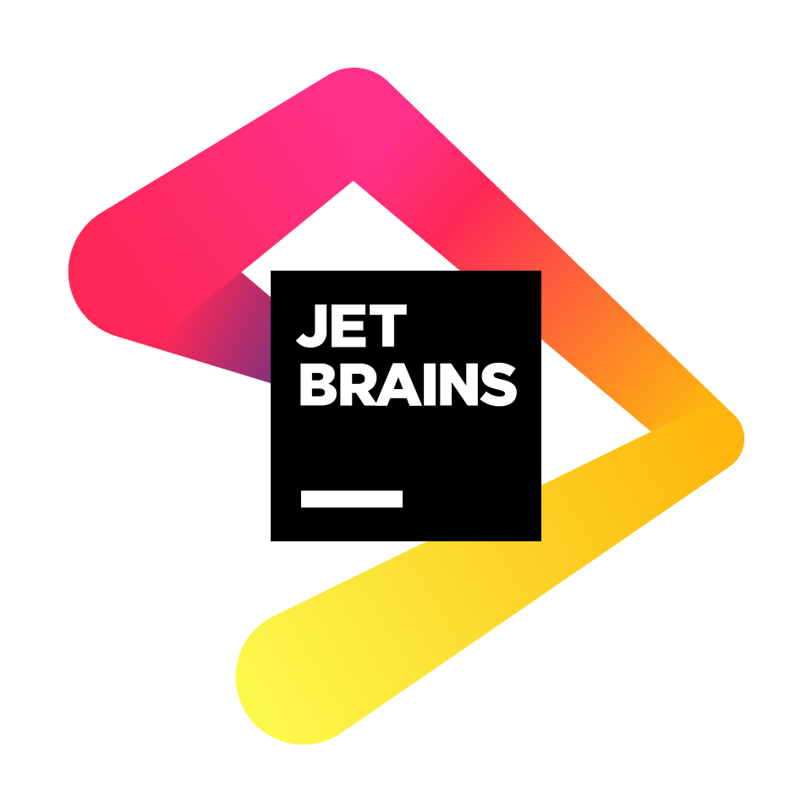


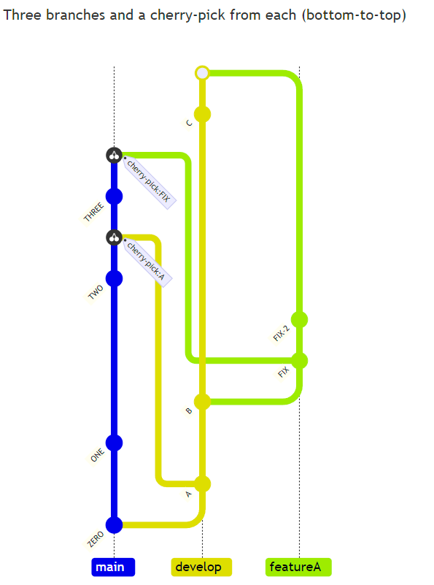
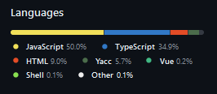
MermaidJS
Christian Gonzalez, Michael Krause, Andrew Lai, Marcel Lee, Trang Vu
Challenges
After dedicating a significant time in familiarizing ourselves with the complex codebase, we faced the challenge of coming up with efficient solutions for implementing new features and bug fixes. This required careful thought for code compatibility while also ensuring its maintainability.
Key Takeaways
We gained valuable insight into the complexities of maintaining an evolving codebase, and the importance of effective collaboration throughout our time contributing. This deepened our understanding of the collaborative aspect of open source projects.
Background
MermaidJS is an open-source JavaScript diagramming and charting tool that renders Markdown-inspired text definitions to create and modify diagrams dynamically.
Mermaid currently supports flowcharts, sequence diagrams, pie charts, timelines, ER diagrams, class diagrams, and many more.
Objective
Contribute to the project by fixing bugs, implementing new features, and updating documentation.
Contributions
Reflection
Introduction
Issues | Pull Request Status | Contributor
No attached issue | PR #5256, #5315, and #5268 all dealt with updates to documentation: fixing typos, punctual corrections, grammar corrections, etc. | Christian
#5108 - Prettier Scans /demos/dev/ failing pnpm tests | PR #5109: Addresses this problem by adding demos/dev/** to the .prettierignore but continues to check against the example.html | Christian
#1981 - Unable to use hashtags or semicolons in Gantt diagrams | PR #5095: Addresses the issue by simply updating regular expressions in the parser file and adding additional test coverage to the parser’s test file to account for the changes. | Christian
#5239 - Bottom-to-top Oriented Gitgraphs to Mimic Git Logs | PR #5259: Addresses the issue by making additions to the parser and renderer. Adds test coverage for the changes and updates to the documentation are made to inform users of the new feature. | Marcel
#2477 - Requirement Diagram long text overflowing out of rendered box | PR #5305: Addresses the issue by updating the outdated text overflow logic in the JavaScript renderer for the Requirement Diagram | Michael
Syntax
MermaidJS uses a Markdown style syntax to create and change diagrams in real time
Creation & Integration
The Mermaid Live Editor allows users to create diagrams online in real time. Additionally integrations are officially supported for ChatGPT, JetBrains IDE, Microsoft Word and PowerPoint, and Visual Studio Code
Diagram Creation
Notable Issues
#5239: Add bottom-top orientation for Gitgraph
Parser: Easy fix
Add “BT” token to the parser
Add test case to check if this new syntax is passed-on to DB correctly
Renderer: Challenging
Original code manually sets the direction/length of lines connecting based on cascades of conditional statements. This means there’s not a simple way of “reversing” the direction.
When running BFS to find position, appendleft the commit id on a separate double-ended queue so that the order is reversed (because order is not kept in track originally as it was hashmap)
TO BE UPDATED
References
Languages & Frameworks

